Slide 1
Building with Flux
Phil MacCart
July 22, 2015
https://github.com/pmaccart/react-chicago-building-with-flux

Slide 2

slalom.com
© 2015 Slalom, LLC. All rights reserved. The information herein is for informational purposes only and represents the current view of Slalom, LLC. as of the date of this presentation. SLALOM MAKES NO WARRANTIES, EXPRESS, IMPLIED, OR STATUTORY, AS TO THE INFORMATION IN THIS PRESENTATION.

Slide 3

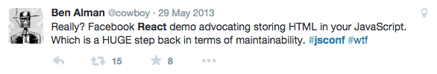
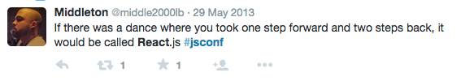
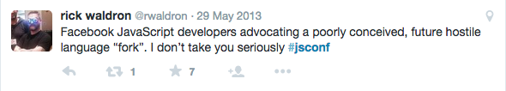

Slide 4
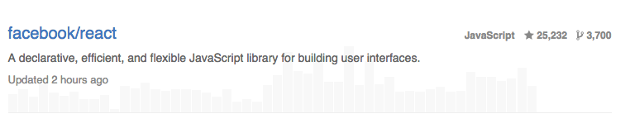

Slide 5
Topics
Flux Architectural Overview
Component Breakdown
API Integrations
Scaling out

Slide 6
Flux is the application architecture that Facebook uses for building client-side web applications. It complements React's composable view components by utilizing a unidirectional data flow. It's more of a pattern rather than a formal framework.
Notes:
From the flux website
Application architecture/pattern, not specific to React
Complements react’s composable view

Slide 7
Action
Action
Dispatcher
Store
View
Notes:
Basic Flux architecture – actions come into the system from either external sources (asynchronous events) or from views
Dispatcher translates actions into events, feeds them into the store, which notifies the views

Slide 8
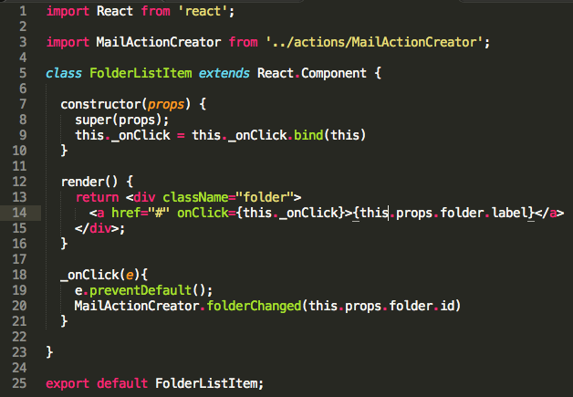
Views
Compositions of components
Stateless (ideally)
Data provided from parent/root
Notes:
Views are composable
Easy to write small, isolated views, then pass data down as props to child views
Data shouldn’t need to flow back up

Slide 9

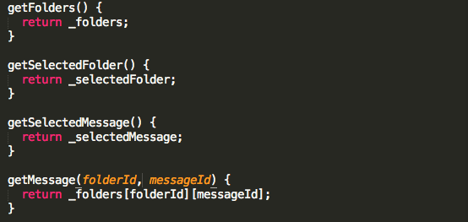
Stores
Hold all application state and data
Represent a domain area
No understanding of data presentation
Listen for events from Dispatcher
Notes:
Stores hold most of the business logic, along with all application data and state
Each store deals with a particular problem domain
-

Slide 10
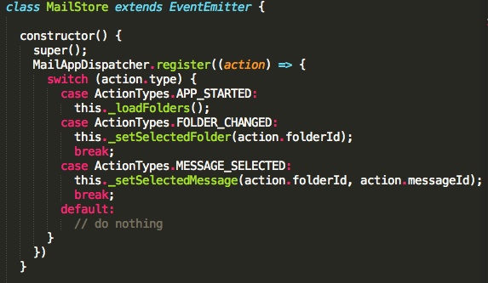
Stores
Listen for events from Dispatcher
Notes:
Stores listen for events fired by the dispatcher, filter over the events, and decide what to do with each event coming in

Slide 11

Dispatcher
Singleton event bus
Sends ALL events to interested handler functions
Notes:
Dispatcher will send ALL events to the stores that have added callbacks
Stores are responsible for looking at the event types and understanding specific events they are interested in

Slide 12
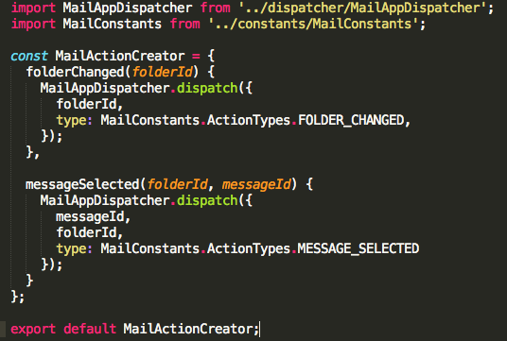
Actions
Object with a type property and data
Represent something that happened in the app
Created by Action Creators
Handed to the Dispatcher
Notes:
An action creator module represents an API for creating related actions.

Slide 13
Action
Action
Dispatcher
Store
View

Slide 14
Stateless Components
No external state
No global state
No mutable state

Slide 15

Views as Pure Functions
Notes:
Pure functions: 1. The function always evaluates the same result value given the same argument value(s). The function result value cannot depend on any hidden information or state that may change as program execution proceeds or between different executions of the program, nor can it depend on any external input from I/O devices (usually—see below). 2. Evaluation of the result does not cause any semantically observable side effect or output, such as mutation of mutable objects or output to I/O devices (usually—see below).

Slide 16
Mail App
Mail
Inbox (5)
Message Listing
Message
Drafts
Deleted

Slide 17
Mail App
Folders
Message List
Message
Inbox
Deleted
Message List Item
Drafts
Message List Item
Message List Item
Message List Item
Message List Item
Notes:
View component hierarchy

Slide 18
Mail App
Folders
Message List
Message
Inbox
Deleted
Message List Item
Drafts
Message List Item
Message List Item
Message List Item
Message List Item
Notes:
Data connections – clicking a folder needs to update the message list
- clicking a message list item needs to update both the message AND the folders view (potentially marking the item as READ)

Slide 19
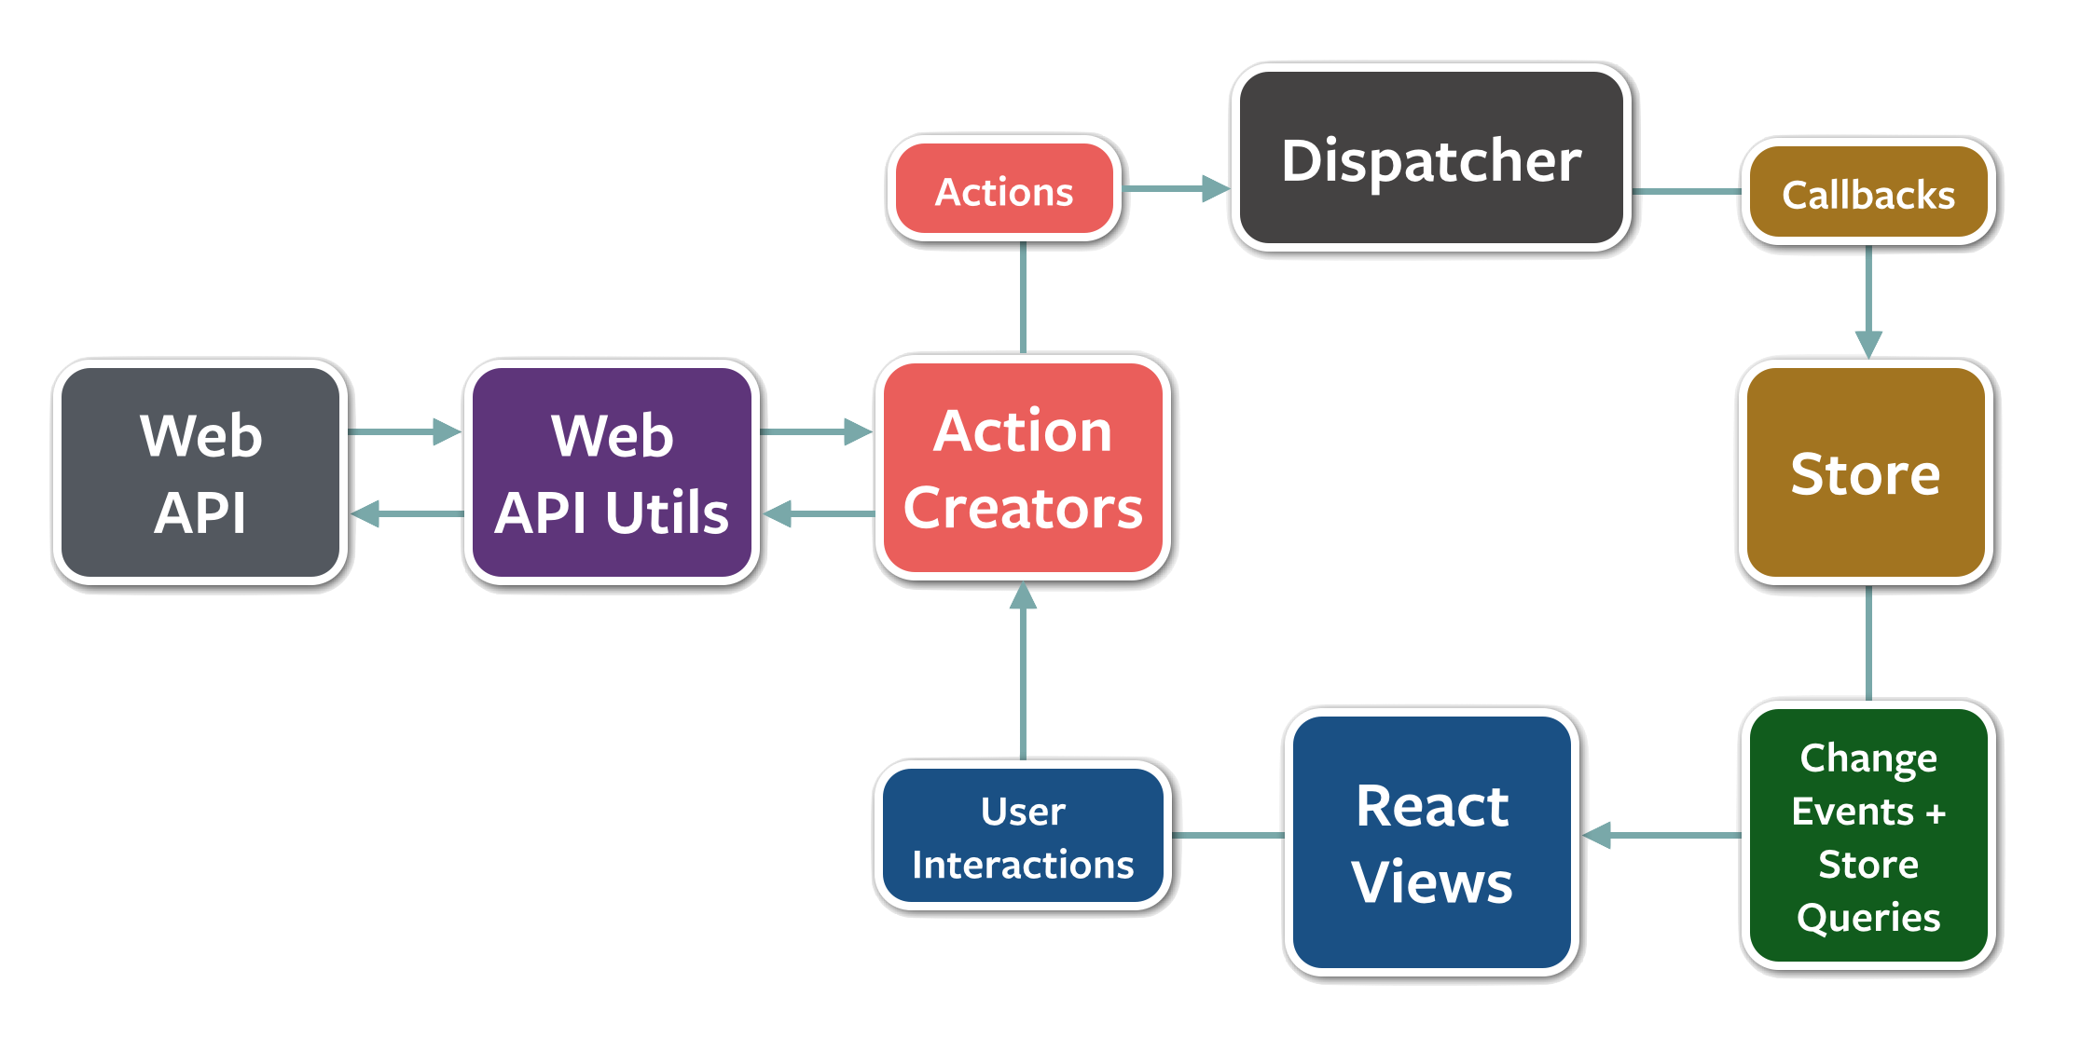
API Interactions

Slide 20
API Interactions
Notes:
We’ve favored keeping our API requests contained within the store, particularly to assist with cases where an action may or may need need to issue an API request
- example: cached data

Slide 21


Slide 22
Actions should be past-tense
Notes:
Actions represent something that HAS happened (button clicked, message sent, etc.)

Slide 23
Favor small components, but don’t oversimplify
Notes:
For items that are HTML and CSS, with no interactivity, you probably don’t need a React component
Exception: HTML + CSS structure is unreasonably large

Slide 24
Pass all data as props, avoid external state
Notes:
Stores are singletons – don’t let views just require stores and import own data

Slide 25
Build stores around single functional domain
Notes:
Stores can hold more than just a model or collection; they can also hold the UI state associate with the UI representations of those models

Slide 26
Keep store events simple
Notes:
Favor having an onChange and an onError event callbacks.
Always refresh state of ENTIRE component when a change event is fired

Slide 27
Avoid partial state updates on store events
Notes:
On changes, views should ask the store(s) for EVERY piece of data they need, rather than just the specific piece of data they think might have changed.

Slide 28
Don’t send data with events
Notes:
When change events are fired from the stores, reload entire view state

Slide 29
Favor all state in stores
Notes:
When in doubt, favor keeping all application state within a store. Some exceptions could exist for component-specific state (dialog position on a screen, widget size, etc.). For more complex interactions (eg: displaying a loading spinner while saving), consider firing multiple onChange events from your store.

Slide 30
Phil MacCart
https://github.com/pmaccart/react-chicago-building-with-flux
@pmaccart

