Slide 1
React + Flux
Phil MacCart

Slide 2
React
Library for building reusable components
No templating
Reactive updates with a virtual DOM
Unidirectional data flow
Simple API

Slide 3
Components
Basic building blocks of user interfaces
Must implement render method to return representation of the view
Allow use of JSX for representing HTML structure in Javascript
var React = require('react');
var App = React.createClass({
render: function() {
return <h2>Hello Slalom!</h2>;
}
});
React.render(<App />, document.getElementById('main'));

Slide 4
Properties
Allow passing of data/configuration from parents down to children
Immutable to the child elements
var React = require('react');
var App = React.createClass({
render: function() {
return <div>
<h2>Hello {this.props.name}!</h2>
</div>;
}
});
React.render(<App name='World' />,
document.getElementById('main'));

Slide 5
State
Managed internally by a component
Mutated over time in response to events
var App = React.createClass({
getInitialState: function() {
return {
count: 1
}
},
render: function() {
return <div>
<h2>Hello {this.props.name}!</h2>
<h4>Count: {this.state.count}</h4>
</div>;
}
});

Slide 6
Props vs. State
Both
Plain JavaScript objects
Trigger a render when changed
Deterministic
Props
Configuration
Immutable to the receiver
State
Managed by own component
Mutable in response to events

Slide 7
Components
Components are just functions: given props and state, return HTML

Slide 8
Events
Synthetic event system wraps browser events
Normalized across all browsers > IE8+
render: function() {
return <div>
<h2>Hello {this.props.name}!</h2>
<h4>Count: {this.state.count}</h4>
<button type="button" className="btn btn-primary" onClick={this._incrementCount}>Increment Count</button>
</div>;
},
_incrementCount: function() {
this.setState({
count: this.state.count + 1
});
}

Slide 9
Components
Composable
Data passed down through props
Events/changes propagated up through channels
render: function() {
var rows = this.props.items.map(function(item, index) {
return <ItemRow key={index} item={item}/>
}.bind(this));
return <table className="table table-striped">
<thead><tr><th>Name</th></tr></thead>
<tbody>
{rows}
</tbody>
</table>;
},

Slide 10
App
Search
ResultsTable
ResultsRow
ResultsRow
ResultsRow

Slide 11
Component Hierarchy
App
Search
ResultsTable
ResultsRow
ResultsRow
ResultsRow

Slide 12
Repository

Slide 13
Challenges
Top level component becomes de-facto owner of all state
Data may need to be passed down many levels
Changes in state becomes difficult to maintain, particularly with derived state

Slide 14
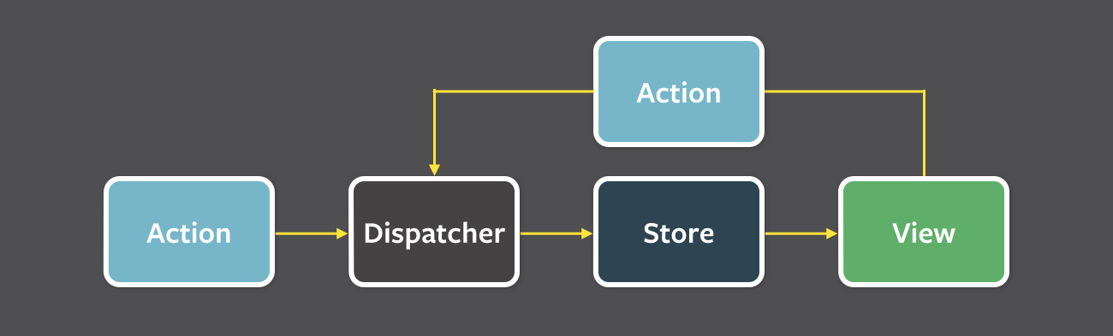
Flux
Unidirectional data flow architecture
All data provided from stores to views
Views re-render given current state
State changes performed in response to actions

Slide 15
Dispatcher

Slide 16
Dispatcher
Central data flow hub
Callback registry for stores, distributes actions and data to registered stores
All stores receive all actions

Slide 17
Stores
Maintain application state, core business logic
Store data for a domain within app (not a single model or collection)
Registers callback w/ dispatcher, processes actions it is interested in
Fire change events on updates

Slide 18
Views
Register change listeners w/ relevant stores
Retrieve data from stores on change events, update own state

Slide 19
Actions
Wrappers for data changes coming into the system
Contain an action type and payload

Slide 20
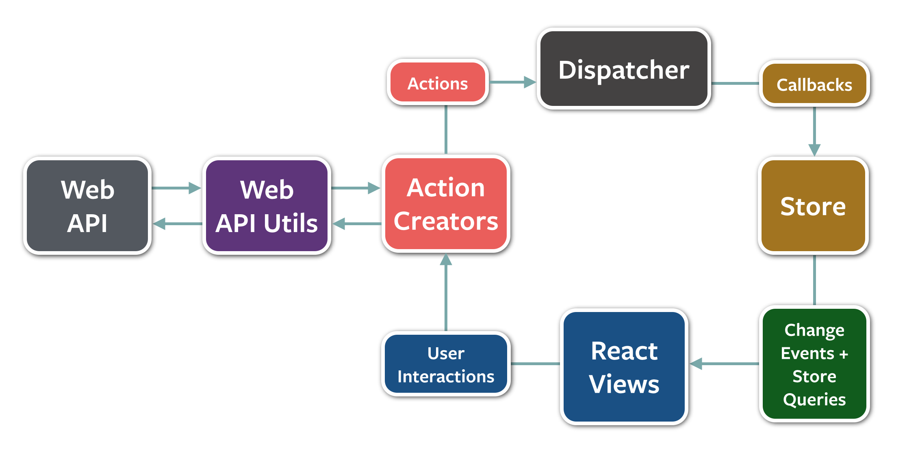
Asynchronous Actions

Slide 21
Lessons Learned
Not every data change needs to go through Flux
Keep all business-logic in stores
Let stores manage API calls
Actions are past tense

Slide 22
Coming Up
React + Flux bootcamp (August)
React Chicago Meetup – July 29th

