Slide 1
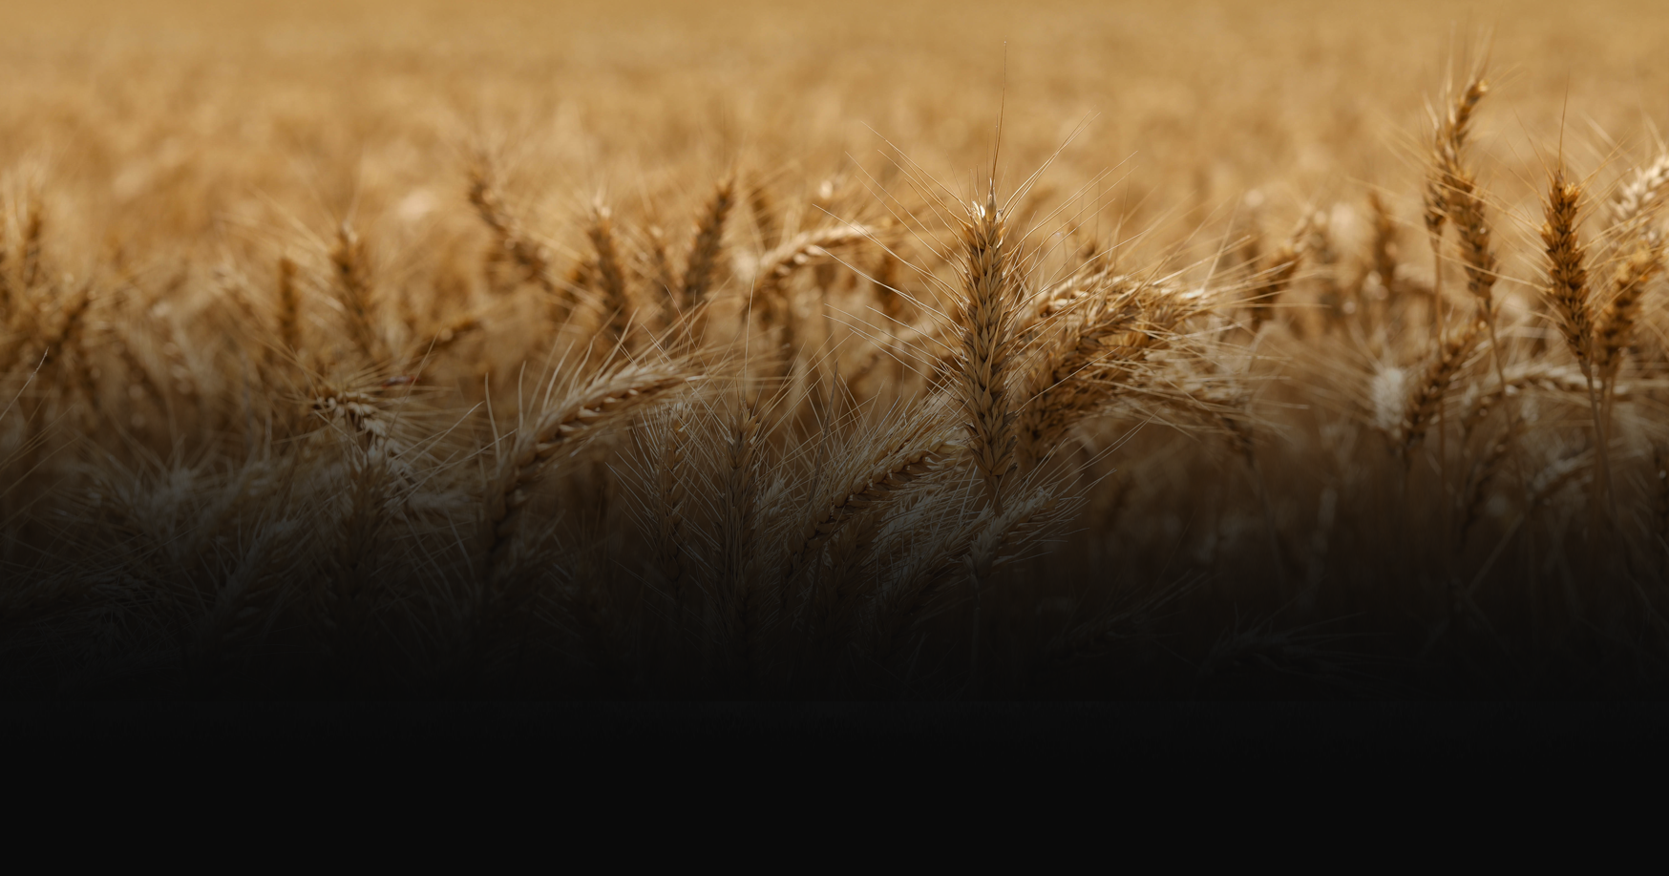

New Plymouth Reformed Church presents:
DISCIPLESHIP
SATURDAY 28 MARCH 2026
NEW PLYMOUTH
Jesus told his followers that they were to “make disciples of all the nations”. What does this mean?
Join us for Kurios 2026 as we explore what the Great Commission means for the church.
FREE CONFERENCE – Register for catering by 23rd March 2026 www.kurios.nz

