Slide 1
Co-training
Peter Mačinec, Lukáš Janík, Vajk Pomichal, František Šefčík

Slide 2
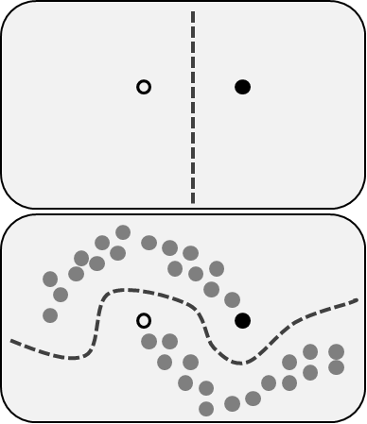
Semi-supervised learning
uses also unlabeled data for learning
mid-point between unsupervised (no labeled data) and supervised (all data labeled) learning
labeling is time-consuming and often expensive
https://en.wikipedia.org/wiki/Semi-supervised_learning

Slide 3
Co-training
small amount of labeled data, a lot of unlabeled data
two classifiers trained on two distinct views (disjoint features)
both disjoint features sets need to be descriptive enough for prediction
very powerful, but only few datasets have independent sets of features

Slide 4
Co-training algorithm
Inputs:
2 initial collections of documents (labeled and unlabeled)
Collection of possible labels (assigned in prediction)
Output:
Two classifiers – A and B predicting class labels for new documents
while (any unlabeled document(s) in unlabeled collection):
Build classifier A using the A portion of each labeled document
Build classifier B using the B portion of each labeled document
Pick unlabeled document (or more) about which label is classifier A most confident and add it to the collection of labeled documents.
Do the same (step 3) using classifier B.
* portion = disjoint features set

Slide 5

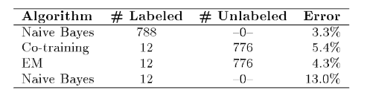
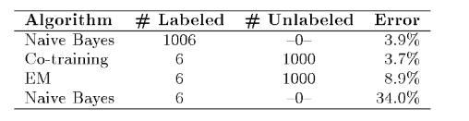
Co-training performance
Blum & Mitchell, webpages classifying by hyperlinks pointing to the page and words that appears on the page
Nigam & Ghani, analysis of webpages classifying with co-training
Dataset that has independent properties

Slide 6
Next lessons
How much labeled data is needed for relevant results using co-training?
Train classifier with all labeled data
Use co-training to achieve as much accuracy as possible with just few labeled records
Evaluate worthiness of using co-training

Slide 7
Resources
Combining labeled and unlabeled data with co-training, Avrim Blum & Tom Mitchell (https://dl.acm.org/citation.cfm?id=279962)
Analyzing the effectiveness and applicability of co-training, Kamal Nigam & Rayid Ghani (https://dl.acm.org/citation.cfm?doid=354756.354805)
Multi-view learning overview: Recent progress and new challenges, Jing Zhao, Xijiong Xie, Xin Xu, Shiliang Sun (https://www.sciencedirect.com/science/article/pii/S1566253516302032)
Semi-supervised learning, Wikipedia (https://en.wikipedia.org/wiki/Semi-supervised_learning)

