Slide 1
Co-training
Peter Mačinec, Lukáš Janík, Vajk Pomichal, František Šefčík

Slide 2

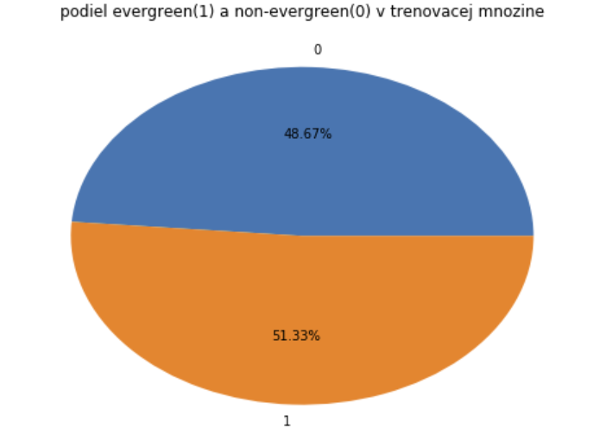
Our task for prediction
Predict whether website is evergeen or ephemeral (non-evegreen)
Evergreen vs ephemeral:
Evergreen content = recipes for carrot cake or intro to data structures, frequently don’t change with time
Ephemeral content = celebrity hot or not trends or local high school sport scores, frequently changes in time (becomes outdated)
Class to be predicted => label:
1 - Evergreen
0 – non-Evergreen
Number of rows is almost equal for both classes

Slide 3
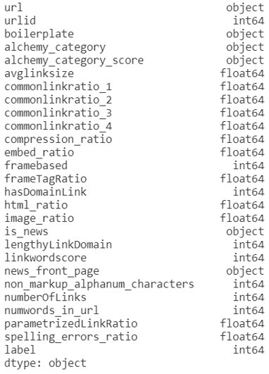
Dataset analysis
Probably the most informative (also the most problematic) – boilerplate:
json – title, body, url
Majority of attributes not showing any usable information (first look)
small differences in attribute values according to labels

Slide 4
Dataset analysis – textual features
Body content of every page
Text preprocessing
text cleaning
stopwords
stemming
Bag of words (57k words)
TF-IDF (top 1k)

Slide 5
2 independent features sets
Initial ideas:
Website content and links
Text and html data
Features selected for first iteration:
1. set
2. set – textual (tf-idf, bow)

Slide 6
Classifying models and their results
Textual features – website content
Naïve Bayes – 66%
RandomForest – 80%
Random Forest (1000 top words) - 79.3%
Other features - links (numeric)
Numeric atributes:
RandomForest – 66%
Logical regression – 59%
Naïve Bayes – 56%

Slide 7
Questions
Correctly chosen independent features sets?
How to check that?
Your questions...

Slide 8
Resources
http://cs229.stanford.edu/proj2014/Elaine%20Zhou,%20Lingtong%20Sun,%20Evergreen%20or%20Ephemeral%20-%20Predicting%20Webpage%20Longevity%20Through%20Relevancy%20Features.pdf

