Slide 1
Co-training
Peter Mačinec, Lukáš Janík, Vajk Pomichal, František Šefčík

Slide 2
Co-training
Comparison to https://github.com/jjrob13/sklearn_cotraining:
FAILED
slightly different approach than ours
lot of errors (more time needed)

Slide 3
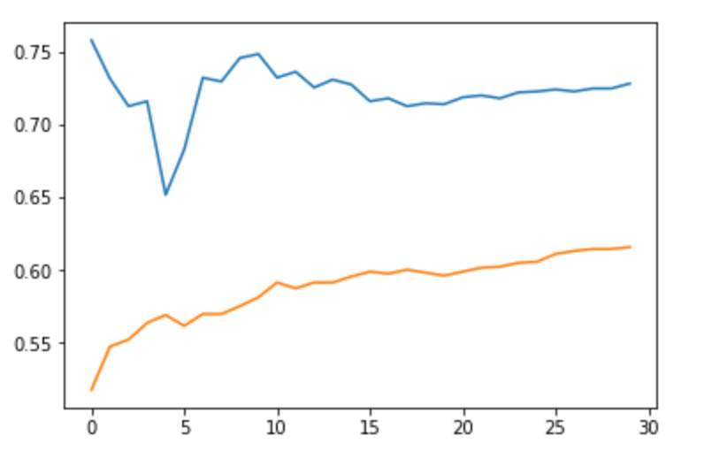
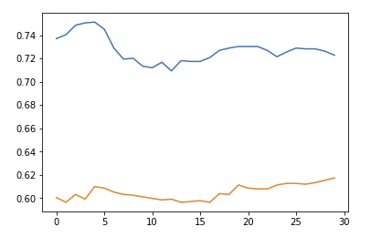
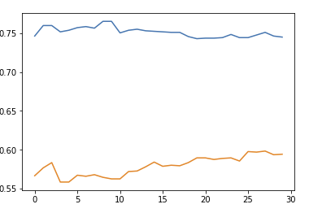
Co-training (2)
Co-training single runs statistics:
One run of co-training = 30 iterations (5 negative, 5 positive)

Slide 4
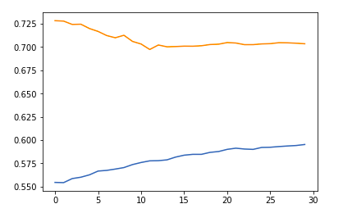
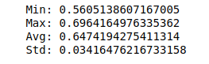
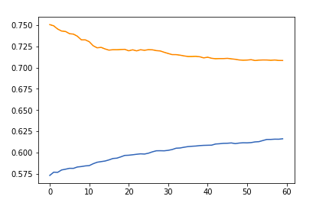
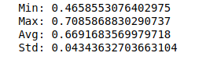
Co-training - with iterations
30 runs of co-training algorithm: (10-10 labeled data, 30 iterations)
average per iteration (average of 30 values for each iteration)
30 runs of co-training algorithm: (20-20 labeled data, 60 iterations)
Combined model results:
Combined model results:

Slide 5
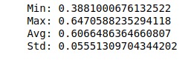
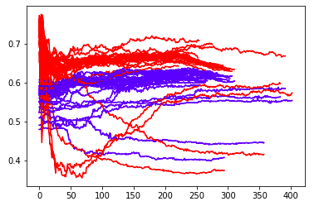
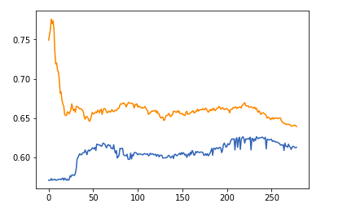
Co-training - with threshold
30 runs of co-training algorithm: (10-10 labeled data, threshold 90%)
Combined model results:
Models accuracy throught iterations:

Slide 6
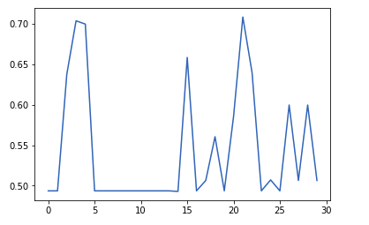
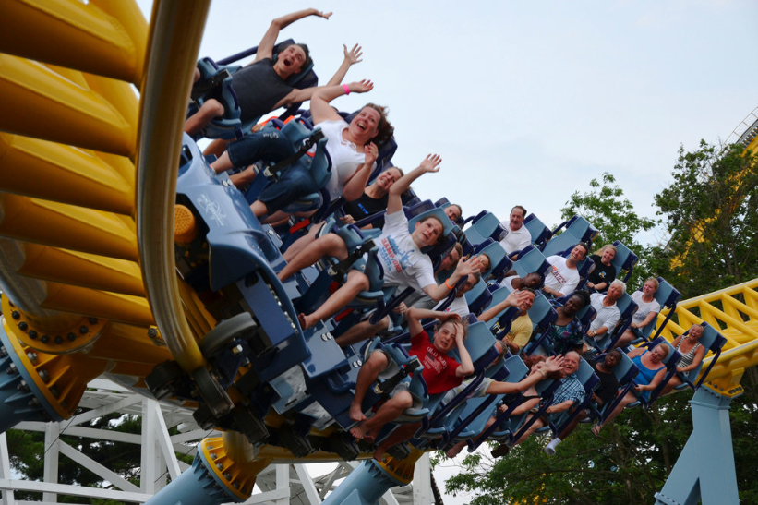
Self-training
Semi-supervised framework
https://github.com/tmadl/semisup-learn
30 runs of semi-supervised algorithm:
Probably very depending on chosen first labeled data

Slide 7
Results and evaluation
30 runs
Benchmark model – 80% accuracy
To compare:
Co-training using iterations
30 iterations, 2 positive, 2 negative
Co-training using threshold
90%, 2 positive, 2 negative
Self-training
All features, still 20 labeled records

Slide 8
Comparison
10-10 labeled records
30 runs each
 | CLF1 | CLF2 | Combined/Basic
Without co-training | - | - | 50
Co-training iterations (10-10 labeled, k=30) | 60 | 70 | 65
Co-training threshold | 59 | 64 | 60
Self-training | - | - | 55

Slide 9

Evaluation
Too much dependent feature sets
Very depending on which records were chosen
In all cases of co-training, accuracy of better classifier was decreased and vice versa, but still relevant

Slide 10
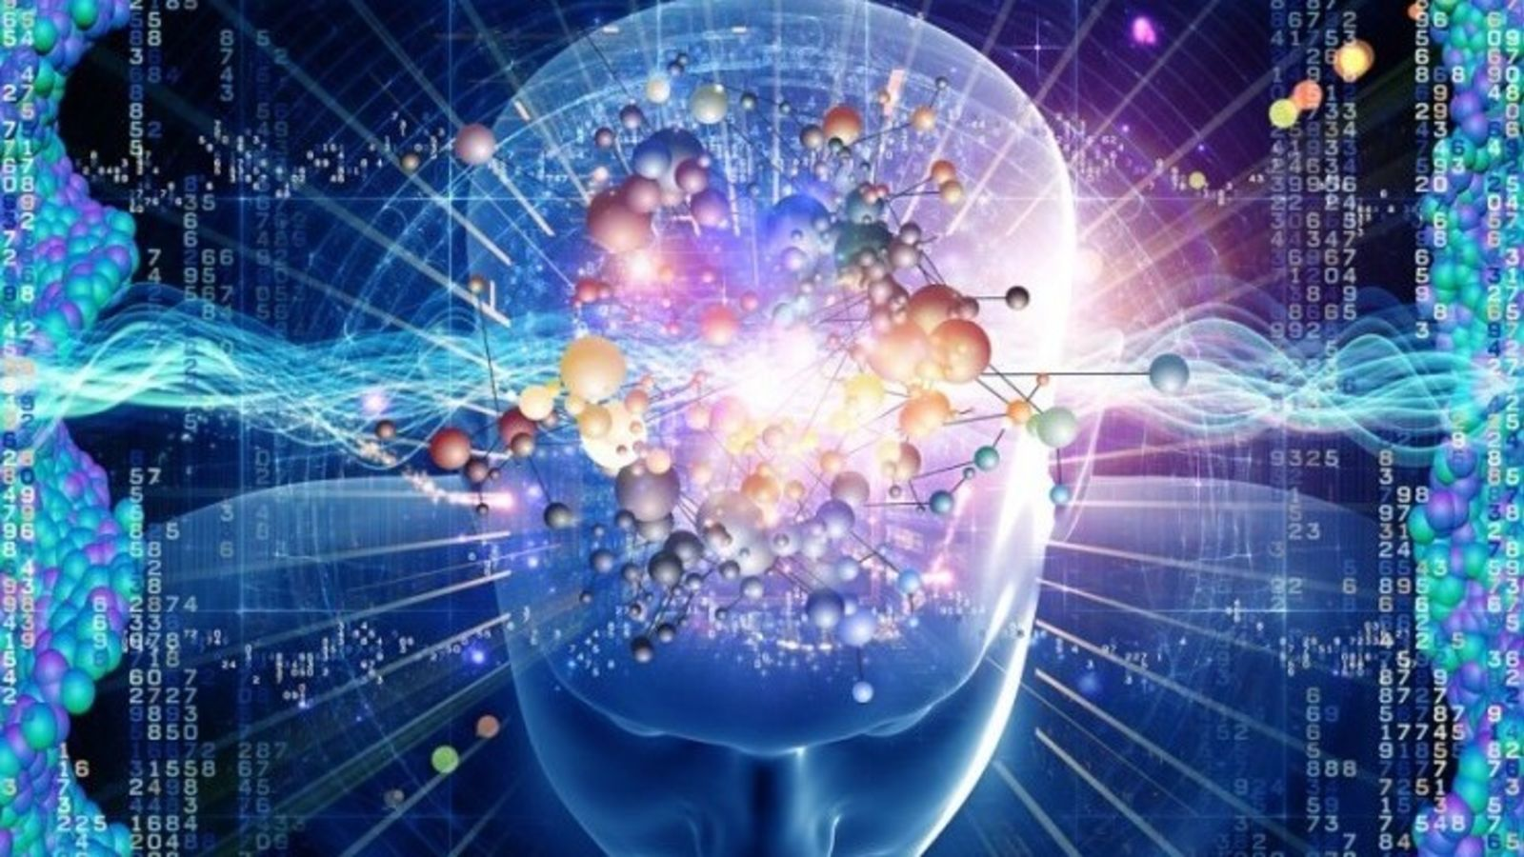
Resources
OUR MINDS

