Slide 1
A Solar Powered Intelligent Iot System Incorporating Bio Fogging For Automated Pest Control And Real Time Crop Monitoring
PRESENTED BY:
LIBNI DHIHONA J M (927623BEE047)
MADHUMITHA P (927623BEE051)
GUIDED BY:
Mrs. P. SASIREKHA M.E.,
ASSISTANT PROFESSOR
DEPARTMENT OF EEE

Slide 2
OVERVIEW OF THE PRESENTATION
Abstract
Introduction
Literature Review
Existing System
Block Diagram of Existing System
Problem Statement
Objective
Block diagram
Working
Proposed System
Circuit Diagram
Result and Discussion
Hardware Implementation
Experimental Setup
Innovation and Uniqueness
Feasibility and Viability
Existing vs Proposed system
Conclusion
Future Scope
References

Slide 3
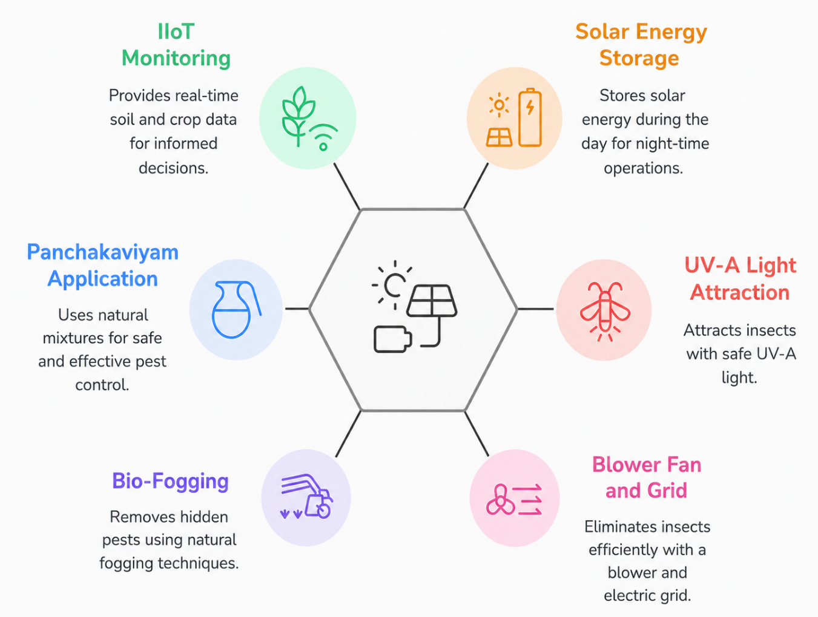
ABSTRACT
The system uses solar energy to power pest control operations
stores energy during day and operates during night
UV-A light of 365 nm attracts insects without causing harm
safe for humans, plants, and environment
Blower fan and electric grid eliminate insects efficiently
provides automatic and continuous pest removal
Bio-fogging removes pests hidden under leaf surfaces
works effectively where UV light cannot reach
Panchakaviyam used in 3–5% concentration for safe fogging
mixed with neem oil and cow-based natural inputs
iot system monitors soil and crop conditions in real time
helps farmers take better decisions remotely

Slide 4
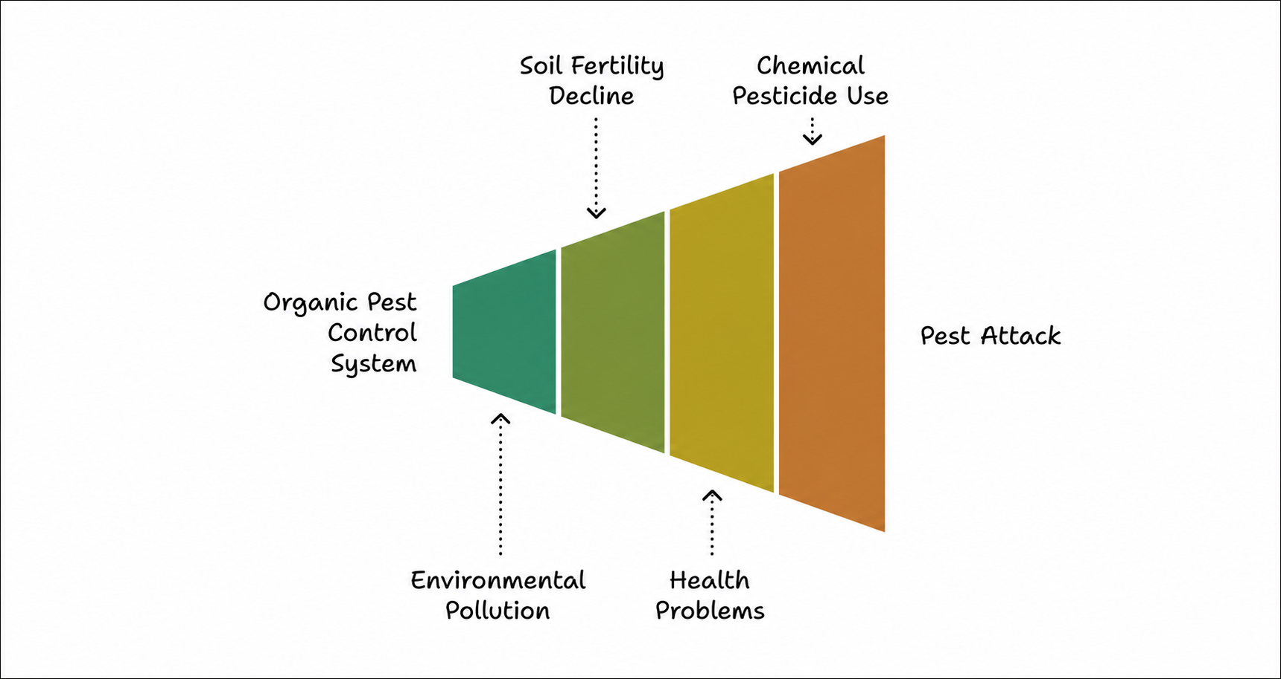
INTRODUCTION
Pest attack damages crops and reduces agricultural yield by affecting plant growth.
Farmers use chemical pesticides for quick and easy pest control.
Chemical pesticides cause serious health problems to farmers and consumers.
Overuse of chemicals reduces soil fertility by killing useful microorganisms.
Pesticides lead to environmental pollution by contaminating air and water.
A smart and organic pest control system is needed for safe and sustainable farming.

Slide 5
LITERATURE REVIEW
S.NO | TITLE | AUTHOR | YEAR OF PUBLICATION | DESCRIPTION | PROBLEMS IDENTIFIED
1 | Solar Powered Insect Trap System | R. Karthikeyan et al | 2023 | Uses solar energy and UV light to attract and trap flying insects in agricultural fields | Only controls flying insects; hidden pests under leaves are not affected
2 | IoT Based Smart Agriculture Monitoring System | S. Rajalakshmi et al | 2022 | Uses sensors and IoT to monitor soil moisture, temperature, and crop health remotely | No pest control mechanism included; only monitoring system
3 | Organic Pest Control using Neem Oil and Panchakaviyam | M. Selvaraj et al | 2021 | Uses natural bio-mixtures like neem oil and panchakaviyam for eco-friendly pest control | Manual spraying required; no automation and inconsistent application

Slide 6
LITERATURE REVIEW
S.NO | TITLE | AUTHOR | YEAR OF PUBLICATION | DESCRIPTION | PROBLEMS IDENTIFIED
4 | UV Light Based Pest Control System | P. Srinivasan et al | 2020 | UV light attracts insects and helps in reducing pest population in farms | Limited to night operation; ineffective for hidden pests
5 | Smart Farming using IIoT Technologies | K. Balaji et al | 2023 | Integrates IoT for smart monitoring and automation in agriculture | Does not include pest control features; focuses only on monitoring
6 | Automated Fogging System for Agriculture | V. Prakash et al | 2022 | Uses fogging technique to spread pesticide or organic solutions in crops | Uses chemicals in many cases; lacks solar integration and smart control

Slide 7

EXISTING SYSTEM
Chemical spraying is widely used
quick results but harmful to soil and human health
Manual pest removal is followed
requires continuous monitoring and more physical effort
Basic UV traps are used
controls only flying insects, not hidden pests
Limited control over pest management
farmers must manually handle pest control activities
No smart monitoring available
field conditions cannot be tracked remotely
High environmental risk exists
due to excessive use of chemical pesticides

Slide 8
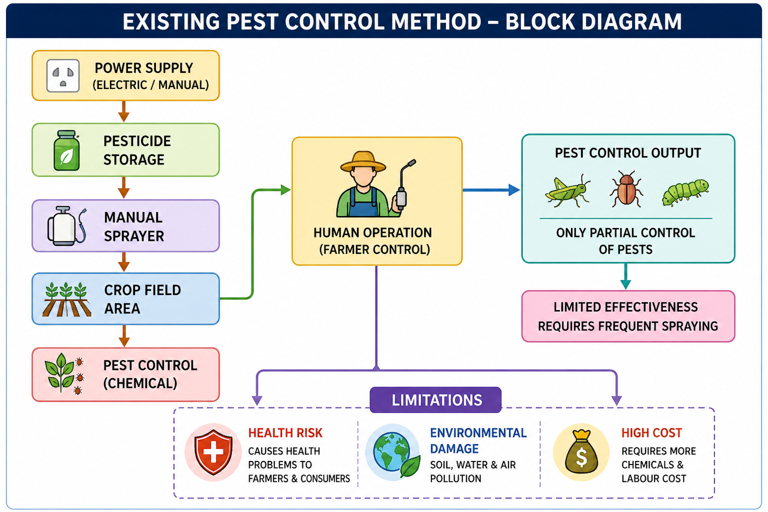
BLOCK DIAGRAM OF EXISTING SYSTEM

Slide 9
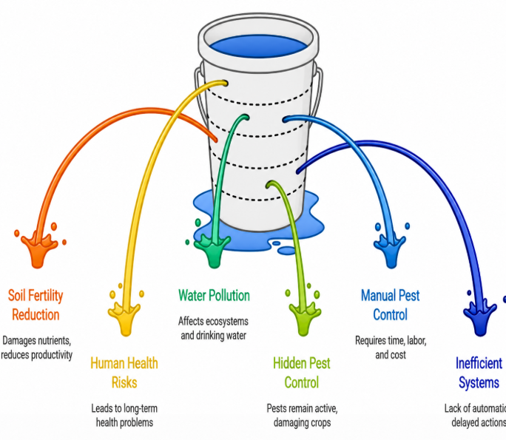
PROBLEM STATEMENT
Excessive pesticide use reduces soil fertility and affects long-term crop productivity.
Chemical residues in crops harm human health and cause serious long-term issues.
Pesticide runoff causes water pollution and affects ecosystems and drinking water.
Hidden pests under leaves are not effectively controlled and continue damaging crops.
Manual pest control requires more time and labor, increasing overall effort.
Current systems are inefficient and lack automation and proper monitoring.

Slide 10
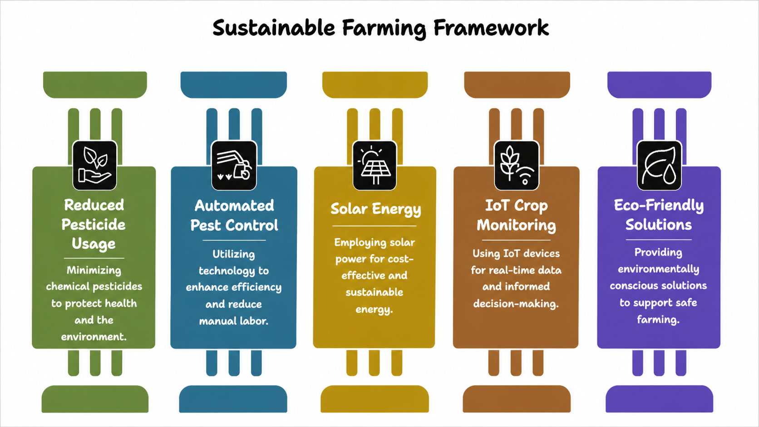
OBJECTIVE

Slide 11
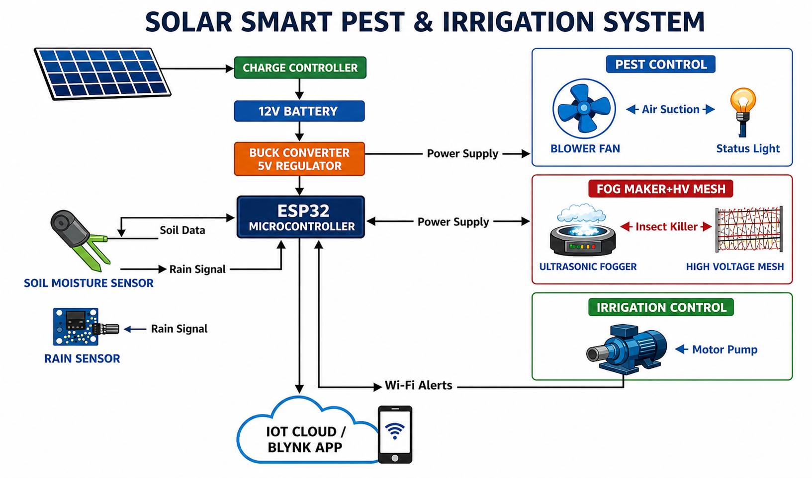
BLOCK DIAGRAM OF PEST CONTROL
11

Slide 12
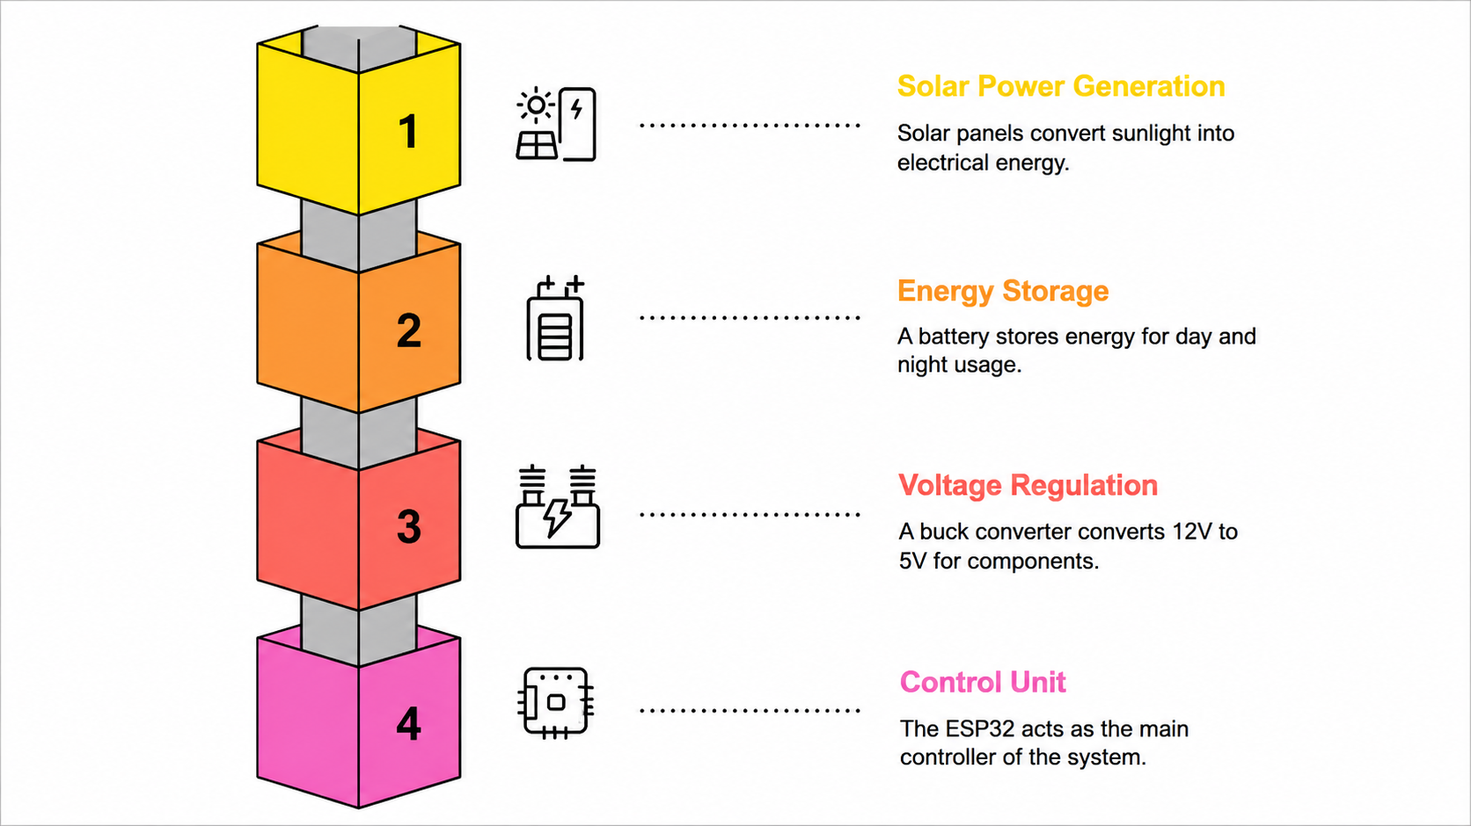
WORKING
12

Slide 13
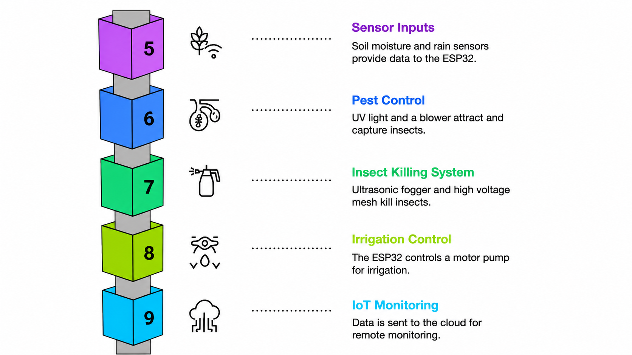
WORKING
13

Slide 14
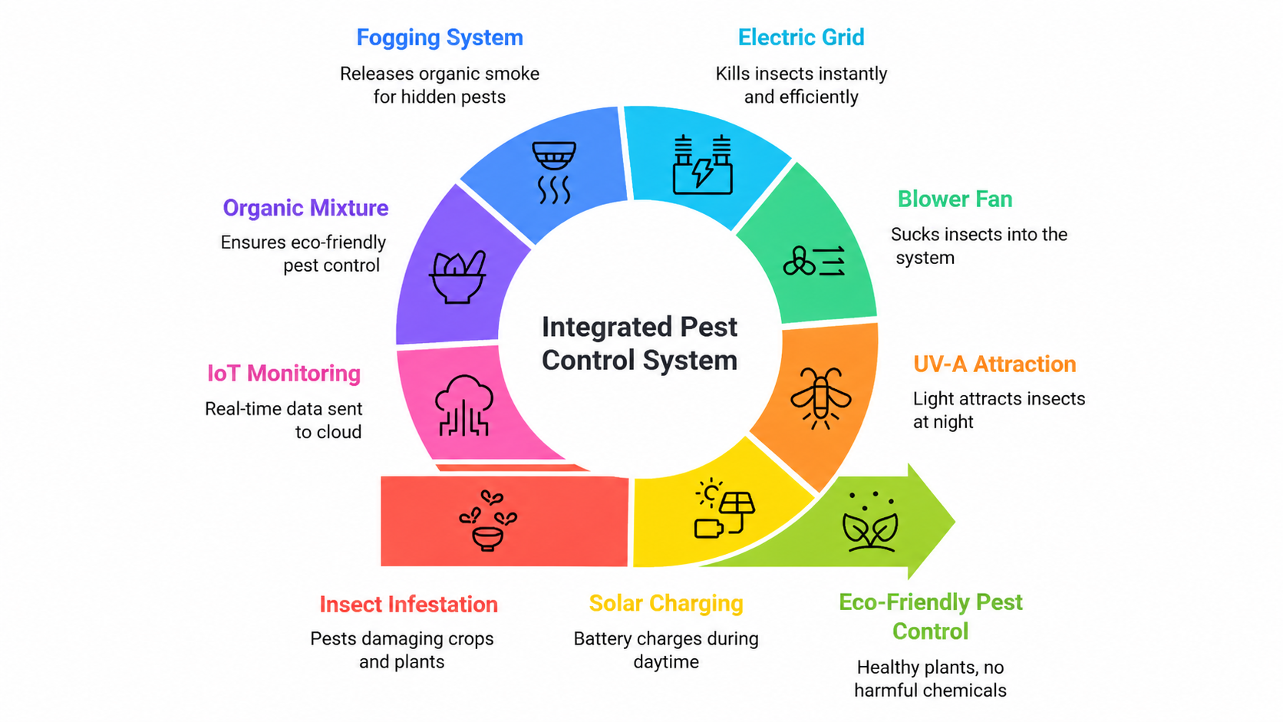
PROPOSED SYSTEM

Slide 15
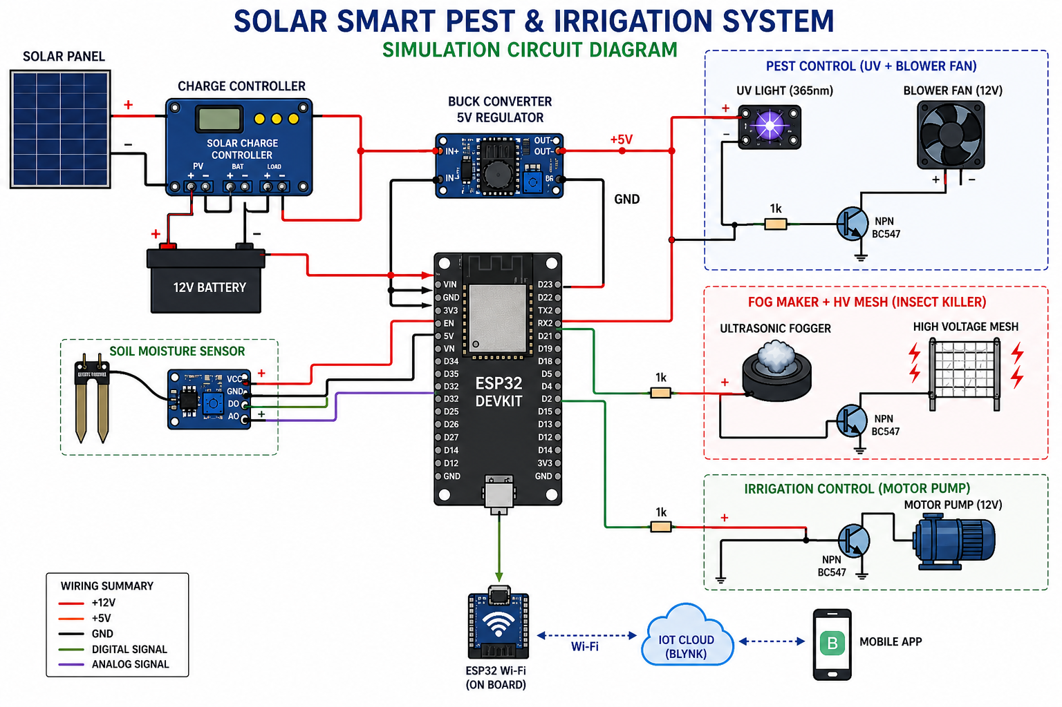
CIRCUIT DIAGRAM OF PEST CONTROL
15

Slide 16
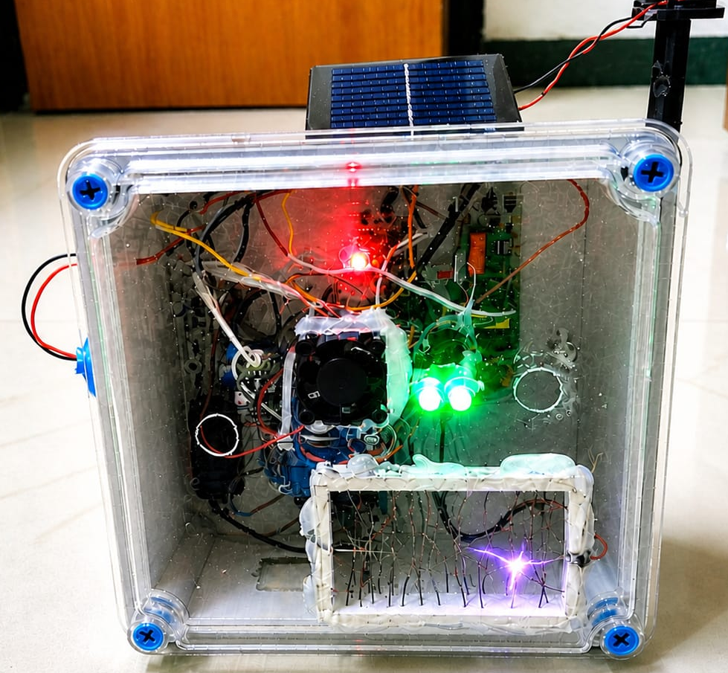
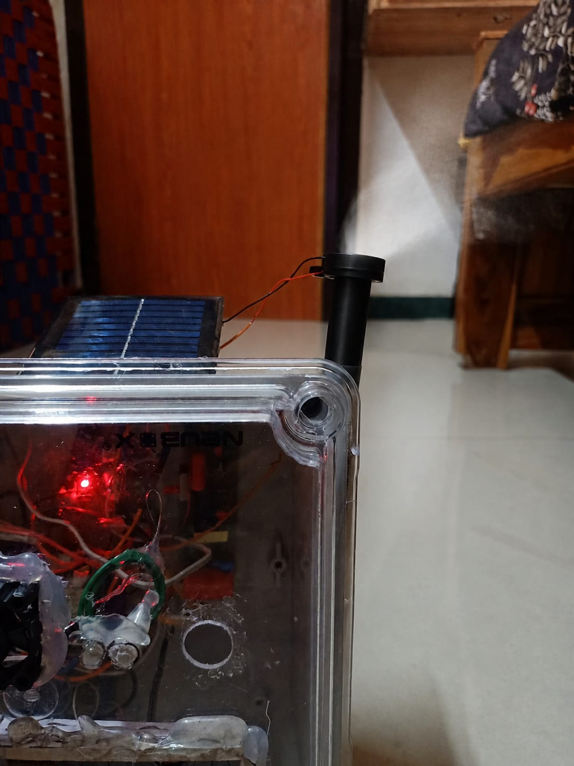
RESULTS AND DISCUSSION
1) FENCING UNIT
2) FOGGING UNIT
16

Slide 17
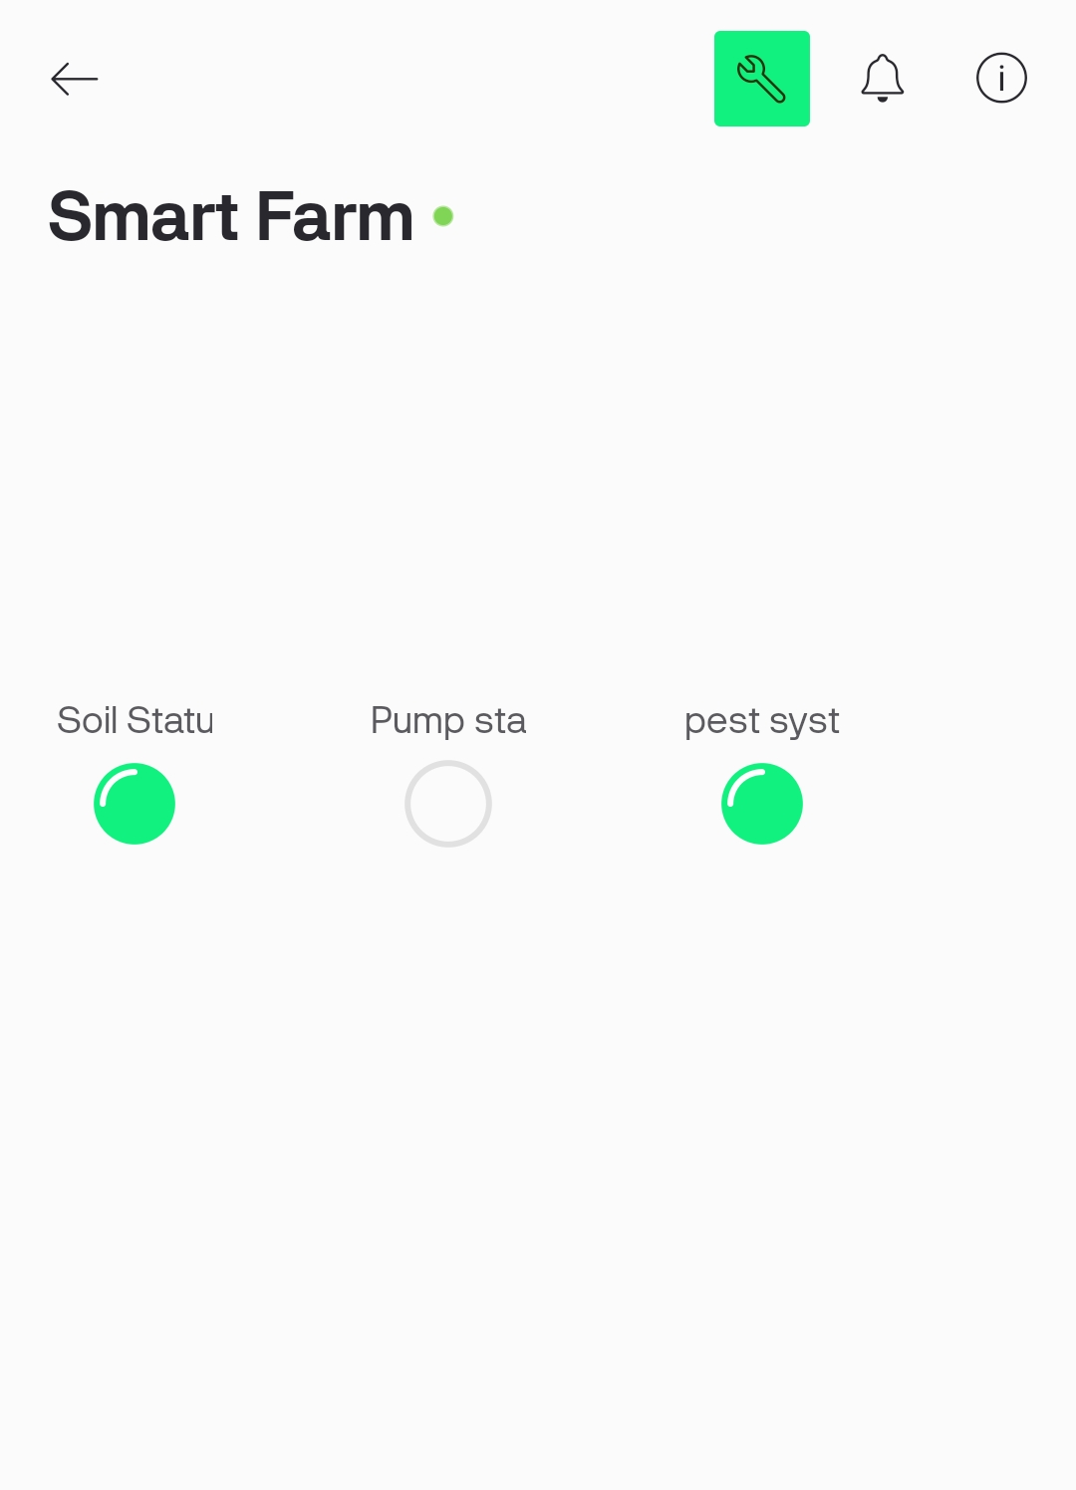
RESULTS AND DISCUSSION
3) MONITORING UNIT
17

Slide 18
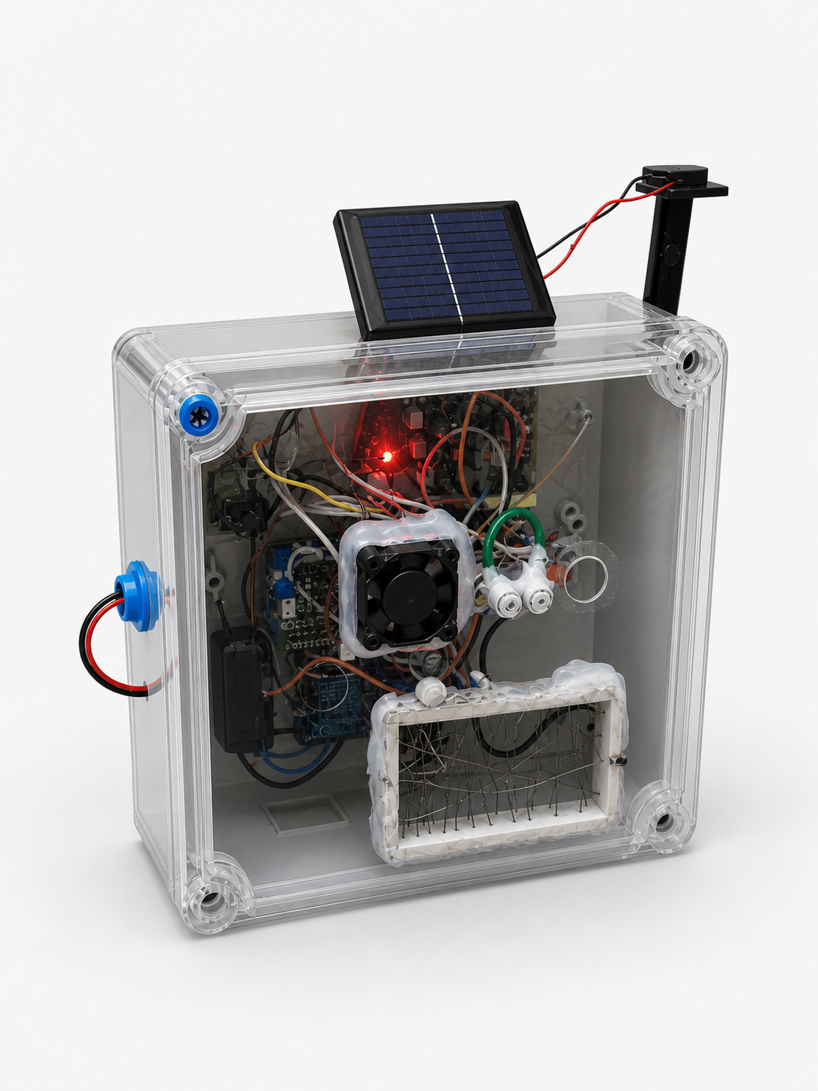
HARDWARE IMPLEMENTATION
18

Slide 19
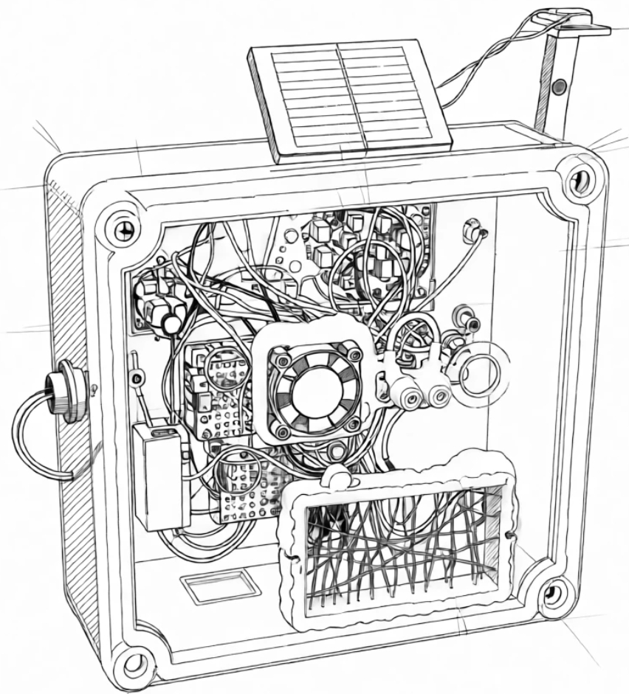
LINE DIAGRAM
FOGGING UNIT
SOLAR PANEL
LED LIGHT
BLOWER FAN
MICROCONTROLLER
FENCING UNIT
19

Slide 20
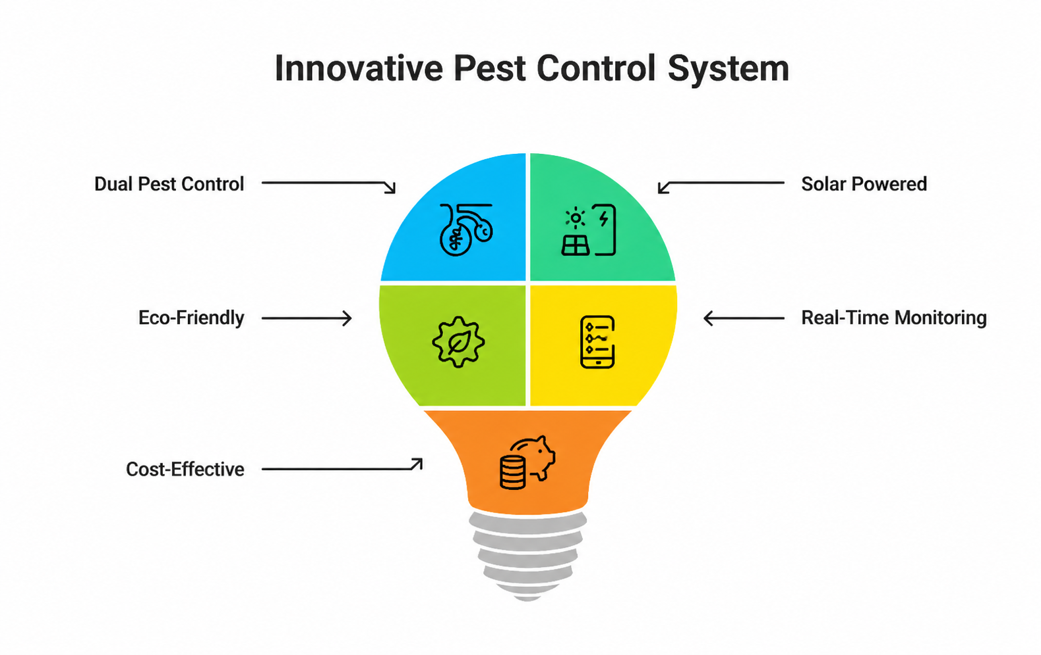
INNOVATION AND UNIQUENESS
Uses dual pest control (UV for flying insects + fogging for hidden pests)
Powered by solar energy, no need for external electricity
Uses eco-friendly organic mixture instead of chemicals
Real-time monitoring through mobile using IoT
Low cost and reduces manual work for farmers

Slide 21
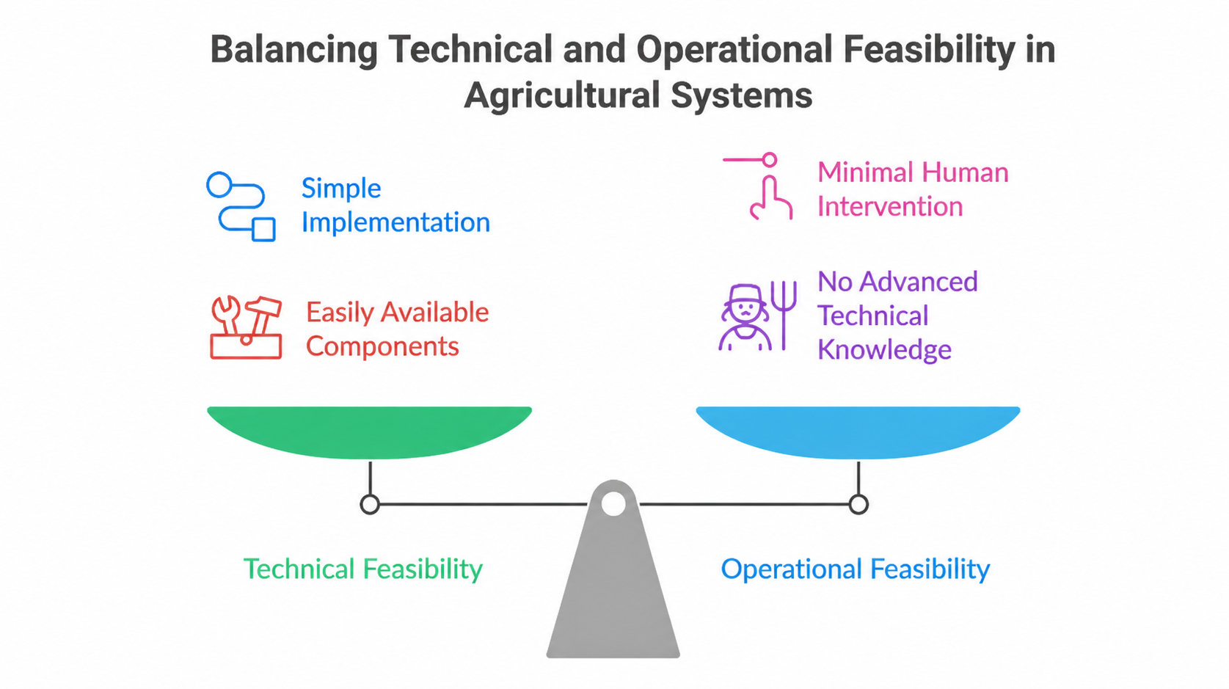
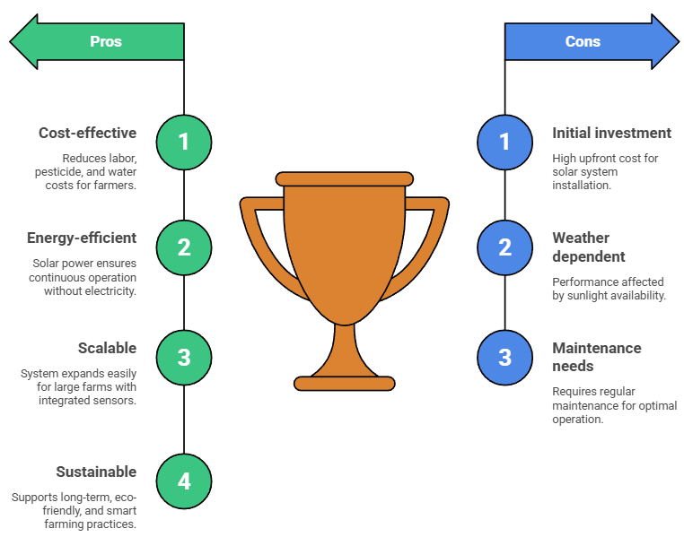
FEASIBILITY AND VIABILITY

Slide 22
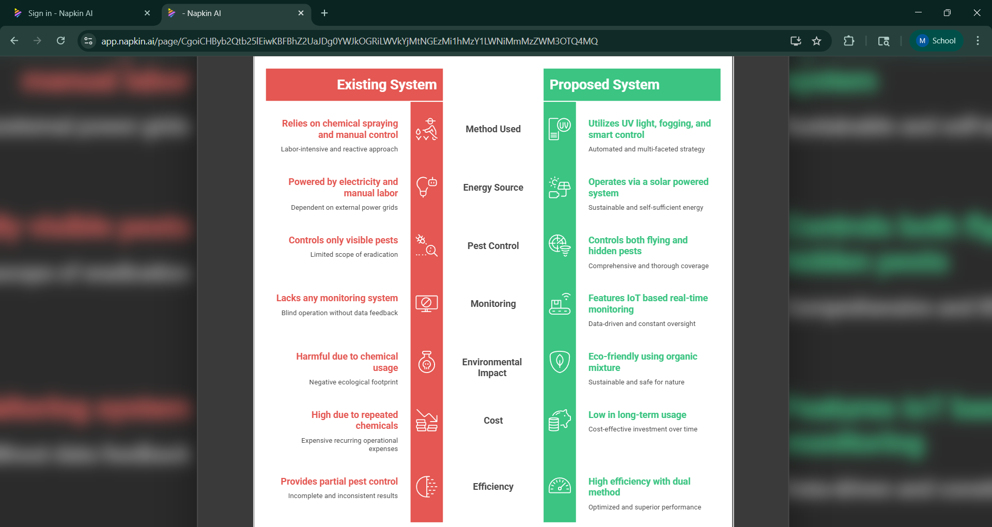
EXISTING vs PROPOSED SYSTEM
22

Slide 23
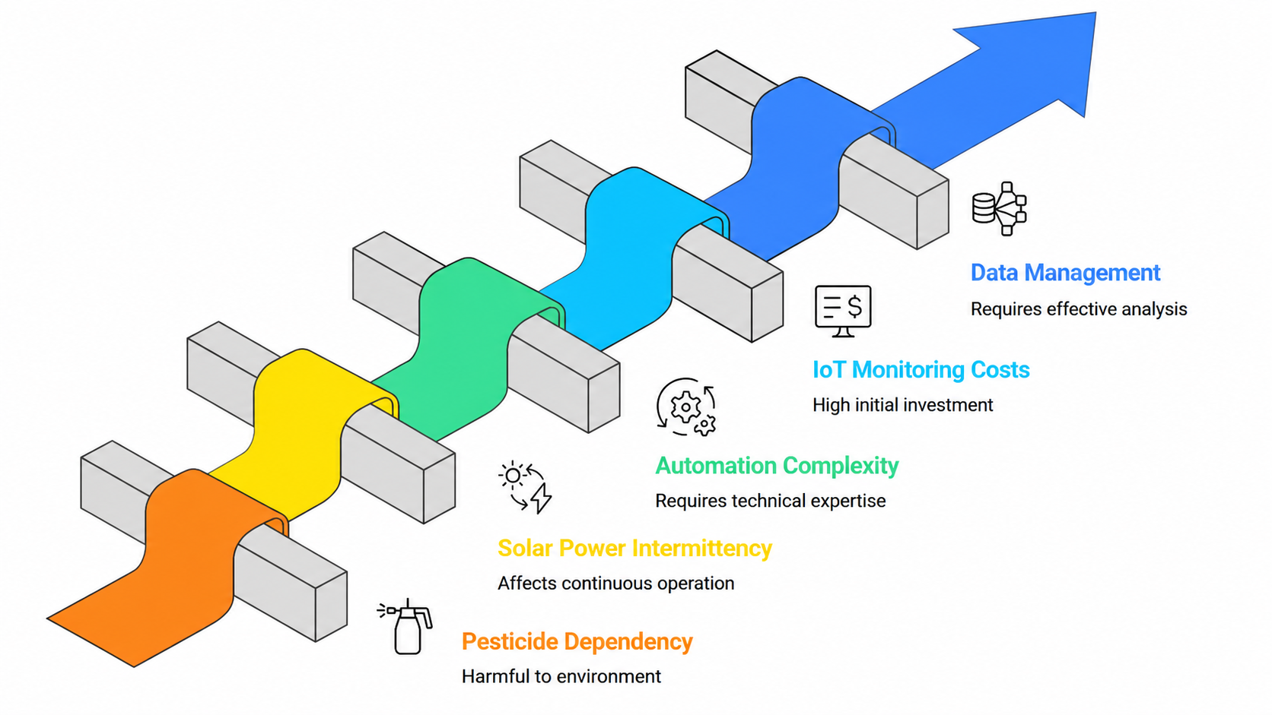
CONCLUSION
The proposed system provides an effective solution for modern agriculture by integrating solar energy, automated pest control and IoT-based monitoring.
It reduces the dependency on chemical pesticides through eco-friendly methods such as UV trapping and Panchakavya-based fogging.
The system ensures continuous operation using solar power and improves efficiency through time-based automation and sensor-based control.
Real-time monitoring allows farmers to make better decisions and manage crops effectively.
Overall, the system is cost-effective, sustainable and suitable for smart farming applications, helping to improve crop yield while protecting the environment.
23

Slide 24


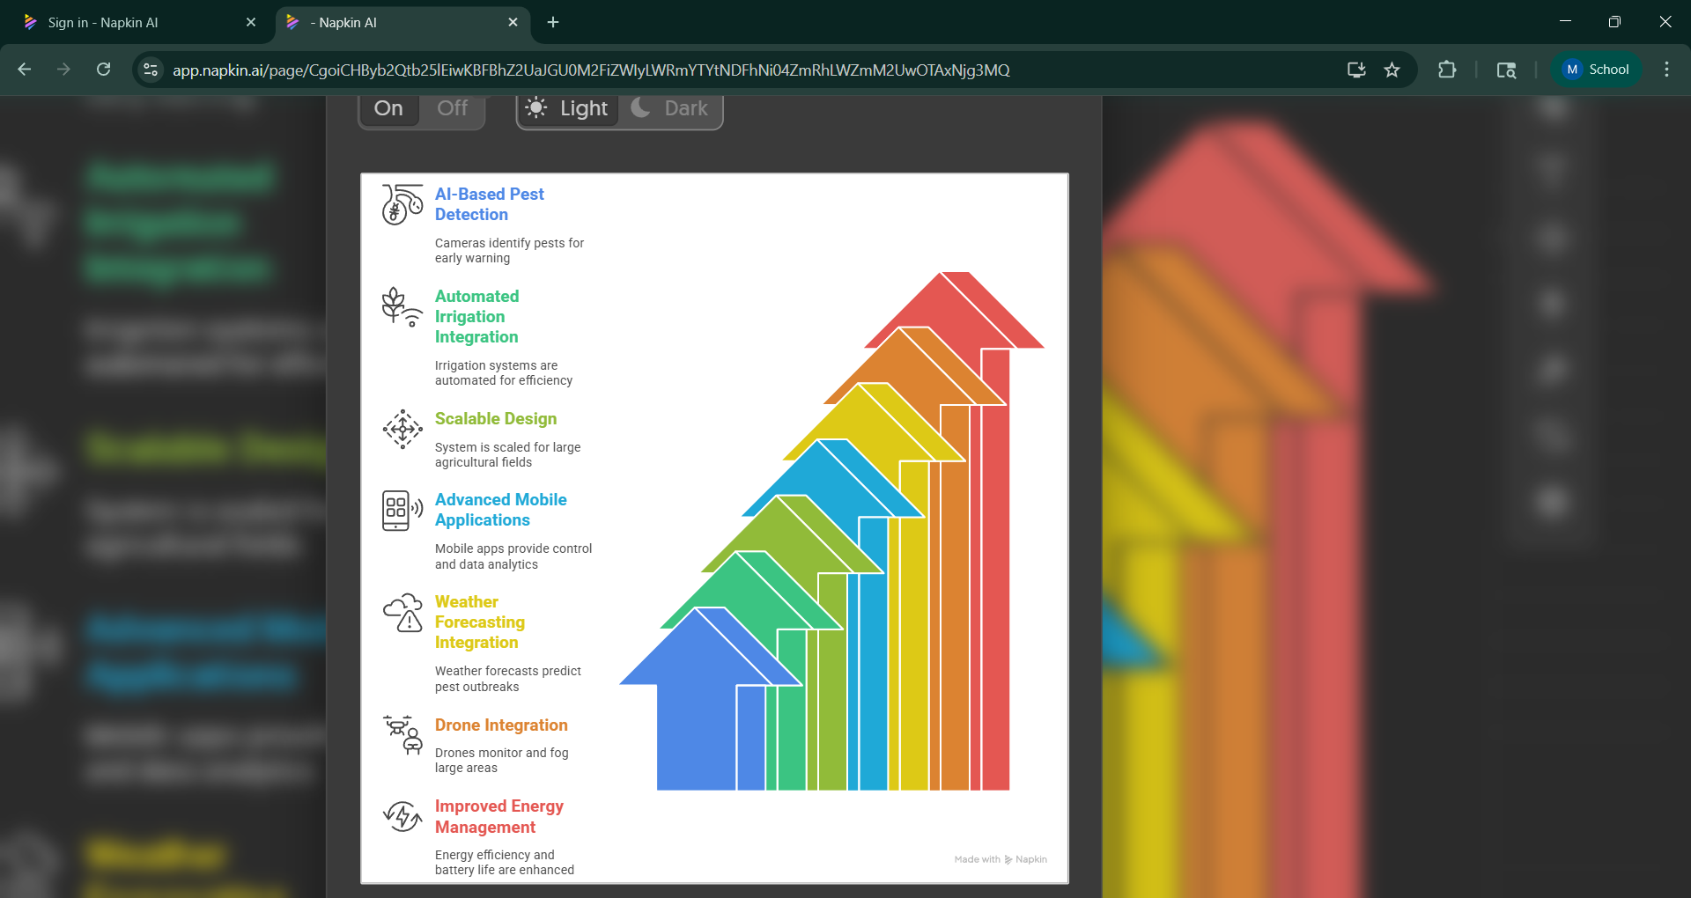
FUTURE SCOPE
The system can be enhanced with AI-based pest detection using cameras for accurate identification and early warning.
Integration with automated irrigation systems can provide a complete smart farming solution.
The design can be scaled for large agricultural fields using multiple interconnected units.
Advanced mobile applications can be developed for better control, alerts and data analytics.
Integration with weather forecasting systems can help predict pest outbreaks and take preventive action.
Use of drones can be added for large-area monitoring and fogging.
Improved energy management techniques can increase system efficiency and battery life.
24

Slide 25
REFERENCES
M. A. Campos, J. L. Hernandez, and R. Torres, “IoT-Based Smart Trap with Computer Vision for Pest Monitoring in Agriculture,” IEEE Access, vol. 8, pp. 102345–102356, Jun. 2020.
E. Alreshidi, “Smart Agriculture System Using IoT and Artificial Intelligence,” IEEE Internet Things J., vol. 7, no. 12, pp. 12345–12354, Dec. 2020.
S. R. S. Prasad, K. Kumar, and P. Singh, “Solar Powered Smart Pest Control System for Sustainable Agriculture,” IEEE Trans. Ind. Appl., vol. 57, no. 5, pp. 4567–4575, Sep. 2021.
R. K. Sharma and A. Gupta, “Design of IoT-Based Pest Detection and Monitoring System Using Wireless Sensor Networks,” IEEE Sensors J., vol. 21, no. 15, pp. 16890–16899, Aug. 2021.
M. S. Farooq, S. Riaz, and A. Abid, “A Survey on the Role of IoT in Smart Agriculture for Pest Control and Monitoring,” IEEE Access, vol. 11, pp. 45678–45695, Mar. 2023.
25

Slide 26
REFERENCES
S. Davarzani, I. Pisica and G. A. Taylor, "Energy management in a demand response framework for efficient voltage control and distribution automation," 2025 50th International Universities Power Engineering Conference (UPEC), Stoke on Trent, UK, 2015, pp. 1-6, doi: 10.1109/UPEC.2015.7339810.
D. S. Sarma, S. Peter and C. Rehtanz, "A Distributed Framework for Agent- based Optimal Energy Management of Distribution Systems," 2023 IEEE PES Innovative Smart Grid Technologies Europe (ISGT EUROPE), Grenoble, France, 2023, pp. 1-5, doi: 10.1109/ISGTEUROPE56780.2023.10407568.
Ioannou, S. Javaid, C. Christophorou, V. Vassiliou, A. Pitsillides and Y. Tan, "A Distributed AI Framework for Nano-Grid Power Management and Control," in IEEE Access, vol. 12, pp. 43350-43377, 2024, doi: 10.1109/ACCESS.2024.3377926.
26

Slide 27
OUTCOME
Our Project will be filed for a patent through our Institute IPM Cell.
27

Slide 28
thank you all for your attention!! 🙏

