Slide 1
Software Development 3
Django Framework

Slide 2
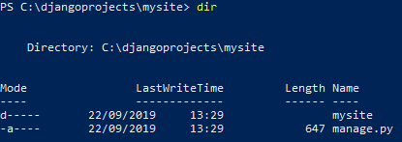
Our First Application
To create a Django project called mysite, we can use the following command:
Here, we are creating a project called mysite in the current directory
When we view the contents of mysite we see the following:

Slide 3
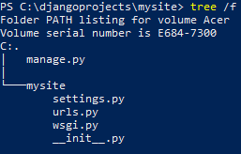
How to View the tree structure of a Django Application
To see all the files and subfolders of a Django project, we can use the tree /f command

Slide 4
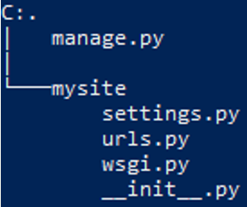
Django Project Packages & Files
manage.py: A command-line utility that lets you interact with the Django project in various ways
The inner mysite/ directory is the actual Python package for your project. Its name is the Python package name you’ll need to use to import anything inside it (e.g. mysite.urls)
mysite/settings.py: Settings/configuration for this Django project
mysite/urls.py: The URL declarations for this Djangoproject; a “table of contents” of your Django-powered site
mysite/wsgi.py: An entry-point for WSGI-compatible web servers to serve your project. WSGI is the Web Server Gateway Interface. It is a specification that describes how a web server communicates with web applications, and how web applications can be chained together to process one request
mysite/__init__.py: An empty file that tells Python that this directory should be considered a Python package e.g. mysite can be treated as a package

Slide 5
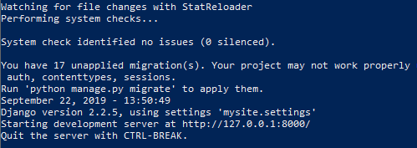
Running the Django Project
To verify your Django project works, change into the outer mysite directory and run the following command
The following output is displayed
This output tells us that the server has started and can be accessed at http://127.0.0.1:8000

Slide 6
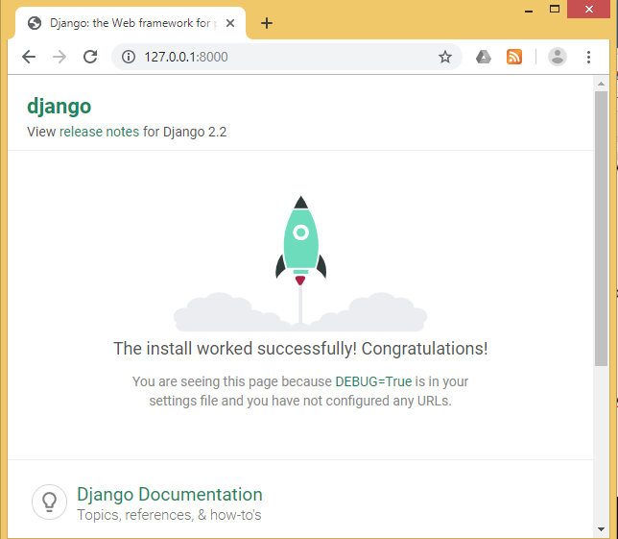
Localhost Access
Typing the URL into the browser will display the following page

Slide 7
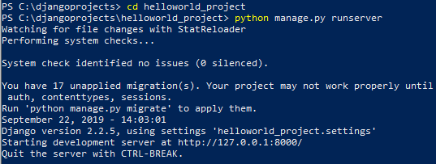
Hello World! Django Application
To create a Django project called helloworld_project, we can use the following command:
We can use the following commands to move into the helloworld_project directory and start the server running

Slide 8
Django Warning
Django is complaining that we have not yet “migrated” or configured our initial database. We are not using a database yet but we will still look at how we can get rid of these warnings
The message after the warning actually tells us the command that we need to run in order to migrate the database
We will cover database migrations in more detail in future exercises
The migrate command created the file db.sqlite3, which contains our SQLite database

Slide 9
Creating an app
Django uses the concept of projects and apps to keep code clean and readable
A single Django project contains one or more apps within it that all work together to form a web application. This is why the command for a new Django project is startproject
For example, a real-world Django e-commerce site might have one app for user authentication, another app for payments, and a third app to deal with item listing details. Each app deals with an isolated piece of functionality
In order to create an app we use the following command

Slide 10
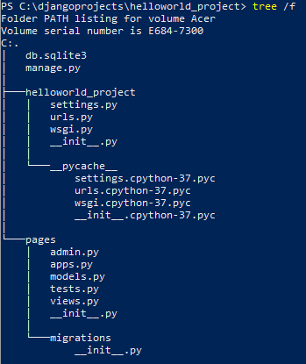
Let’s see the new directory structure
To see all the files and subfolders of a django project, we can use the tree /f command to view the tree structure of the application
Django has created a pages directory with the usual files
Note that the pages app contains the migrations folder to store migration files and model to write business logic

Slide 11
What is __pycache__?
When you run a program in python, the interpreter compiles it to bytecode first and stores it in the __pycache__ folder
Note the .pyc or .pyo files. These are bytecode-compiled and optimized bytecode-compiled versions of your program's files, respectively.
As a programmer, you can largely just ignore it... All it does is make your program start a little faster. When your scripts change, they will be recompiled, and if you delete the files or the whole folder and run your program again, they will reappear (unless you specifically suppress that behaviour)

Slide 12
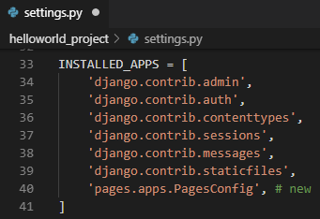
settings.py
The settings.py is the central configuration for all Django projects
Even though our new app exists within the Django project, Django doesn’t “know” about it until we explicitly add it
We should always add our own local apps at the bottom because Django will read our INSTALLED_APPS in top down order
Therefore, the internal admin app is loaded first, then auth, and so on. We want the core Django apps to be available since it’s quite likely our own apps will rely on their functionality

Slide 13
Views & URLConf
In Django, Views determine what content is displayed on a given page while URLConfs determine where that content is going
When a user requests a specific page, like the homepage, the URLConf uses a regular expression to map that request to the appropriate view function which then returns the correct data
In other words, our view will output the text “Hello, World” while our url will ensure that when the user visits the homepage they are redirected to the correct view
When you type in a URL, such as https://www.tudublin.ie
a URLpattern is found that matches the homepage
The URLpattern specifies a view which then determines the content for the page (usually from the database) and a template for styling
The end result is sent back to the user as an HTTP response

Slide 14
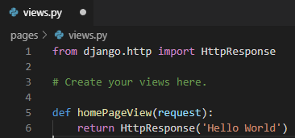
views.py
Whenever the view function homePageView is called, return the text “Hello, World!”
More specifically, we’ve imported the built-in HttpResponse method so we can return a response object to the user
We’ve created a function called homePageView that accepts the request object and returns a response with the string Hello, World!.

Slide 15
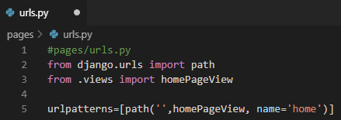
urls.py
When we want to access a view via a URL, Django has it’s own way for URL mapping and it's done by editing the urls.py file
When a user makes a request for a page on your web app, the Django controller takes over to look for the corresponding view via the urls.py file, and then return the HTML response or a 404 not found error, if not found
In urls.py, the most important thing is the "urlpatterns" where you define the mapping between URLs and views

Slide 16
urls.py
Line 2: Import Django's function path which we will use on line 5
Line 3: Import homePageView from views. By using the period .views we reference the current directory, which is our pages app containing both views.py and urls.py
Line 5: Our URLpattern has three parts:
a Python regular expression for the empty string ‘ '
specify the view which is called homePageView
add an optional URL name of 'home'

Slide 17
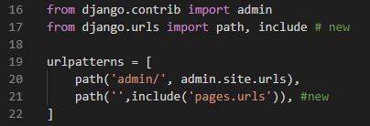
helloworld_project/urls.py
Now we need to update our helloworld_project/urls.py file. It’s common to have multiple apps within a single Django project, likes pages here, and they each need their own dedicated URL path
Line 17: Import Django’s include function
Line 21: Create a new URLpattern for our pages app
We are importing URLs from our pages application to the main mysite/urls.py file using the include function
Django will now redirect everything that comes into 'http://127.0.0.1:8000/' to pages.urls and look for further instructions there

Slide 18
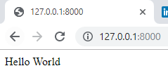
Running the Application
We have all the code we need now! To confirm everything works as expected, restart our Django server

