Slide 1
Customer Revenue Growth at Rackspace Hosting
as presented by:
Patrick Magnusson, Paulina Pastrana, Lyric Smith, and Charlie Wagner

Slide 2
Objectives
To help Rackspace Hosting better understand the variables leading to higher revenue from customers based on product usage and variety
To gauge the same variables’ effects on customer support call volume and sentiment score
Use the above information to aid the company in forming models for educated decisions

Slide 3
Descriptive Statistics: X-variables
Linux: 62% usage
Windows: 17%
All other products (firewalls, routers, storage, etc.): < 3%
Server count: 0, based on mean alone
Support: 11 calls/month (mean), 7 calls/month (median)
Highly skewed (15,441 max), enormous kurtosis (9,429)
Sentiment: 5/10 (median), 4.68/10 (mean)
Skew and kurtosis far more balanced: spread out

Slide 4
Descriptive Statistics - Revenue
Total: $182.43/month on average
skewed off of median $16.67/month, SD $1,341, $89,431 max
Cloud: $124.86 on average
median $14.64, SD of $794.21
Dedicated: $60.58 on average
brought down by being minority product and large number of $0 bills
$0 median
computed statistics not reflective of dollar truth

Slide 5
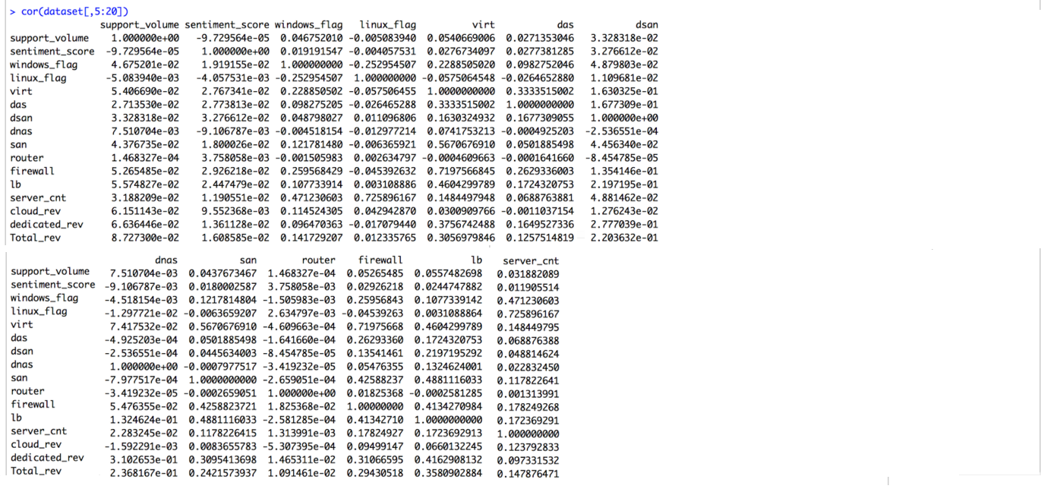
Revenue-Correlated Variables
Cloud:
Server count 12.4%
Windows ~10%
Firewall, LB, Support V 6-10% Dedicated:
Load Balancers 41.6%
Virt., SAN, Firewalls 30-40%
DAS 16.5%
Total Revenue:
Load Balancers 35.8%
Virtualization 30.6%
Firewalls 29.4%
SAN 24.2%
All Else less than 15%
Routers, Support minimal

Slide 6
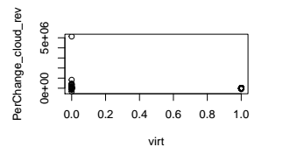
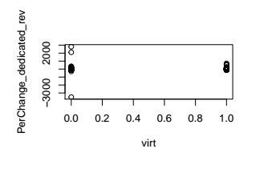
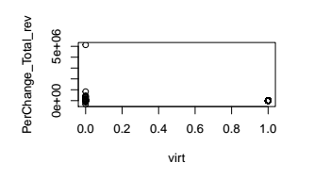
Do Customers Using a Particular Product Grow Faster than other Customers?
Evaluating Growth
Average Percentage Change of Cloud Revenue : 108%
Average Percentage Change of Dedicated Revenue: -1.19%
Average Percentage Change of Total Revenue: 107%
Plot Analysis
Relationship between percent change of each type of revenue by product

Slide 7
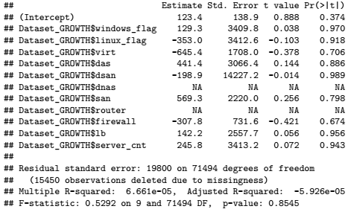
Do Customers Using a Particular Product Grow Faster than other Customers?
Analysis through Multiple Linear Regression Models - Percentage Change Cloud Revenue

Slide 8
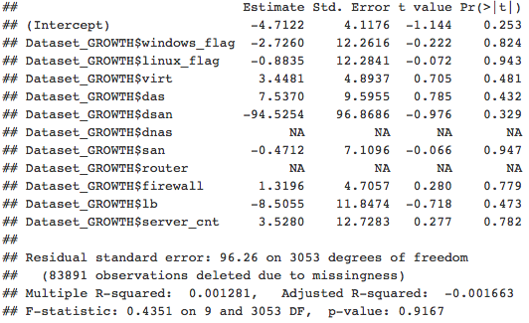
Do Customers Using a Particular Product Grow Faster than other Customers?
Analysis through Multiple Linear Regression Models - Percentage Change Dedicated Revenue

Slide 9
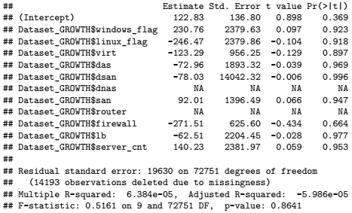
Do Customers Using a Particular Product Grow Faster than other Customers?
Analysis through Multiple Linear Regression Models - Percentage Change Total Revenue

Slide 10
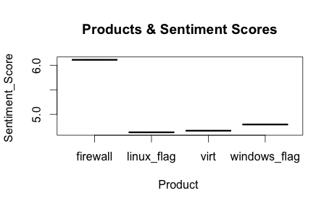
Do customers using a particular product have better sentiment?
Subset data by exclusively used products
4 products left for evaluation
Windows, Linux, Firewall Protection, and Virtualization
Products | Sentiment Scores | Number of Customers
Windows | 4.792916 | 1,101
Linux | 4.633442 | 6,441
Virtualization | 4.666667 | 3
Firewall | 6.111111 | 9

Slide 11
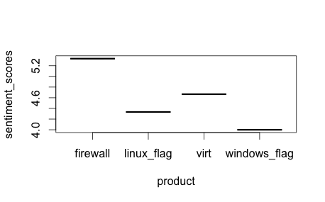
Random Sample of Customers
Products | Sentiment Scores | Number of Customers
Windows | 4 | 3
Linux | 4.333333 | 3
Virtualization | 4.666667 | 3
Firewall | 5.333333 | 3

Slide 12
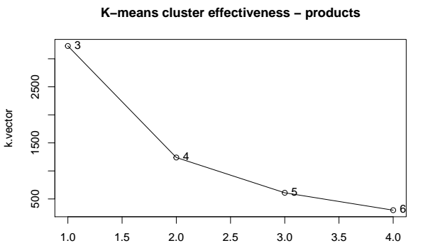
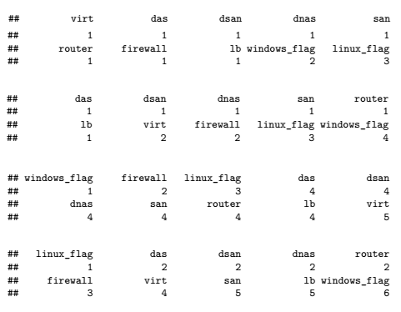
What Combination of Products Drives Revenue Growth?

Slide 13
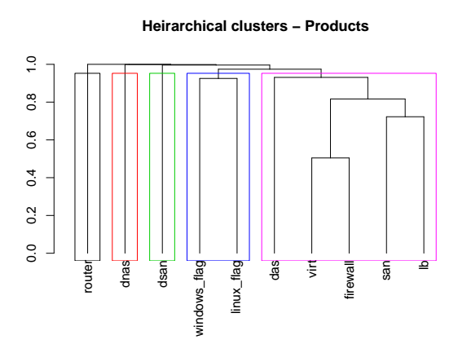
What Combination of Products Drives Revenue Growth?

Slide 14
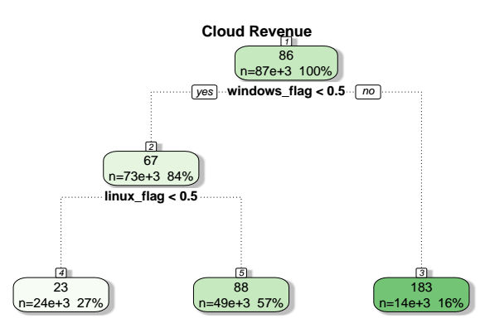
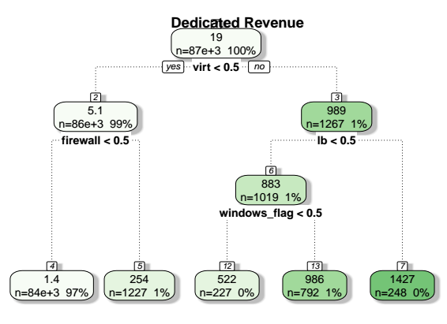

Slide 15
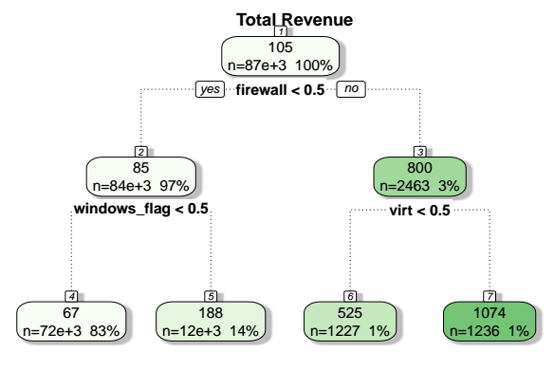

Slide 16
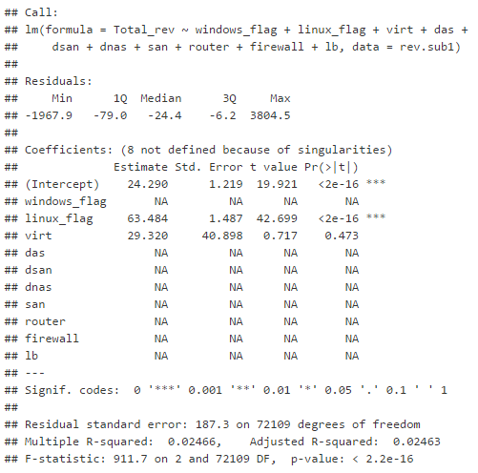
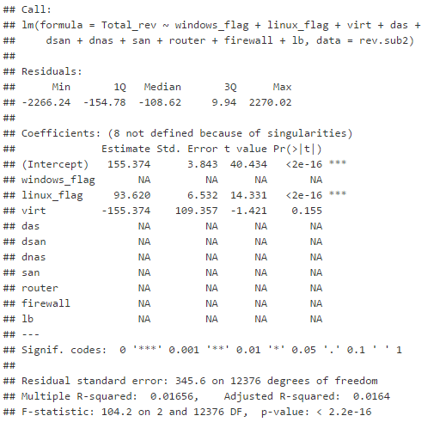
Regression Results - Groups 1 and 2

Slide 17
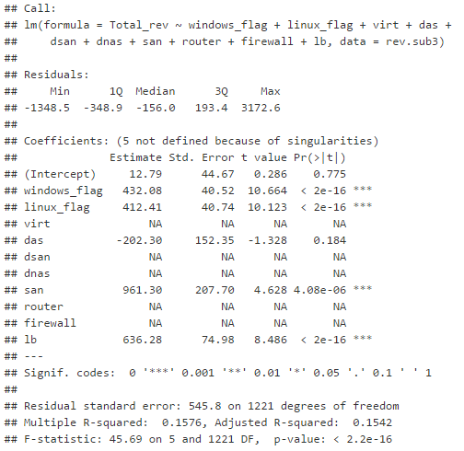
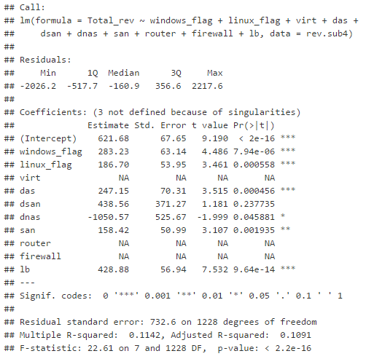
Regression Results - Groups 3 and 4

Slide 18
Analyzing Support Volume
Three Methods:
Support volume by server count
Customers using a product with one server vs. multiple servers
Linear regression
support volume and Rackspace products and services
Regression forest
Multiple regression models

Slide 19
Support Volume by Server Count
Averages of support volume for customers with multiple servers:
Highest: DSAN (190) and DNAS (128)
Lowest: Windows (24) and Linux (23.2)
Averages of support volume for customers with one server:
Highest: DAS (74.4) and DSAN (62.2)
Lowest: SAN (0) and DNAS (0)
Largest changes:
DSAN: 305% increase of support volume from single to multiple servers
Linux: 260% increase of support volume from single to multiple servers
A customer with any product has larger support volume with multiple servers

Slide 20
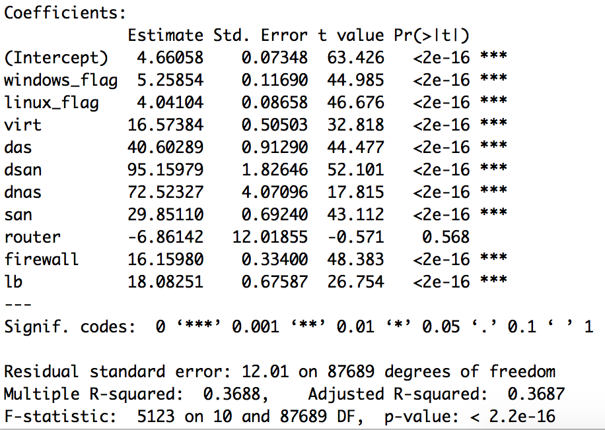
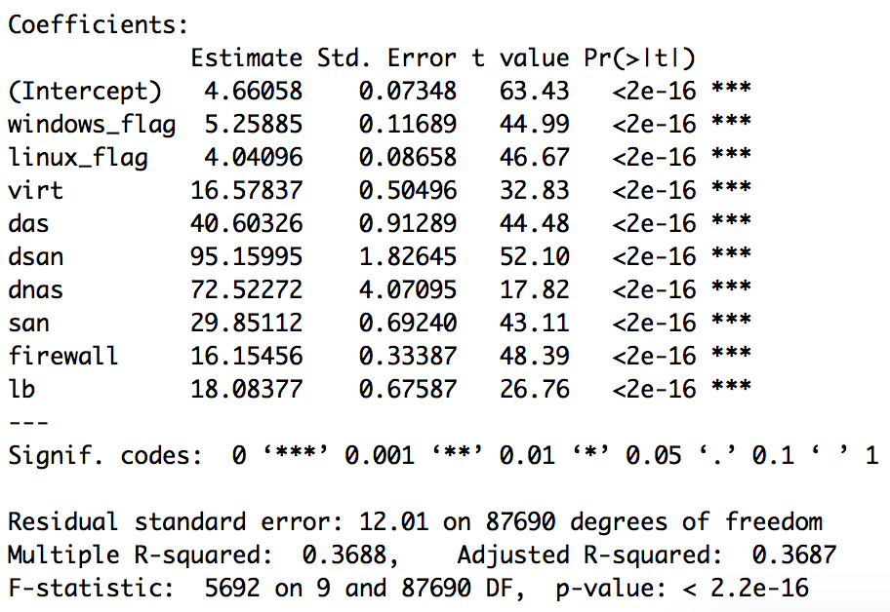
Linear Regression of Support Volume
Regression results: Model 1 Regression Results: Model 2

Slide 21
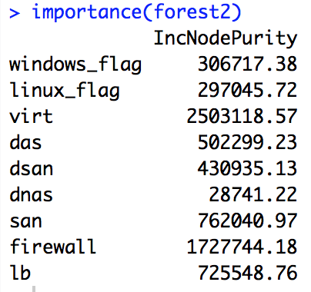
Regression Forest
Forest 1:
Router insignificant
Variance explained: 38.39%
Forest 2: Variance explained: 38.84%

