Slide 1
AI FLUENCY PRE-LAUNCH ASSESSMENT
Baseline Report
DC CAP Enterprise AI Leadership Pilot
April 3, 2026
1

Slide 2
EXECUTIVE SUMMARY
Average AI Fluency: 63% | Range: 30–85%
Strongest Construct: Learning Orientation (78.9%) | Weakest: Current AI Use (53.1%)
Fluency Distribution: 4 Leading | 6 Applying | 4 Building | 1 Exploring
Knowing-Doing Gap exists for 10 of 15 participants (avg 14.3%)
2

Slide 3
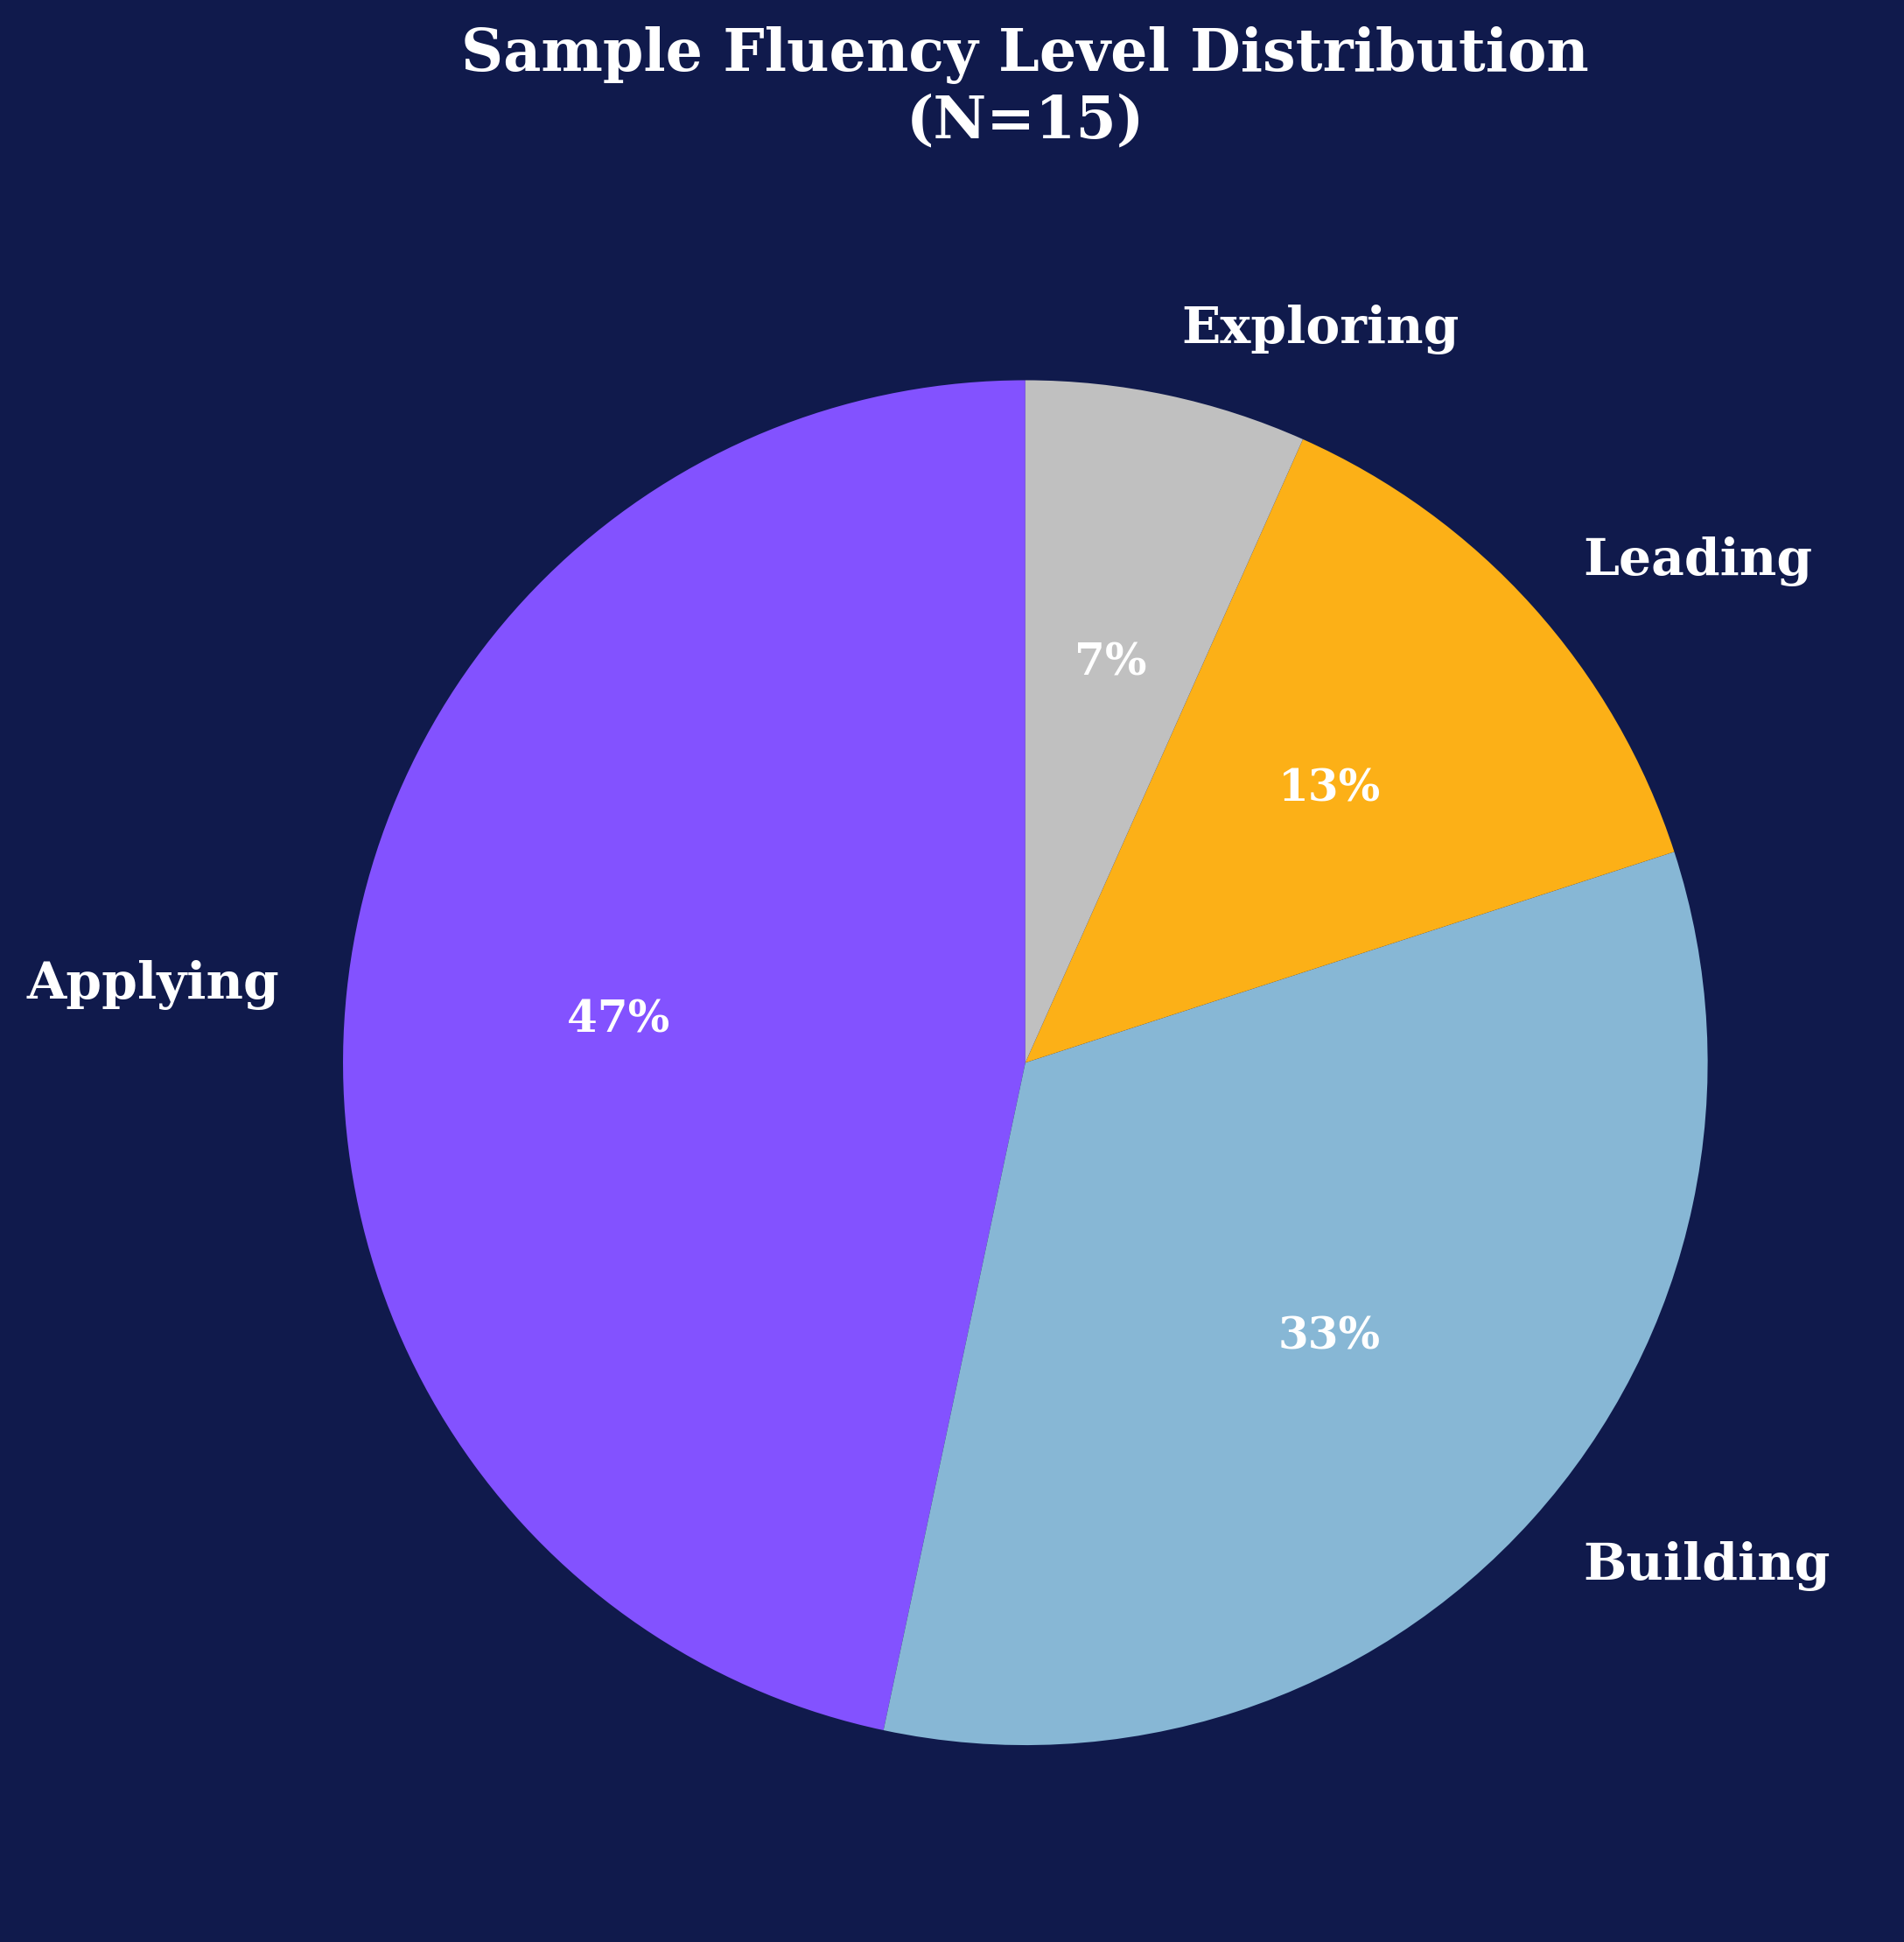
SAMPLE OVERVIEW
3

Slide 4
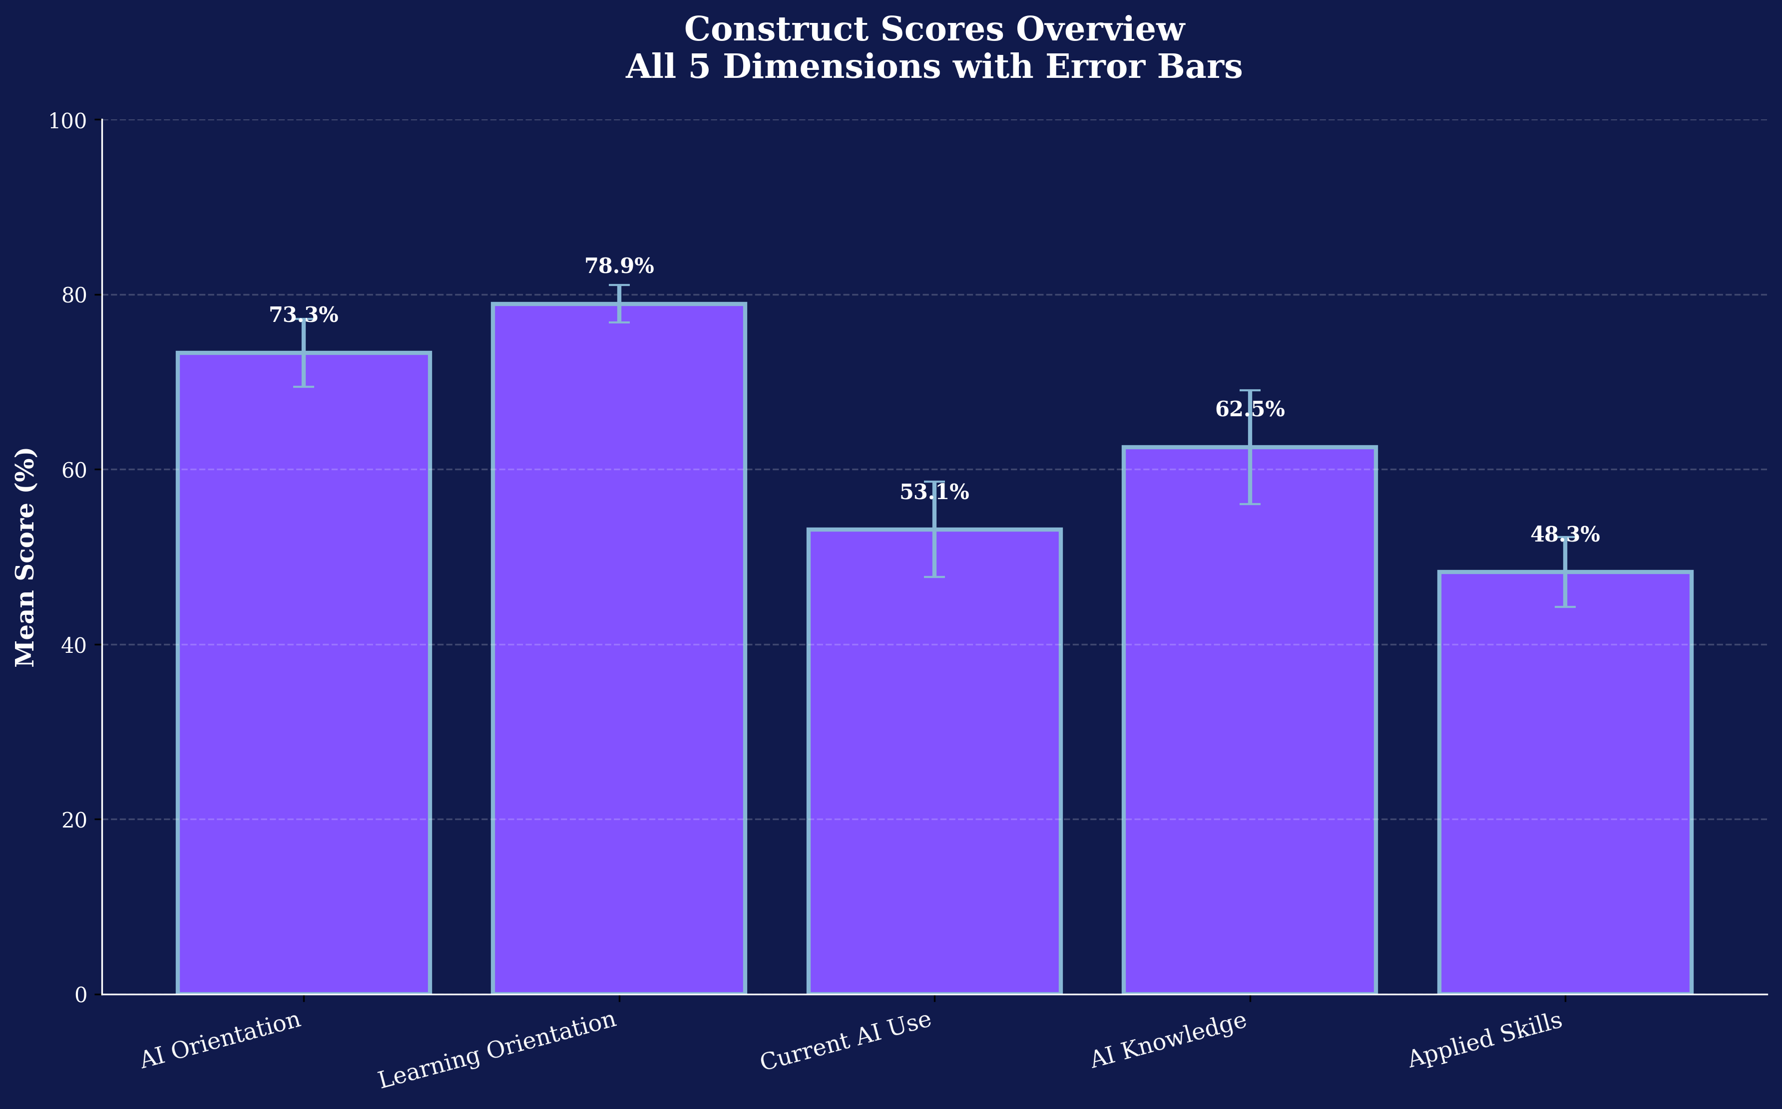
CONSTRUCT SCORES OVERVIEW
4

Slide 5
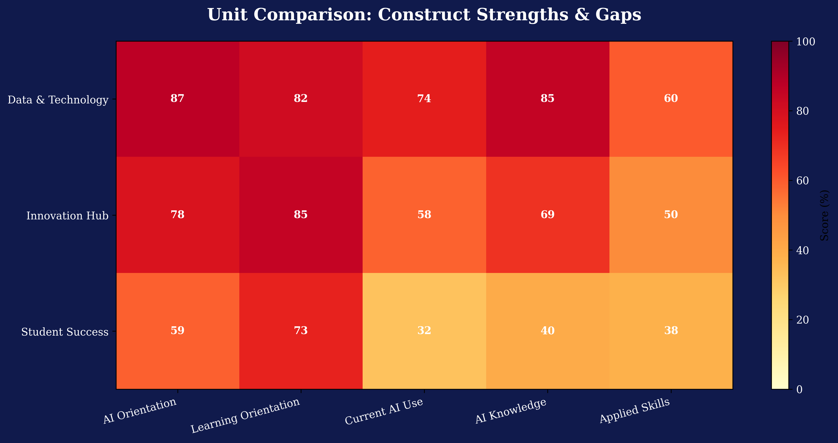
UNIT COMPARISON
5

Slide 6
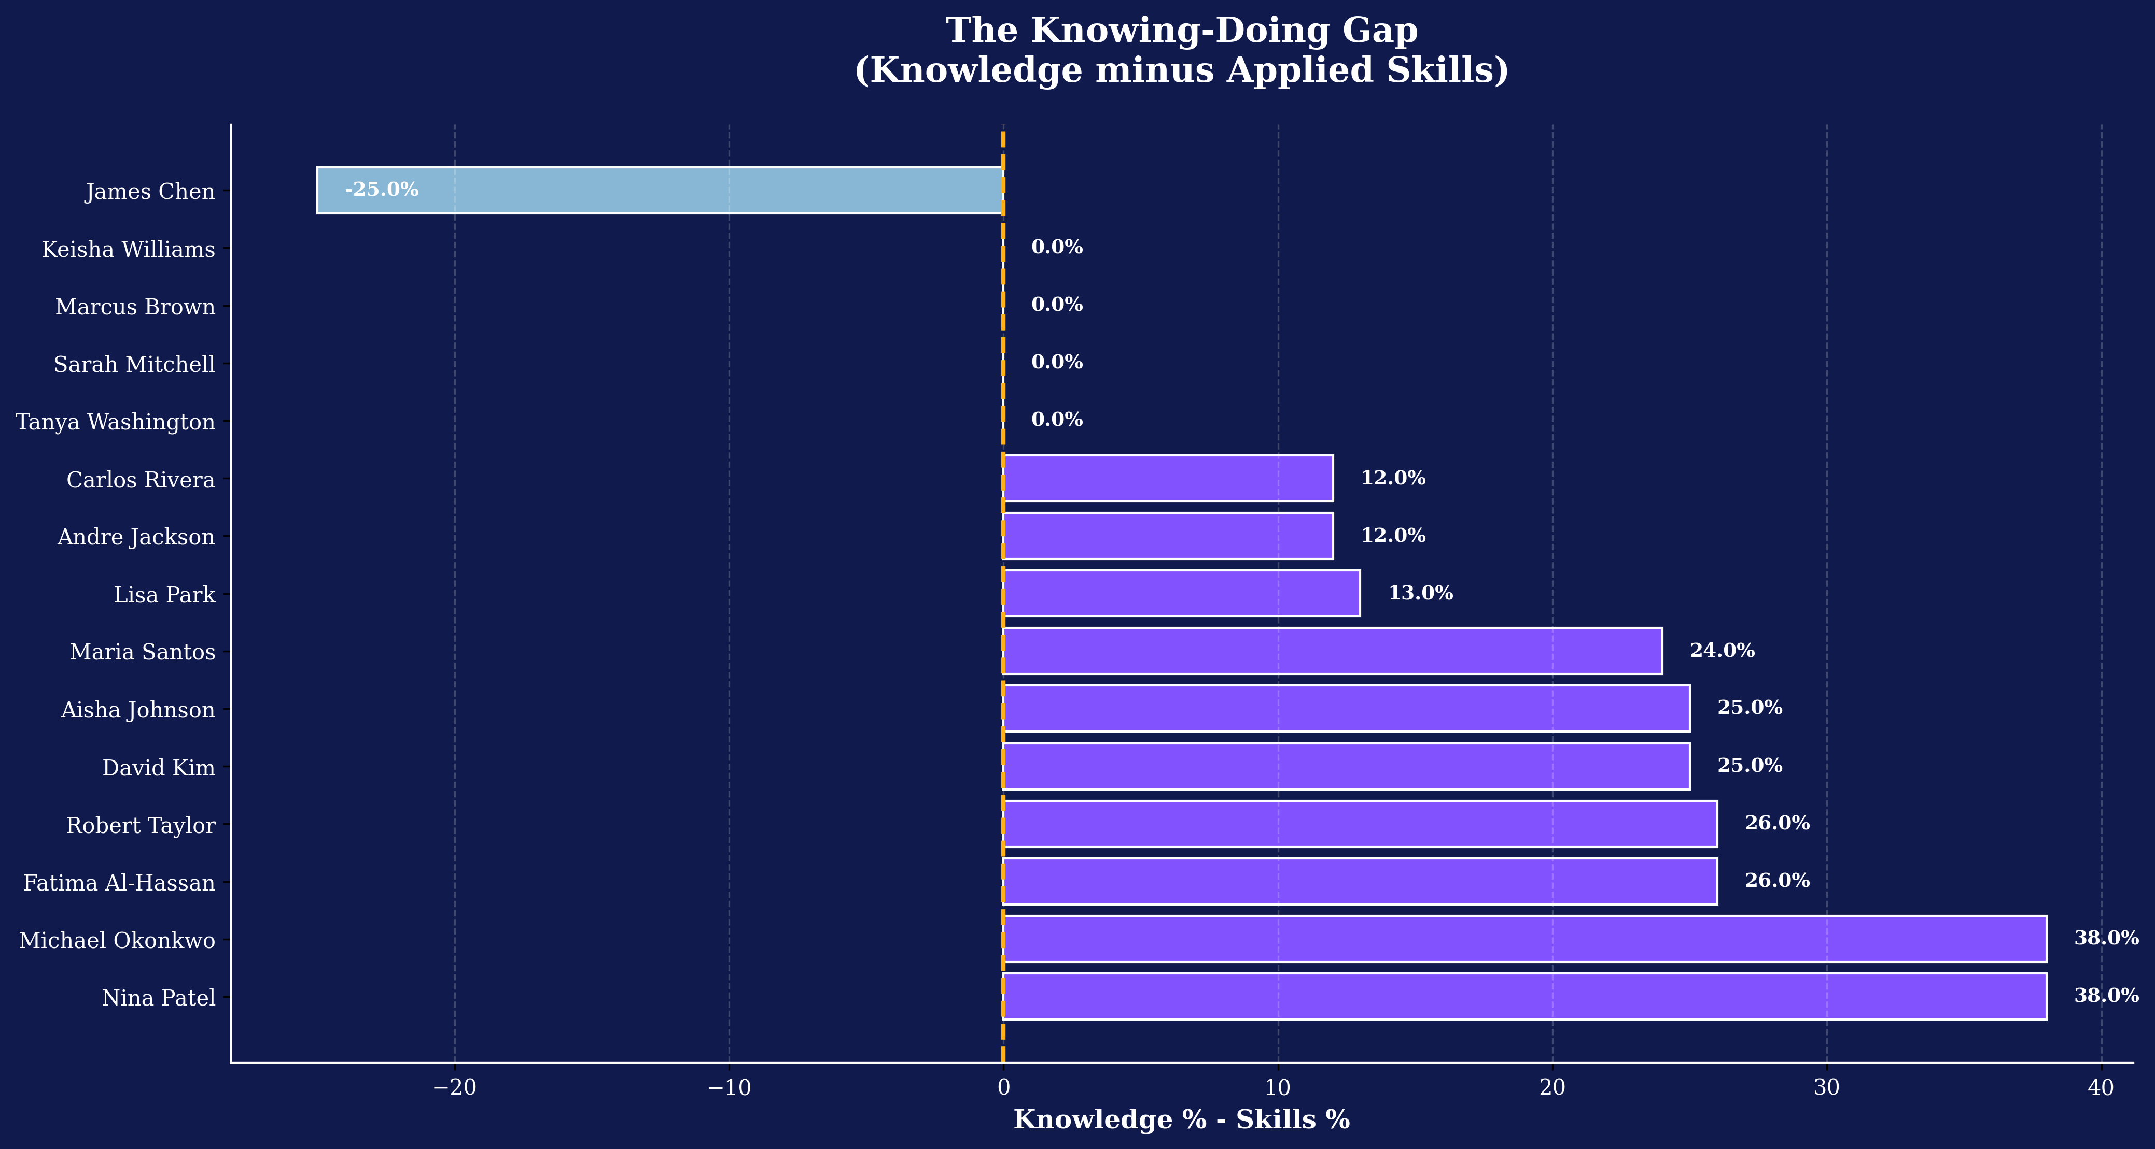
THE KNOWING-DOING GAP
6

Slide 7
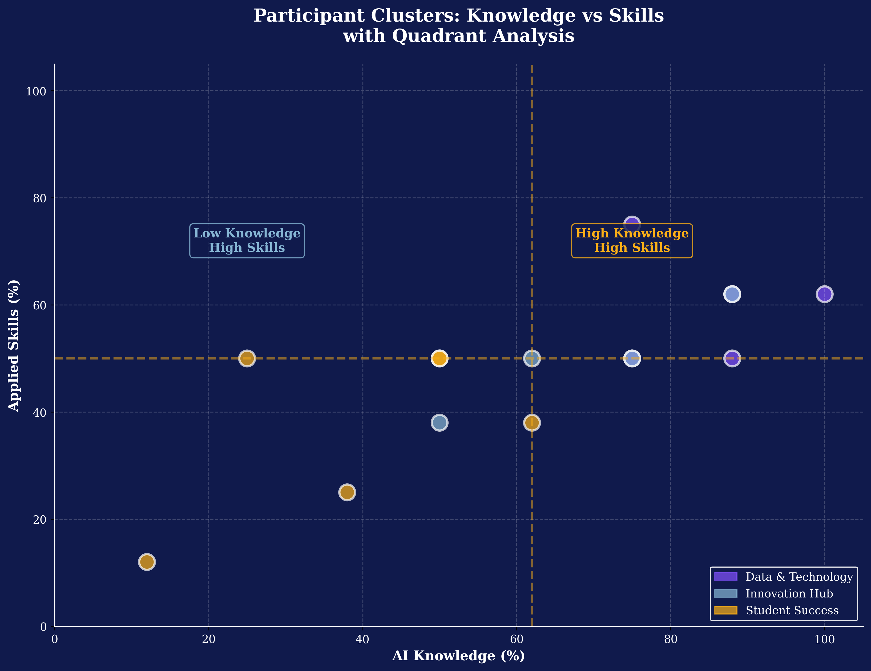
PARTICIPANT CLUSTERS
7

Slide 8
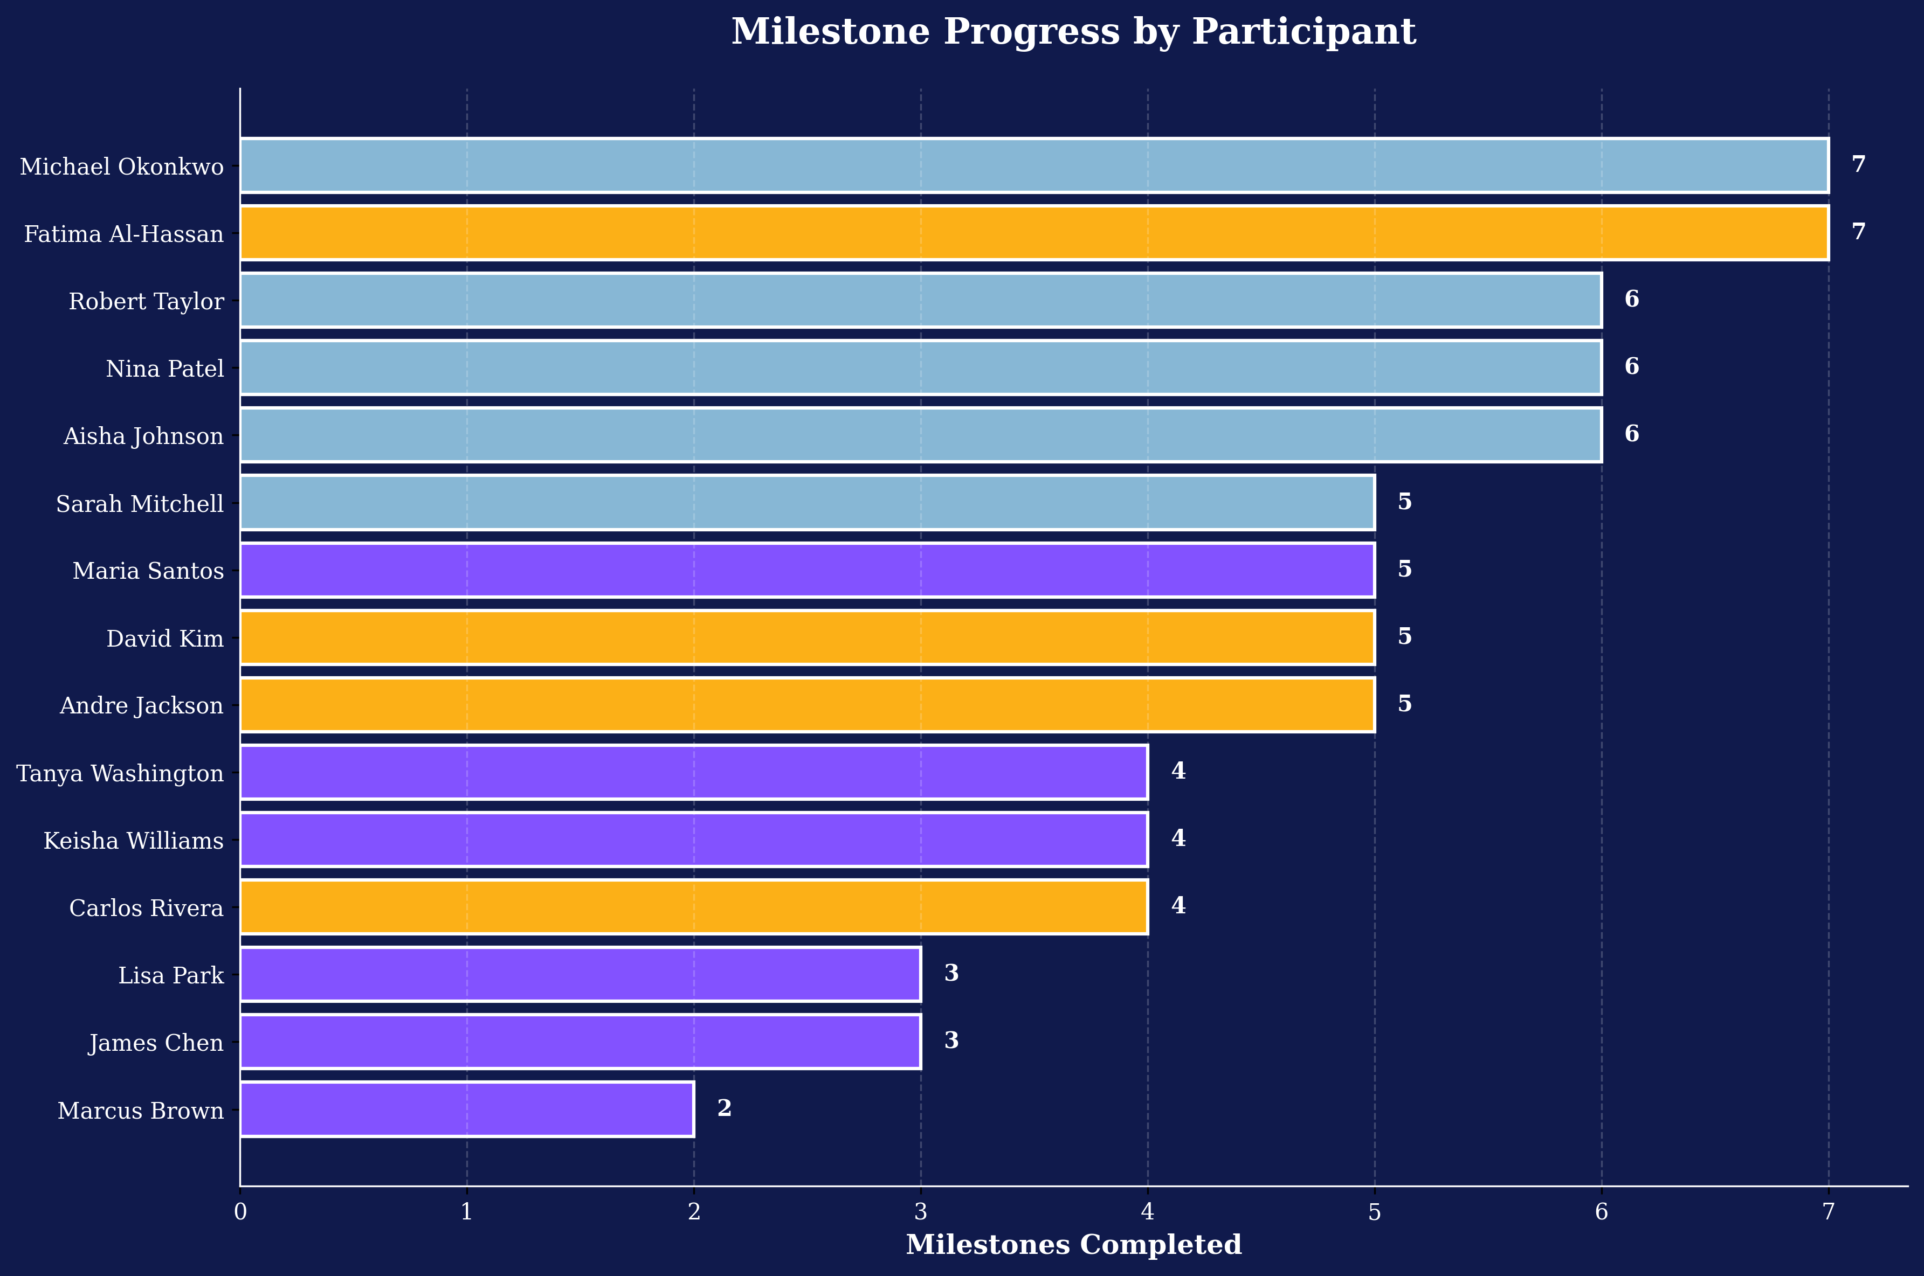
MILESTONE PROGRESS
8

Slide 9
KEY INSIGHTS BY UNIT
DATA & TECHNOLOGY
INNOVATION HUB
STUDENT SUCCESS
N=5
Avg Fluency: 78%
Top Construct: AI Orientation
Gap Risk: 4 of 5
N=4
Avg Fluency: 68%
Top Construct: Learning Orientation
Gap Risk: 4 of 4
N=6
Avg Fluency: 48%
Top Construct: Learning Orientation
Gap Risk: 2 of 6
9

Slide 10
RECOMMENDED INTERVENTIONS
Skill-Building Accelerator
6 participants show knowing-doing gap > 10%. Provide hands-on practice labs for governance use cases.
Knowledge Integration Sessions
Current AI Use lags other constructs. Host weekly 30-min integration sessions pairing theory with practice.
Peer Mentoring: High-to-Emerging
4 Leading participants mentor 5 Exploring/Building staff. Establishes peer learning culture.
Unit-Specific Coaching
Student Success needs AI application focus. Innovation Hub ready for advanced governance topics.
10

Slide 11
NEXT STEPS
April 8 – Phase 1 Launch
All participants begin Governance Foundations activities.
Bi-weekly Pulse Checks
Brief 5-question surveys to track knowledge application & barriers.
Mid-Phase Coaching Sprints
Week 3–4: Unit leads identify and address gaps with peer mentors.
Post-Phase 1 Assessment (May 15)
Full fluency re-assessment; compare baseline to 6-week growth.
Success Metrics to Watch
Completion rates >90%, knowing-doing gap closure >15%, Unit Success >75% fluency.
11

