Slide 1
Date: 06/01/2025
Title: Assessing impact of a new triage policy on emergency services

Slide 2
Motivation
The high pressure on emergency rooms has long been a significant concern for the Portuguese National Health System.
In response to these challenges, public health authorities introduced a mandatory telephone pre-triage system, which was initially trialed in December 2023 at a limited number of locations. This mandatory pre-triage system is now promoted as a central component of the government’s strategy to alleviate emergency room congestion,
The “Ligue antes, salve vidas” project in Vila do Conde/Póvoa de Varzim had an initial phase aimed at informing the public (from May to December 2023), with the current phase starting in January 2024. In this second phase, the rule is that hospital emergency services will only attend to cases that have been pre-screened by the SNS24 telephone service. It is expected that this service will direct simpler cases to primary healthcare providers, with same-day or next-day appointments arranged directly. A call to SNS24 must be made, even if it is placed from a phone located physically near the hospital emergency department.
Initial analysis and blog post by Professor Pedro Pita Barros from Nova SBE, motivated this study,
He studies if the introduction of a mandatory pre-triage system (the intervention) had had any impact on the total number of emergencies on one the trial Locations, UlS Vila do Conde,
To assess the impact, he compares observed total values between January 2024 (start of the intervention) and September 2024 (last data point available) with the same data for ULS Barcelos (the reference or control series),
He concludes:
“a obrigação da referenciação tem como resultado, ao fim de sensivelmente 4 meses, uma redução no número de urgências de cerca de 10%, já tendo em consideração uma evolução geral que teria lugar de qualquer modo (que é capturada pela diferença para a urgência hospitalar de Barcelos). a mudança de estratégia de “convencimento da população” para “obrigação da população” em usar a linha SNS24 terá tido os resultados pretendidos (pode-se discutir se a magnitude de redução de idas às urgências é a desejada” Pedro Pita Barros

Slide 3
Question
Based on historical information and using a reference series, is it possible to assess the impact of a new policy using time series analysis?

Slide 4
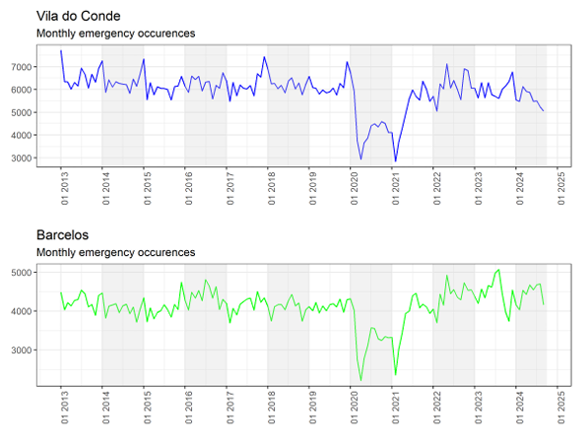
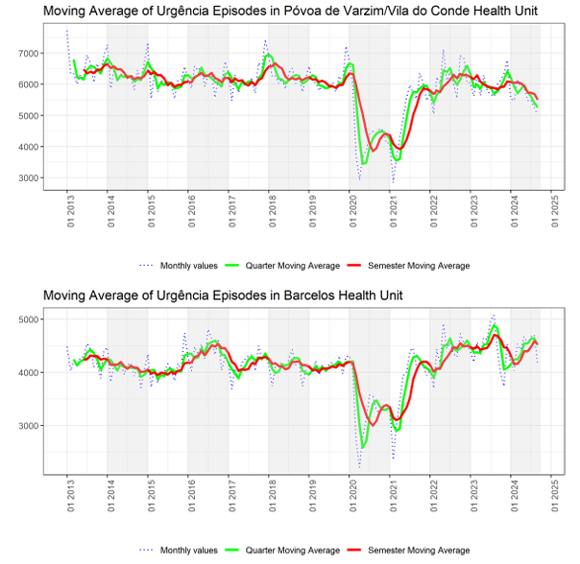
Visual exploration
Notes:
Gráficos das duas séries em estudo desde Janeiro de 2013 a Setembro 2024,
Informação original apenas apresenta acumulados, estas séries foram construídas desses dados
Médias movies trimestrais e semestrais ajudam a suavizar a série e a identicar tendências.
CONCLUSÕES
Existem pelo menos 3 fases distintas em cada série: pré covid, covid e pós covid,
No pre e pos covid é visível uma sazonalidade de 12 meses apesar de com diferentes níveis de intensidade. Esta sazonalidade está em linha com o padrão de maior procura no Inverno devido a doenças endémicas como a gripe,
O pré-covid apresenta diferentes momentos de outlier, resultado de acções externas como greves de médicos ou maior intensidade da época de gripe
O pré-covid em ambos os casos não apresenta no entanto uma tendência muito definida ao contrárido do pós covid onde Vila do conde aparenta uma tendência à diminuição desde 2023 e Barcelos um aumento

Slide 5
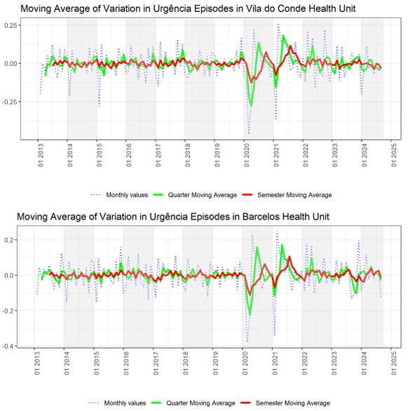
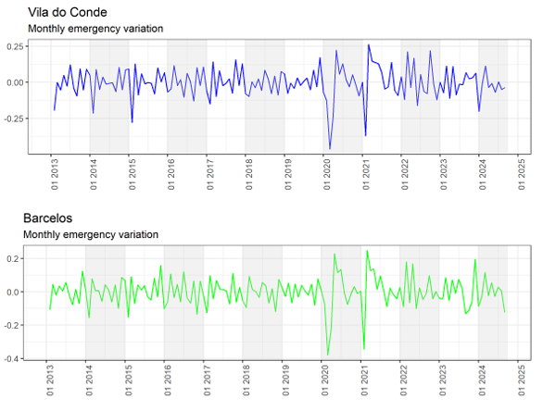
First transformation > Zn = Log(Xn/Xn-1)
Notes:
Transformação utilizando log returns
Séries estacionários no pre e pos covid comprovado por kpss e adf
Transformação permite análise semelhante ao uso de totais

Slide 6
Approach
Intervention analysis, introduced by Box and Tiao (1975), provides a framework for evaluating the effect of an intervention on a time series under study. The approach assumes that the intervention affects the process by altering the mean function or trend of the time series (Cryer and Chan 2009a , pp. 249).,
In this option, we could approach the introduction of a new policy through an exogenous variable. However, we lack sufficient information to determine the best approach to model the effects and duration of this intervention. (Simple variables such as 'pulse' or 'step' may be inadequate, as they assume no spillover effects or that such effects are linear)
Since ULS Barcelos is presented by a domain expert as a reference, incorporating this information will enrich the signal and enable the inference of a new theoretical series to be used as a counterfactual. In practice, this involves modelling an alternative reality without the intervention and measuring the differences to infer the intensity of the impact.
A counterfactual series will be forecasted using historical data from Vila do Conde, with Barcelos serving as an external variable and acting as a control group.
Data from 2013 to 2020 will be used to replace the COVID-19 period from January 2020 to March 2021.
The newly generated series for the period 2013-2023 will be used to fit a model, which will then generate the counterfactual. Given the objectives of this study, no smoothing will be applied between the actual series from 2013 to 2020 and the COVID-19 replacement period

Slide 7
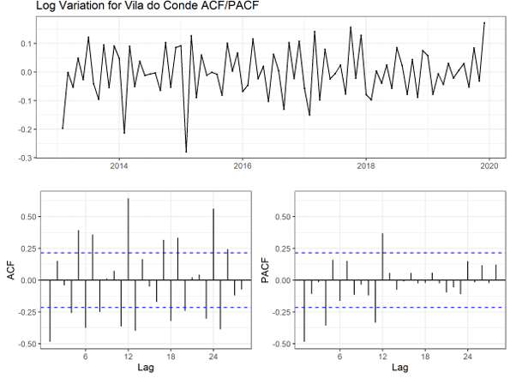
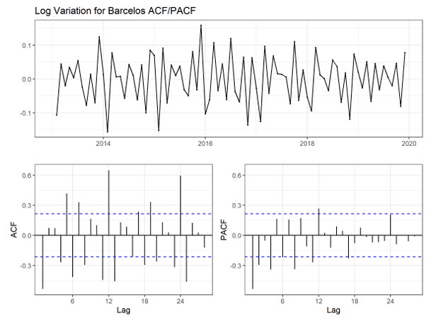
Reconstruct series for Covid-19 pandemic
Notes:
- Significant lags also exist at the 6 and 18 lags suggesting multi sesonality. Intuition suggests that a 6 month cycle could exist given the number of emergencies due to seasonal illnesses like f lu which typical are at its high during winter
- SARIMA tem limitações na inclusão de multisasonalidade pelo que para modelação usaremos a sazonalidade a 12 meses

Slide 8
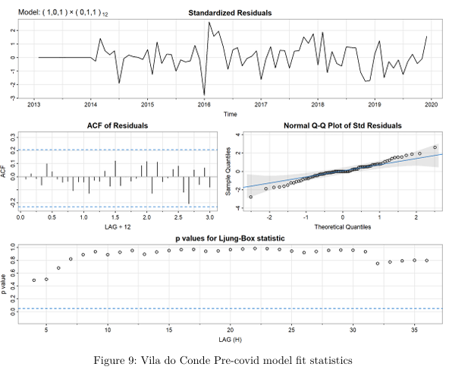
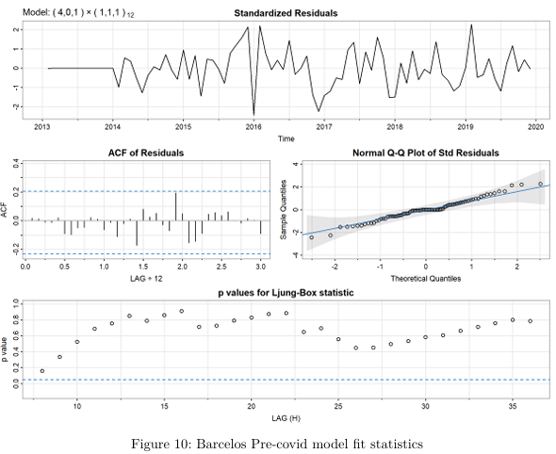
Reconstruct series for Covid-19 pandemic
Notes:
Barcelos a AR(4) é uma consequência da não inclusão de sazonalidade a 6 meses indicando que existem outros modelos que poderiam capturar esta série de forma mais eficaz.
Analisando os residuais concluímos que ambos os models são utilizáveis para os nossos objectivos de substituir o period de covid -19
Pretendemos substituir este período para ter a série mais larga de dados para análise

Slide 9
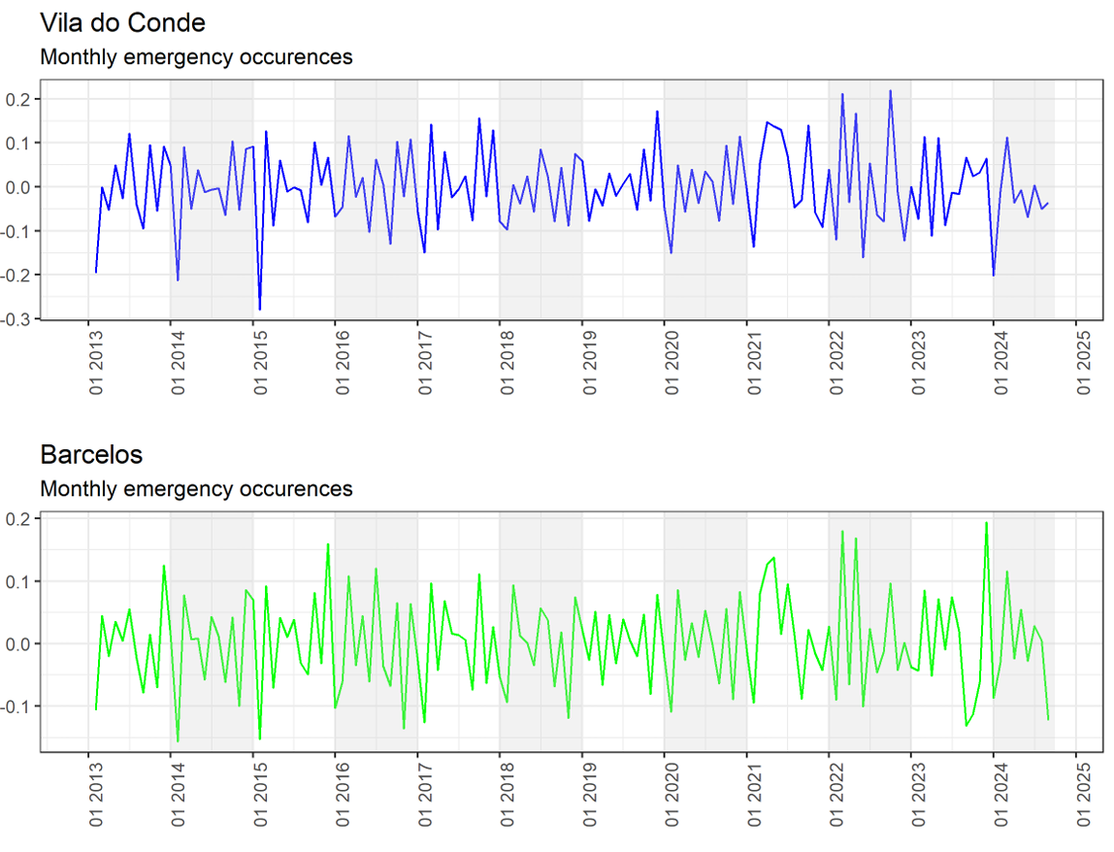
Reconstructed series for Covid-19 pandemic
Notes:
- Série reconstruída é estacionária

Slide 10
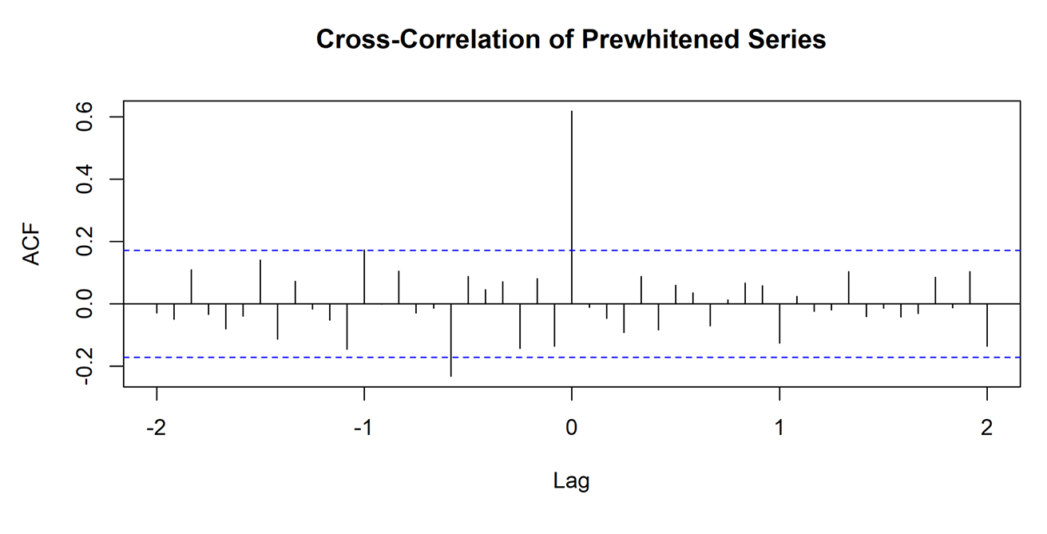
Confirming reference series
Notes:
Cross correlation entre as séries de vila do conde e de barcelos.
Vila do conde foi pre-whitened usandos os ressudais de um ARIMA
Este mesmo ARIMA assim estimado foi utilizado para calcular os residuais de Barcelos
O result é uma forte correlação instantanea validando em parte o pressuposto subjacente à utilização de ULS Barcelos como série de referência

Slide 11
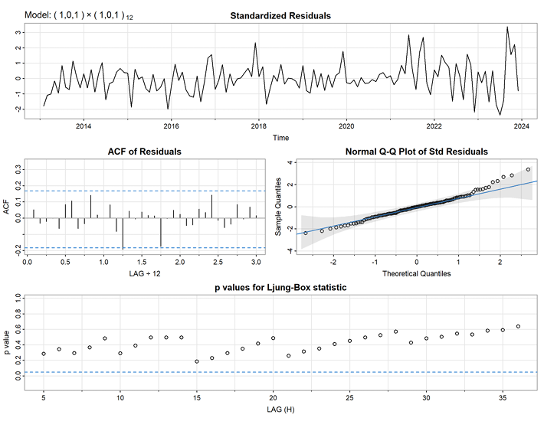
Counterfactual model

Slide 12
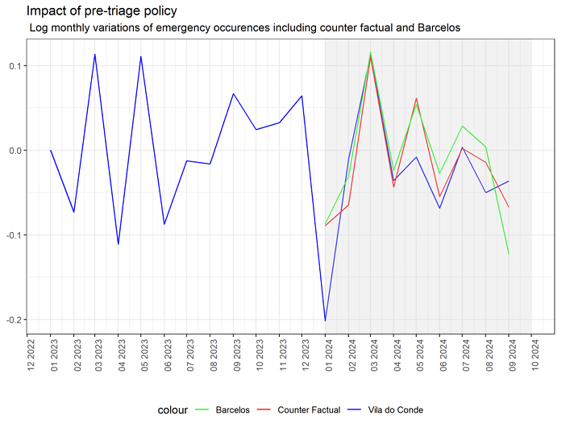
Conclusions and future work
Average difference between real and counter factual of 1.38 p.p.
Means, that intervention lead on average to an additional reduction of 1.38 percentage points
Notes:
- Erro no relatório com a utilização de T-test

Slide 13
Conclusions and future work
Analysis of historical data and reference series suggest that during the initial trial period, the new mandatory pre-triage policy had marginal impact of an additional 1.3 percentage points to the trend.
Despite these results, it is important not to hastily conclude the ineffectiveness of such policies. As highlighted by Barros and SBE (2024b) in the article that motivated this study, there are additional considerations and questions that should be addressed before drawing any conclusions, such as:
Is the number of emergencies the best metric to measure the impact of such an intervention?
Do other locations that participated in the trial period show similar results?
In the event of a reduction in emergencies, where were the patients redirected?
Does the data reflect a like-for-like comparison, ensuring a comparable situation between different periods (e.g., same number of doctors and nurses)?
While this analysis focuses on the mean (the first moment), shouldn’t the scope of such a policy also consider the predictability of random events (the second moment)?
At best, this study, with its simplified approach, highlights the complexities and nuances of data and impact analysis in the context of decision-making. It serves as a reminder that first impressions can be misleading

