Slide 1
Date: 16/01/2022
Version: 1.0.0
Title: Long project

Slide 2
Project structure
A hybrid approach of CRISP-DM and TDSF was used to organize this project
Stage 1 - Understand Business and Its environment
Stage 2 - Understand and explore data: study of distribution and relationship among available data
Stage 3 - Data preparation for modeling: Preprocessing workflow
Stage 4 - Modeling: Model definition, initial experiments and hyperparameter tunning
Stage 5 - Delivery: Conclusions of the project

Slide 3
Business understanding
Main findings:
Based on the available information the project is binary classification problem with a focus on inference. The company is looking to identify session variables which signal users which will convert or not in order to redefine marketing strategies and approaches. There are only to available states, either the user “bought” or it didn’t.
No information is provide regarding the expected use of this project. Therefore it will be assumed through this project that the main stakeholders is the marketing team and are human. Therefore, a bigger focus on the modeling process and coefficients is needed and is considered part of the deliver. The assumption is relevant since it impacts the final conclusions and the final model chosen. Given 2 similar models with sensible the same target metric the more interpretable one will be chosen.
Target metrics
Given the goals of this project stated before on Business Objectives the focus will be on maximizing Accuracy. The business is looking for the model which more accurately explains session conversion.
Data questions
During this project the following questions will be addressed
Is there a relationship between a conversion and information available related to that session ?
Which is the contribution of each of the variables to conversion?
How accurately can we estimate the effect on conversion?
Is there synergy among each session elements?
Does a model surpass a naive baseline approach of assuming the most shown class?
Does Data imbalance impact output?

Slide 4
Exploring data
Main takeaways:
- Features Device Group and Platform showed a strong relationship between them. Given that Platform provides more information Device Group will be removed
- Features starting with “has_” referes to milestones on customer journey, therefore the need to include all of them should be taken in consideration. We will use PCA to merge this into one feature and experiment between the use of them individual or together,
- Duration feature is Right Skewed and contains observations which lack business sense. To avoid any impact on the model, specially on ones more sensible to variance, it will be log transformed and observations above 24hours will be removed
- Replace all Missing values on country, browser_name and is_subscribed using Nearest Neighbors imputation with a very a k of 3,
- Reduce the number of observations of class country and browser_name by compressing smaller ones into a generic class named others. This will be done because some models do not manage very well the fact that some dummy variables only have one level,
- Reduce the number of levels of Segment by re factoring into a class of has or not segment,
- Specially for the use of Neural Networks and Supervisor Vector Machines, numeric variables will be normalized and scaled
- Converts unique_browse_designer_qty, unique_product_qty, unique_browse_designer_qty, unique_browse_category_qty to ratios over Total Pageviews (view_qty) which provides information on the amount of page views actually related to that category and subsequently log transform,
- Sessions with duration lower than 2 seconds and a total page view of 0 or 1 will be removed,
- The graphical analysis already provides a important insight given the business objectives. From the unbalanced data available we can conclude that around of 46% shopping carts are lost on that session. That raises a question of how are this recovered (example on a next session) or if this means that all this sales are lost right at the end of the sales funnel.

Slide 5
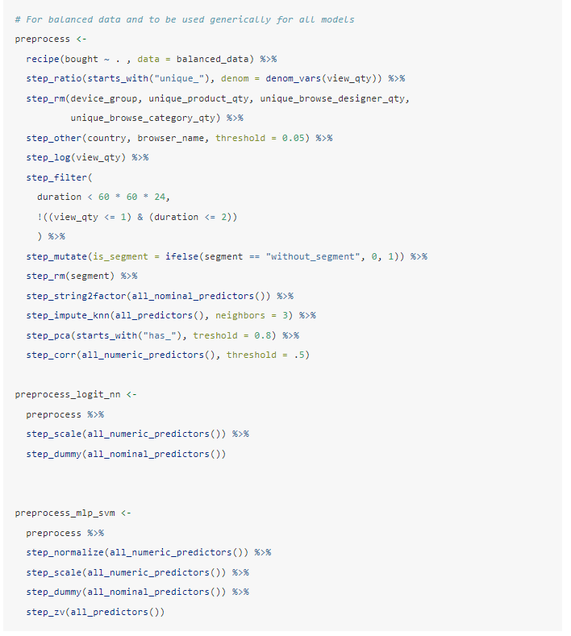
Data transformations
Preprocessing workflow:
- Features Device Group and Platform showed a strong relationship between them. Given that Platform provides more information Device Group will be removed
- Features starting with “has_” refers to milestones on customer journey, therefore the need to include all of them should be taken in consideration. We will use PCA to merge this into one feature and experiment between the use of them individual or together,
- Duration feature is Right Skewed and contains observations which lack business sense. To avoid any impact on the model, specially on ones more sensible to variance, it will be log transformed and observations above 24hours will be removed
- Replace all Missing values on country, browser_name and is_subscribed using Nearest Neighbors imputation with a very a k of 3,
- Reduce the number of observations of class country and browser_name by compressing smaller ones into a generic class named others. This will be done because some models do not manage very well the fact that some dummy variables only have one level,
- Reduce the number of levels of Segment by re factoring into a class of has or not segment,
- Specially for the use of Neural Networks and Supervisor Vector Machines, numeric variables will be normalized and scaled
- Converts unique_browse_designer_qty, unique_product_qty, unique_browse_designer_qty, unique_browse_category_qty to ratios over Total Pageviews (view_qty) which provides information on the amount of page views actually related to that category and subsequently log transform,
- Sessions with duration lower than 2 seconds and a total page view of 0 or 1 will be removed

Slide 6
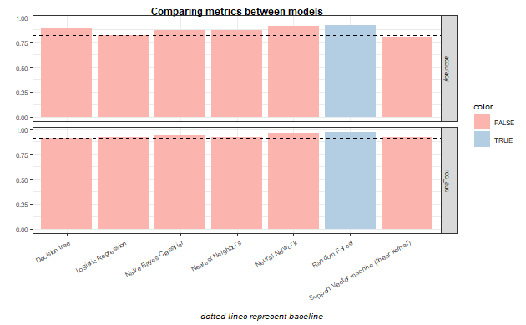
Conclusion
Main results:
Based on the results Random Forest shows the most promising values and future developments would be made using this model. It not only presents the highest metric for both accuracy and AUC ROC as it provides a more understandable model when compared to others.
Is worth noticing that the increase from a baseline of a simple model without any substantial pre-processing is not substantial making the case towards the use a simpler model, with simpler feature importance attribution and less need for heavy pre-processing.

Slide 7
Next steps
If no time constrains existed or this project was done on a real environment i would do the following differently:
- Business understanding and the discovery phase in general is key to a successful project. The available information raise doubts about the data and the expected use for the model. Although some questions can be assumed its of paramount importance to gain a deeper knowledge about the "question" the company, client, project, etc wishes to answer. It impacts the list of models to experiment, the metrics to focus, etc.
- A model is as good as the action it enacts. This is particularly key on settings similar to this project were we analyse marketing data. Modeling for a marketing team is not the same as modelling to trigger an automation pipeline. The first tend to prefer a inferring models which provide more information about the role of different features. In this context, black box models like Neural Networks might not be advisable.
- On a similar note, when testing linear models, it makes sense to communicate and study coefficients even if its not the model with the highest metrics.
- More information how data was gathered is needed for a better exploration. Many questions were raise during the EDA stage which needed to be assumed.
- Data exploration needed to be expanded with more context information. This is not independent from the previous statement but some industry specific features might exist which could make sense to include.
- Except for a random grid search, no hyperparameter tunning was done on this project. Random grid search is a first step when no more information is available to know on which direction to keep tuning the model. Next steps would include a manual grid search which would narrow the field of test for each model.
- On this project uses the default model engine for each model. Different machines can return different models and have different performances.
- Each model error (difference between real observation and prediction) would need to be studied to validate assumptions, quality of the model.

