Slide 1


Slide 2
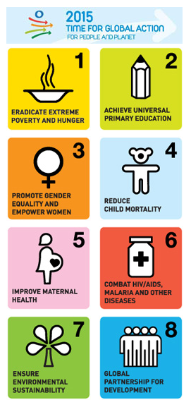

Slide 3
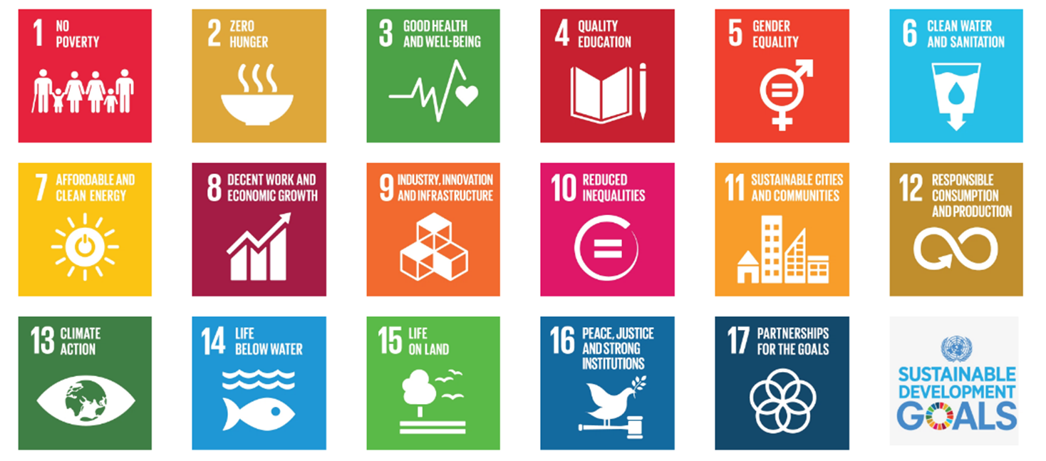

Slide 4



Sustainable Design

Slide 5


Sustainable Energy

Slide 6

Land Use

Slide 8


