Slide 1
INSURANCE AGENCY MANAGEMENT SYSTEM
MINI PROJECT
DEARTMENT OF MCA,MES COLLEGE OF ENGINEERING,KUTTIPPURAM
PREPARED BY
AISWARYA P M (MES22MCA-2004)
1

Slide 2
GUIDED BY
PROF.HYDERALI K
HEAD OF THE DEPARTMENT
DEPARTMENT OF COMPUTER APPLICATION
MES COLLEGE OF ENGINEERING,KUTTIPPURAM
2

Slide 3
CONTENTS
Introduction
Modules
Data Flow Diagram
Product Backlog
User story
Project Plan
Sprint
Developing Environment
3

Slide 4
INTRODUCTION
The project “INSURANCE AGENCY MANAGEMENT SYSTEM” is a website for online insurance analysis and information management system that provides easy access of information regarding the people and resources of insurance. This system has been proposed to maintain the record of the policyholder, agent details, policy details. And it recommend insurance policy by our need. When need to claim a request for health or vehicles it is very difficulty to initiate the procedings and find current status of the claim. primary focus on efficiently managing and tracking the current status of insurance claims.
The insurance agency management system is tailor-made to address the challenges faced by insurance agencies in handling claims, offering a unified platform where agents and clients can interact, initiate and monitor claims, and stay updated in real- time. With features such as secure user authentication, real-time claim status tracking, document management the Insurance agency management system empowers insurance agencies provide top-notch service, minimize paperwork, and enhance overall operatonal efficiency.
4

Slide 5
MODULES
ADMIN
LOGIN
ADD AND MANAGE POLICY
VIEW REQUEST FROM USERS AND UPDATE STATUS
VIEW COMPLAINTS AND SEND REPLY
VIEW FEEDBACK
VIEW RATING
VIEW CLAIM REQUEST AND APPROVE
VIEW USERS
USER
REGISTER
LOGIN
VIEW POLICY AND SEND REQUEST
VIEW REQUEST STATUS
SEND COMPLAINTS AND VIEW REPLY
SEND FEEDBACK
SEND RATING
SEND CLAIM AND VIEW STATUS
5

Slide 6
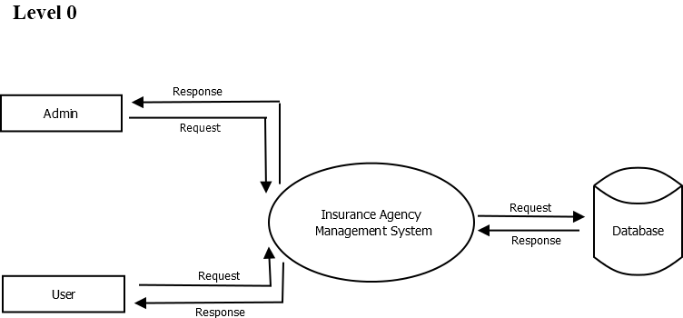
DATA FLOW DIAGRAM
6

Slide 7
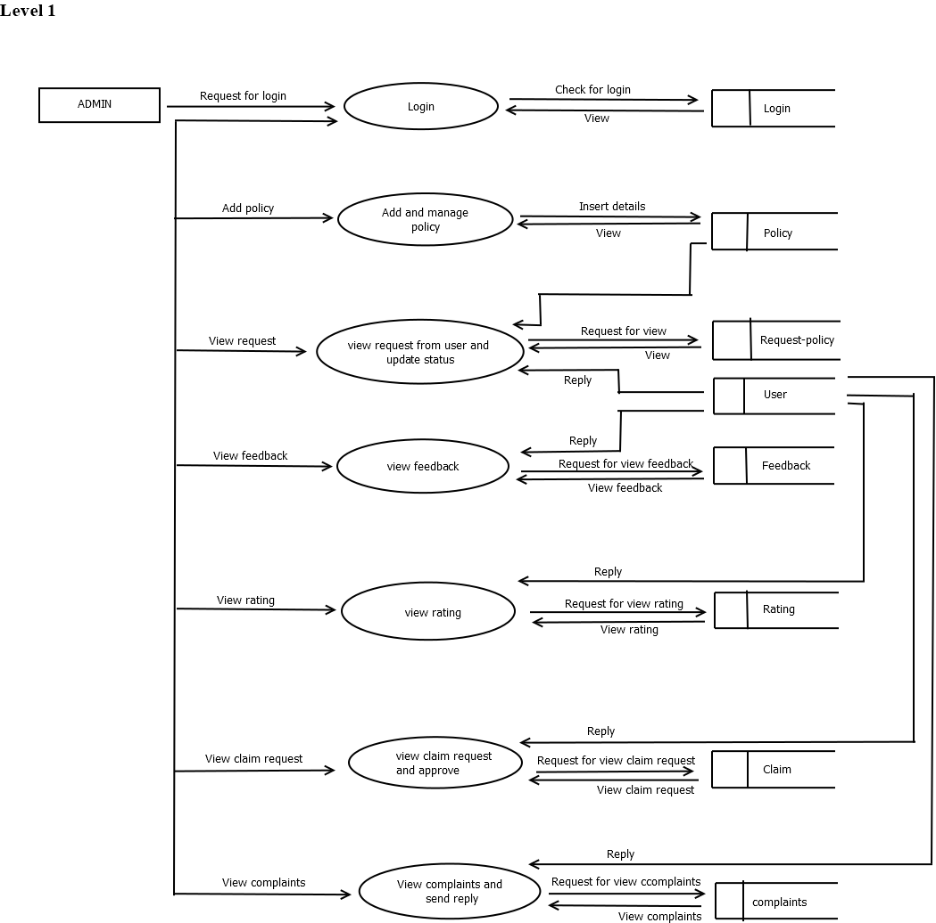
7

Slide 8
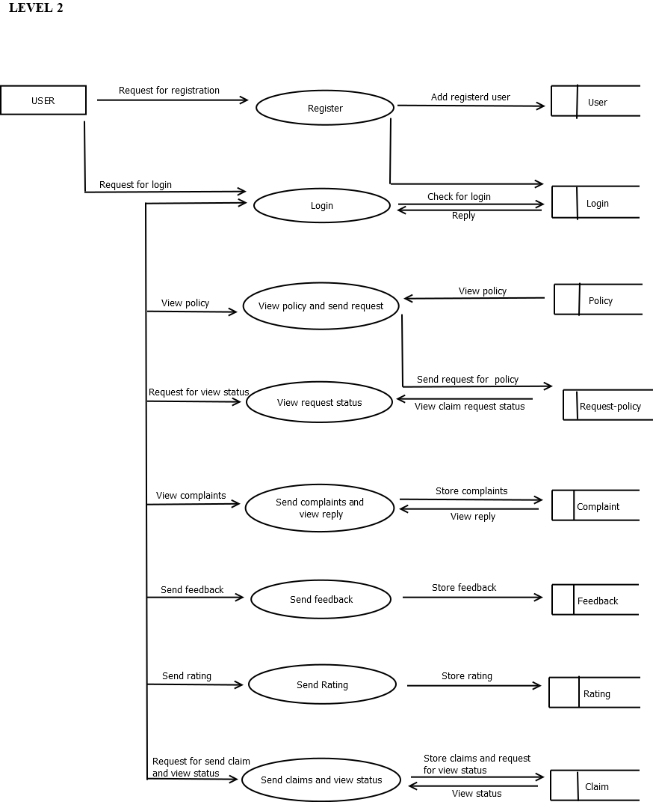
8

Slide 9
PRODUCT BACKLOG
ID | PRIORITY | SIZE (HOURS) | SPRINT | STATUS | NAME
1 | Medium | 5 | 1 | Planned | Registration
2 | Medium | 5 |  | Planned | Login
3 | High | 10 | 2 | Partially Completed | Table Design
4 | High | 15 | 3 | Planned | Coding
5 | Medium | 10 | 3 | Planned | Testing Data
6 | High | 5 |  | Planned | Output generation
9

Slide 10
USER STORY
USER STORY ID | AS A <TYPE OF USER> | I WANT TO | SO THAT I CAN
1 | Admin | Login | Login successful with correct username and password
2 | Admin | Add and manage agency | Add agency
3 | Admin | View complaints and reply | View all complaints and replies
4 | Admin | View feedback about agency | View all feedback about agency
5 | Admin | View agency rating | View all rating about agency
6 | Admin | View policy based on agency | View policies
7 | Admin | Block/unblock agencies | Block/unblock agencies
10

Slide 11
USER STORY ID | AS A<TYPE OF USER> | I WANT TO | SO THAT I CAN
8 | Admin | View users | View all users
9 | Agency | Login | Login successful with correct username and password
10 | Agency | Add and manage policy | Add policy
11 | Agency | View request from users and update status | View policy request from users
12 | Agency | View feedback | View all feedback
13 | Agency | View rating | View rating
14 | Agency | View claim request and approve | View all claim request
11

Slide 12
USER STORY ID | AS A <TYPE OF USER> | I WANT TO | SO THAT I CAN
15 | User | Registration | Register to get username and password
16 | User | Login | Login successful with correct username and password
17 | User | View policy and send request | View all policies and send request for policy
18 | User | View request status | View policy request status
19 | User | Send complaints and view reply | Can send complaints and view reply
20 | User | Send feedback | Can send feedback
21 | User | Send rating | Can send rating
22 | User | Send claim and view status | Send claim and view status
12

Slide 13
PROJECT PLAN
USER STORY ID | SPRINT | START DATE | END DATE | HOURS | STATUS
1,9,15,16 | Sprint 1 | 15/09/2023 | 12/10/2023 | 13 | Planned
 |  |  |  |  | Planned
2-8, 10,12,13,20,21 | Sprint 2 | 13/10/2023 | 08/11/2023 | 15 | Planned
 |  |  |  |  | Planned
11,14,17-19,22 | Sprint 3 | 09/11/2023 | 30/11/2023 | 15 | Planned
 |  |  |  |  | Planned
13

Slide 14
SPRINT 1
Backlog item | Status and completion date | Original estimate in hours | Day 1 15/09 | DAY 2 20/09 | DAY 3 21/09 | DAY 4 28/09 | DAY 5 29/09 | DAY 6 04/10 | DAY 7 05/10 | DAY 8 06/10 | DAY 9 11/10 | DAY 10 12/10
Form Design | 15/09 | 2 | 2 | 0 | 0 | 0 | 0 | 0 | 0 | 0 | 0 | 0
Table Design | 28/09 | 3 | 0 | 1 | 1 | 1 | 0 | 0 | 0 | 0 | 0 | 0
Coding | 06/10 | 6 | 0 | 0 | 0 | 0 | 2 | 1 | 1 | 2 | 0 | 0
Testing&validation | 12/10 | 2 | 0 | 0 | 0 | 0 | 0 | 0 | 0 | 0 | 1 | 1
Total |  | 13 | 2 | 1 | 1 | 1 | 2 | 1 | 1 | 2 | 1 | 1
14

Slide 15
SPRINT 2
Backlog item | Status and completion date | Original estimate in hours | Day 1 13/10 | Day 2 18/10 | Day 3 19/10 | Day 4 20/10 | Day 5 25/10 | Day 6 26/10 | Day 7 27/10 | Day 8 01/11 | Day 9 02/11 | Day 10 03/11 | Day 11 8/11
Form design | 13/10 | 2 | 2 | 0 | 0 | 0 | 0 | 0 | 0 | 0 | 0 | 0 | 0
Table design | 18/10 | 1 | 0 | 1 | 0 | 0 | 0 | 0 | 0 | 0 | 0 | 0 | 0
Coding | 19/10 | 9 | 0 | 0 | 1 | 2 | 1 | 1 | 2 | 1 | 1 | 0 | 0
Testing | 08/11 | 3 | 0 | 0 | 0 | 0 | 0 | 0 | 0 | 0 | 0 | 2 | 1
Total |  | 15 | 2 | 1 | 1 | 2 | 1 | 1 | 2 | 1 | 1 | 2 | 1
15

Slide 16
SPRINT 3
Backlog item | Status and completion date | Original estimate in hours | Day 1 9/11 | Day 2 10/11 | Day 3 15/11 | Day 4 16/11 | Day 5 17/11 | Day 6 22/11 | Day 7 23/11 | Day 8 24/11 | Day 9 28/11 | Day 10 29/11 | Day 11 30/11
Coding | 09/11 | 10 | 1 | 2 | 1 | 1 | 2 | 1 | 1 | 1 | 0 | 0 | 0
Testing | 30/11 | 5 | 0 | 0 | 0 | 0 | 0 | 0 | 0 | 1 | 1 | 1 | 2
Total |  | 15 | 1 | 2 | 1 | 1 | 2 | 1 | 1 | 2 | 1 | 1 | 2
16

Slide 17
DEVELOPMENT ENVIRONMENT
SOFTWARE SPECIFICATION
Operating System :Windows 11
Frond End :HTML, CSS, Javascript
Coding language :Python
Framework :Django
Backend :MySQL
IDE :PyCharm
HARDWARE SPECIFICATION
Processor :Intel i3
RAM :4GB or above
Hard Disk :512GB
17

Slide 18
THANK YOU
18

