Slide 1
Diagnosing Rainfall Variability Within A Series of Atmospheric Rivers over Northern California in February 2017
Parker Malek, Portland State University

Slide 2
Outline
Background
Research Questions
Study Area
Methods
Preliminary Results
Discussion
Future Research

Slide 3
Broad Background
High Intensity Precipitation (HIP)
Any unusually high precipitation rate in a precipitation event
Drivers of hydrometeorological hazards (flooding, erosion, landslides, etc) (IPCC, 2023)
HIP embedded within larger storm systems exacerbates hazards
Issues with understandings of HIP:
Poor representation of HIP in climatology (I.E. longer time-frame climate patterns)
Poor understanding of meteorological forcings that cause high-intensity precipitation
Poor simulation of small-scale high-intensity precipitation in atmospheric models

Slide 4
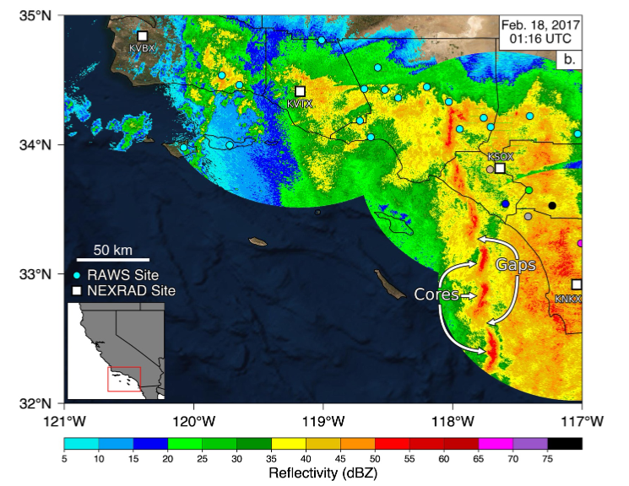
HIP on the West Coast
Usually associated with the presence of larger scale atmospheric rivers (AR)
Narrow cold frontal rainbands (NCFR)
Locations within storms with notably high rates of precipitation (Houze et al., 1976; Hobbs & Persson, 1982; Koch & Kocin, 1991)
Notable in destructive and costly events in Southern California (Cannon et al., 2018; Oakley et al., 2017; Sukup et al., 2016, de Orla-Barile, 2022).
Orographic enhancement
Source: de Orla-Barile, 2022

Slide 5
Research Questions
What meteorological drivers modulate rainfall intensity within AR events on the West Coast?
How do these drivers propagate temporally?
What synoptic and mesoscale features are present?

Slide 6
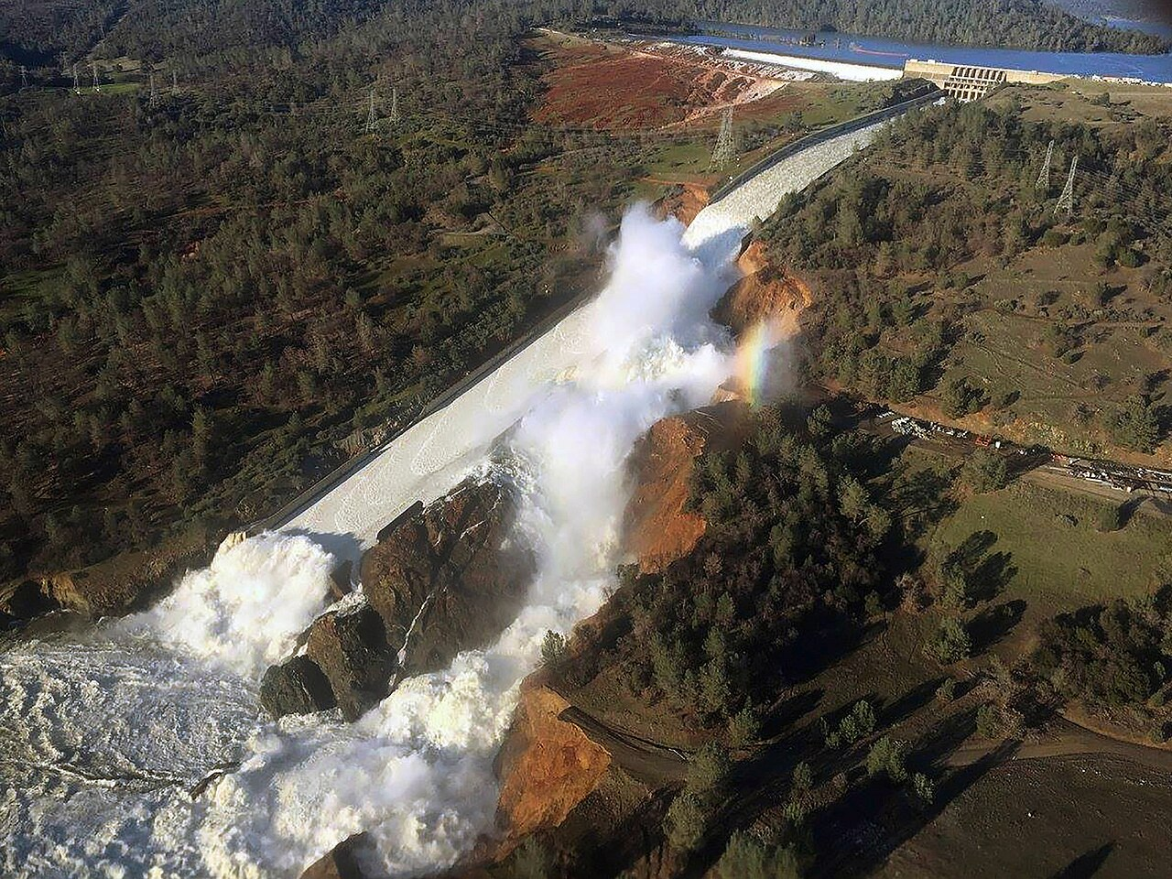
Case Study: 2017 Oroville Dam Crisis
Partially driven by a series of AR events during an exceptionally wet water year in California
Heavy damage to the primary and emergency spillway of the Oroville Dam
Over $1 billion dollars In damages
Mass evacuations

Slide 7
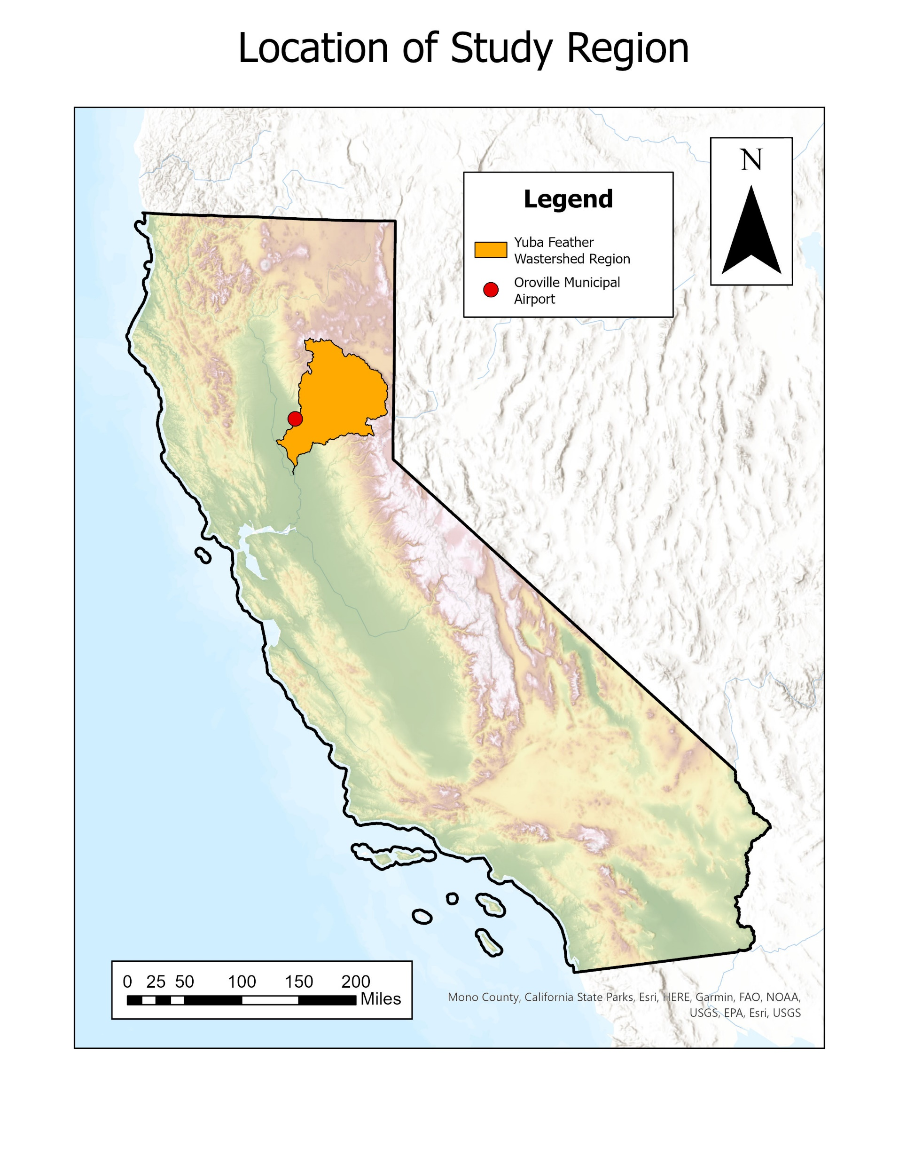
Study Area
Yuba-Feather watershed region
Long history of catastrophic flooding
Forecast-Informed Reservoir Operations (FIRO) project as part of the Center for Western Weather and Water Extremes

Slide 8
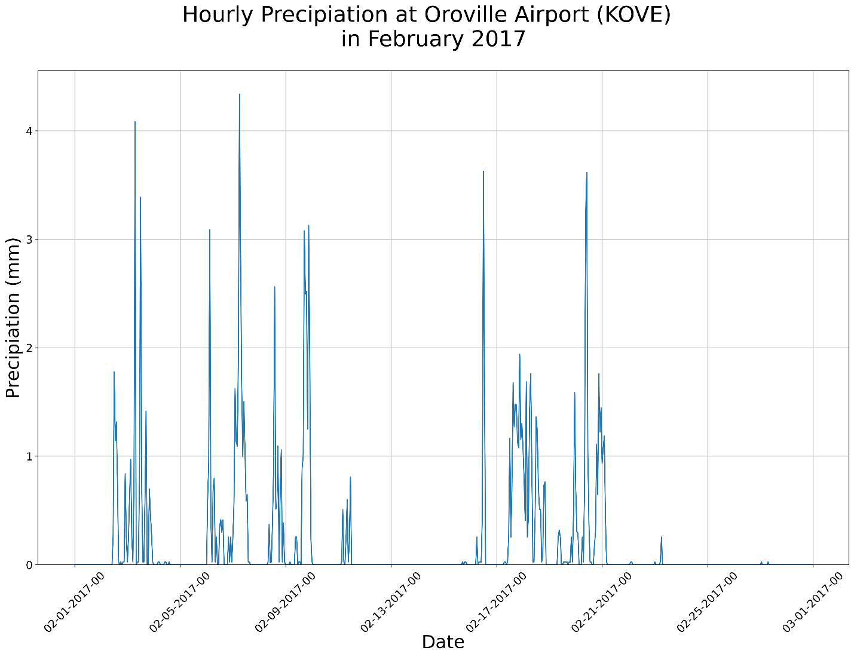
Methods – Identifying Synoptic-Scale Events
Airport station data (MesoWest)
Hourly precipitation time series
Oroville Municipal Airport
7 total synoptic-scale events identified
Visually identification through time series
Synoptic-Scale Events
Source: MesoWest (https://mesowest.utah.edu/)

Slide 9
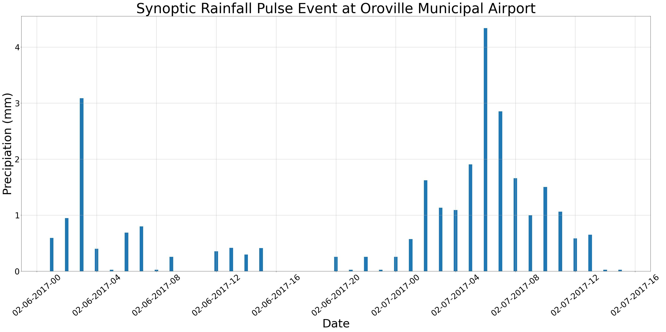
Methods – Identifying within-event precipitation pulses
Distinct waves of precipitation within longer duration events
What are the meteorological drivers behind these pulse events
Interested in these individual precipitation pulses

Slide 10
Methods – Characterize Events
Large scale (synoptic: 1000 km+)
Integrated water vapor transport (IVT)
Temperature advection
Small scale (mesoscale: 1 - 1000 km)
Using radar products to inspect structure of systems (NOAA’s Multi-Radar/Multi-Sensor System data, NEXRAD Radar)
Does the event contain an NCFR
Is there orographic forcing?
Basic Characteristics
Event start/end
Precipitation statistics

Slide 11
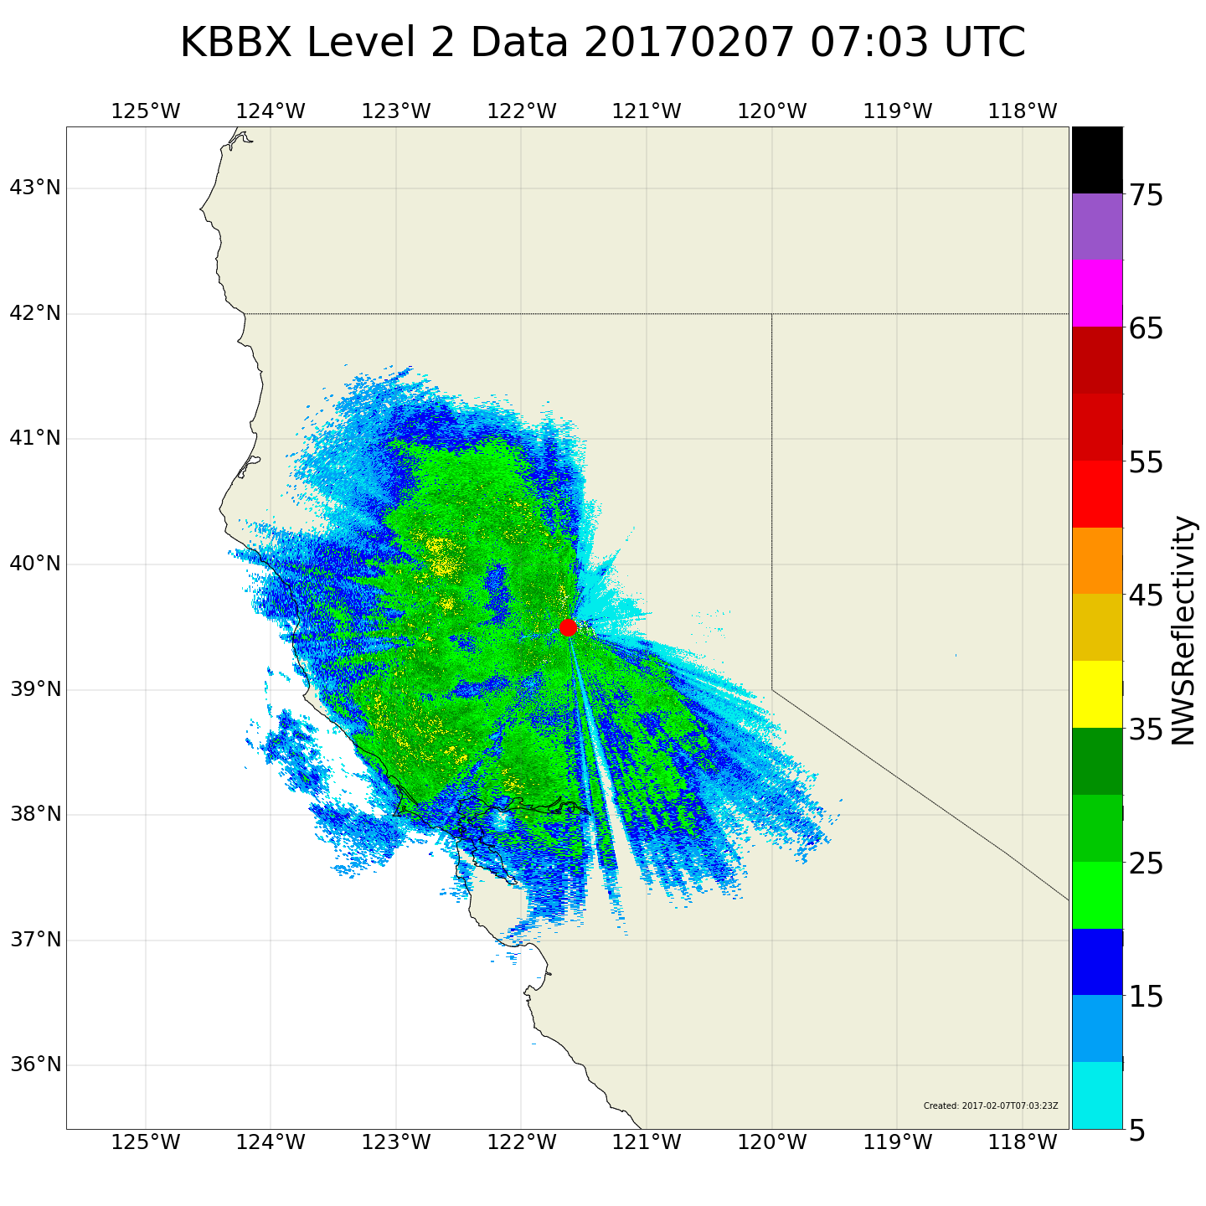
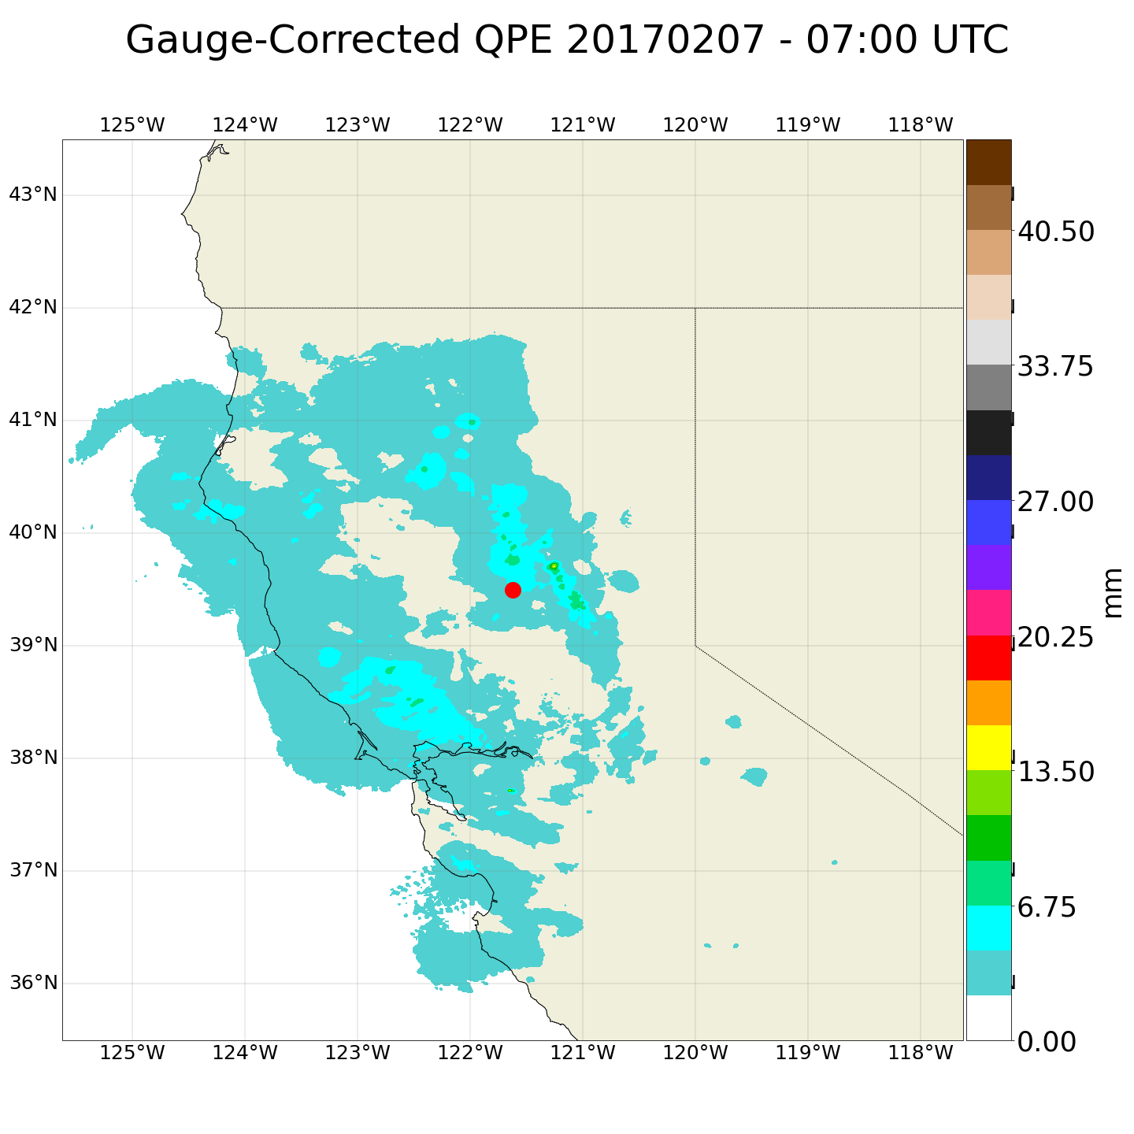
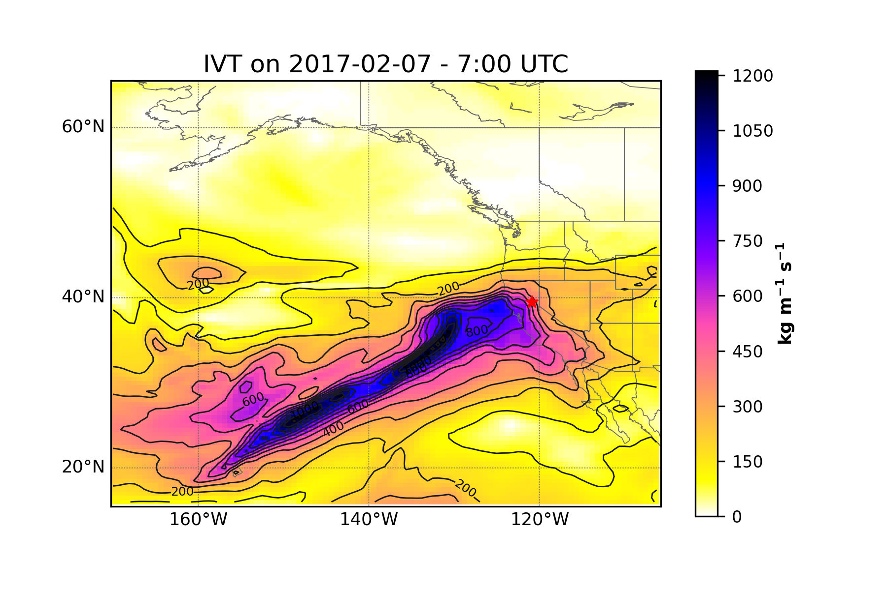
Preliminary Satellite and Radar data
1
2
3
Radar (NEXRAD II)
Quantitative Precipitation Estimates (MRMS)
IVT (MERRA 2)

Slide 12
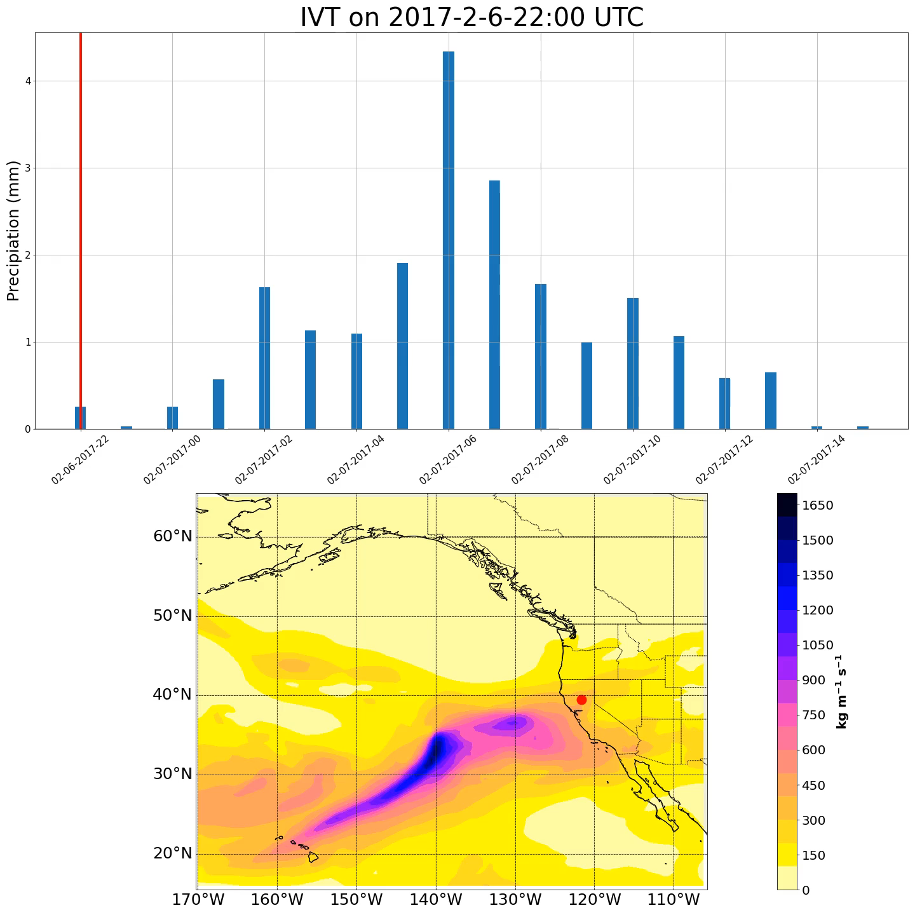
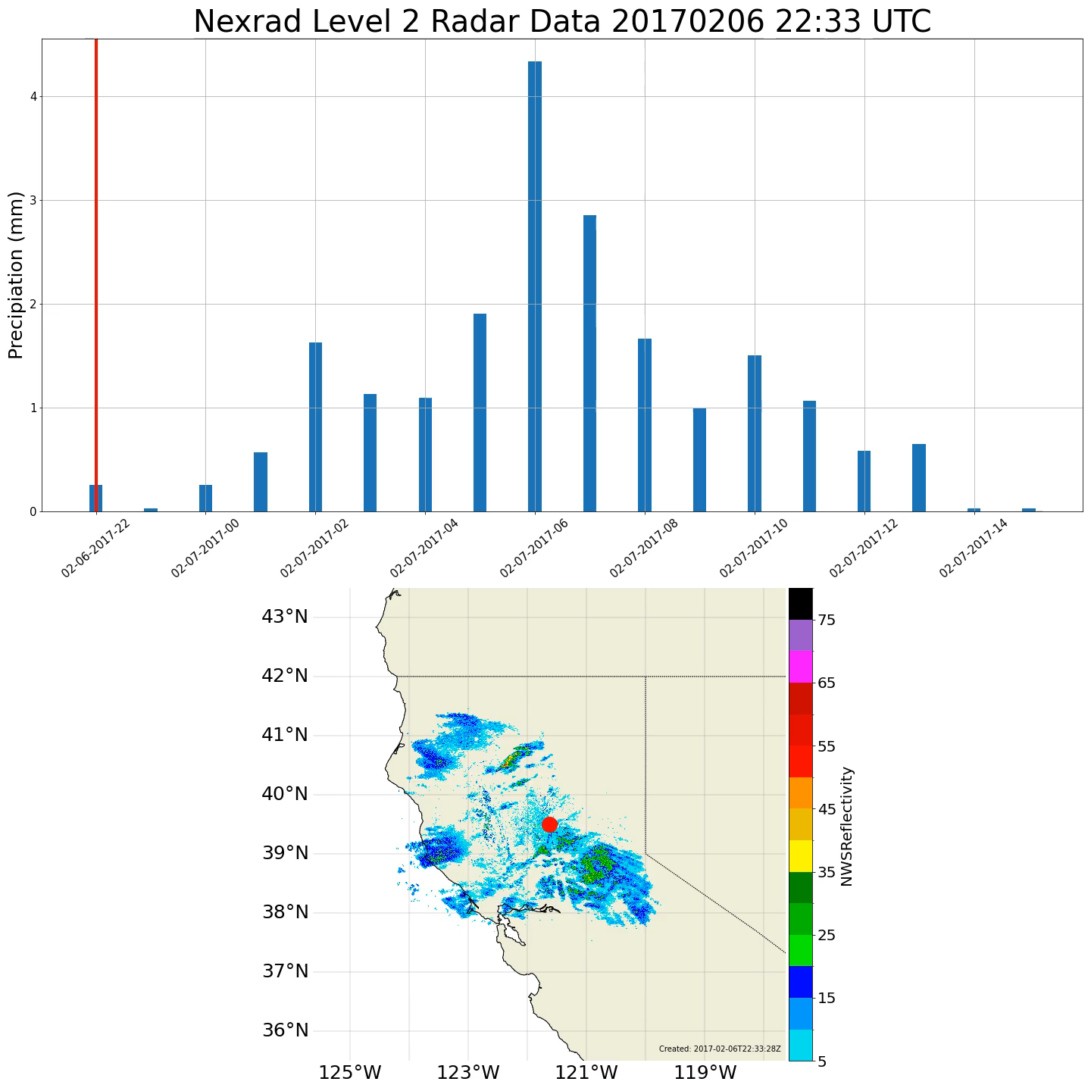

Slide 13
Discussion and Broader Impact
Extreme precipitation events are likely to increase in frequency as the climate warms
Known drivers of landscape shaping processes such as flash flooding, erosion, snowmelt, landsliding and debris flows.
Mitigation strategies
Disaster management
Improve climate/weather models

Slide 14
Future Research
Data being used in this study is available for most of the United States
Opportunities to scale
Characterization process of within-event pulses can be used as the basis for algorithm development

Slide 15
Project Timeline
MS in Geography objective timeline | Fall 2024 | Winter 2024 (Defend Thesis Proposal) | Spring 2024 or Fall 2025 (Defend Thesis)
Credits to take (research and thesis credits) | 1 | 3 | 3

Slide 16
Thank You

Slide 17
