Slide 1

CRICKET ANALYSIS
Group 17
Preetam Shankar Malla
Tilak Mudgal
Sai Gopal Jarabana

Slide 2
ABSTRACT
International Cricket is a very competitive tournament where team selection is a very tricky and tedious procedure. Analysis of sports data and Prediction of each player’s performance helps in filtering the best players. A novel method employing the techniques of Data Analytics and Data Visualization is used in this project to extract individual player performance from huge statistics and datasets. The visualizations are created to bridge the space between selecting team, coaches, and team management and to give a better interpretation on player consistency, scoring and further capabilities. In this project, we used d3.js for visualization and HTML, CSS for the front-end application. The proposed application can be beneficial for team managements and decision making.

Slide 3
MOTIVATION
The motivation for creating the cricket analysis visualization using d3.js is to provide cricket fans and analysts with a powerful tool for understanding and analyzing the game. By using interactive and dynamic visualizations, users can gain a deeper understanding of cricket performance and make more informed decisions about their favorite teams and players. Additionally, the use of real-time data in the visualization allows users to stay up-to-date on the latest developments in the world of cricket. Overall, the goal of the visualization would be to enhance the user's experience of following and analyzing the game, and to provide them with valuable insights into the performance of their favorite teams and players.

Slide 4
DATA SOURCE LINKS
https://www.kaggle.com/datasets/mahendran1/icc-cricket
https://stats.espncricinfo.com/ci/engine/records/index.html

Slide 5
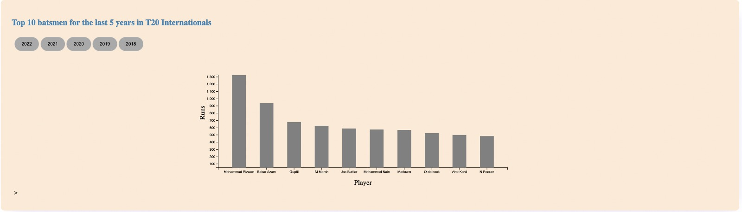
BAR CHART

Slide 6
The first visualization is a bar chart that shows the top 10 run scorers in T20 international matches during the previous five years, from 2018 to 2022.
The runs make up the y-axis, while the players' names and nations make up the x-axis.
The chart is interactive, allowing users to hover over or click on individual years to see more detailed information about the player’s performance.
This bar chart visualization provide a clear and easy-to-understand view of the top 10 run getters in the last five years, allowing users to quickly compare the performance of different players and gain insights into their scoring patterns.

Slide 7

LINE CHART

Slide 8
The T20 international wickets are displayed in the first image of the second visualization.
The y-axis displays the amount of wickets taken.
The player information is displayed on the x-axis, and there is a dropdown menu where we may choose between the T20, Test, or ODI formats.
This line chart visualization provide, easy-to-understand view of the trend in bowling performance over time in various format like T20, Test, and ODI, allowing users to quickly compare the performance of different teams and players and gain insights into their scoring patterns.

Slide 9
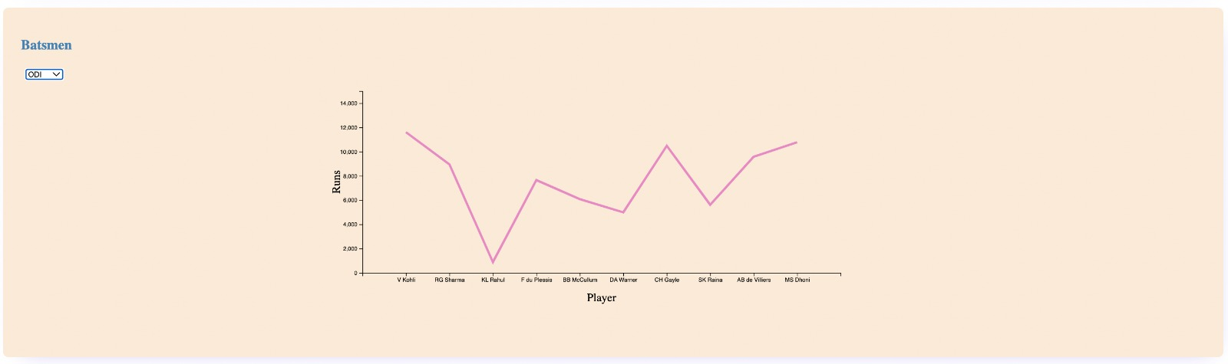
LINE CHART

Slide 10
The ODI international top run scorers are displayed in the second image of the second visualization.
The y-axis displays the amount of runs scored in the ODI international match.
The player information is displayed on the x-axis, and also there is a dropdown menu where we may choose between the T20, Test, or ODI formats, it shows tops players in every format of international cricket.
This line chart visualization provide, easy-to-understand view of the trend in batting performance over time in various format like T20, Test, and ODI, allowing users to quickly compare the performance of different teams and players and gain insights into their scoring patterns.
This analysis make easy for selectors and the international board members to choose the player for the upcoming matches based on the performances.

Slide 11
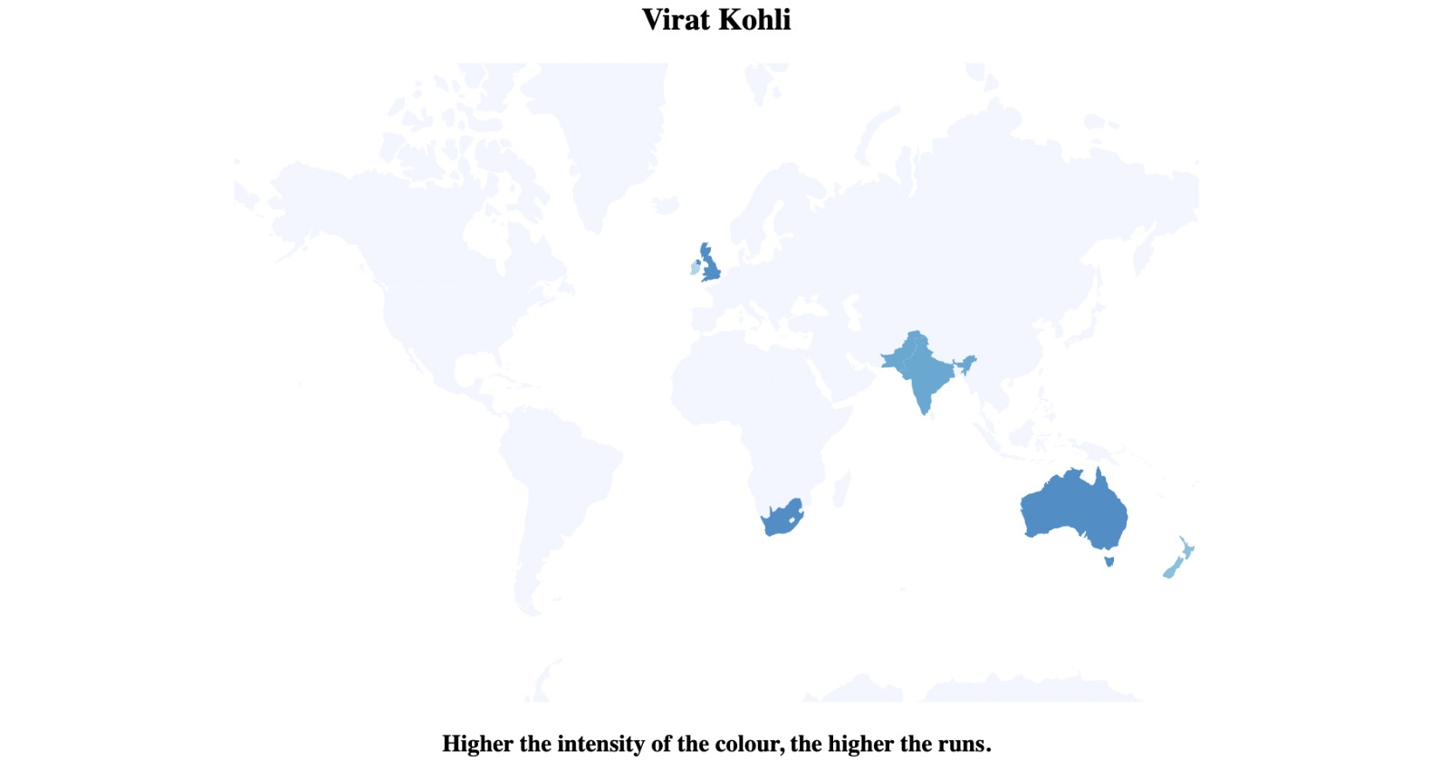
GEOSPATIAL

Slide 12
We have added player to the Dropbox , where we can select the desired player.
The world map shows the runs scored in particular are by intensity of the color.
If the certain region have high intensity of color then the player scored more runs in the country.

Slide 13
THE END

