Slide 1

Simulating a Boxing Match in ModSimPy
Patrick Maloney
DATA 604 Summer 2020

Slide 2
“The Fight of the Century”
While analytics now proliferates pro sports, boxing has been slow to catch on.
The Floyd Mayweather vs. Manny Pacquaio match in 2015 was one of the richest events ever:
Over $600 Million in gross revenues
Each fighter made a 9-figure payday for the evening
Over $50 million dollars was wagered on the fight’s outcome
I have attempted to recreate this match up through a Monte Carlo simulation

Slide 3

Flowchart
Punch thrown
Punch lands
Tally for the round will be incremented
Punch knocks down opponent
Fighter will receive an extra point at the end of round
Opponent is Knocked Out
Fight is over.
Fighter who threw the punch wins
This is the basic time-step function that is the foundation of the simulation. Each fighter will pass through this sequence during each moment of the fight.

Slide 4
Flowchart 2
Round ends
At the end of each round of the fight, points are awarded according to this logic.
If a knockout does not occur, the fighter with the higher score total at the end of the last round is the winner.
Punches tallied
10 points
Fighter scored more knockdowns
Equal or no knockdowns
Fighter scored fewer knockdowns
9 points &
-1 per knockdown
Fighter landed more punches
Equal landed punches
Fighter landed fewer punches
10 points
10 points
(both fighters)
9 points

Slide 5

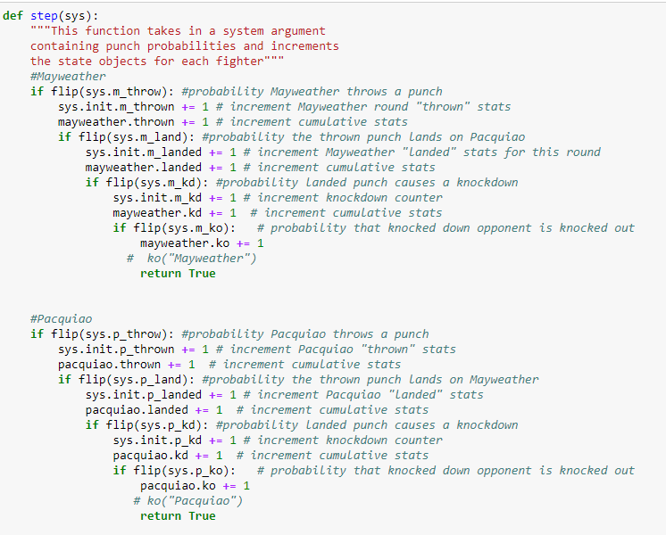
Code: Step function

Slide 6
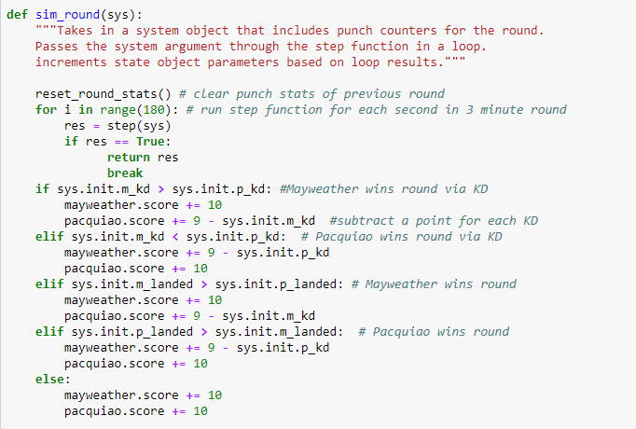
Code: Simulating a round

Slide 7
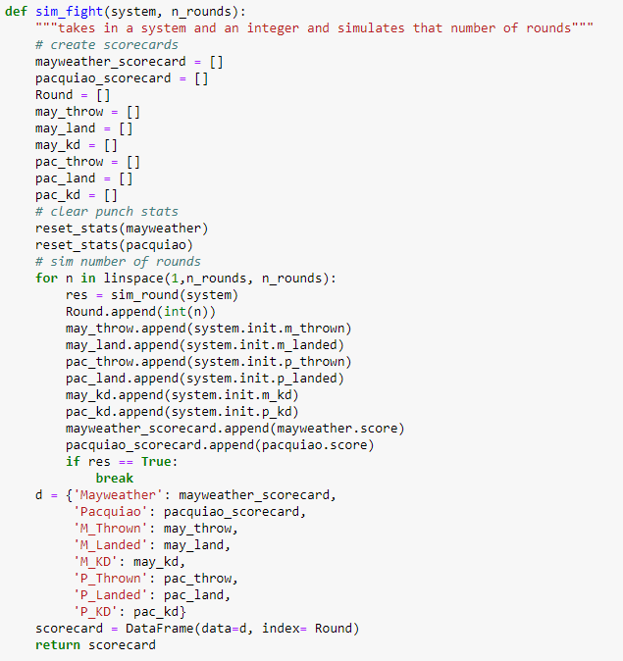
Code: Simulating a fight

Slide 8
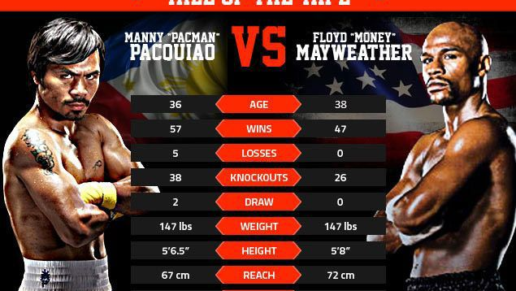
Setting System parameters
The simulation relies on a system of probability parameters calculated from each fighter’s career punch statistics in fights tracked by CompuBox, Inc.

Slide 9
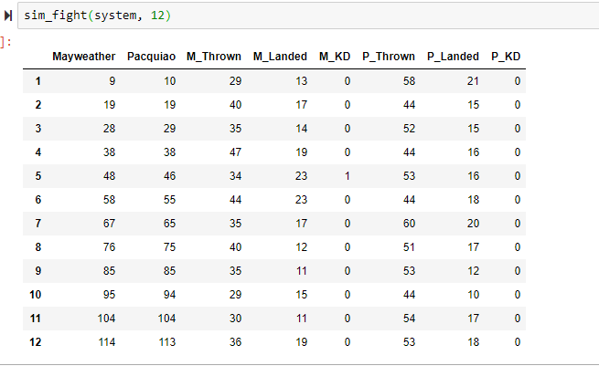
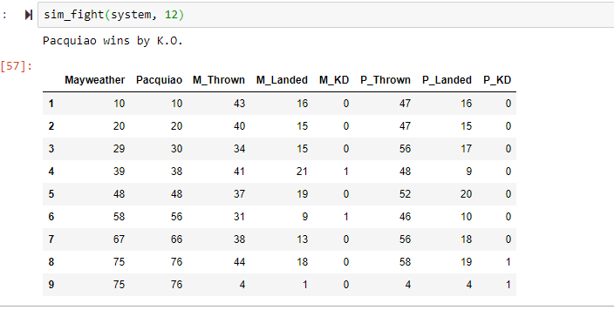
Interpreting outputs
These scorecards tell us the story of what happened in a simulated fight.

Slide 10
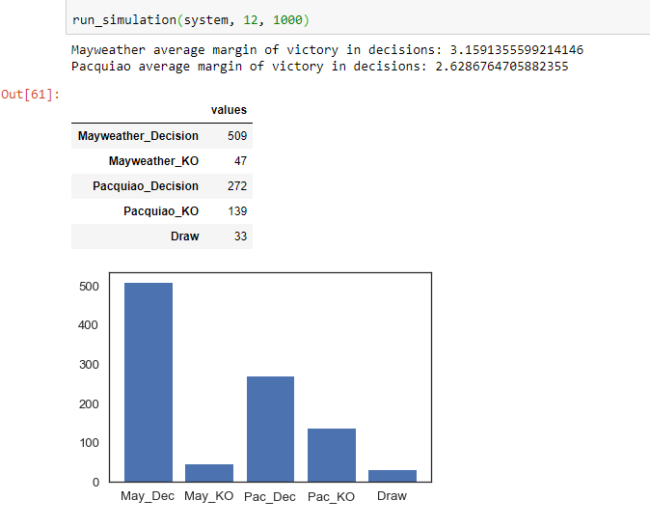
Results
After running the simulation 1000 times, Mayweather wins the majority of the matches. Interestingly, Mayweather is also more likely to win a decision by a wider margin than Pacquiao tends to. Pacquiao is more likely to end the fight by KO than Mayweather is, but nearly three quarters of the fights went the distance in this match up.

Slide 11
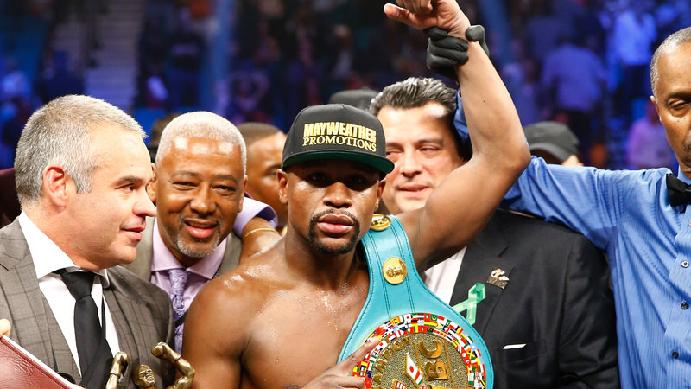
Validation
When the two did face off in 2015, Mayweather won the unanimous decision, with two judges scoring 116-112, and the third 118-110. That scenario appears to be one of the most common in our simulations, as we have Mayweather by decision as the most common outcome, and the average margin of victory at over 3 points. On the night of the fight, Pacquiao had a much lower than usual punch output, which he attributed to a shoulder injury, but is also common for Mayweather opponents.
The simulation reflects Mayweather’s career as a whole, while still seeing Pacquiao win around a third of the time, proving him a worthy opponent.
Punch stats for simulated fights are in line with career averages
Parameters were adjusted to account for Mayweather opponents throwing fewer punches than usual when facing him.

