Slide 1
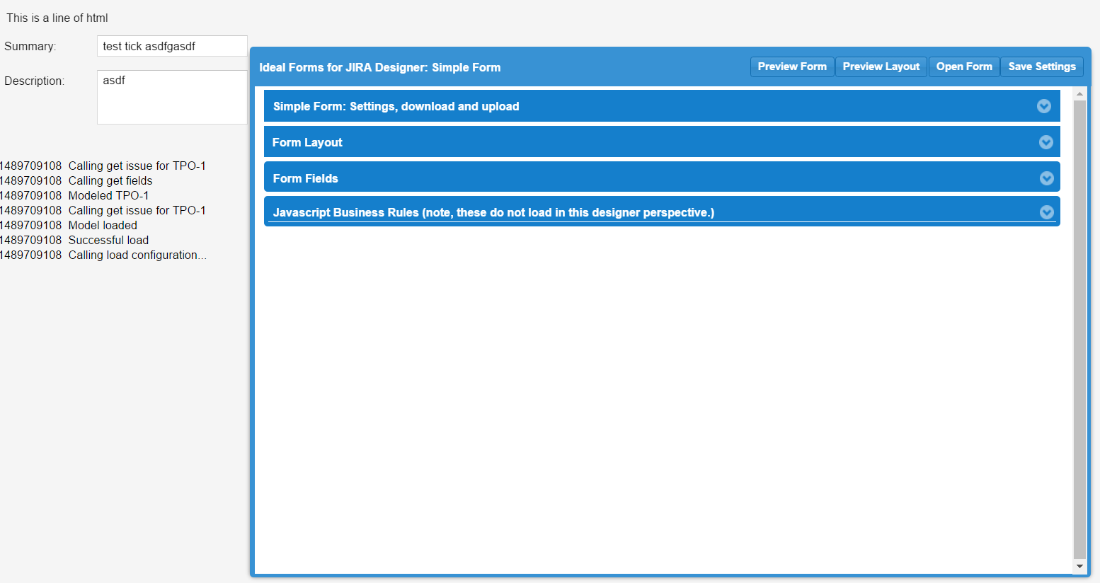
Previewed Form
Form Settings, moveable dialog window with all settings
Debug Log

