Slide 1

Improving a System – ExpertSystem Search
CS410 Course Project, Fall 2020
pmanden2@illinois.edu

Slide 2
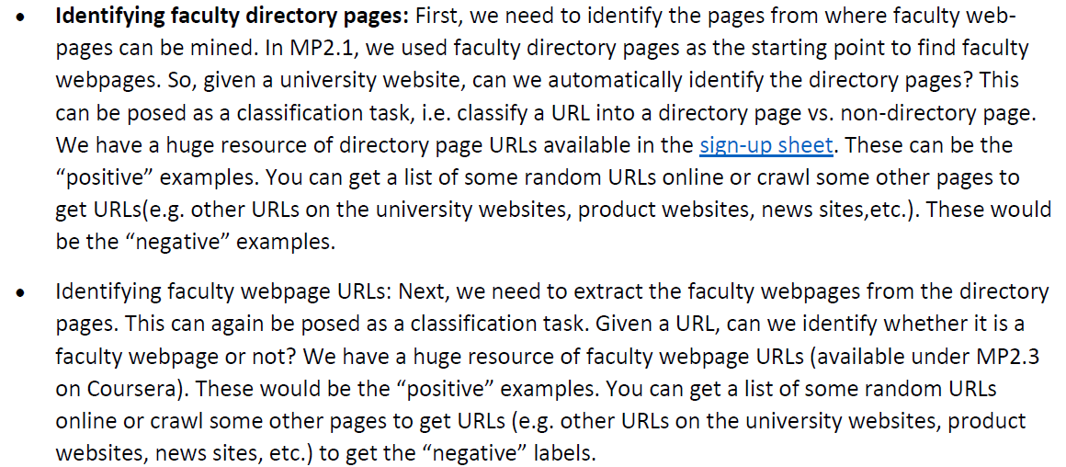


Objectives From Improving a System – ExpertSystem Search
1
2

Slide 3
Objectives
Given a URL classify it as directory vs non-directory page
Given a URL classify it as faculty or non-faculty page
[This project was done by myself as a one person team]

Slide 4
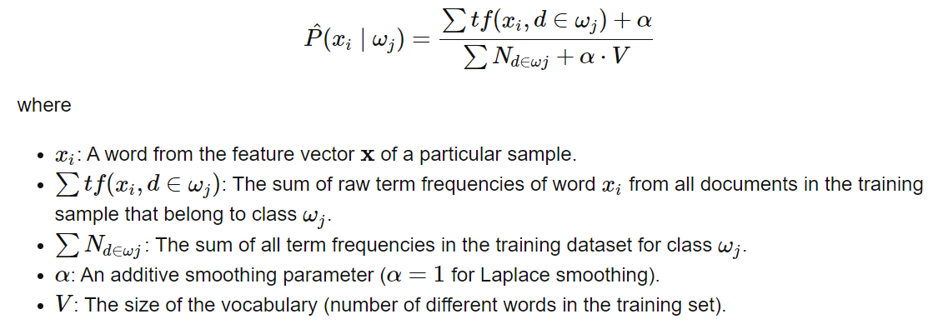
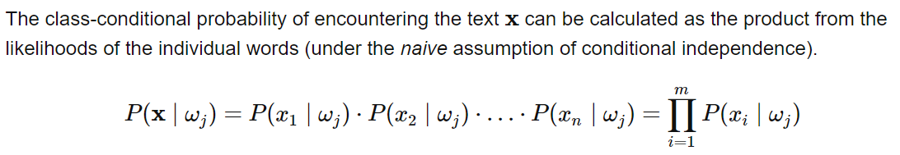
Naïve Bayes classifier
Credit - https://sebastianraschka.com/Articles/2014_naive_bayes_1.html

Slide 5
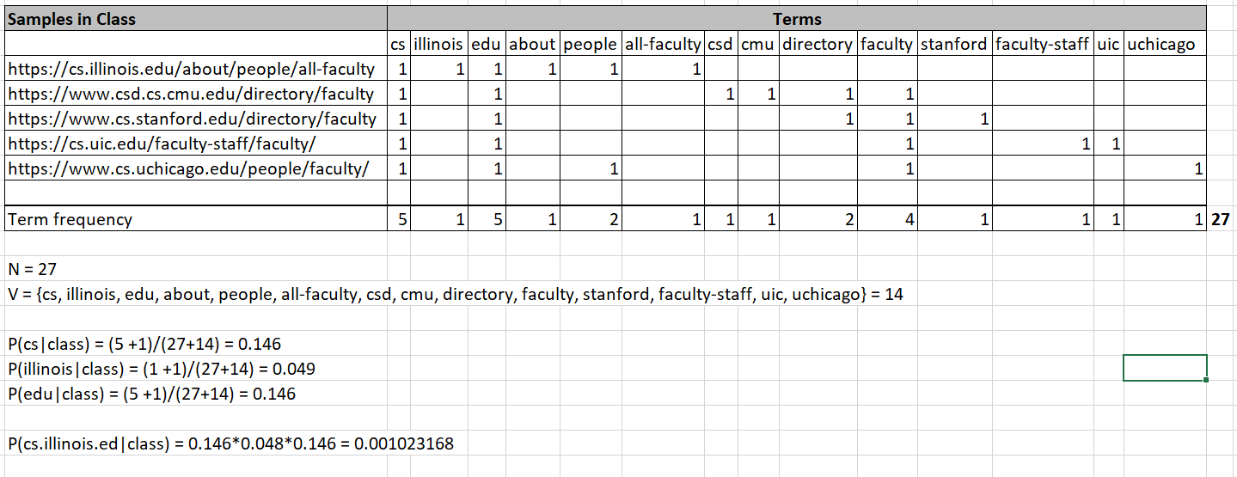
Text representation – Bag of words

Slide 6
Implementation
2 Classifiers built
Directory link classifier
Faculty link classifier
Directory link classifier Training data
Positive Samples collected from MP2.1 signup spreadsheet (as suggested)
900 Samples are available (in file ‘directory-positives.txt’ in source code)
Negative Samples
A scraper utility was written to collect links from university webpages, which excluded all links with keywords such as ‘directory’, ‘staff’ etc. to ensure negative samples
6592 samples are available (in file ‘directory-negatives.txt’ in source code)

Slide 7
Implementation
Faculty link classifier Training data
Positive samples
Faculty pages from MP2.3 data on Coursera was used as suggested
16492 samples are available (in file ‘faculty-pages-positives.txt’)
Negative samples
The same scraper was used to generate links from university websites. Links with keywords such as ‘faculty’, ‘staff’ are removed to ensure negative links
6592 samples available (in file ‘faculty-pages-negatives.txt’)

Slide 8
Source code – (Core file)
Classifier.py
Implements Naïve Bayes Classifier in ‘class naive_bayes_classifier’
Input
Name of file that contains positive samples
Name of file that contains negative samples
Number of samples to be used for training
‘initialize_classifier’ method
Loads the samples from the specified files
Calculates and saves term document matrix, term frequency, no of terms, total counts for each terms for both positive and negative samples
‘classify’ method
Accepts a url
Calculates probability of the words in url with laplace smoothing for both positive and negative classes
Returns True if the positive class probability is > negative class probability
It can be run to test the code independently
To test, Run – ‘python classify.py’, tests model accuracy and shows results

Slide 9
Model Accuracy
Directory Classifier (with 800 samples, 100 test data)
Precision 0.96
Recall 0.94
F1 score 0.94
Faculty Classifier (with 6000 samples, 300 test data)
Precision 0.99%
Recall 0.98
F1 score 0.99

Slide 10
Source Code - Utilities
scraper.py : Scrapes all universities listed at
http://doors.stanford.edu/~sr/universities.html
1,088 universities available
Identify 10 links from the home page of each university
Removes all links with key words that identify directory pages, such as ‘directory’, etc.
Removes all links with key words that identify faculty pages, such as ‘faculty’ etc.
Generates a list that is used as negative samples for both classifiers
Run – python scraper.py
Will take 3-4 hours to run. (Change ‘no_universities_to_scrape’ line 137 to test on limited number of universities)

Slide 11
Source Code – UI, Data files
ExpertSearch app UI was modified to test URLs
UI changes are only for testing & and not relevant to improving the system!
templates/index.html
Modified to support a new pull down menu
static/index.js
Java script code changes to interface with backend
Data files
directory_positives.txt (Directory positive samples)
directory_negatives.txt (Directory negative samples)
faculty_positives.txt (Faculty positive samples)
faculty_negatives.txt (Faculty negative samples)

Slide 12
Running the Application
To run ExpertSearch App run
python server.py
Open a browser and point to http://localhost:8095/
Demo! – Play ProjectDemo.mp4

