Slide 1
Team Number: 13 Forest Monitoring System
Lukas Pollmann & Anahit Hayrapetyan, 14.12.2017

Slide 2
Contents
Main Idea of Prototype
Conceptual Approach
Architecture of Prototype
Learnings
Outlook

Slide 3
Main Idea of Prototype

Slide 4
Conceptual Approach

Slide 5
Architecture

Slide 6
Learnings
Went Well
Went Wrong
Finding a Dashboard in Node Red
...
Setup of Raspberry Pi
Using Nodered W/o Pi

Slide 7
Outlook
Prediction Model
Dashboard
Pi Camera

Slide 8
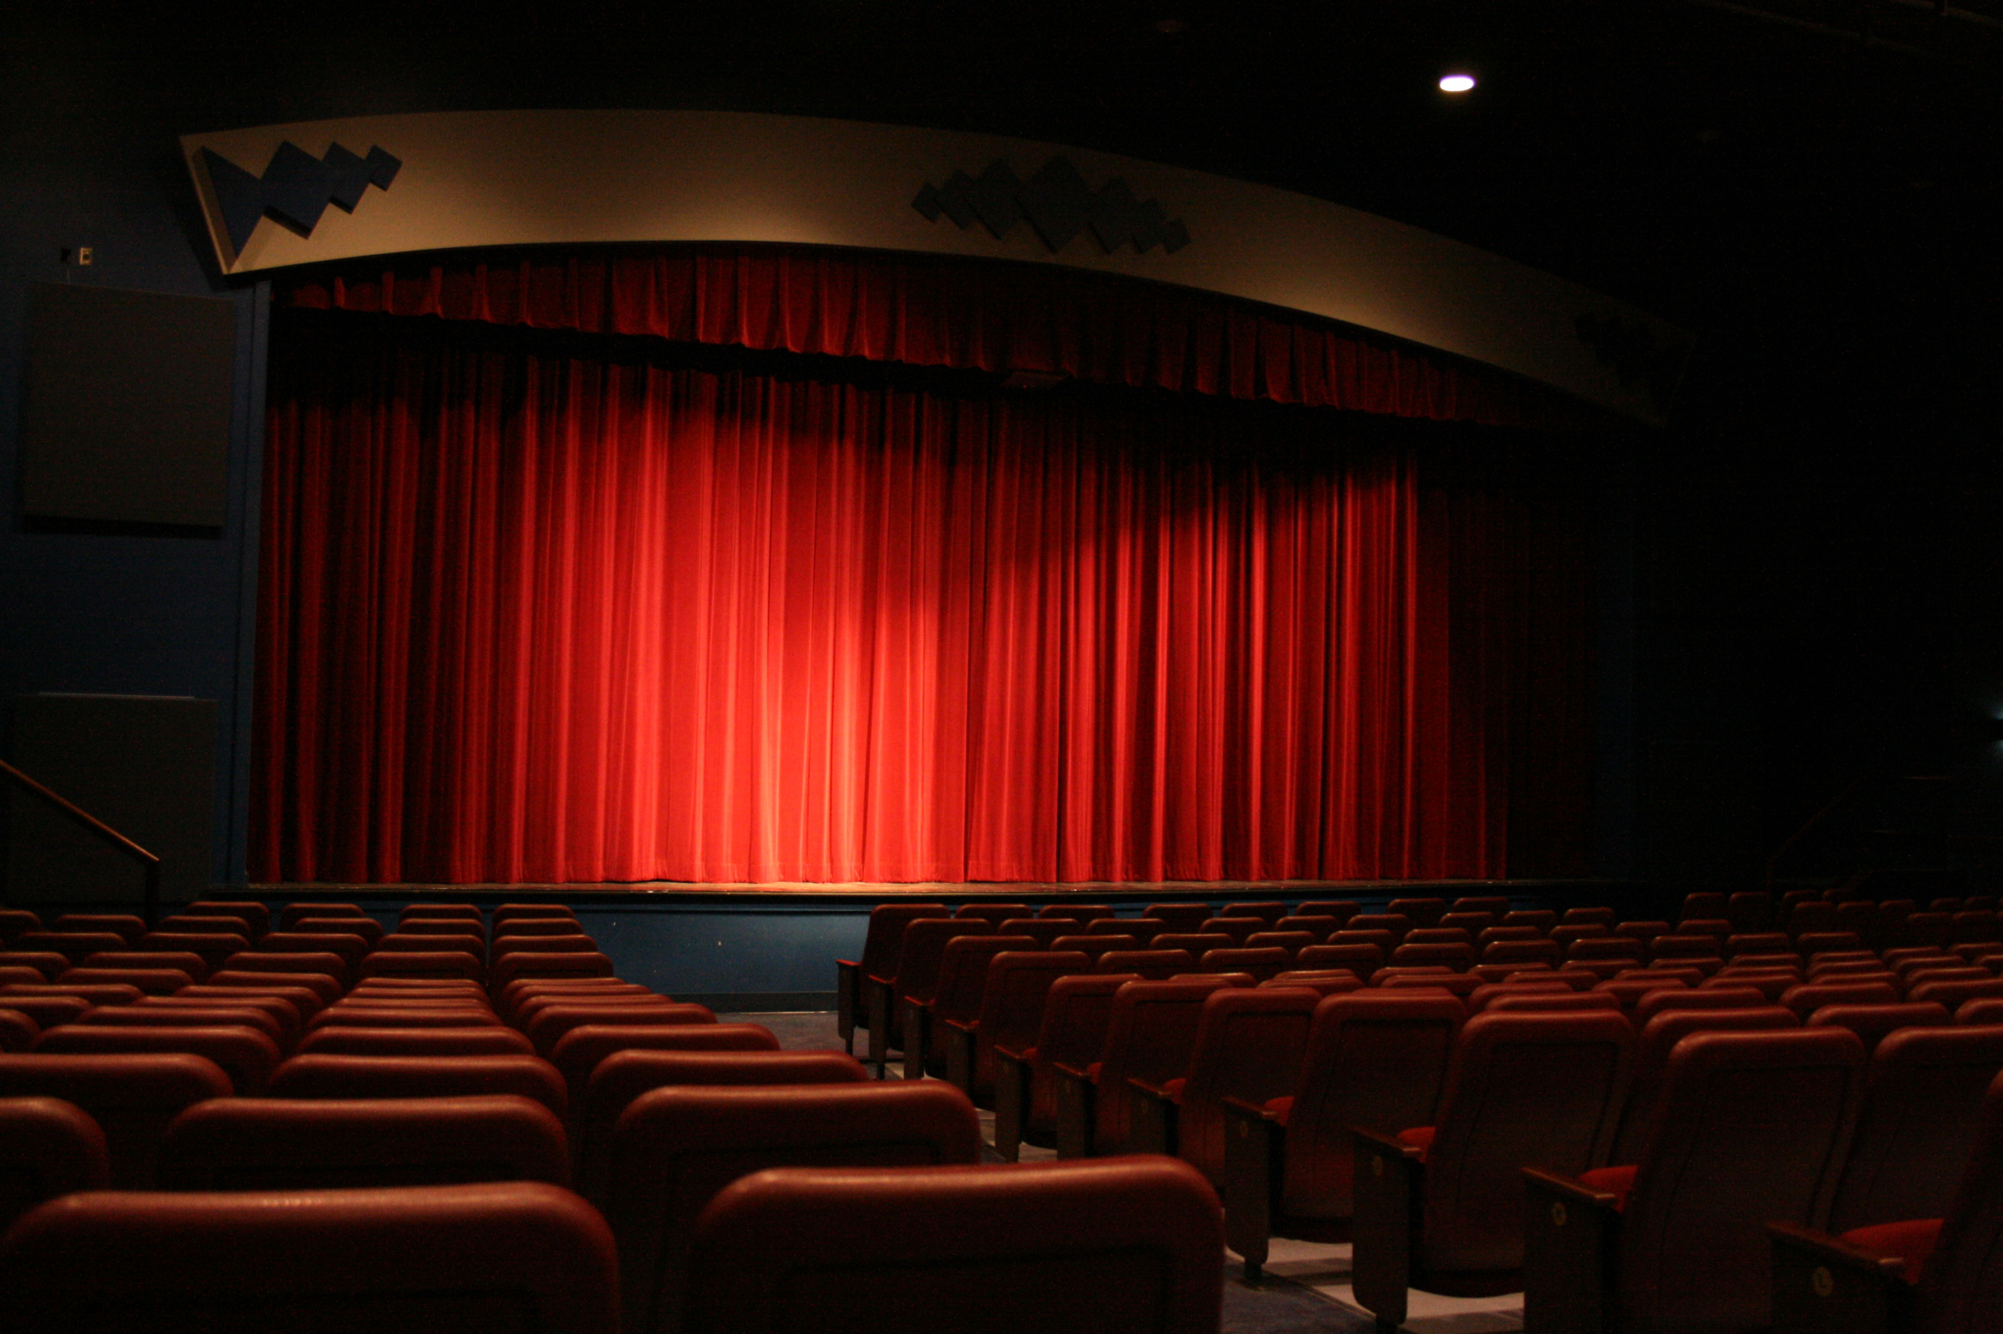
Thank you!

