Slide 1
PROJECT On Course Registration System Submitted By Manoj Kumar Potlapalli [700635028] Sandeep Reddy Aredla [700635578] Ravali Gujja [700641004] Himabindu Chittimalla [700641264]

Slide 2
Problem Statement
The traditional way of managing courses was declined day by day, because of time consuming. After the existence of internet
Some colleges have a comprehensive website for course registration(eg:-My central).
Comprehensive website led to heavy traffic problems and confusion for the students

Slide 3
Existing System
To register for the courses of particular major in the same Comprehensive Website (ex-My central) results server problems
This also interrupts other activities and degrades the performance of the website.
Whenever an issue such as course cancellation or change of timings arises administrator of the website should carefully address such as no other activity is interrupted.

Slide 4
Proposed System
A website which is completely dedicated for registration allows students to register for the courses swiftly
The proposed website contains all the details about the Majors of the college, courses and particular lecturers and timings of their proposed classes .
A database is created and maintained wherein the data regarding the Lecturers of different courses, their contact details , Students and the lecturers are intimated through Confirmation email whenever a student registers to their Course.

Slide 5
Scope
The goal of this project is to allow the users to easily navigate through the web application and get registered to their interested Courses as quickly as possible. It provides the users with an interactive interface which responds to user inputs.

Slide 6
Development Environment
Software and hardware required to develop this project are mentioned below.
Software Requirements
Programming Platform : HTML5,CSS,JavaScript,PHP5.4
Editor : Notepad++
Database : MySQL 5.5
Web Server : Apache Http Server 2.4

Slide 7
Hardware requirements
RAM : 512MB or high
Processor : INTEL-P4 or higher
Hard disk : 40GB or more
Operating Environment
Environment in which this product operates is described here.
Client Side Requirements
Software requirements :
Operating System : Windows XP or Advanced
Web Browser : Chrome or Mozilla

Slide 8
Hardware requirements
Hard disk : 40 GB or high
RAM : 512MB or higher
Processor : Pentium 4 or Advanced
Server Side Requirements
Software requirements:
Operating System : Windows XP or advanced
Web Server : Apache Http Server
Database : MySQL 5.5

Slide 9
Hardware requirements
Hard disk : 40GB or more
RAM :1 GB or higher
Processor :INTEL-P4 or advanced

Slide 10
System features
The major functionalities of this project will be as follows:
Drop down List
Quick Registration
Confirmation Email
User Query

Slide 11
Performance Requirements
The product will take time to load depending upon the internet connection speed which also depends on the media from which the application is run.
Safety Requirements
The access of unauthorized users may result in loss or damage of data. So the access to the database is restricted.
Security Requirements
Administrator is provided with secure login, password thus database will be secure.
The system’s back-end servers will not be visible or accessible to the users.

Slide 12
ANALYSIS
The main aim of analysis phase to understand the requirements of the client by analyzing and refining them for more deeper understanding for the development of the software.
This analysis is a nine step process in order to analyze the client requirements.
Step 1: Drawing the Data Flow Diagrams: The following are the two levels of data flow diagrams used to analyze the requirements more precisely.

Slide 13
Step 2:
Sections to computerize: For this project the entire operations of the system are computerized.
Step 3:
Determine the details of the Data Flows: The details to be determined are as follows,
Student details
Course details
Data Dictionary:
Data Element | Description | Narrative
Student details | Name Roll No Email-id | unique details of the student
Course details | Subject Name Course Timings Professor Name | receives email to the student and respective professor for each selected course

Slide 14
Step 4: Logic of the process Definition:
The details of the users is validated whenever a request is placed. The course details are entered, stored, retrieved whenever a user request(s) to enroll a subject(s).
Step 5: Define the Data stores: The data stores Student details and Course details are defined in this step.
Step 6: Define the Physical Resources: The data stores are stored on the hard disk and no cloud storages are defined.
Step 7: Determine the Input/Output Specifications: The input will be the entering the student details, choosing the courses, submitting the details in the google forms and selecting the professors. The output will be the received emails and getting registered for the courses.
Step 8: Perform Sizing: The storage requirements are based on the hard disk in the system.
Step 9:
Pentium based systems with a minimum of P4
512MB RAM (minimum)

Slide 15
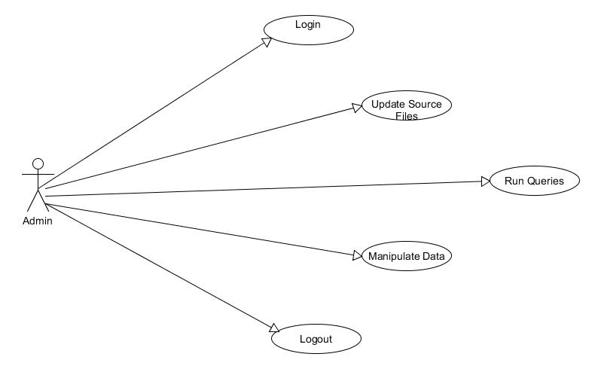
UML Diagrams

Slide 16
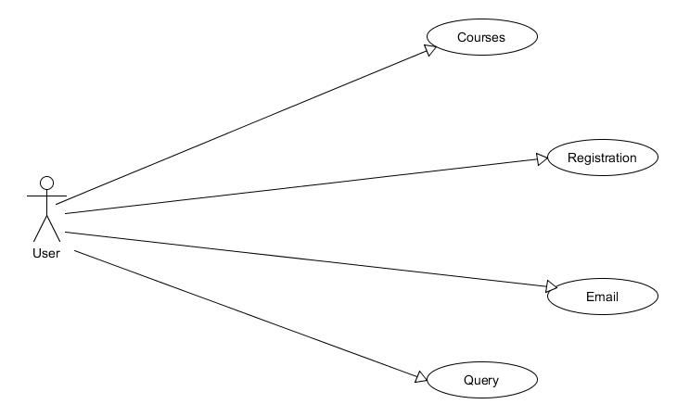
Use Case Diagram

Slide 17
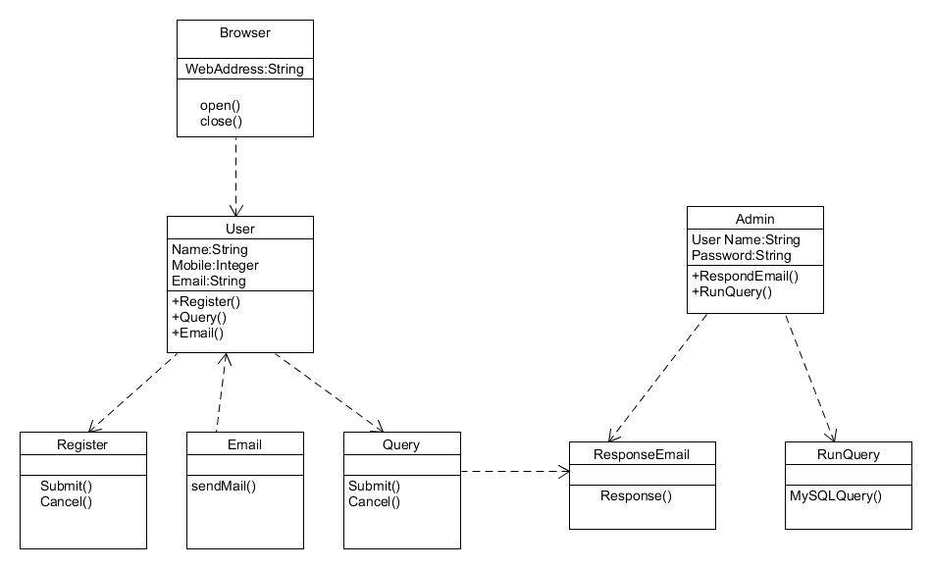
Class Diagram

Slide 18
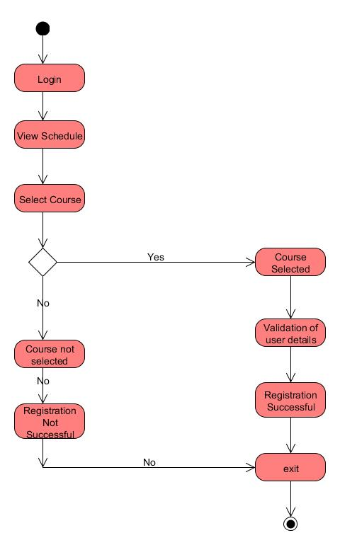
Activity Diagram

Slide 19
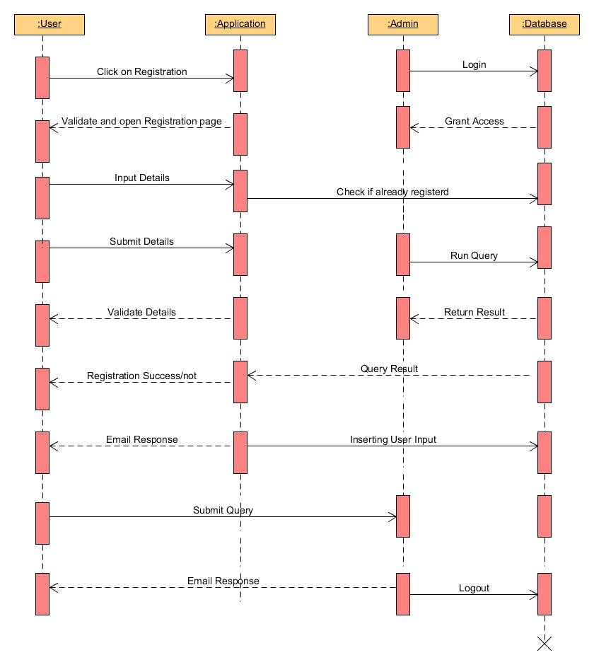
Sequence Diagram

Slide 20
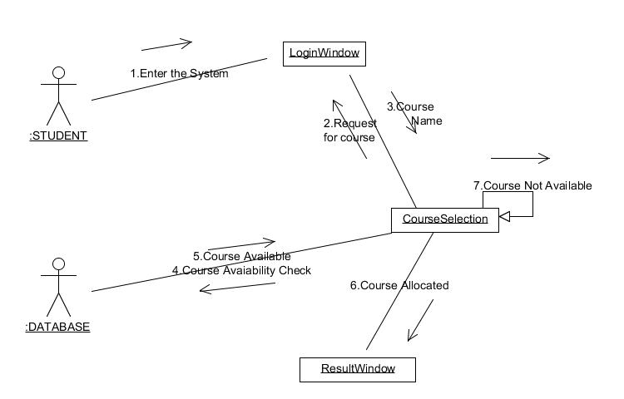
Collaboration Diagram

Slide 21
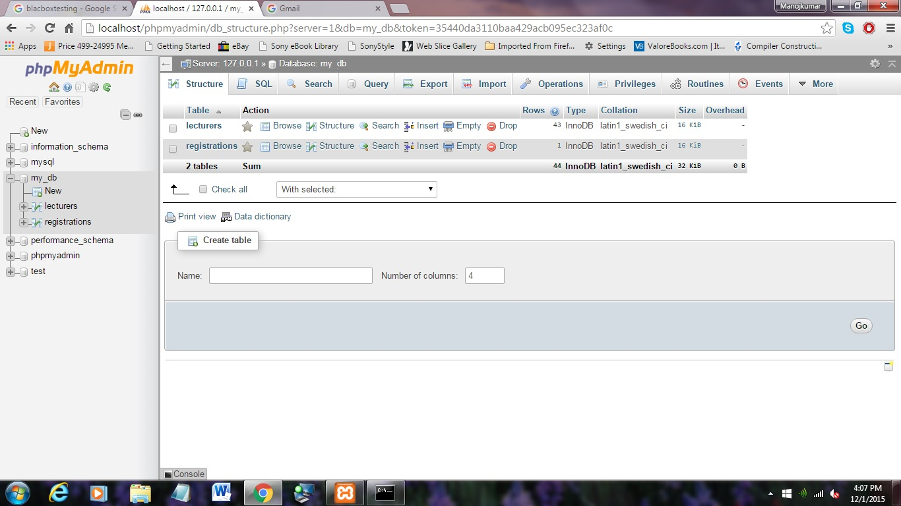
Administrator Window

Slide 22
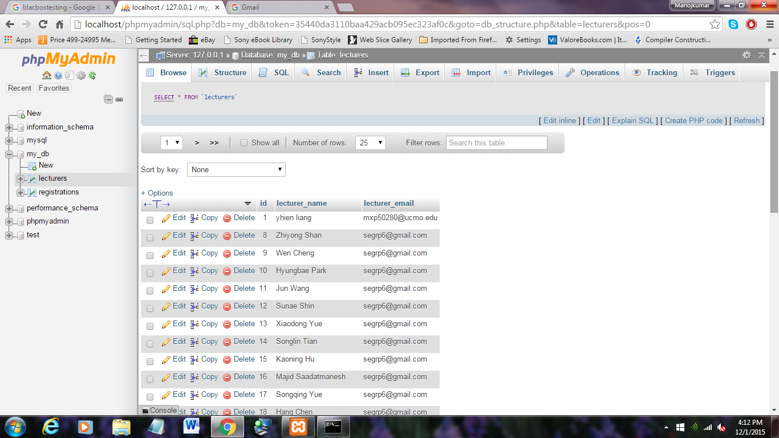
Administrator Window

Slide 23
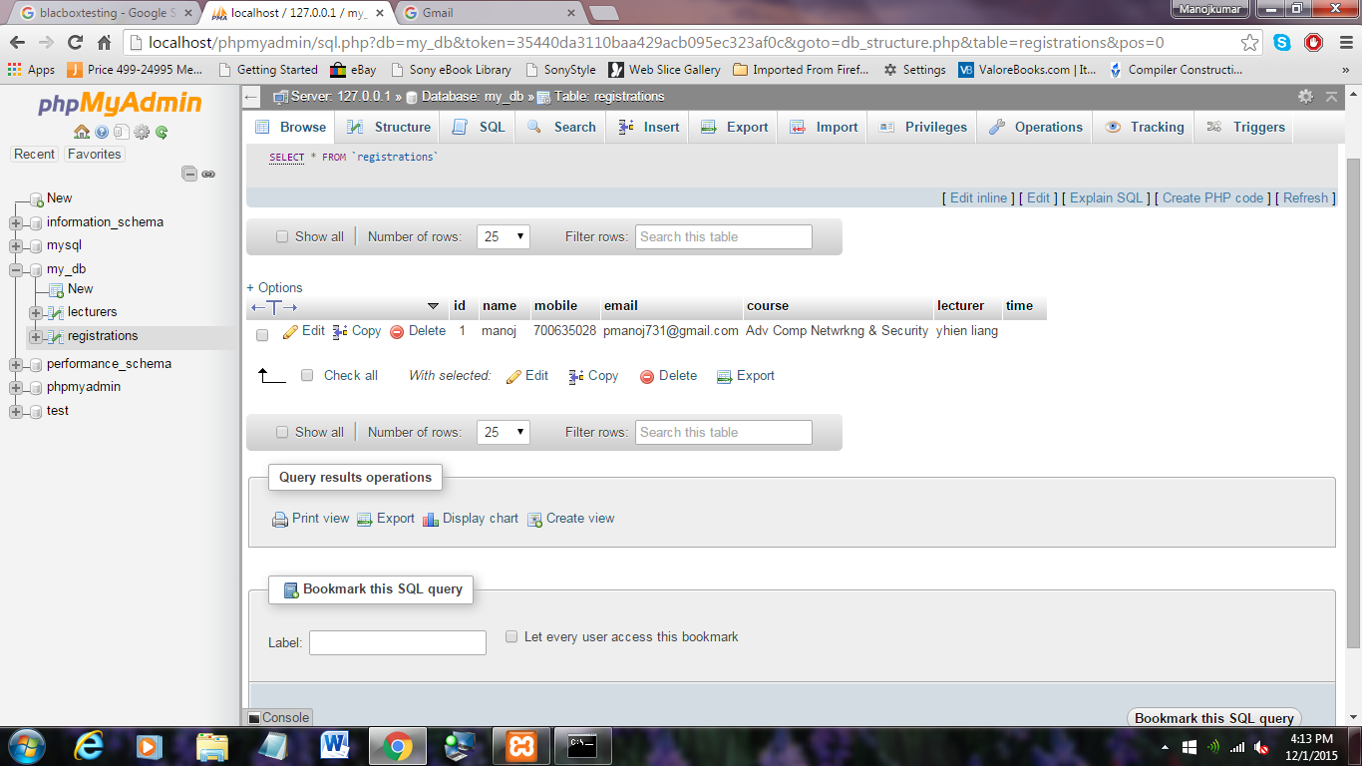
Administrator Window

Slide 24
Testing:
System Testing is a kind of black box testing. It is performed as the final test to verify that the system meets the specifications and its purpose The main focus of this testing is to evaluate End-user requirements.
Test Environment:
Operating System: Windows 7
RAM : 4GB
Web Browser : Chrome/Mozilla Firefox
Technical Software: XAMPP

Slide 25
Test case 1
Test Case Id | Case Type | Description | Expected Value | Actual value | Result
1 | Checking the internet connection | We need to go to the network connection | Internet connected | Internet connected Successfully | Internet connected Successfully
2 | Unable to start the internet service | Internet is not getting connected due to some network problems | Error in connecting to internet | Internet will not get connected | Internet is not connected. Checking the network connection.

Slide 26
Test case 2
Test Case Id | Case Type | Description | Expected value | Actual value | Result
1 | Giving proper credentials by user while registering | all the details of the user should be entered correctly | All the details of the user are correct | User should check all the details | User will get registered after checking the details
2 | Not giving correct credentials by user while registering | Username ,number and all user details are not entered correctly | All the details are correct | User didnot check all the details | User will not be able to register because of wrong credentials

Slide 27
Test case 3
 | Case Type | Description | Expected Value | Actual value | Result
1 | Registering before or after deadline | Clicked button before or after deadline | Before deadline | Allow Registration | Open Registration Page
2 | Registering before or after deadline | Clicked button before or after deadline | After deadline | Don’t Allow Registration | Show Time out page

Slide 28
Test case 4
Test Case id | Case Type | Description | Expected Value | Actual value | Result
1 | Correct Email or Not | The user can send Query to admin | Send Query to admin | An email is sent to admin | Email sent successfully
2 | Correct Email or Not | The user can send Query to admin | Show a warning | A warning is displayed | The user is warned for wrong email.

Slide 29
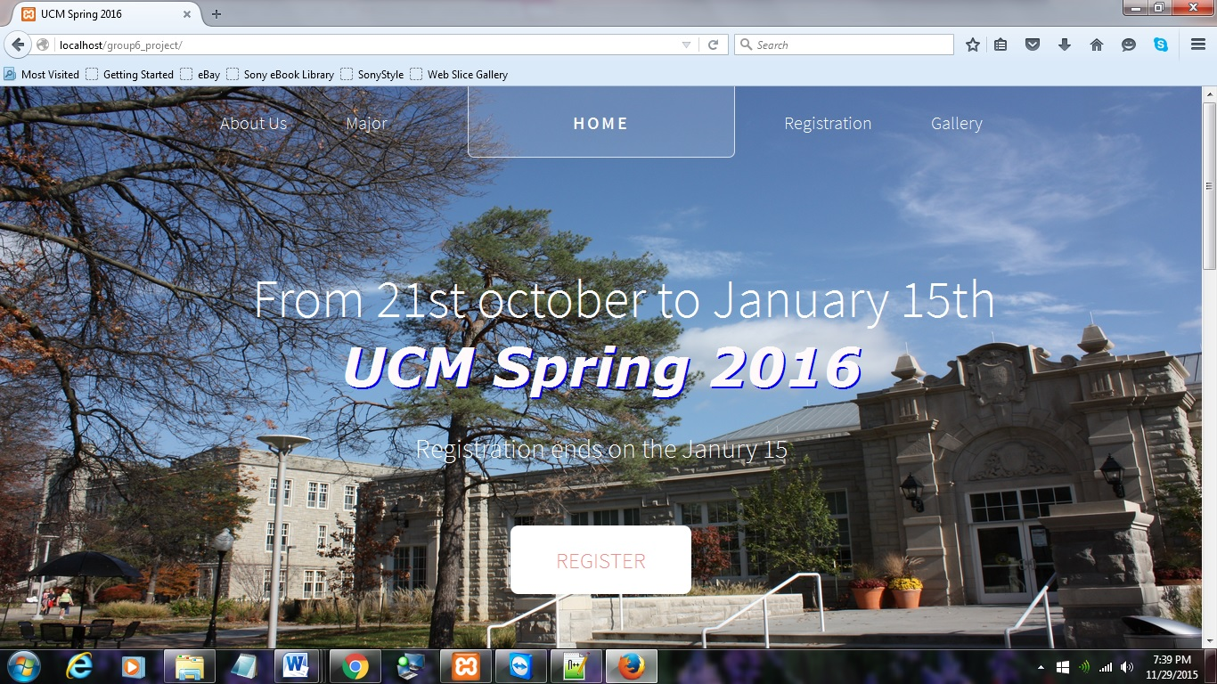
Screen Shots

Slide 30
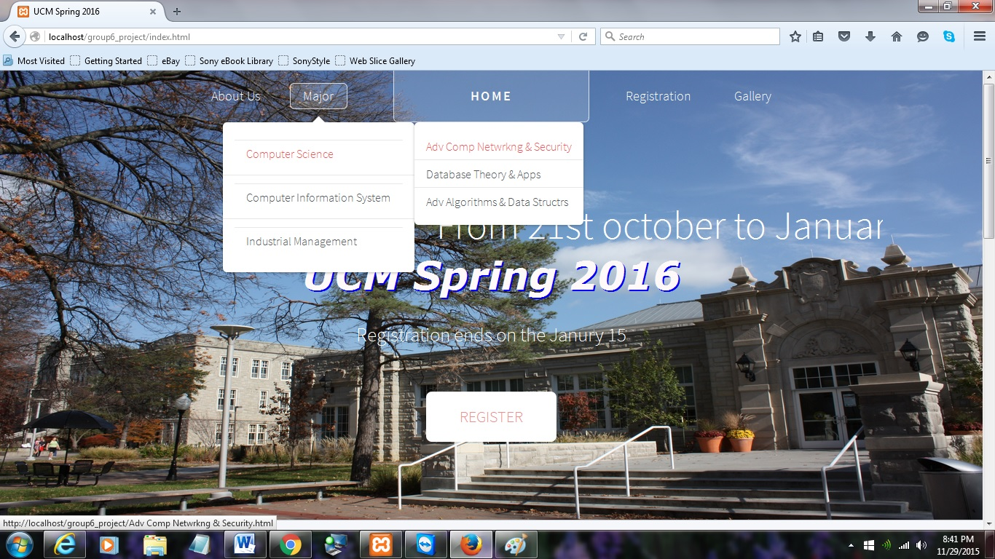
Navigation Bar

Slide 31
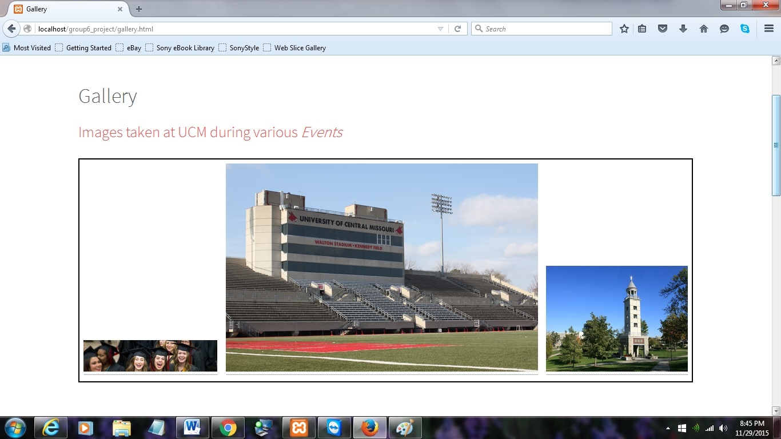
Gallery

Slide 32
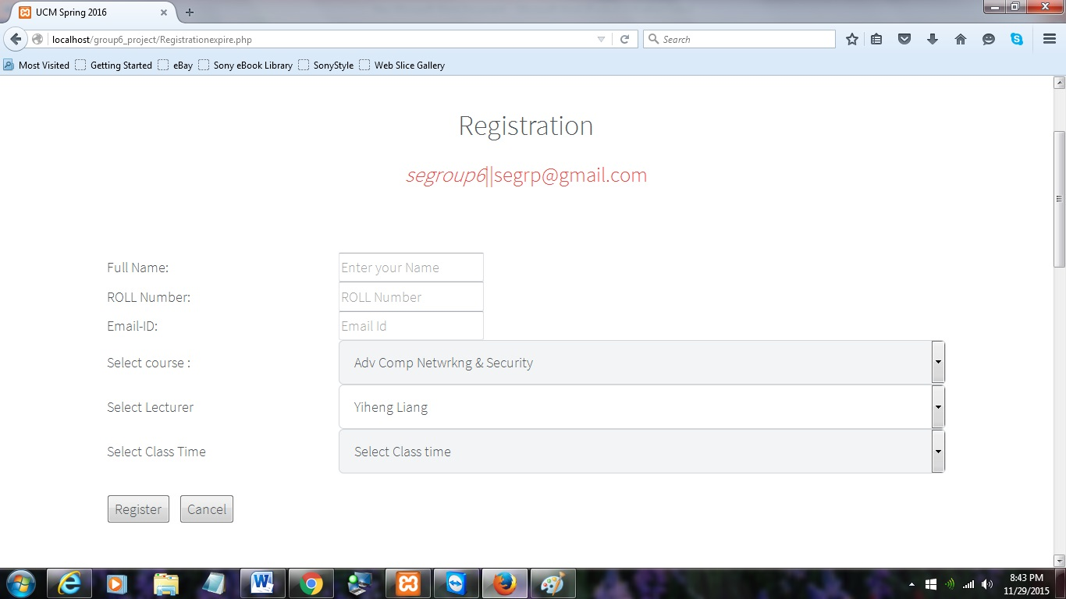
Registration

Slide 33
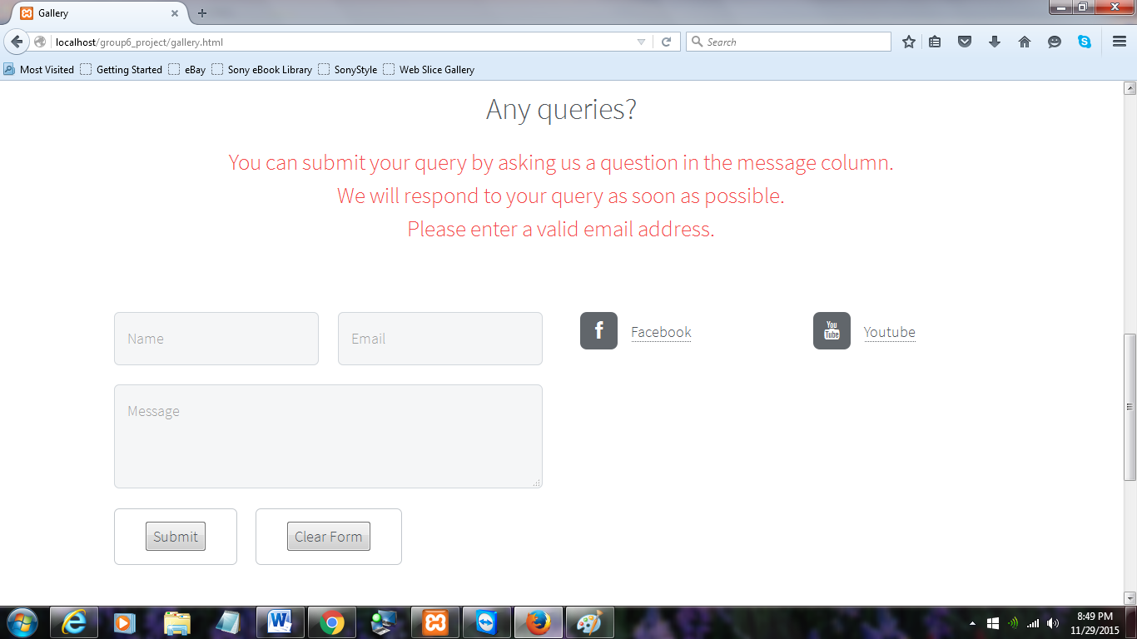
Query Submission

Slide 34
Thank you
Any Queries ?

