Slide 1
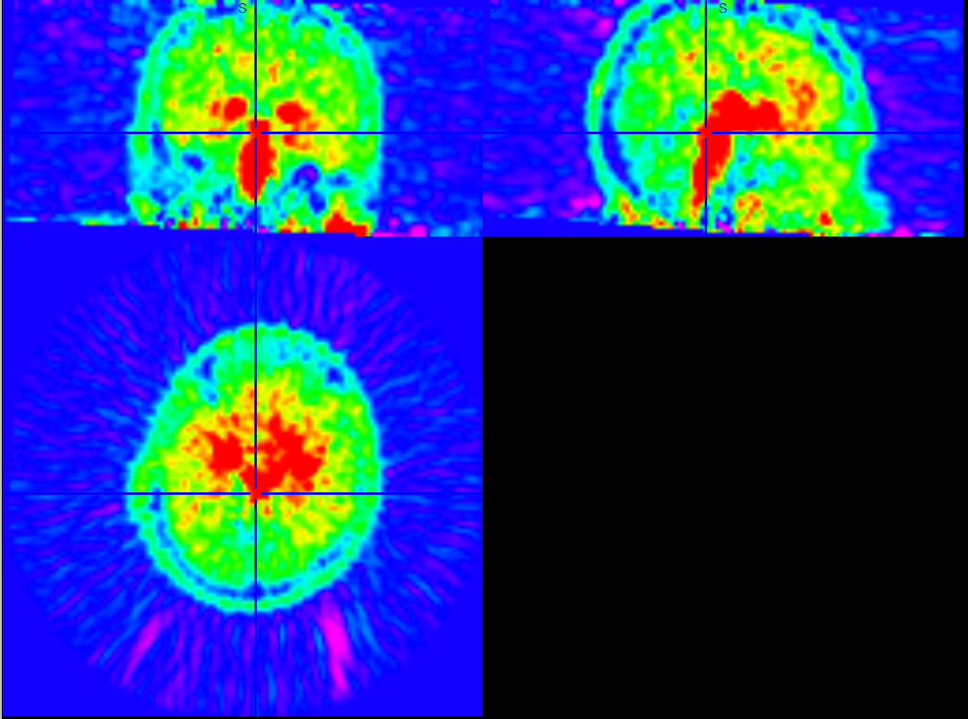
R
L
P
A

Slide 2
