Slide 1
FGC Evening Service
Weekday evening, 20:00-24:00 - prepared for the transport authority.

Slide 2
Evening service is uneven
Riders on the thinner-served lines wait far longer for a train than riders on the core network.

Slide 3
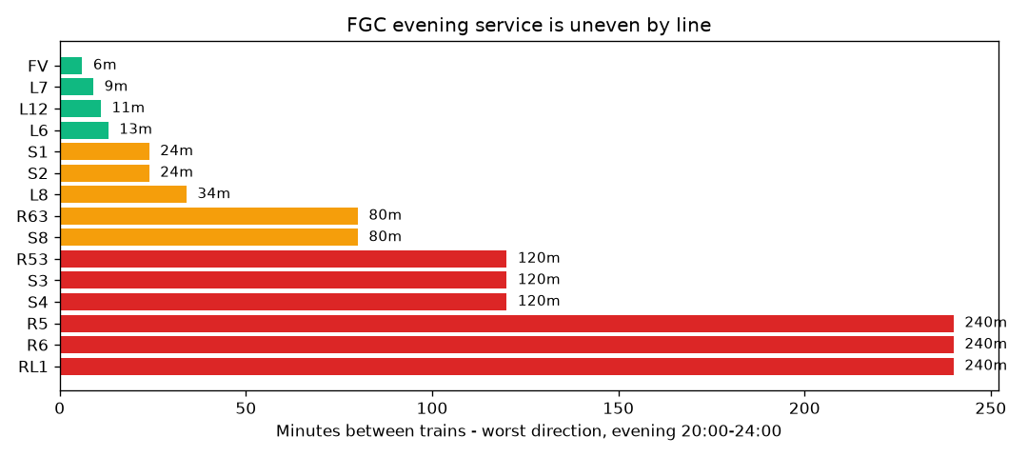
The gap is large
The best line runs every 6 minutes; the worst waits 240 minutes between trains - 40 times longer.

Slide 4
Six lines are barely served
R53, S3, S4, R5, R6 and RL1 wait two hours or more between evening trains.

Slide 5
The imbalance is structural
The best line runs 20 trains an hour; the worst runs one every two hours.

Slide 6
Recommendation
Add evening trips on the lines waiting two hours or more, then re-check after the next timetable change.

