Slide 1
FGC Evening Service Frequency
Weekday evening, 20:00-24:00. Prepared for the transport authority.

Slide 2
The bottom line
Evening service is uneven — riders on the thinner-served lines wait far longer for a train than riders on the core network.

Slide 3
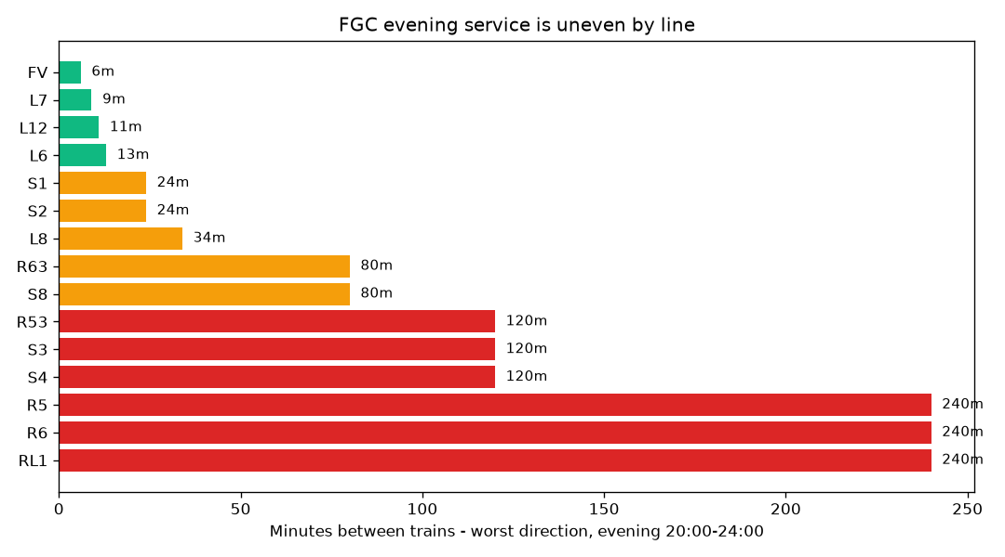
Evidence
Minutes between evening trains, by line.

Slide 4
The gap is large
The best-served line runs every 6 minutes; the worst waits 240 minutes — 40 times longer.

Slide 5
Who is affected
Six lines wait two hours or more between evening trains: R53, S3, S4, R5, R6 and RL1.

Slide 6
What it means
Riders on the outer rail lines face far longer evening waits than the core metro network.

Slide 7
Recommendation
Add evening trips on the lines waiting two hours or more, then re-check after the next timetable change.

