Slide 1
CONTINUOUS ( x , y ) LOCALIZATION
Regression results on the A3 phantom
Predicting the target's exact inch-coordinate — CNN vs MLP, under honest cross-validation
0.16 in
3–4×
+14%
best cross-session error (CNN)
harder to interpolate an unseen spot
mixup gain on the hardest case

Slide 2
From “which cell” to “exact (x, y)”
Same CNN & MLP, same data, same folds — the classifier's head swapped for coordinate regression
Targets
RnCmPp grid label → true (x, y) in inches (±0.375 in corner offsets, plus photo-digitized positions where the insert blocked a corner).
1
Models
CNN: conv trunk → fc(2). MLP: 3-seed ensemble. Raw S-parameter input, per-session z-score, v2 preprocessing.
2
Metric
Euclidean error in inches — never snapped to a grid point. Median error + % within the 0.5 in half-cell.
3
Protocols
LOSO = hold out a whole session (new scan of a known grid). LOPO = hold out a position (interpolate to an unseen spot).
4

Slide 3
New scan of a known grid (LOSO)
Median localization error — the CNN nails it; the MLP lags and physics features break it
What it says
CNN wins everywhere — ~0.16 in on empty (a sixth of a cell), under ¼ in even on F5.
Raw ≈ physics for the CNN, so raw is the pick (simpler, faster).
MLP is 3–4× worse on raw; with physics it collapses to the predict-centre baseline (1.1–1.3 in).
Opposite of classification, where physics was the MLP's best input.

Slide 4
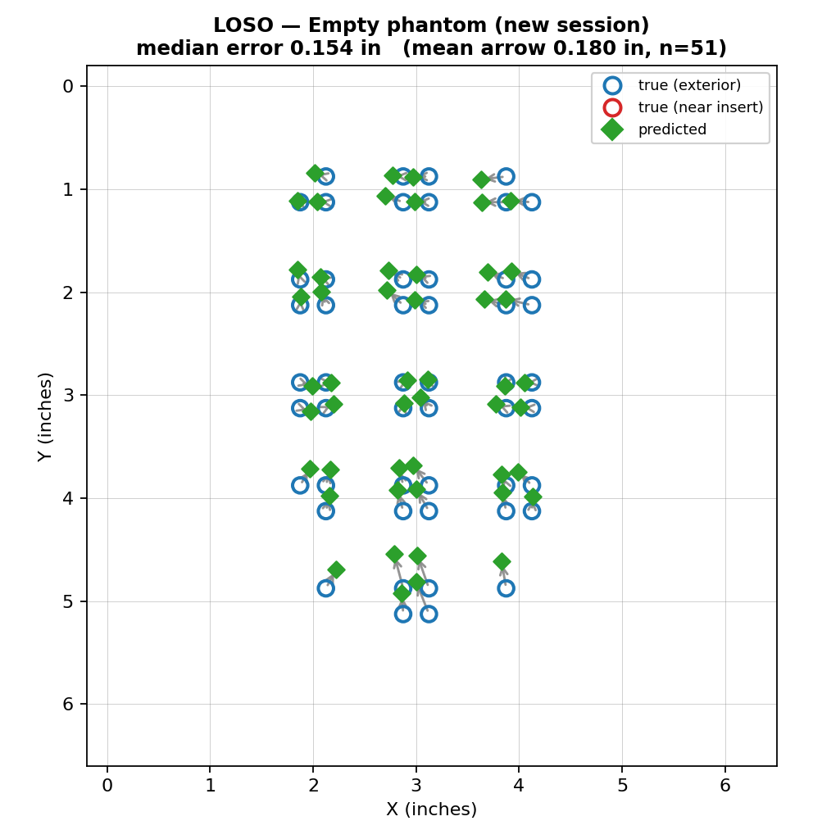
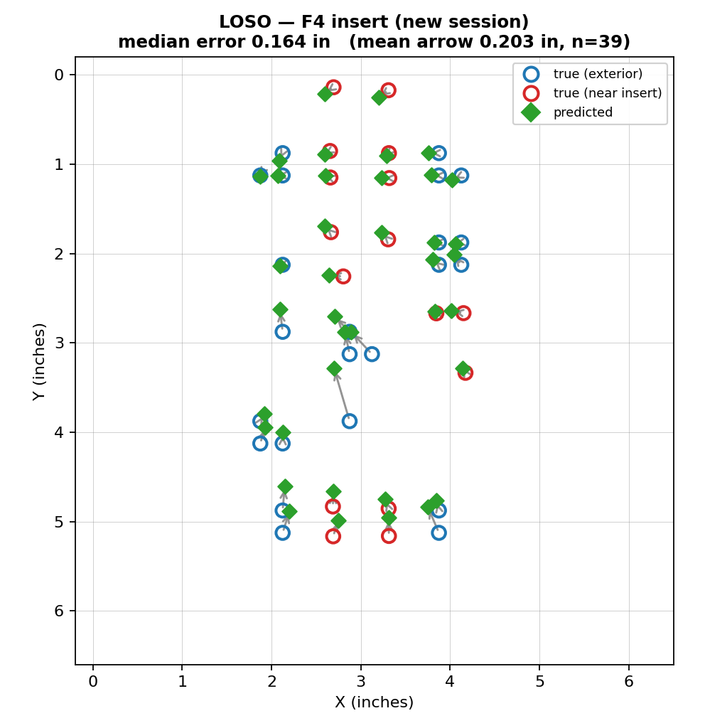
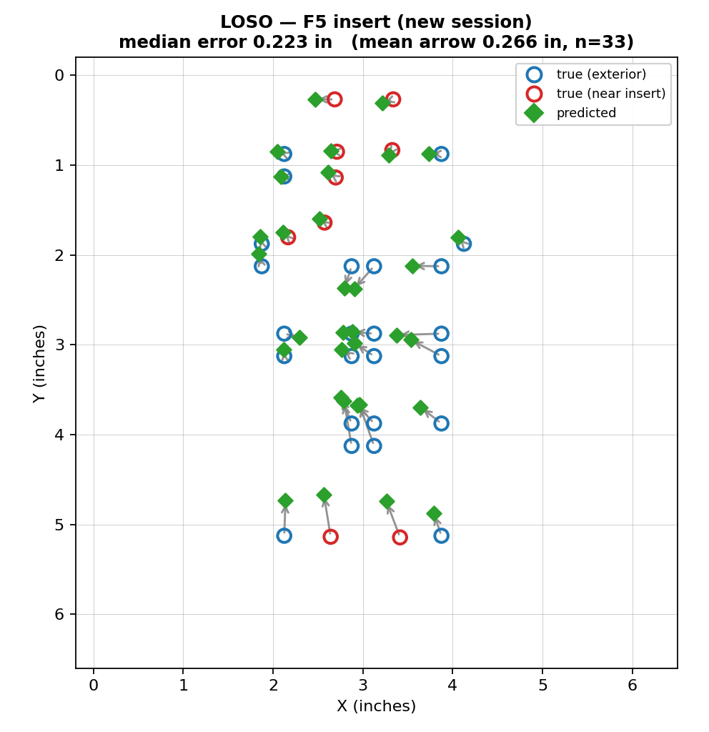
Predicted vs. actual — LOSO (all phantoms)
Green diamonds = CNN prediction · circles = true position · arrow = the error
Empty median 0.15 in
F4 insert median 0.16 in
F5 insert median 0.22 in
Across empty, small (F4) and large (F5) inserts the CNN lands within a fifth of a cell — a new measurement session is not a problem.

Slide 5
Interpolating to an unseen location (LOPO)
Hold a whole grid cell out of training — the model must predict a spot it has never seen a signature for
Three findings
Interpolation is 3–4× harder than session transfer (0.45–0.75 in vs 0.16–0.22 in).
Pooled beats in-session on all three setups — for interpolation, more data > removing drift.
The glandular barrier surfaces: near-insert cells are now WORSE than exterior (F4 pooled 0.75 vs 0.41 in) — the reverse of LOSO.

Slide 6
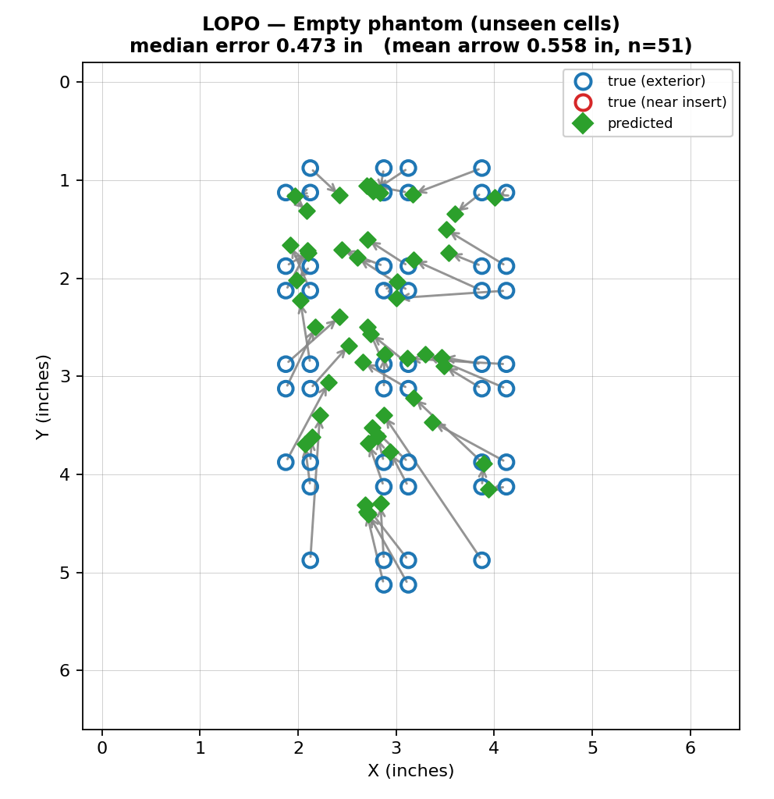
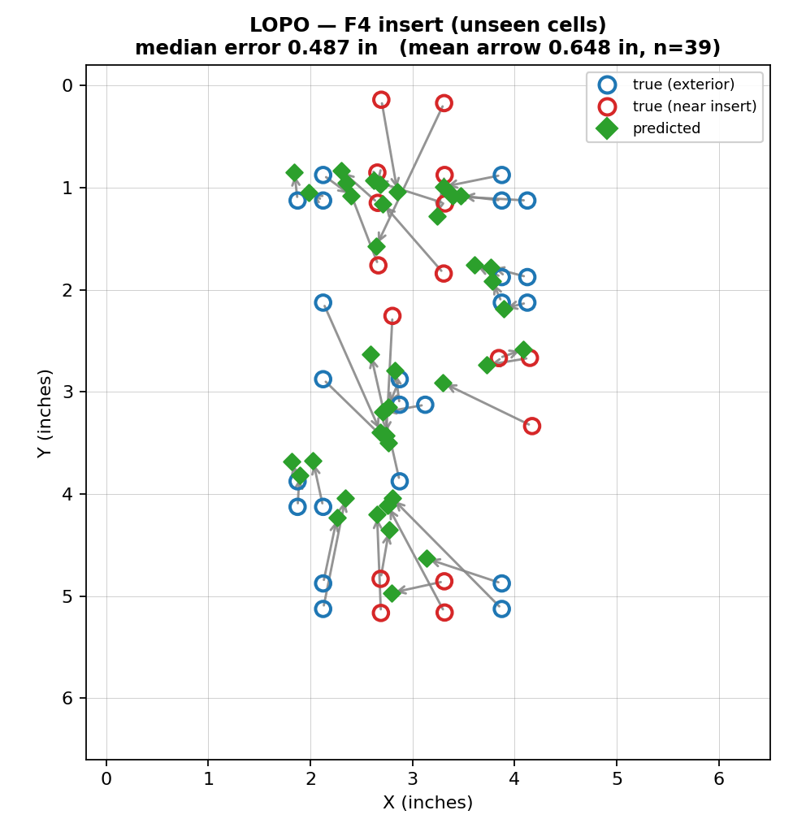
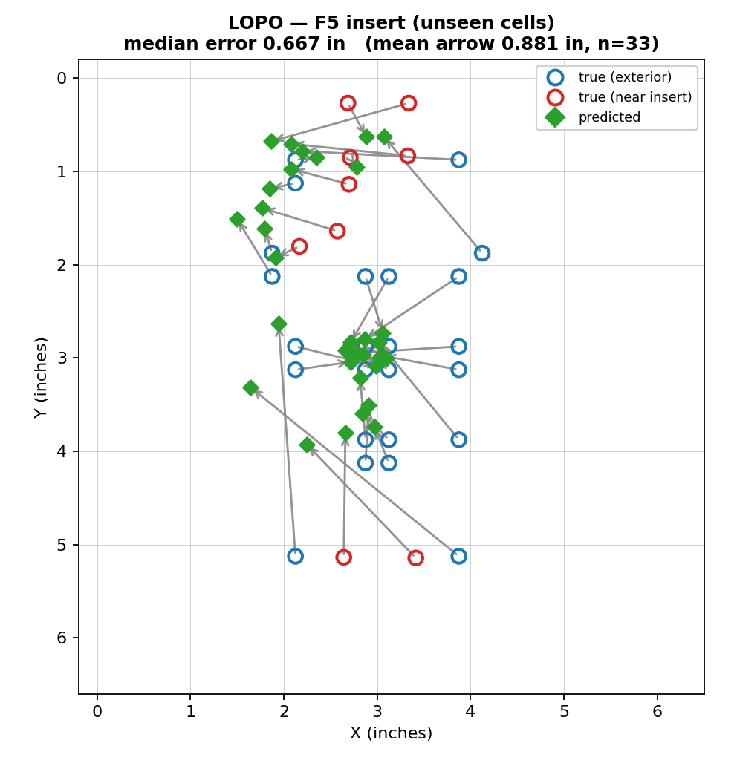
Predicted vs. actual — LOPO (all phantoms, unseen cells)
Now predicting locations never sampled — arrows grow and pull inward; red-ringed points sit over the glandular insert
Empty median 0.47 in
F4 insert median 0.49 in
F5 insert median 0.67 in
Interpolation error climbs with insert size (0.47 → 0.49 → 0.67 in) and concentrates on the near-insert cells — the CNN can't bridge the dielectric barrier it never sampled.

Slide 7
Can we teach it to interpolate?
Three fixes tried on the hardest case (F5 pooled/cell, baseline 0.664 in) — only one helps
Verdict
Mixup — WIN
blend sample pairs + their (x,y): 0.664 → 0.572, and it helps the barrier region most.
Position-disjoint validation — no
starves the ~30 scarce training positions.
Heatmap output — no
centroid readout biases predictions toward centre.

Slide 8
Bottom line
1
The CNN localizes to a sixth of a cell — ≈0.16 in cross-session on the empty phantom, <¼ in with a glandular insert — regression works, and the CNN owns it.
2
Raw beats physics for regression — physics features are redundant for the CNN and outright break the MLP — the reverse of the classification result.
3
Interpolation is a different, harder problem — predicting an unseen location is 3–4× harder than a new scan of a known grid; the data supports the latter far better.
4
The glandular barrier is real & measurable — LOPO error concentrates on near-insert cells (≈1.8× exterior) — the model can't interpolate across the dielectric jump.
5
Mixup is the one lever that helps — teaching a smooth signal→coordinate map cuts error 14% and helps the barrier most; validation-splitting and heatmap output hurt.
github.com/pmart1534/microwave-phantom-localization-cnn-mlp

