Slide 1
TUMOR LOCALIZATION IN BREAST PHANTOMS
CNN vs MLP
A matched, head-to-head comparison of two machine-learning approaches
for microwave tumor localization
Peter Martin · University of Utah · Electrical & Computer Engineering
Preprocessing pipeline v1 (includes session-mean subtraction)

Slide 2
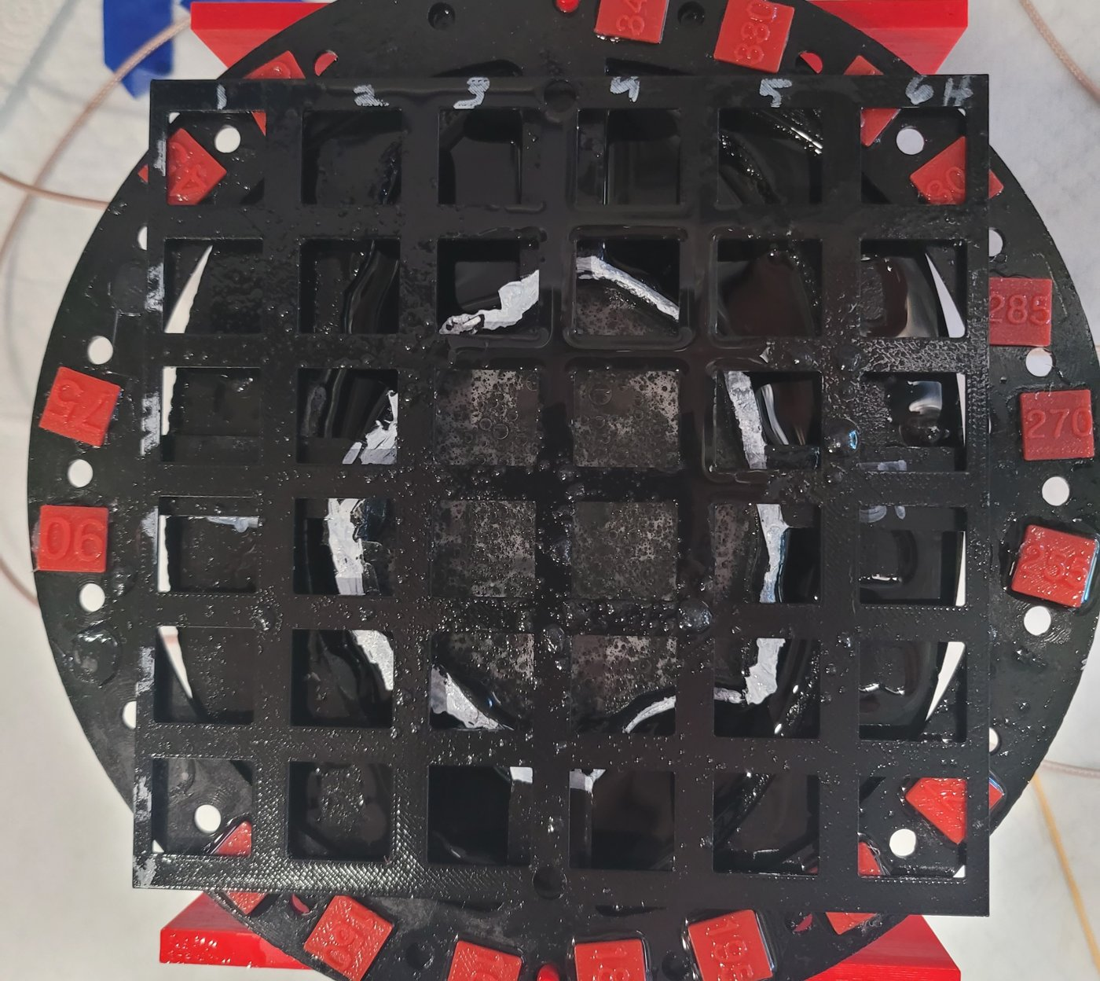
THE PROBLEM
Find a hidden tumor inside a breast phantom
Goal: locate a small tumor surrogate (metal fishing weight) placed inside a realistic breast phantom, without opening it up.
Microwave imaging: low-cost, non-ionizing alternative screening modality.
The tumor perturbs how microwaves reflect and transmit through the tissue, but the change is tiny and buried in drift and noise.
Worst case: a glandular insert (dense tissue) further masks the tumor signal.
Task: given one measurement, which of ~33–51 grid positions holds the tumor?
A3 breast phantom with F5 glandular insert and measurement grid

Slide 3
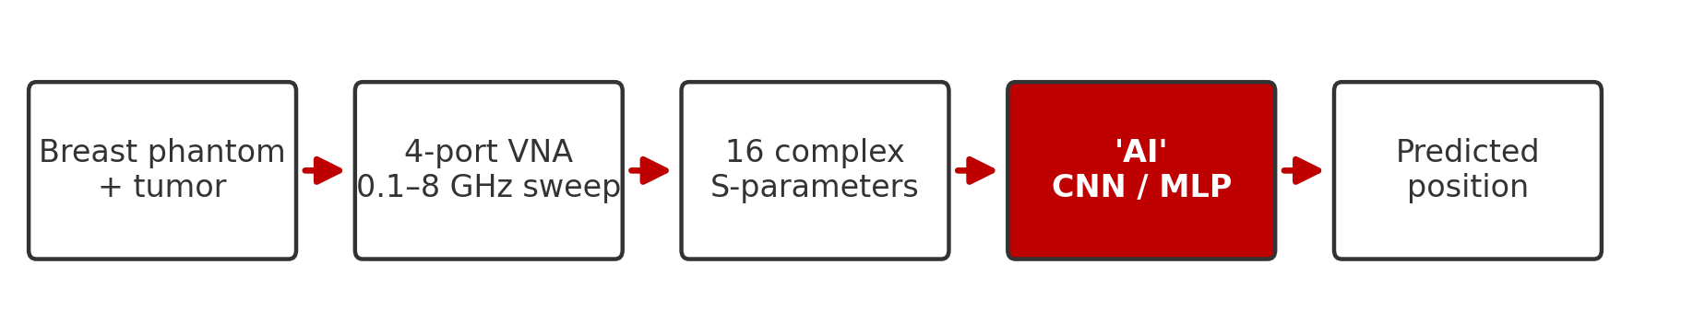
THE SOLUTION
Let a machine learn the fingerprint of every position
Classic inverse-scattering reconstruction is slow and fragile. Instead, we treat localization as a pattern-recognition problem: measure the phantom with the tumor at every known position, then train a model to recognise each position's electromagnetic fingerprint.
16
791
~2–3%
S-parameters per sweep
frequency points, 0.1–8 GHz
chance-level accuracy

Slide 4
PART 1
Methods
The measurement, the two models, and how they differ

Slide 5
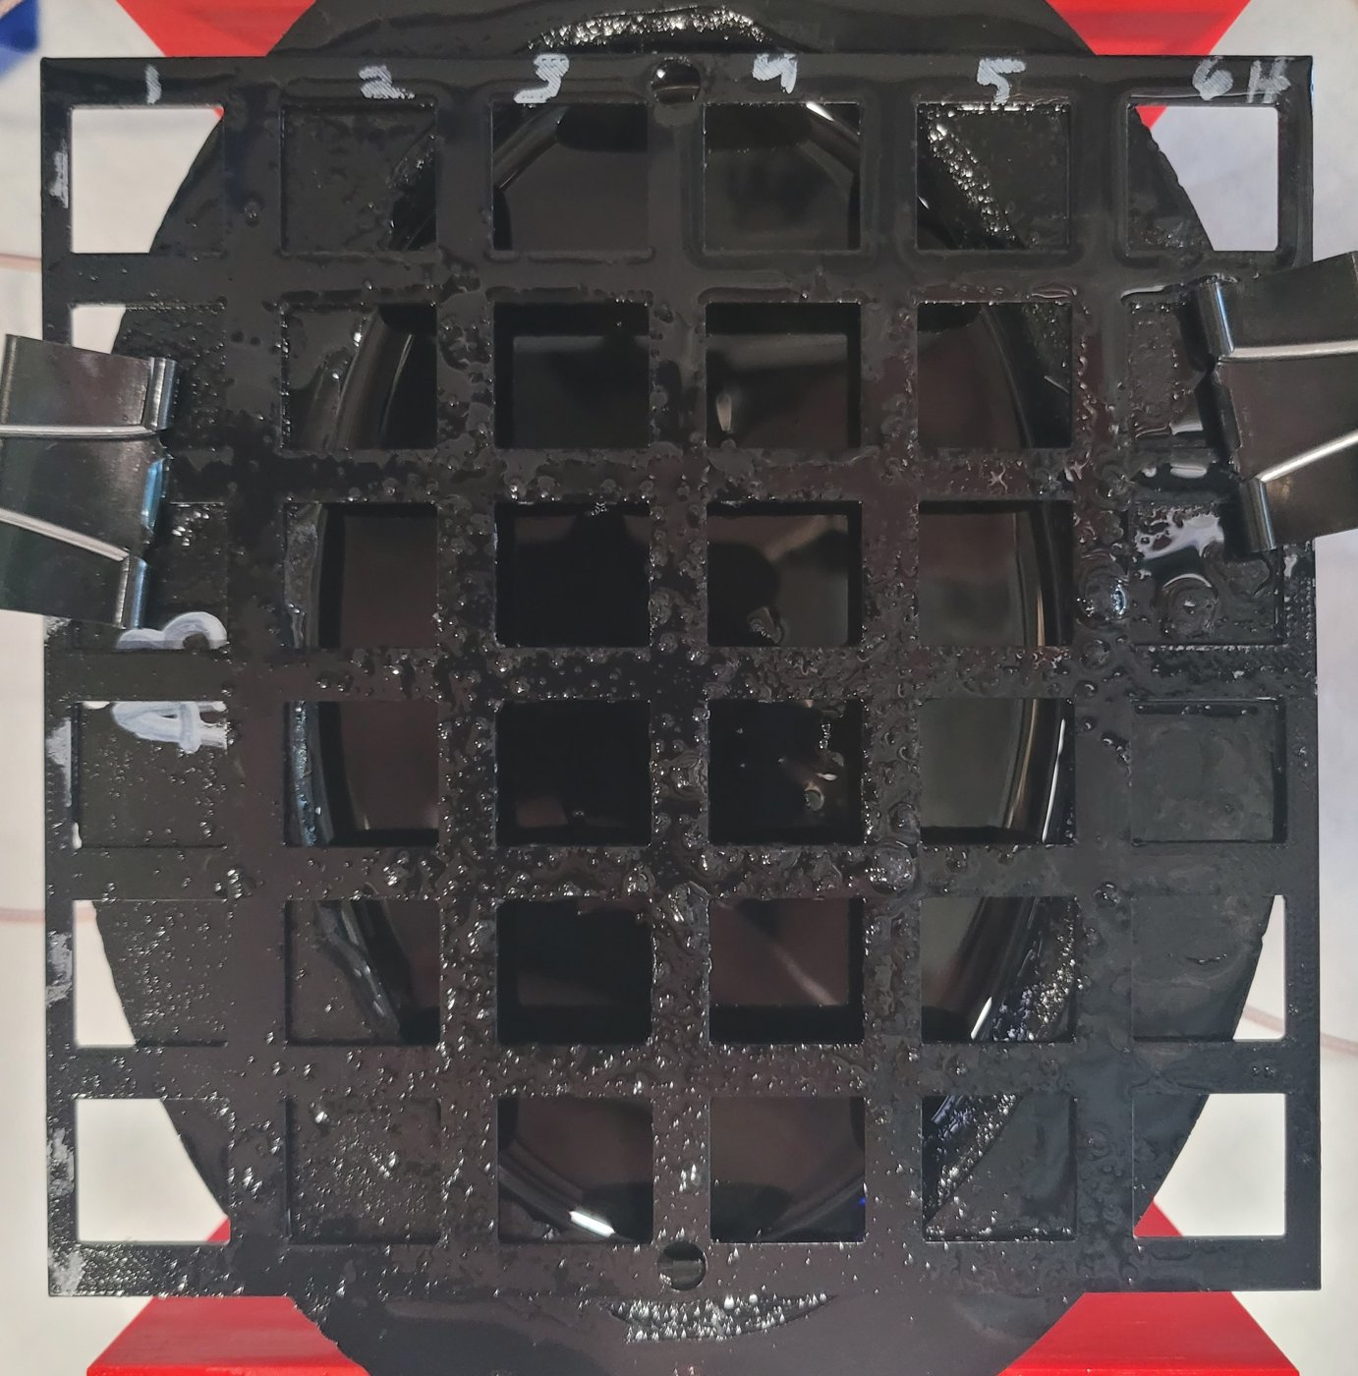
METHODS
The physical measurement
4-port Hunter VNA sweeps 0.1–8 GHz (791 points) through 4 antennas around the phantom.
Each sweep captures all 16 S-parameters: 4 reflections (S11…S44) plus transmissions between every antenna pair.
Tumor surrogate is moved through a grid of cell corner positions; 16 repeat trials per position.
Baseline (empty-phantom) sweeps recorded each session for calibration.
Each setup measured in 3–4 independent sessions on different setups/times; this matters later (LOSO).
Empty A3 phantom: adipose bowl, 6×6 in grid, 4 antennas at the rim

Slide 6
METHODS
Two ways to turn a measurement into a position
Both models receive the SAME preprocessed measurement and output a probability for every grid position. They differ in how they look at the data.
CNN
MLP
Convolutional Neural Network · MATLAB
Multi-Layer Perceptron · Python
Sees the measurement as a 2-D image: y axis = channels, x axis = frequency
Convolution filters slide along frequency, learning local patterns
Sees the measurement as one long flattened vector of numbers
Every input connects to every neuron: the network has no built-in idea that neighboring frequencies are related, so any such structure must be learned from scratch

Slide 7
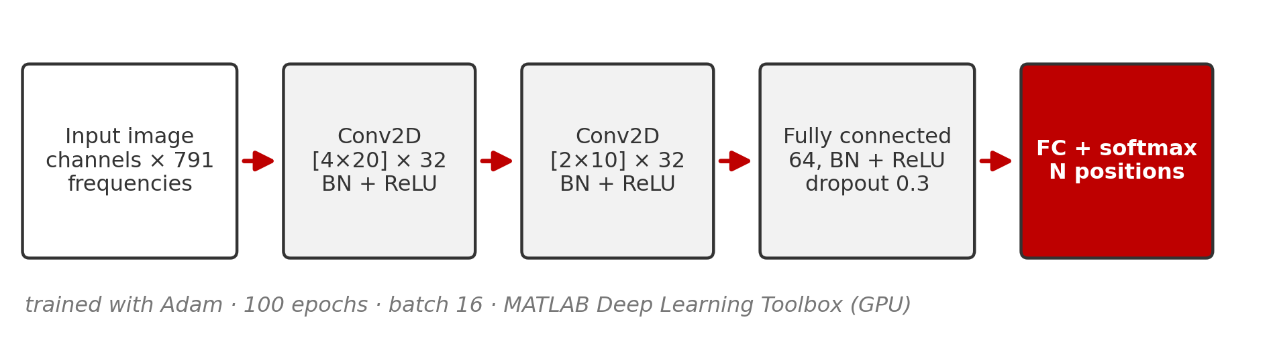
METHODS
The CNN
Input is an image: one row per data channel (e.g. |S11|, ∠S11, …), one column per frequency point (791).
Two convolution layers (32 filters each) detect local patterns such as resonance shifts and ripples anywhere along the spectrum, sharing weights across frequency.
Batch-normalisation + ReLU after every layer; 30% dropout fights overfitting.
One network, trained 100 epochs with Adam (batch 16) on the GPU; softmax outputs one probability per grid position.
Cost: 5-45 min per LOSO fold on a laptop GPU (input-size dependent); the slowest configs take hours per evaluation.

Slide 8
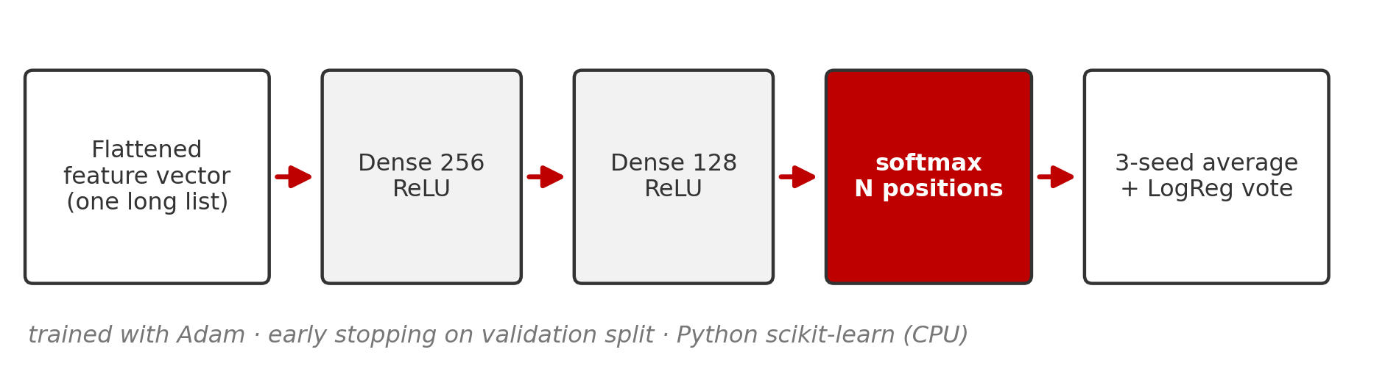
METHODS
The MLP
Input is a flat vector: all channels and frequencies concatenated (thousands of features). No spatial structure is assumed.
Two dense layers (256 → 128, ReLU): every feature can interact with every other, but nothing is shared or localized.
Early stopping on a held-out validation split prevents overtraining.
Ensemble: 3 networks with different random seeds are averaged, plus a logistic-regression model; the ensemble vote is the prediction.
Cost: seconds to a few minutes per LOSO fold on a plain CPU; the full study sweep trains ~10x faster than the CNN's.

Slide 9
METHODS
CNN vs MLP: structural differences
 | CNN | MLP
How it sees data | 2-D image (channels × frequency) | 1-D flattened vector
Inductive bias | Local patterns, shared across frequency | None; fully general
Parameters | Small conv filters + FC (~0.5–2 M) | Huge first layer (features × 256)
Training | Fixed 100 epochs, single network | Early stopping, 3-seed ensemble + LogReg
Framework | MATLAB Deep Learning Toolbox (GPU) | Python scikit-learn (CPU)
Training time | 5-45 min per LOSO fold (GPU); ~20 h for the full sweep | 10 s-7 min per fold (CPU); ~3-4 h for the same sweep
Same job, opposite philosophies: the CNN assumes frequency-local structure; the MLP assumes nothing. The CNN buys its accuracy with compute: roughly 10x the training time, even with a GPU. Inference is milliseconds for both.

Slide 10
PART 2
The data pipeline
What happens to a measurement before any 'AI' ever sees it. Identical for both models.

Slide 11
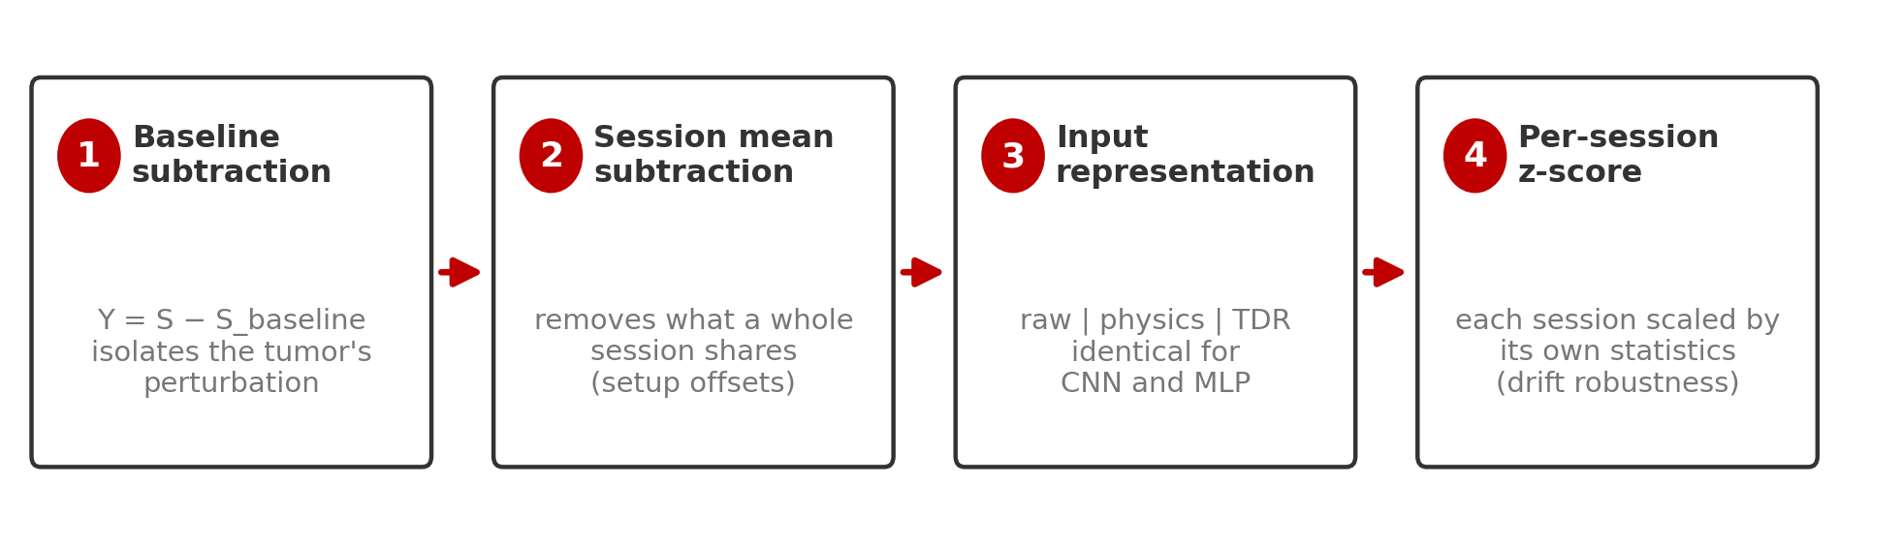
DATA PIPELINE
Four steps from raw sweep to model input
Steps 1–2 remove everything that is not the tumor; step 4 (per-session z-score) is the key drift defense: each session is standardized by its own statistics. Applied identically to CNN and MLP.
Upgrading the CNN to this pipeline was worth +17 pts on F5 single-antenna (59→76%) with fold-to-fold σ cut from 40% to 9%, and +15 pts on F4 single-antenna (82→97%). Its catastrophic cross-session failures disappeared entirely.

Slide 12
DATA PIPELINE
Three input representations
RAW
PHYSICS
TDR-ONLY
Magnitude + phase of each calibrated S-parameter.
The measurement as the VNA reports it. Used for the main results.
Adds real & imaginary parts and the IFFT time-domain (TDR) envelope.
Derived at no cost from the same data; covered at the end.
Just the time-domain envelope, a pulse-echo view.
An ablation: how much lives in time domain alone?
Same numbers, two shapes:
CNN: channels stacked as image rows × 791 frequency columns
MLP: the same rows laid end-to-end as one long vector
Antenna subsets work the same way: '2 antennas' keeps only S-parameters among ports 1 & 3; '1 antenna' keeps only S11.

Slide 13
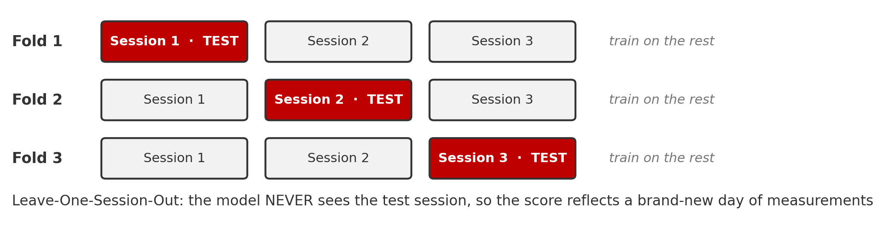
DATA PIPELINE
How we score: Leave-One-Session-Out
A random 75/25 split mixes trials from the same session into train AND test, so the model can cheat off session drift, inflating accuracy.
LOSO trains on N−1 sessions and tests on the session it has never seen; every session takes a turn. We report per-position majority vote over its 16 trials.
We have thoroughly stress-tested LOSO and verified that it works: under LOSO, models cannot exploit session drift, and drift-only information scores near chance.

Slide 14
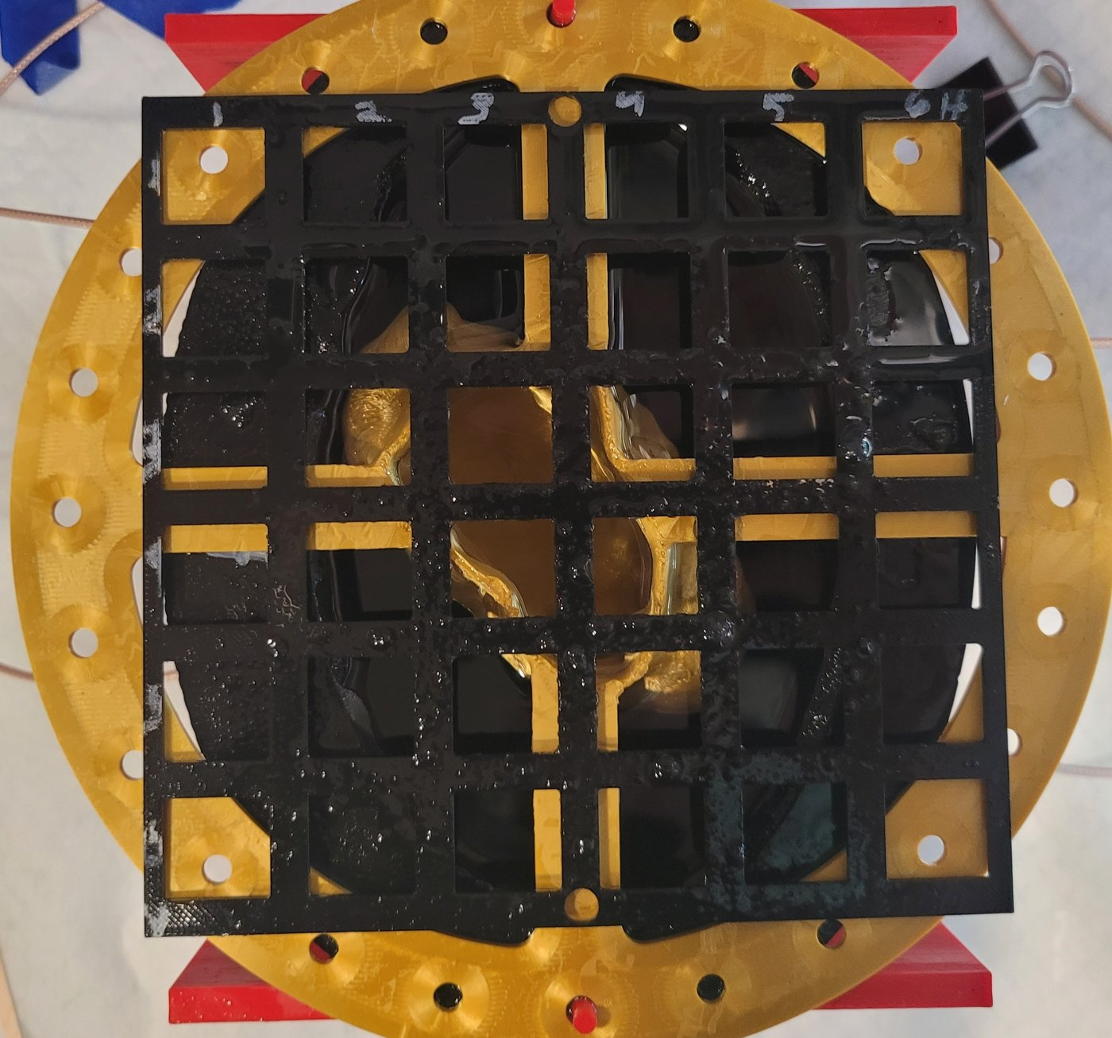
DATA PIPELINE
Three phantom setups, increasing difficulty
A3 Empty
A3 + F4
A3 + F5
adipose only
51 positions · 3 sessions
small glandular insert
39 positions · 4 sessions
large glandular insert
33 positions · 3 sessions (latest)

Slide 15
PART 3
Results
Per-position vote accuracy (%) under LOSO · identical raw inputs (mag + phase) · chance = 2–3%

Slide 16
RESULTS · RAW INPUTS
All 4 antennas: full S-parameters (16)
Phantom setup | Positions | CNN (%) | MLP (%) | CNN − MLP
A3 Empty | 51-way | 99.3 ± 1.1 | 99.3 ± 0.9 | +0.0
A3 + F4 | 39-way | 97.4 ± 3.0 | 97.4 ± 1.8 | +0.0
A3 + F5 | 33-way | 100.0 ± 0.0 | 96.0 ± 2.9 | +4.0
Mean ± std over LOSO folds. Bold = better method.
With the full antenna array, both methods are near-perfect on every phantom; drift and glandular masking are fully compensated. CNN edges ahead on the hardest setup (F5).

Slide 17
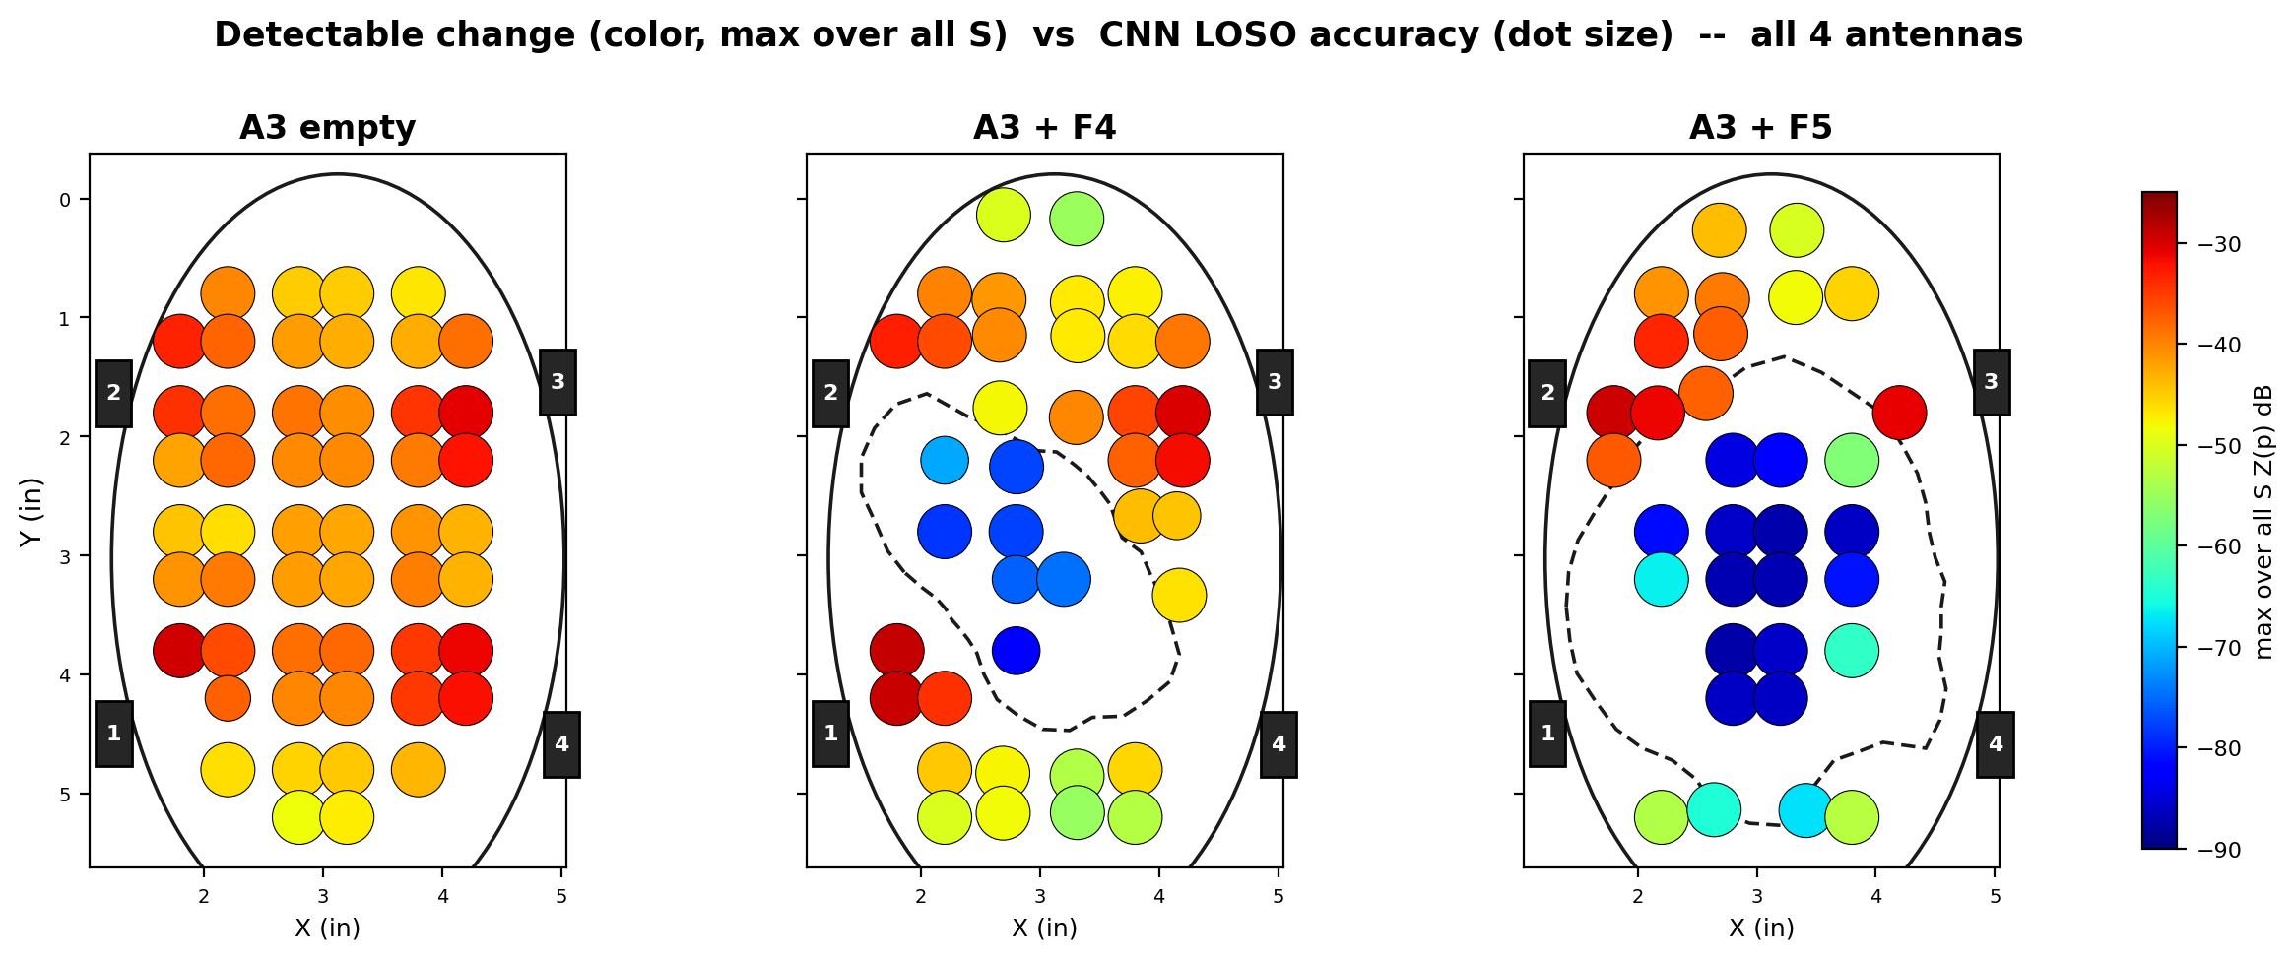
RESULTS · SPATIAL VIEW
Error Locations: all 4 antennas
Dot color = how strongly the tumor physically changes the signal (detectable difference). Dot size = CNN LOSO accuracy at that position. Dashed outline = glandular insert.
Detectable change still dips inside the glandular insert (blue), but with 16 complementary views the classifier compensates: accuracy dots stay large almost everywhere. MLP versions look qualitatively identical.

Slide 18
RESULTS · RAW INPUTS
All 4 antennas: reflection only (S11, S22, S33, S44)
Phantom setup | Positions | CNN (%) | MLP (%) | CNN − MLP
A3 Empty | 51-way | 100.0 ± 0.0 | 99.3 ± 0.9 | +0.7
A3 + F4 | 39-way | 98.7 ± 1.5 | 93.6 ± 4.3 | +5.1
A3 + F5 | 33-way | 100.0 ± 0.0 | 88.9 ± 2.9 | +11.1
No through-phantom transmission paths; each antenna only listens to its own echo.
Dropping transmission barely touches the CNN (F5 stays at 100%), while the MLP gives up 4-7 points on the glandular phantoms. Four reflection coefficients are enough for a CNN.

Slide 19
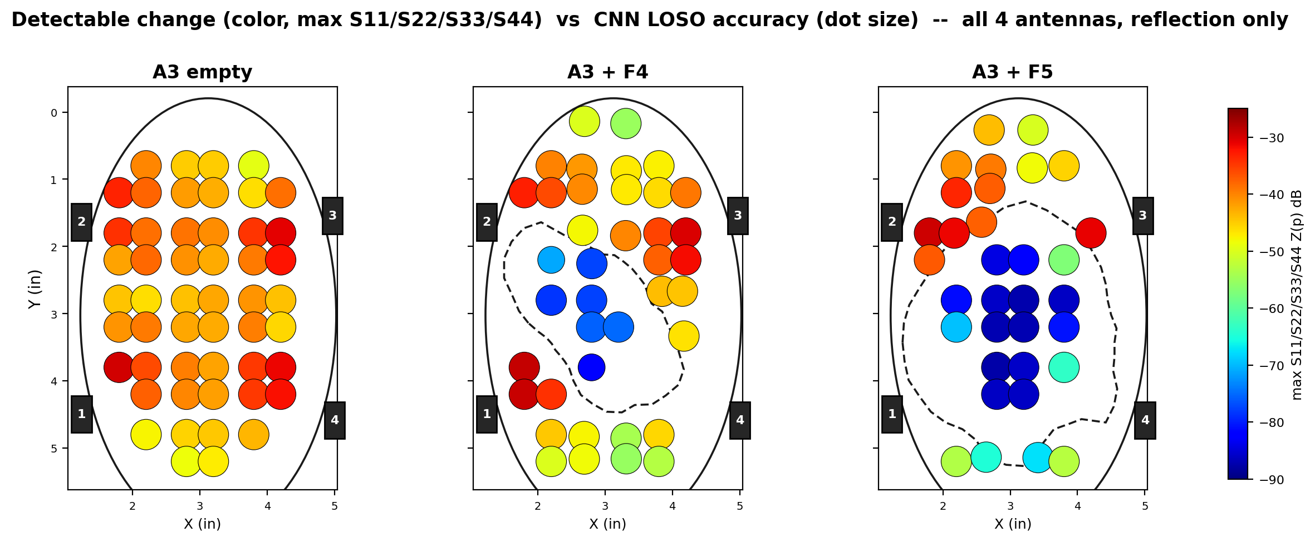
RESULTS · SPATIAL VIEW
Error Locations: all 4 antennas, reflection only
Reflection-only detectable change (max of S11, S22, S33, S44). The insert still carves a low-signal pocket, but CNN accuracy dots stay large.

Slide 20
RESULTS · RAW INPUTS
2 antennas (ports 1 & 3): full S-parameters
Phantom setup | Positions | CNN (%) | MLP (%) | CNN − MLP
A3 Empty | 51-way | 99.3 ± 1.1 | 99.3 ± 0.9 | +0.0
A3 + F4 | 39-way | 95.5 ± 1.3 | 93.6 ± 4.3 | +1.9
A3 + F5 | 33-way | 96.0 ± 7.0 | 81.8 ± 4.3 | +14.2
Antennas 1 & 3 sit on opposite sides of the phantom (most informative pair).
Halving the antennas separates the methods: the CNN stays high (96%+ everywhere) while the MLP drops 14 points on F5. Convolutional structure extracts more from less hardware.

Slide 21
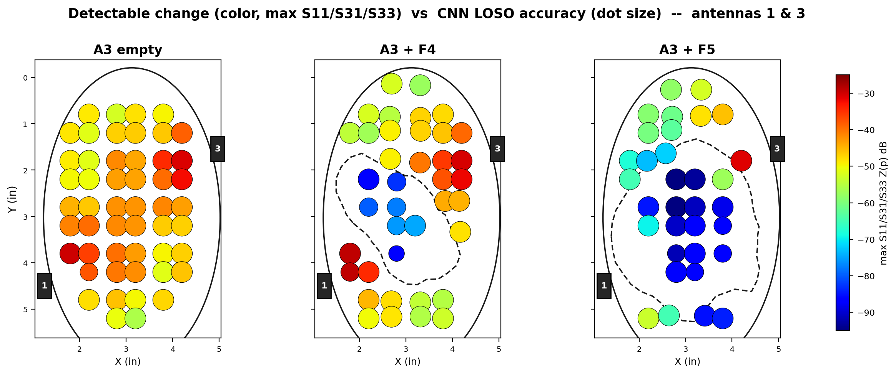
RESULTS · SPATIAL VIEW
Error Locations: 2 antennas (1 & 3)
With two antennas a low-signal pocket appears inside the glandular insert, and accuracy dots shrink with it.

Slide 22
RESULTS · RAW INPUTS
2 antennas (1 & 3): reflection only (S11, S33)
Phantom setup | Positions | CNN (%) | MLP (%) | CNN − MLP
A3 Empty | 51-way | 99.3 ± 1.1 | 99.3 ± 0.9 | +0.0
A3 + F4 | 39-way | 92.3 ± 5.9 | 93.6 ± 5.9 | −1.3
A3 + F5 | 33-way | 90.9 ± 5.3 | 74.8 ± 6.2 | +16.1
The toughest 2-antenna condition: two reflection coefficients and nothing else.
The CNN holds 91-99% while the MLP falls to 75% on F5. F4 is the single config in the study where the MLP edges the CNN (93.6 vs 92.3).

Slide 23
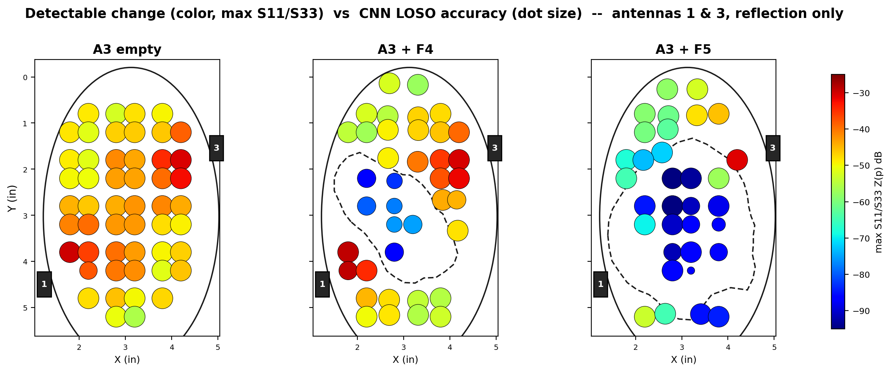
RESULTS · SPATIAL VIEW
Error Locations: 2 antennas (1 & 3), reflection only
With only S11 and S33, the low-signal pocket deepens and CNN errors start to appear inside the insert.

Slide 24
RESULTS · RAW INPUTS
1 antenna: S11 only
Phantom setup | Positions | CNN (%) | MLP (%) | CNN − MLP
A3 Empty | 51-way | 98.0 ± 2.0 | 99.3 ± 0.9 | −1.3
A3 + F4 | 39-way | 96.8 ± 4.9 | 91.0 ± 5.6 | +5.8
A3 + F5 | 33-way | 75.8 ± 9.1 | 58.6 ± 9.4 | +17.2
A single reflection coefficient: the minimal possible hardware.
The extreme case: one antenna, one S-parameter. The CNN holds 76–98%; the MLP falls to 59% on F5. The gap grows exactly as the task gets harder, and the F5 errors cluster inside the glandular insert (next slide).

Slide 25
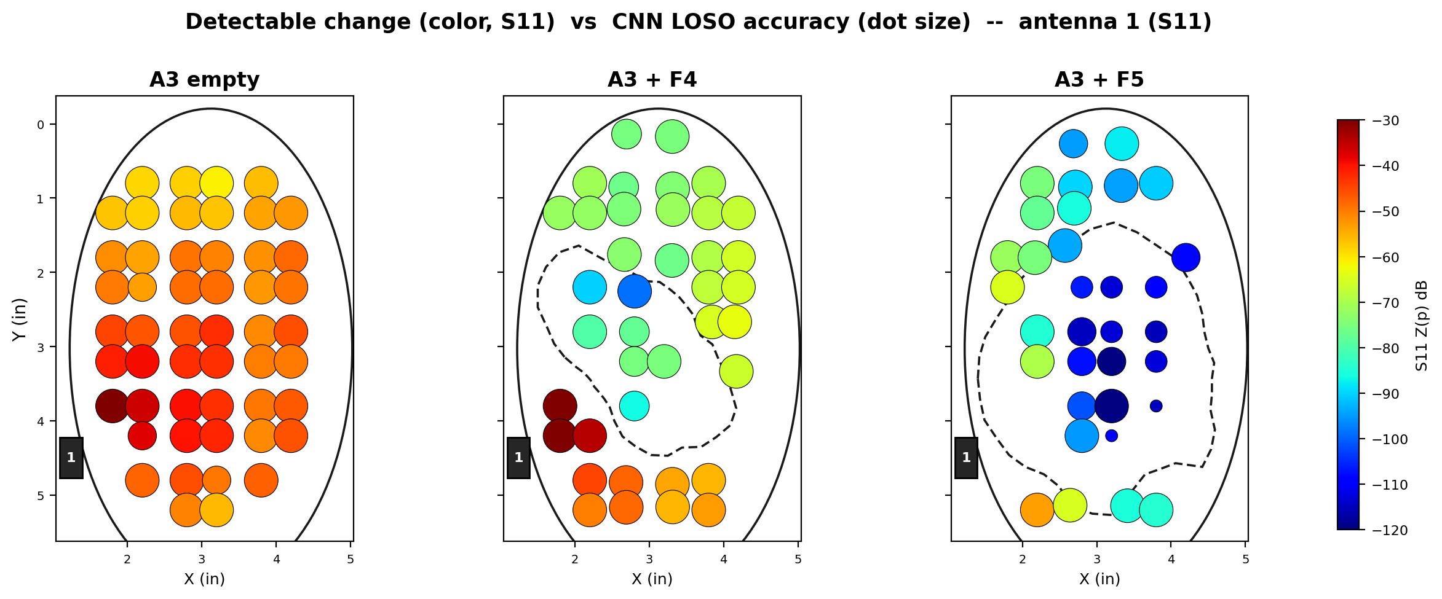
RESULTS · SPATIAL VIEW
Error Locations: 1 antenna (S11)
Single antenna (S11): small blue dots cluster inside the insert. Where physics buries the tumor, the classifier fails.

Slide 26
PART 4
Physics-informed features
Squeezing more out of the same measurement: no new hardware, no new data collection

Slide 27
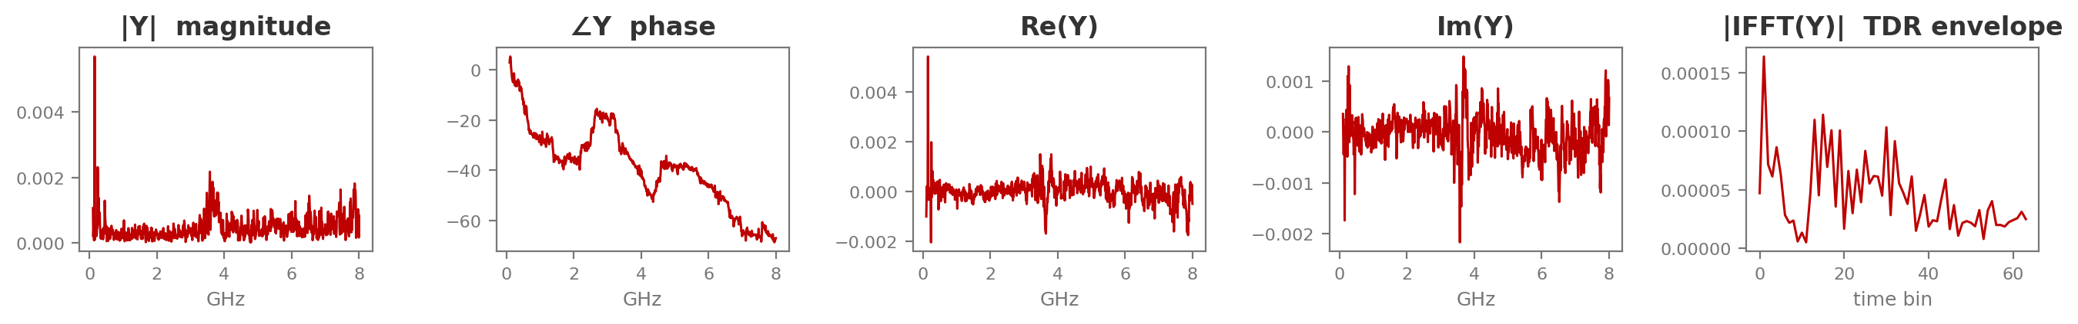
PHYSICS-INFORMED FEATURES
One complex measurement, five physical views
Each calibrated S-parameter Y(f) is one complex spectrum. From it we derive, at zero measurement cost: magnitude & phase (resonance behaviour), real & imaginary parts (full complex information), and the inverse-FFT envelope, a time-domain reflectometry (TDR) view where the tumor appears as an echo at its round-trip delay.
Real example: A3+F5 phantom, S11, tumor at grid position R3C4 (calibrated response Y)
The 'physics' input feeds all five views to both models: the CNN as extra image rows, the MLP as extra vector features. Identical information, matched again.

Slide 28
PHYSICS-INFORMED RESULTS
Same tests, physics inputs
All-4-antenna physics: both models at ceiling, 97–100% (F5 reaches 100 / 100). Below: the configs where it matters. Reflection-only: next slide.
2 antennas (1 & 3), physics input
Phantom setup | Positions | CNN (%) | MLP (%) | CNN − MLP
A3 Empty | 51-way | 99.3 ± 1.1 | 99.3 ± 0.9 | +0.0
A3 + F4 | 39-way | 98.1 ± 1.3 | 92.3 ± 3.1 | +5.8
A3 + F5 | 33-way | 98.0 ± 3.5 | 85.9 ± 7.6 | +12.1
1 antenna (S11), physics input
Phantom setup | Positions | CNN (%) | MLP (%) | CNN − MLP
A3 Empty | 51-way | 98.7 ± 1.1 | 98.7 ± 1.8 | +0.0
A3 + F4 | 39-way | 95.5 ± 4.4 | 91.7 ± 5.8 | +3.8
A3 + F5 | 33-way | 79.8 ± 3.5 | 62.6 ± 8.0 | +17.2

Slide 29
PHYSICS-INFORMED RESULTS
Reflection only + physics features
All 4 antennas, reflection only (S11, S22, S33, S44), physics input
Phantom setup | Positions | CNN (%) | MLP (%) | CNN − MLP
A3 Empty | 51-way | 100.0 ± 0.0 | 99.3 ± 0.9 | +0.7
A3 + F4 | 39-way | 98.1 ± 1.3 | 94.2 ± 3.3 | +3.9
A3 + F5 | 33-way | 100.0 ± 0.0 | 87.9 ± 6.6 | +12.1
2 antennas (1 & 3), reflection only (S11, S33), physics input
Phantom setup | Positions | CNN (%) | MLP (%) | CNN − MLP
A3 Empty | 51-way | 100.0 ± 0.0 | 98.7 ± 1.9 | +1.3
A3 + F4 | 39-way | 94.2 ± 3.2 | 90.4 ± 3.3 | +3.8
A3 + F5 | 33-way | 97.0 ± 5.3 | 79.8 ± 7.6 | +17.2
With physics features, reflection-only costs the CNN almost nothing (F5: 100% with four antennas, 97% with two); the MLP pays 8-12 points. A reflection-only system is practical with a CNN.

Slide 30
PHYSICS-INFORMED RESULTS
What the derived features buy, and what TDR alone can't
Physics vs raw (percentage points gained)
Additional finding: hierarchical (quadrant → position) classification
F5, 2 antennas: CNN +2.0 (96→98) · MLP +4.1 (82→86)
F5, 1 antenna: CNN +4.0 (76→80) · MLP +4.0 (59→63)
F5, all 4: MLP +4.0 (96→100), joining CNN at 100%
Easy setups (empty, F4 full-array): no change, already at ceiling.
Physics features help most exactly where raw inputs struggle.
Two-stage 'find the corner first' scheme tested on both models.
It never helps, and hurts the hardest cases: CNN −6 on F5, MLP −6 on F4-single.
Wrong quadrant = unrecoverable. Single-stage wins under LOSO.
TDR-only ablation (selected)
F4, 1 antenna: CNN 84 / MLP 64 (vs 97 / 91 raw): a big loss for both.
But the CNN mines far more from TDR alone (F5 all-4: 98 vs MLP's 76).

Slide 31
CONCLUSIONS
What we learned
CNN ≥ MLP, everywhere
The gap grows with difficulty
On matched inputs the CNN ties easy cases and wins hard ones by up to 17 points, at ~10x the training cost.
Fewer antennas + bigger glandular insert = bigger CNN advantage.
Preprocessing drives robustness
Physics features add accuracy at no cost
Per-session z-score eliminated the CNN's catastrophic cross-session failures.
Derived views (+TDR) add up to 4 points on the hardest configurations.
Errors follow the physics
Fewer antennas is viable with a CNN
Misses cluster inside the glandular insert, where detectable signal change collapses.
2 antennas: 96–98% on every phantom. Even 1 antenna: 76–98%.

