Slide 1
TUMOR LOCALIZATION IN BREAST PHANTOMS
CNN vs MLP
A matched, head-to-head comparison of two machine-learning approaches
for microwave tumor localization
Peter Martin · University of Utah · Electrical & Computer Engineering
Preprocessing pipeline v2 (session-mean subtraction removed)

Slide 2
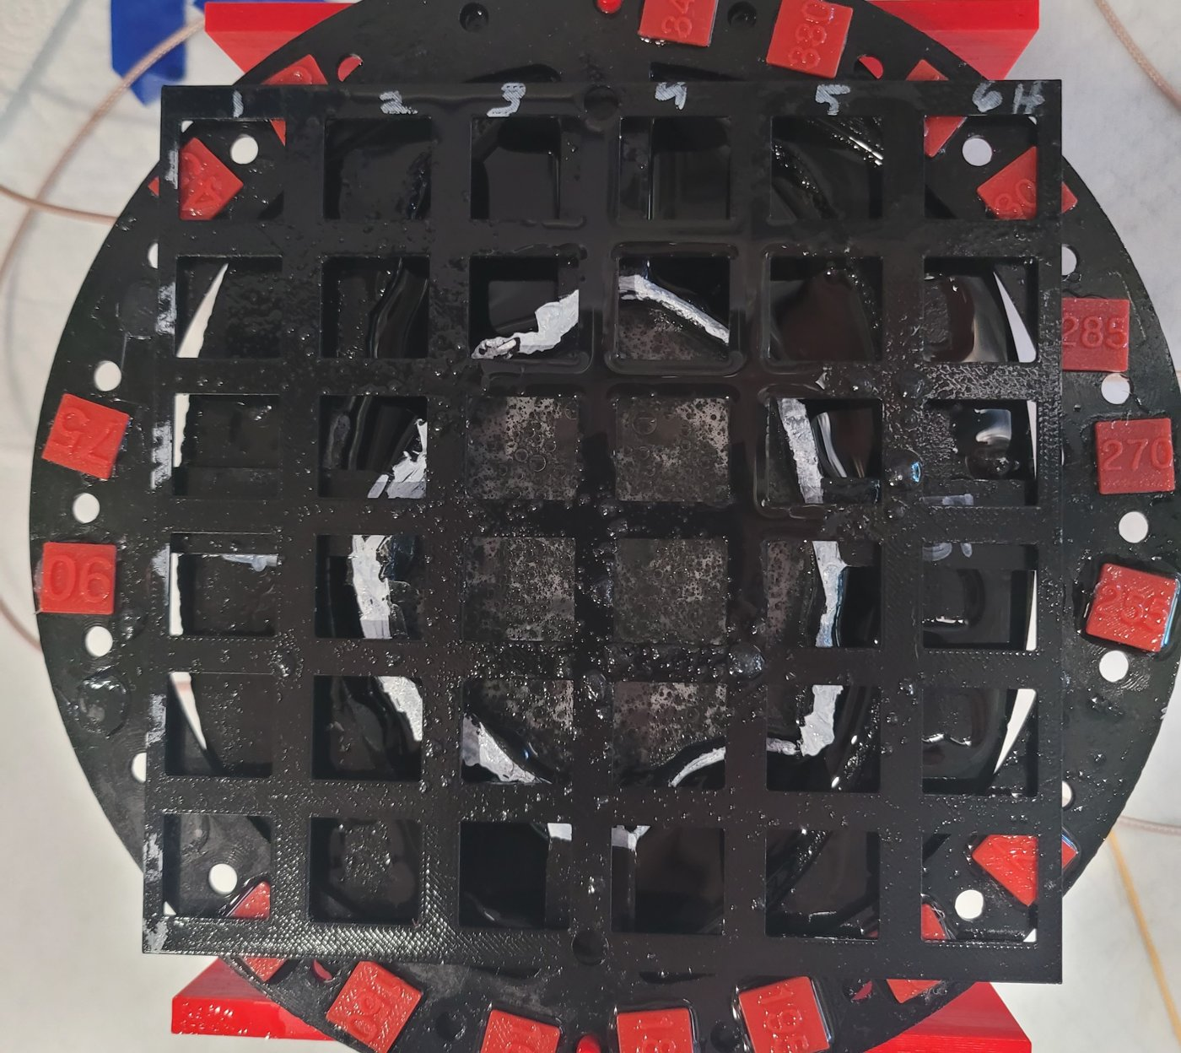
THE PROBLEM
Find a hidden tumor inside a breast phantom
Goal: locate a small tumor surrogate (metal fishing weight) placed inside a realistic breast phantom, without opening it up.
Microwave imaging: low-cost, non-ionizing alternative screening modality.
The tumor perturbs how microwaves reflect and transmit through the tissue, but the change is tiny and buried in drift and noise.
Worst case: a glandular insert (dense tissue) further masks the tumor signal.
Task: given one measurement, which of ~33–51 grid positions holds the tumor?
A3 breast phantom with F5 glandular insert and measurement grid

Slide 3
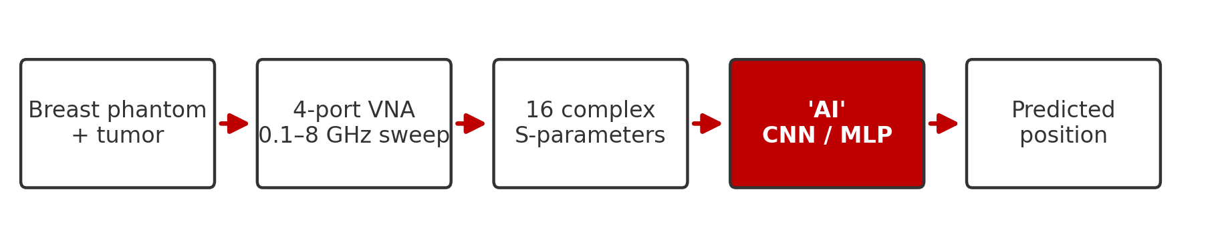
THE SOLUTION
Let a machine learn the fingerprint of every position
Classic inverse-scattering reconstruction is slow and fragile. Instead, we treat localization as a pattern-recognition problem: measure the phantom with the tumor at every known position, then train a model to recognise each position's electromagnetic fingerprint.
16
791
~2–3%
S-parameters per sweep
frequency points, 0.1–8 GHz
chance-level accuracy

Slide 4
PART 1
Methods
The measurement, the two models, and how they differ

Slide 5
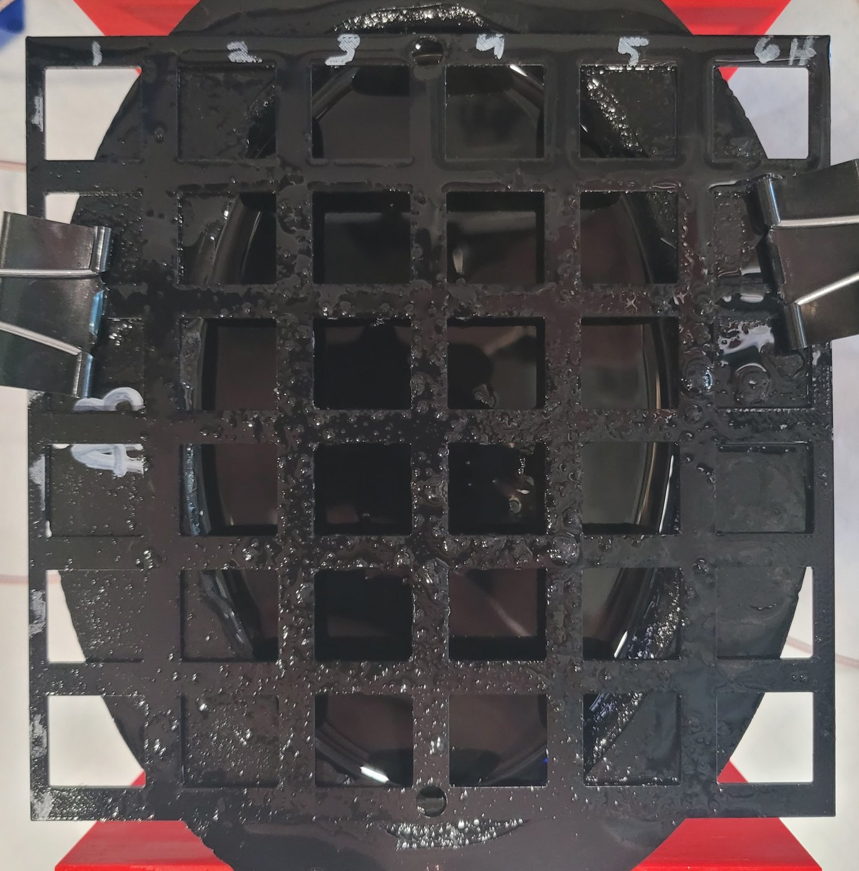
METHODS
The physical measurement
4-port Hunter VNA sweeps 0.1–8 GHz (791 points) through 4 antennas around the phantom.
Each sweep captures all 16 S-parameters: 4 reflections (S11…S44) plus transmissions between every antenna pair.
Tumor surrogate is moved through a grid of cell corner positions; 16 repeat trials per position.
Baseline (empty-phantom) sweeps recorded each session for calibration.
Each setup measured in 3–4 independent sessions on different setups/times; this matters later (LOSO).
Empty A3 phantom: adipose bowl, 6×6 in grid, 4 antennas at the rim

Slide 6
METHODS
Two ways to turn a measurement into a position
Both models receive the SAME preprocessed measurement and output a probability for every grid position. They differ in how they look at the data.
CNN
MLP
Convolutional Neural Network · MATLAB
Multi-Layer Perceptron · Python
Sees the measurement as a 2-D image: y axis = channels, x axis = frequency
Convolution filters slide along frequency, learning local patterns
Sees the measurement as one long flattened vector of numbers
Every input connects to every neuron: the network has no built-in idea that neighboring frequencies are related, so any such structure must be learned from scratch

Slide 7
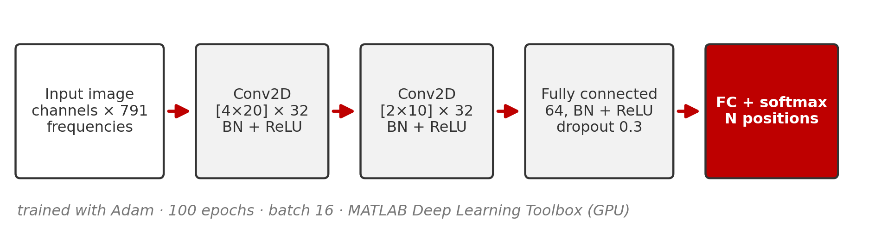
METHODS
The CNN
Input is an image: one row per data channel (e.g. |S11|, ∠S11, …), one column per frequency point (791).
Two convolution layers (32 filters each) detect local patterns such as resonance shifts and ripples anywhere along the spectrum, sharing weights across frequency.
Batch-normalisation + ReLU after every layer; 30% dropout fights overfitting.
One network, trained 100 epochs with Adam (batch 16) on the GPU; softmax outputs one probability per grid position.
Cost: 5-45 min per LOSO fold on a laptop GPU (input-size dependent); the slowest configs take hours per evaluation.

Slide 8
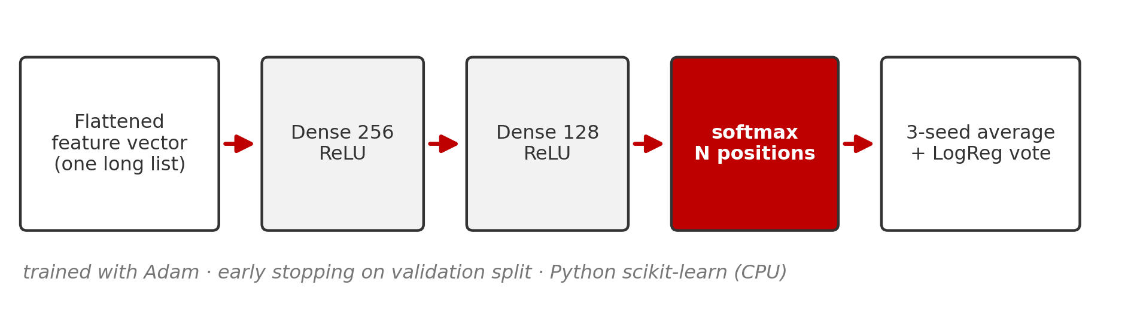
METHODS
The MLP
Input is a flat vector: all channels and frequencies concatenated (thousands of features). No spatial structure is assumed.
Two dense layers (256 → 128, ReLU): every feature can interact with every other, but nothing is shared or localized.
Early stopping on a held-out validation split prevents overtraining.
Ensemble: 3 networks with different random seeds are averaged, plus a logistic-regression model; the ensemble vote is the prediction.
Cost: seconds to a few minutes per LOSO fold on a plain CPU; the full study sweep trains ~10x faster than the CNN's.

Slide 9
METHODS
CNN vs MLP: structural differences
 | CNN | MLP
How it sees data | 2-D image (channels × frequency) | 1-D flattened vector
Inductive bias | Local patterns, shared across frequency | None; fully general
Parameters | Small conv filters + FC (~0.5–2 M) | Huge first layer (features × 256)
Training | Fixed 100 epochs, single network | Early stopping, 3-seed ensemble + LogReg
Framework | MATLAB Deep Learning Toolbox (GPU) | Python scikit-learn (CPU)
Training time | 5-45 min per LOSO fold (GPU); ~20 h for the full sweep | 10 s-7 min per fold (CPU); ~3-4 h for the same sweep
Same job, opposite philosophies: the CNN assumes frequency-local structure; the MLP assumes nothing. The CNN buys its accuracy with compute: roughly 10x the training time, even with a GPU. Inference is milliseconds for both.

Slide 10
PART 2
The data pipeline
What happens to a measurement before any 'AI' ever sees it. Identical for both models.

Slide 11
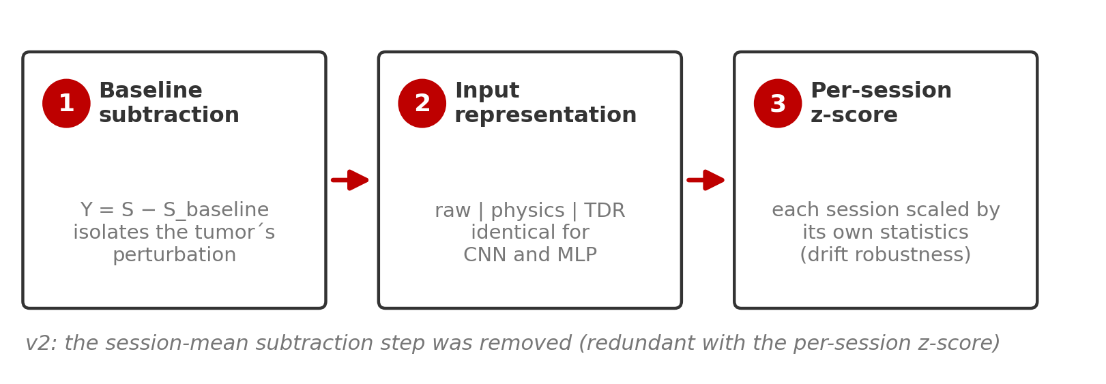
DATA PIPELINE
Three steps from raw sweep to model input
Step 1 removes everything that is not the tumor; step 3 (per-session z-score) is the key drift defense: each session is standardized by its own statistics. Applied identically to CNN and MLP.
v2 change: the per-session mean subtraction used in v1 was removed. An ablation showed it was redundant with the z-score for the MLP (up to +6 pts recovered on hard configs) and roughly neutral for the CNN outside TDR inputs.

Slide 12
DATA PIPELINE
Three input representations
RAW
PHYSICS
TDR-ONLY
Magnitude + phase of each calibrated S-parameter.
The measurement as the VNA reports it. Used for the main results.
Adds real & imaginary parts and the IFFT time-domain (TDR) envelope.
Derived at no cost from the same data; covered at the end.
Just the time-domain envelope, a pulse-echo view.
An ablation: how much lives in time domain alone?
Same numbers, two shapes:
CNN: channels stacked as image rows × 791 frequency columns
MLP: the same rows laid end-to-end as one long vector
Antenna subsets work the same way: '2 antennas' keeps only S-parameters among ports 1 & 3; '1 antenna' keeps only S11.

Slide 13
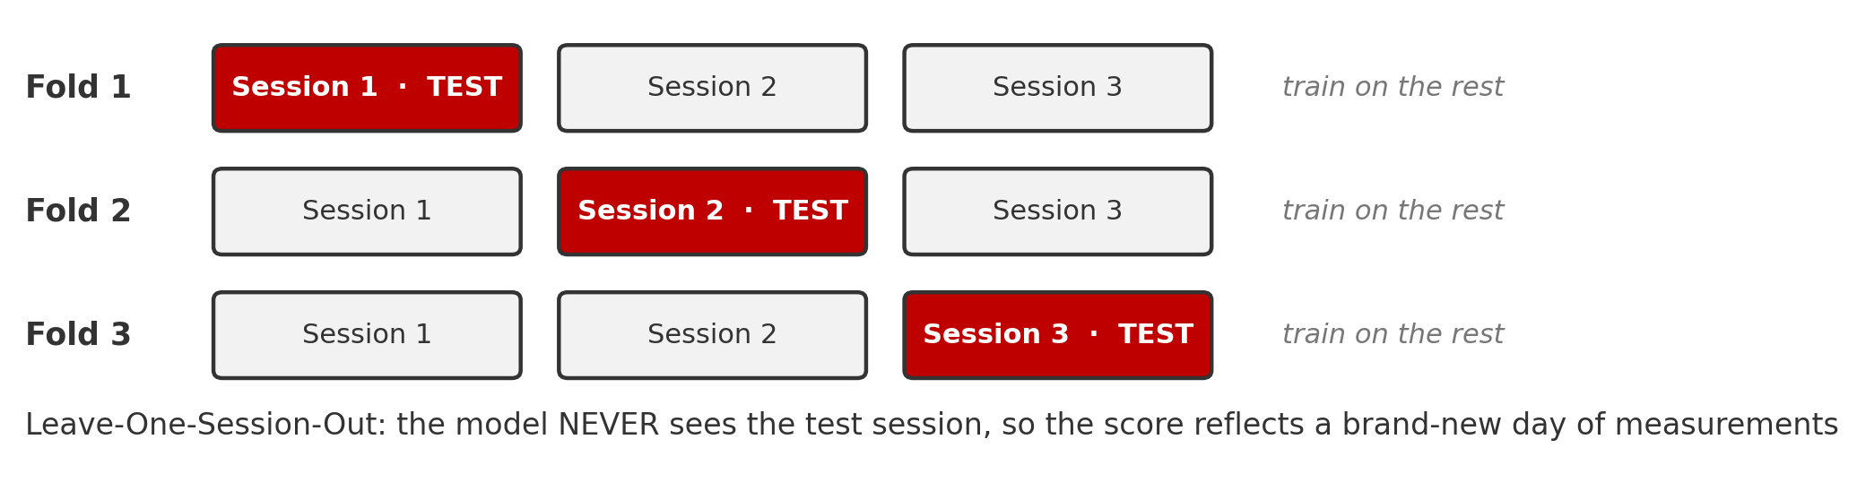
DATA PIPELINE
How we score: Leave-One-Session-Out
A random 75/25 split mixes trials from the same session into train AND test, so the model can cheat off session drift, inflating accuracy.
LOSO trains on N−1 sessions and tests on the session it has never seen; every session takes a turn. We report per-position majority vote over its 16 trials.
We have thoroughly stress-tested LOSO and verified that it works: under LOSO, models cannot exploit session drift, and drift-only information scores near chance.

Slide 14
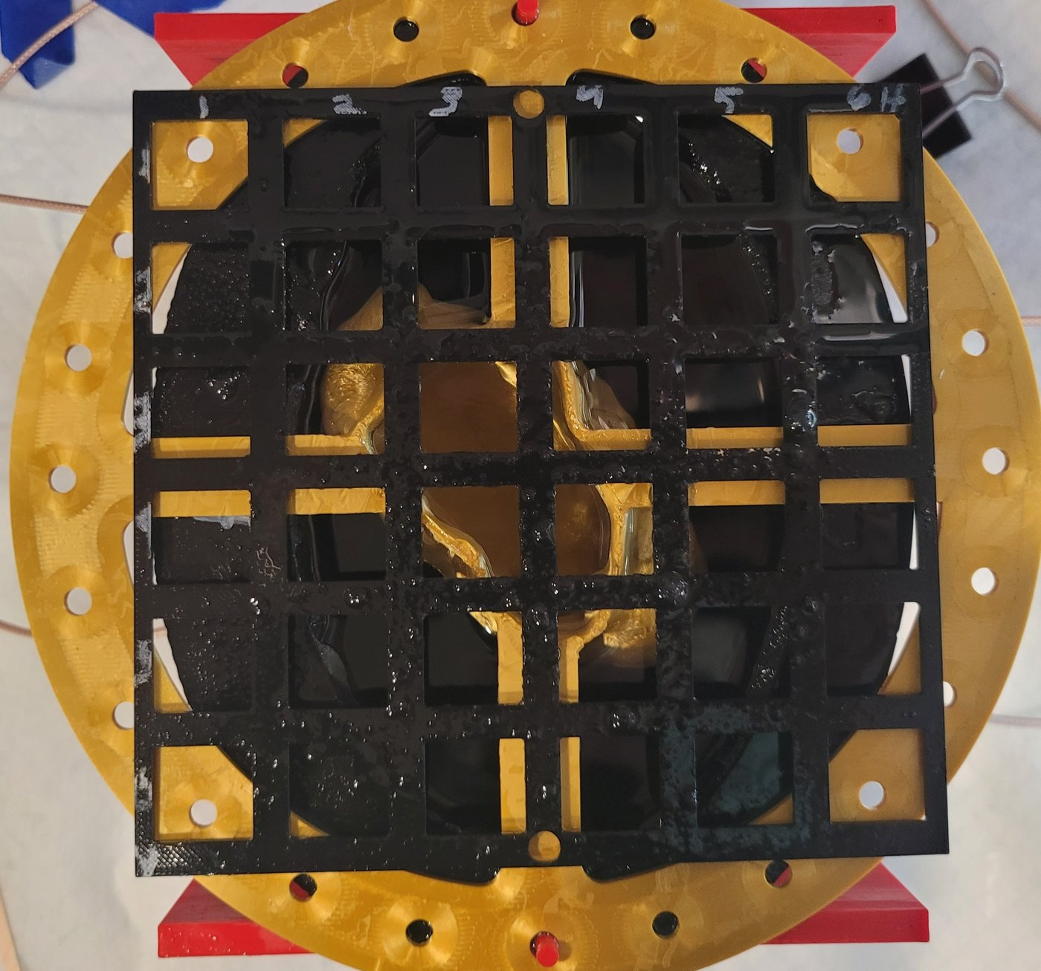
DATA PIPELINE
Three phantom setups, increasing difficulty
A3 Empty
A3 + F4
A3 + F5
adipose only
51 positions · 3 sessions
small glandular insert
39 positions · 4 sessions
large glandular insert
33 positions · 3 sessions (latest)

Slide 15
PART 3
Results
Per-position vote accuracy (%) under LOSO · identical raw inputs (mag + phase) · chance = 2–3% · pipeline v2

Slide 16
RESULTS · RAW INPUTS
All 4 antennas: full S-parameters (16)
Phantom setup | Positions | CNN (%) | MLP (%) | CNN − MLP
A3 Empty | 51-way | 99.3 ± 1.1 | 99.3 ± 0.9 | +0.0
A3 + F4 | 39-way | 97.4 ± 3.0 | 98.7 ± 2.2 | −1.3
A3 + F5 | 33-way | 100.0 ± 0.0 | 94.9 ± 3.8 | +5.1
Mean ± std over LOSO folds. Bold = better method.
With the full antenna array, both methods are near-perfect on every phantom. The CNN stays at 100% on F5; the MLP gives up ~5 points there under pipeline v2.

Slide 17
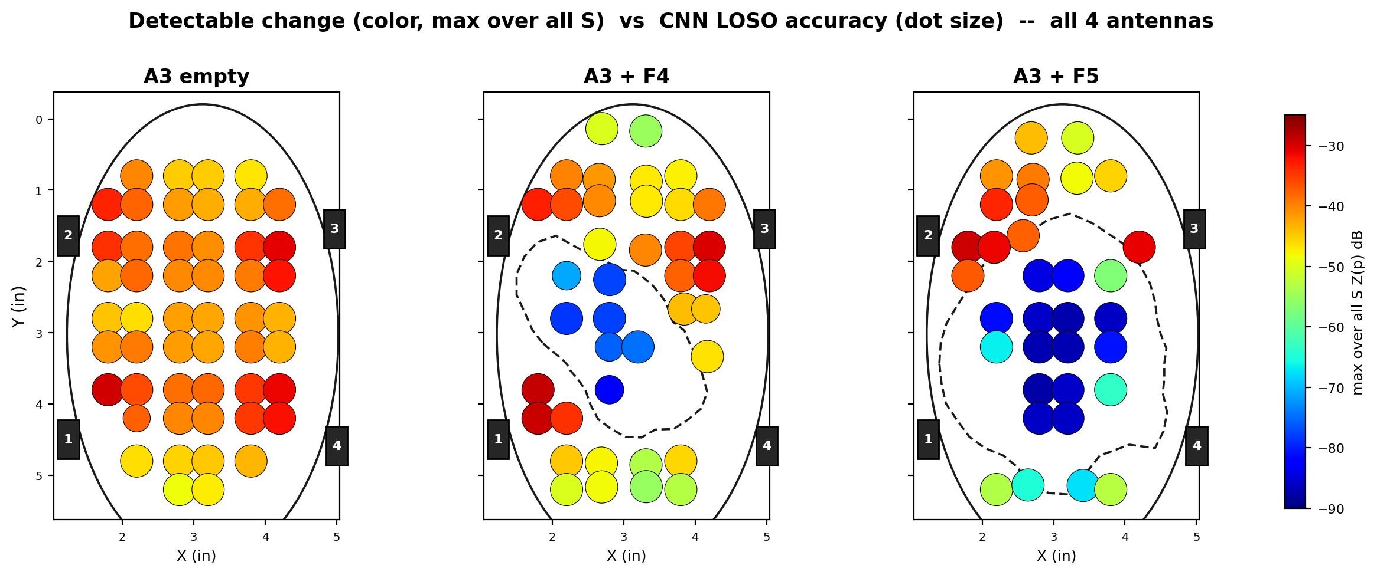
RESULTS · SPATIAL VIEW
Error Locations: all 4 antennas
Dot color = how strongly the tumor physically changes the signal (detectable difference). Dot size = CNN LOSO accuracy at that position. Dashed outline = glandular insert.
Detectable change still dips inside the glandular insert (blue), but with 16 complementary views the classifier compensates: accuracy dots stay large almost everywhere. MLP versions look qualitatively identical.

Slide 18
RESULTS · RAW INPUTS
All 4 antennas: reflection only (S11, S22, S33, S44)
Phantom setup | Positions | CNN (%) | MLP (%) | CNN − MLP
A3 Empty | 51-way | 99.3 ± 1.1 | 99.3 ± 0.9 | +0.0
A3 + F4 | 39-way | 95.5 ± 3.9 | 93.6 ± 3.9 | +1.9
A3 + F5 | 33-way | 100.0 ± 0.0 | 91.9 ± 3.8 | +8.1
No through-phantom transmission paths; each antenna only listens to its own echo.
Dropping transmission barely touches the CNN (F5 stays at 100%), while the MLP gives up 3-5 points on the glandular phantoms. Four reflection coefficients are enough for a CNN.

Slide 19
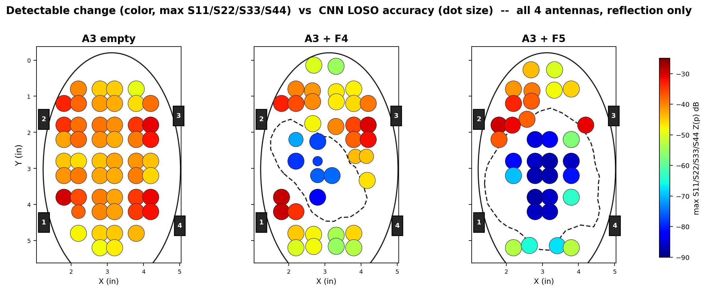
RESULTS · SPATIAL VIEW
Error Locations: all 4 antennas, reflection only
Reflection-only detectable change (max of S11, S22, S33, S44). The insert still carves a low-signal pocket, but CNN accuracy dots stay large.

Slide 20
RESULTS · RAW INPUTS
2 antennas (ports 1 & 3): full S-parameters
Phantom setup | Positions | CNN (%) | MLP (%) | CNN − MLP
A3 Empty | 51-way | 99.3 ± 1.1 | 99.3 ± 0.9 | +0.0
A3 + F4 | 39-way | 96.8 ± 2.5 | 96.8 ± 2.1 | +0.0
A3 + F5 | 33-way | 97.0 ± 5.3 | 84.9 ± 6.6 | +12.1
Antennas 1 & 3 sit on opposite sides of the phantom (most informative pair).
Halving the antennas separates the methods on F5: the CNN holds 97% while the MLP drops to 85%. On F4 the two are tied under pipeline v2.

Slide 21
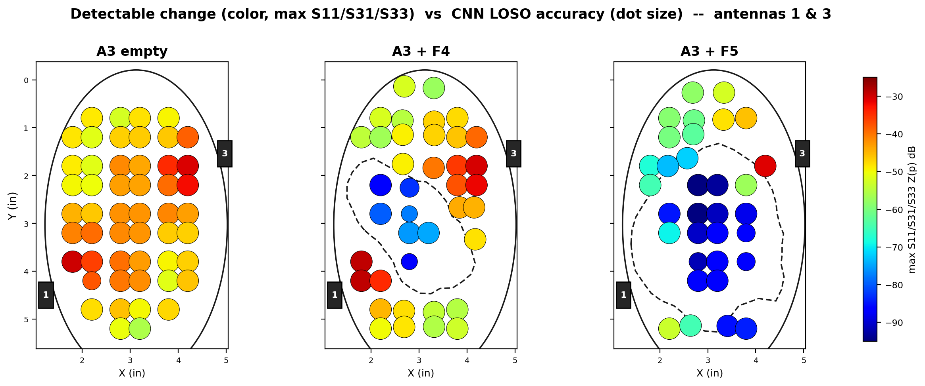
RESULTS · SPATIAL VIEW
Error Locations: 2 antennas (1 & 3)
With two antennas a low-signal pocket appears inside the glandular insert, and accuracy dots shrink with it.

Slide 22
RESULTS · RAW INPUTS
2 antennas (1 & 3): reflection only (S11, S33)
Phantom setup | Positions | CNN (%) | MLP (%) | CNN − MLP
A3 Empty | 51-way | 99.3 ± 1.1 | 99.3 ± 0.9 | +0.0
A3 + F4 | 39-way | 91.7 ± 2.5 | 92.3 ± 3.6 | −0.6
A3 + F5 | 33-way | 92.9 ± 4.6 | 80.8 ± 7.1 | +12.1
The toughest 2-antenna condition: two reflection coefficients and nothing else.
The CNN holds 92-99% while the MLP falls to 81% on F5. F4 remains the single config in the study where the MLP edges the CNN (92.3 vs 91.7).

Slide 23
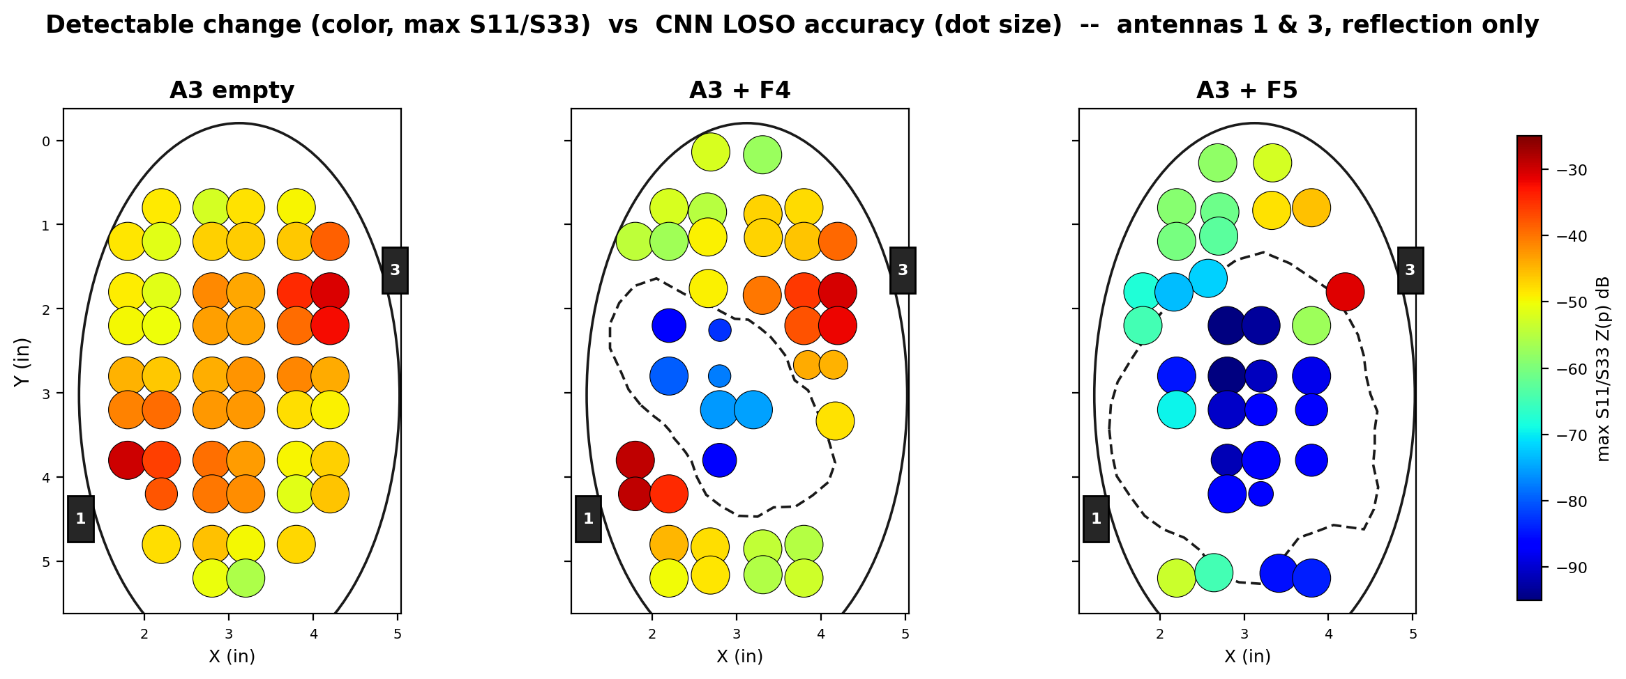
RESULTS · SPATIAL VIEW
Error Locations: 2 antennas (1 & 3), reflection only
With only S11 and S33, the low-signal pocket deepens and CNN errors start to appear inside the insert.

Slide 24
RESULTS · RAW INPUTS
1 antenna: S11 only
Phantom setup | Positions | CNN (%) | MLP (%) | CNN − MLP
A3 Empty | 51-way | 99.3 ± 1.1 | 99.3 ± 0.9 | +0.0
A3 + F4 | 39-way | 92.9 ± 7.4 | 90.4 ± 8.0 | +2.5
A3 + F5 | 33-way | 72.7 ± 6.1 | 64.7 ± 5.7 | +8.0
A single reflection coefficient: the minimal possible hardware.
The extreme case: one antenna, one S-parameter. The CNN holds 73–99%; the MLP falls to 65% on F5. The gap grows as the task gets harder, and the F5 errors cluster inside the glandular insert (next slide).

Slide 25
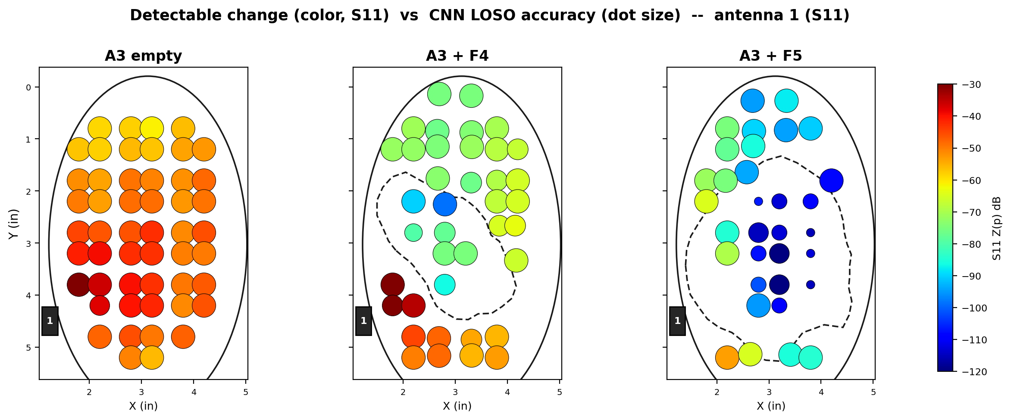
RESULTS · SPATIAL VIEW
Error Locations: 1 antenna (S11)
Single antenna (S11): small blue dots cluster inside the insert. Where physics buries the tumor, the classifier fails.

Slide 26
PART 4
Physics-informed features
Squeezing more out of the same measurement: no new hardware, no new data collection

Slide 27
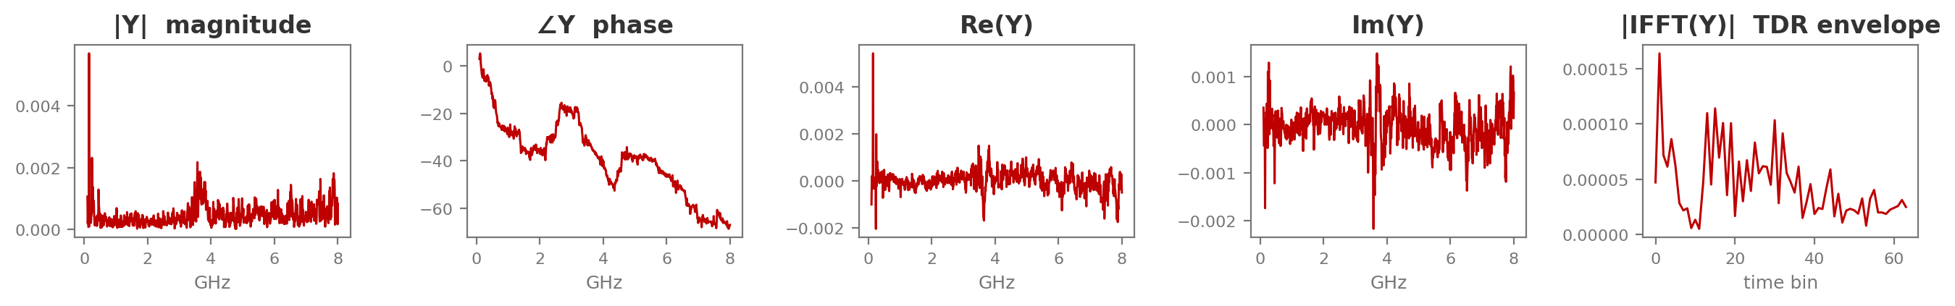
PHYSICS-INFORMED FEATURES
One complex measurement, five physical views
Each calibrated S-parameter Y(f) is one complex spectrum. From it we derive, at zero measurement cost: magnitude & phase (resonance behaviour), real & imaginary parts (full complex information), and the inverse-FFT envelope, a time-domain reflectometry (TDR) view where the tumor appears as an echo at its round-trip delay.
Real example: A3+F5 phantom, S11, tumor at grid position R3C4 (calibrated response Y)
The 'physics' input feeds all five views to both models: the CNN as extra image rows, the MLP as extra vector features. Identical information, matched again.

Slide 28
PHYSICS-INFORMED RESULTS
Same tests, physics inputs
All-4-antenna physics: both models at ceiling, 97–100% (F5 reaches 100 / 100). Below: the configs where it matters. Reflection-only: next slide.
2 antennas (1 & 3), physics input
Phantom setup | Positions | CNN (%) | MLP (%) | CNN − MLP
A3 Empty | 51-way | 99.3 ± 1.1 | 99.3 ± 0.9 | +0.0
A3 + F4 | 39-way | 98.7 ± 2.6 | 97.4 ± 2.6 | +1.3
A3 + F5 | 33-way | 99.0 ± 1.8 | 89.9 ± 7.6 | +9.1
1 antenna (S11), physics input
Phantom setup | Positions | CNN (%) | MLP (%) | CNN − MLP
A3 Empty | 51-way | 99.3 ± 1.1 | 98.7 ± 1.9 | +0.6
A3 + F4 | 39-way | 95.5 ± 3.2 | 93.6 ± 4.6 | +1.9
A3 + F5 | 33-way | 76.8 ± 3.5 | 66.7 ± 8.9 | +10.1

Slide 29
PHYSICS-INFORMED RESULTS
Reflection only + physics features
All 4 antennas, reflection only (S11, S22, S33, S44), physics input
Phantom setup | Positions | CNN (%) | MLP (%) | CNN − MLP
A3 Empty | 51-way | 99.3 ± 1.1 | 99.3 ± 0.9 | +0.0
A3 + F4 | 39-way | 96.2 ± 3.3 | 94.2 ± 2.8 | +2.0
A3 + F5 | 33-way | 100.0 ± 0.0 | 88.9 ± 5.2 | +11.1
2 antennas (1 & 3), reflection only (S11, S33), physics input
Phantom setup | Positions | CNN (%) | MLP (%) | CNN − MLP
A3 Empty | 51-way | 99.3 ± 1.1 | 98.0 ± 1.6 | +1.3
A3 + F4 | 39-way | 94.2 ± 2.5 | 91.7 ± 4.6 | +2.5
A3 + F5 | 33-way | 98.0 ± 3.5 | 81.8 ± 4.3 | +16.2
With physics features, reflection-only costs the CNN almost nothing (F5: 100% with four antennas, 98% with two); the MLP pays 8-11 points. A reflection-only system is practical with a CNN.

Slide 30
PHYSICS-INFORMED RESULTS
What the derived features buy, and what TDR alone can't
Physics vs raw (percentage points gained)
Additional finding: hierarchical (quadrant → position) classification
F5, 2 antennas: CNN +2.0 (97→99) · MLP +5.1 (85→90)
F5, 1 antenna: CNN +4.0 (73→77) · MLP +2.0 (65→67)
F5, all 4: MLP +4.0 (95→99); CNN already at 100
Easy setups (empty, F4 full-array): no change, already at ceiling.
Physics features help most exactly where raw inputs struggle.
Two-stage 'find the corner first' scheme tested on both models.
It never helps, and hurts the hardest cases: CNN −6 on F5, MLP −6 on F4-single.
Wrong quadrant = unrecoverable. Single-stage wins under LOSO.
TDR-only ablation (selected)
F4, 1 antenna: CNN 55 / MLP 64 (vs 93 / 90 raw): a big loss for both.
TDR is where v2 hurts: removing the mean subtraction leaves coherent session clutter in the envelope (CNN F5-pair tdr fell 79→63).

Slide 31
PIPELINE COMPARISON
What removing the mean subtraction changed (v1 vs v2)
MLP: clear gains
CNN: mixed, mostly neutral
F5 single raw: 58.6 → 64.7 (+6.1)
F5 refl-pair raw: 74.8 → 80.8 (+6.1)
F4 pair physics: 92.3 → 97.4 (+5.1)
F5 pair physics: 85.9 → 89.9 (+4.0)
F4 pair raw: 93.6 → 96.8 (+3.2)
Empty phantom: unchanged (ceiling).
Most raw / physics configs: within ±1 point of v1.
Single-antenna dips: F4 raw 96.8 → 92.9, F5 raw 75.8 → 72.7, F5 physics 79.8 → 76.8.
TDR-only suffers badly: F5 pair 78.8 → 62.6; F4 single 84.0 → 55.1 (a fold collapse returns).
Verdict: the mean subtraction was redundant for frequency-domain inputs once the per-session z-score exists (the MLP gains by dropping it), but TDR inputs genuinely need it: coherent session clutter must be removed BEFORE the envelope is computed. Best practice going forward: skip it for raw/physics, keep it for TDR.

Slide 32
CONCLUSIONS
What we learned
CNN ≥ MLP, everywhere
The gap grows with difficulty
On matched inputs the CNN ties easy cases and wins hard ones by up to 16 points, at ~10x the training cost.
Fewer antennas + bigger glandular insert = bigger CNN advantage.
Preprocessing drives robustness
Physics features add accuracy at no cost
Per-session z-score eliminated the CNN's cross-session failures; the v1 mean-sub step proved unnecessary.
Derived views (+TDR) add up to 4 points on the hardest configurations.
Errors follow the physics
Fewer antennas is viable with a CNN
Misses cluster inside the glandular insert, where detectable signal change collapses.
2 antennas: 97–99% on every phantom. Even 1 antenna: 73–99%.

