Slide 1
PART 2 . SIMULATED DATA
3D (x, y, z) tumor localization in HFSS
A dense simulated tumor sweep (91 positions x 13 depth planes) lets us resolve depth and measure how much data the CNN needs
3.9 mm
2.1 mm
~450
lateral error (8-fold)
depth error, not the weak axis
training positions needed

Slide 2
Simulation setup
HFSS full-wave model of Sam's Medium antennas + the A3 phantom (SamMakin tumor sweep)
Model
HFSS full-wave solve of Sam's Medium antennas (the same 4-antenna array as the bench) around the A3 phantom in oil. A metal tumor is moved through a 3D grid; a dielectric (beet) tumor is run identically for comparison.
1
Sampling
Uniform 10 mm (x,y) lattice, 91 positions, swept over 13 depth planes z = -15 to +45 mm (5 mm steps). 1074 tumor positions total (off-grid z = 3 mm excluded).
2
Signal
4-port S-matrix exported 2 to 8 GHz (3001 pts, resampled to 256). Input = differential dS = S(tumor) minus S(empty), using each depth's own HFSS-batch empty baseline.
3
Task
Same conv trunk as the measured CNN, head to fc(3) for (x,y,z) in mm. 8-fold position cross-validation; lateral and depth error reported separately.
4

Slide 3
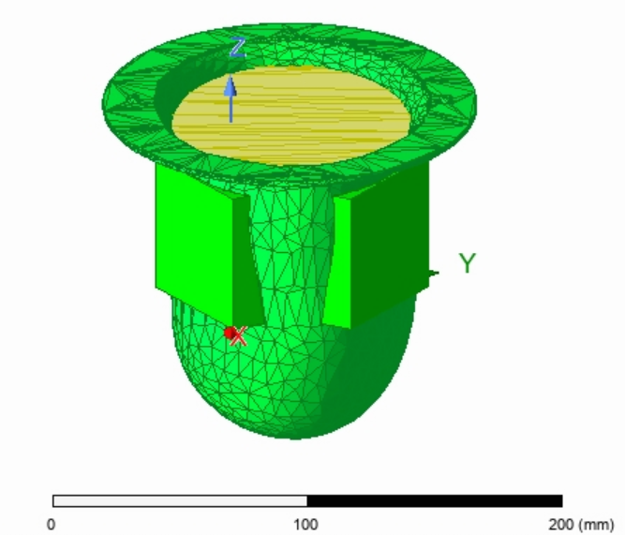
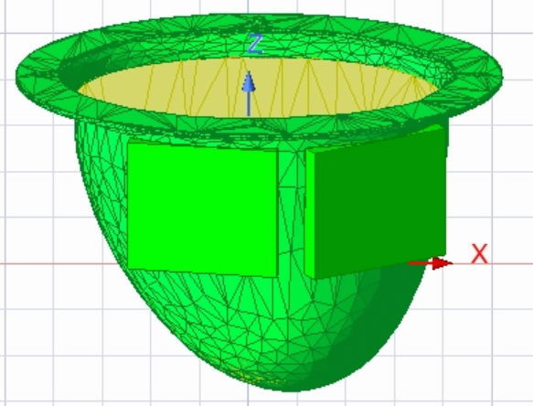
The simulated setup, in pictures
HFSS model of the phantom, oil, antennas and tumor
Antennas around the phantom bowl
Full HFSS model (phantom, oil, tumor)

Slide 4
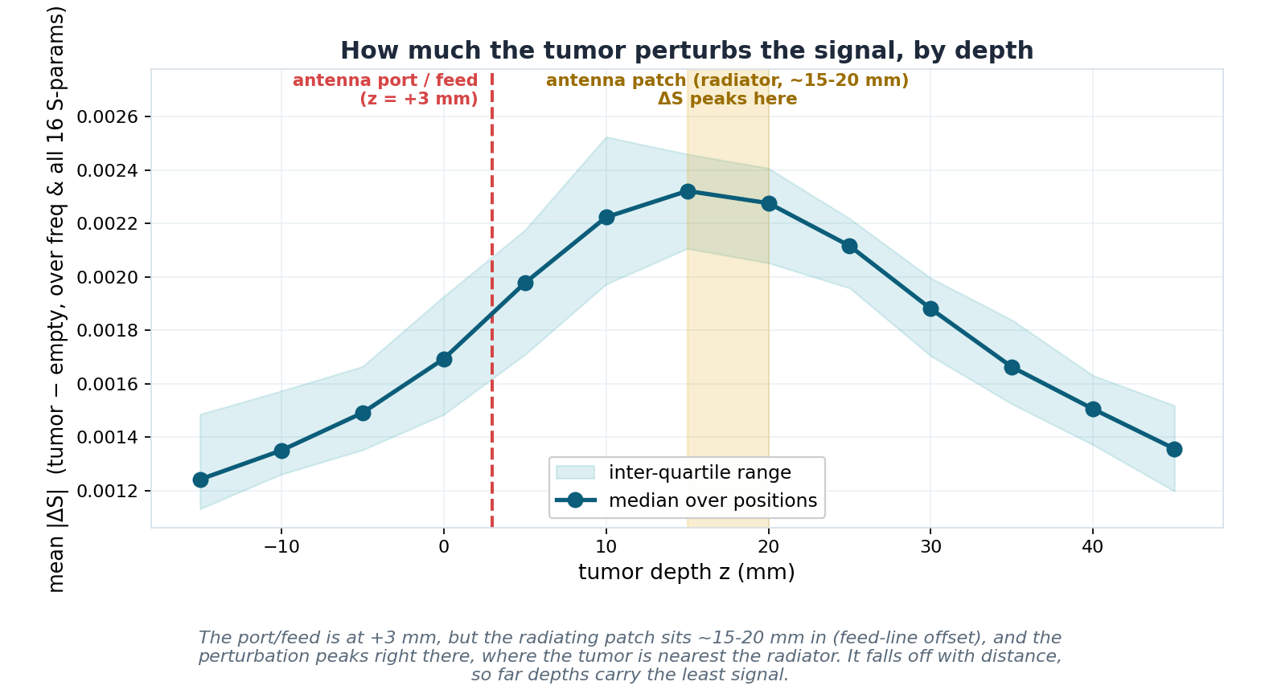
Depth planes and the signal they carry
13 tumor heights; the perturbation peaks at the radiating patch and fades with distance
The physical driver
dS = tumor minus empty, averaged over frequency and all 16 S-parameters.
Port/feed is at z = +3 mm, but the radiating patch sits ~15 to 20 mm in (feed-line offset).
dS peaks right at the patch (~15 to 20 mm), where the tumor is nearest the radiator.
Falls off both ways; far depths carry the least signal, so localization degrades there. (The main measured data sits near the patch, ~5 to 20 mm.)

Slide 5
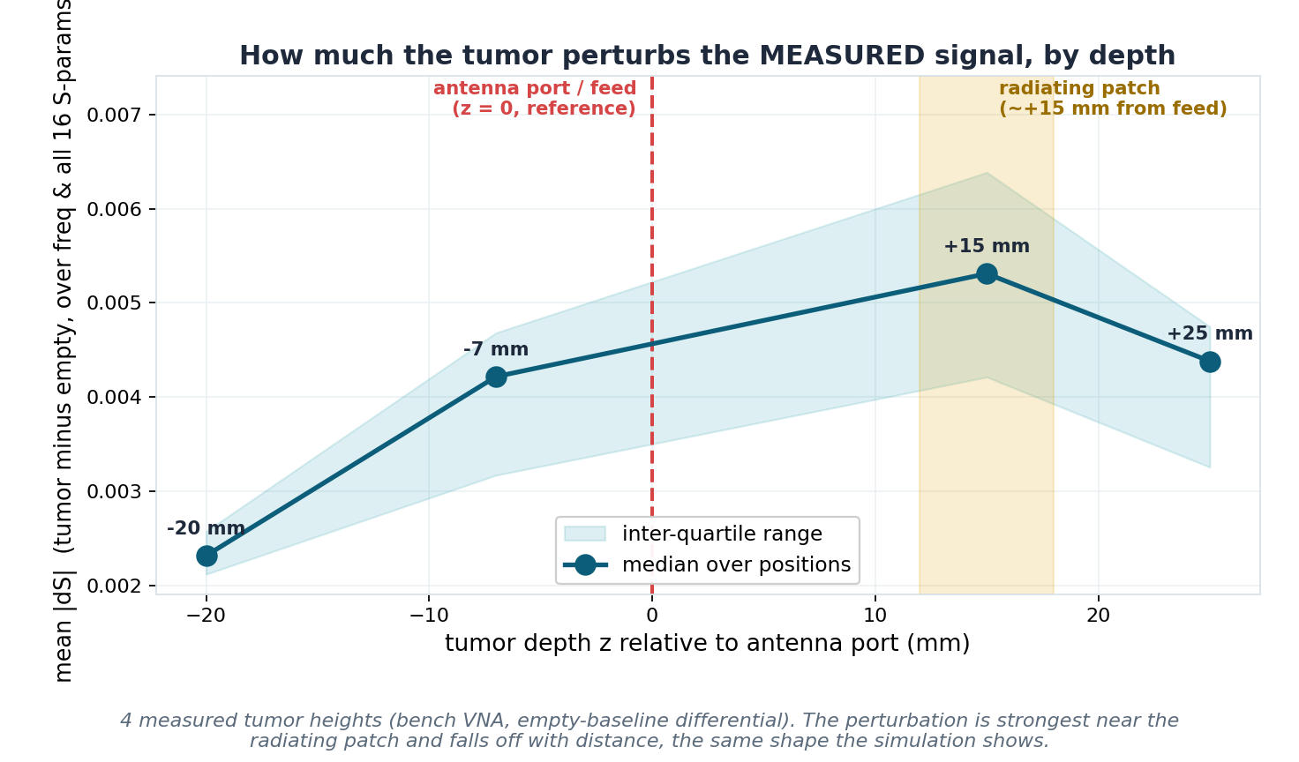
Same pattern on measured data
Measured tumor perturbation across 4 tumor heights, independent of the simulation
Measured, same trend
4 measured tumor heights, a full 51-position grid at each.
Mean |dS| peaks at +15 mm, at the radiating patch, consistent with the simulation.
The perturbation falls off with distance in both directions.
Measurement and simulation agree on which depths carry the strongest signal.

Slide 6
The 3D localization network
Same architecture as the measured CNN, with one extra output for depth
Input
dS as a 32 x 256 image (16 S-params x [mag, phase], 256 frequencies). Per-sample z-score normalization.
1
Trunk
2 conv blocks (32 filters each) plus pooling and dropout, identical to the measured (x,y) CNN.
2
Head
fc(3) plus regression to (x, y, z) in mm. Trained with an L2 coordinate loss, 60 epochs.
3
Evaluation
8-fold hold-out by POSITION (every position predicted once, out-of-fold). Lateral = sqrt(dx^2+dy^2); depth = |dz|, reported separately so one axis cannot hide the other.
4

Slide 7
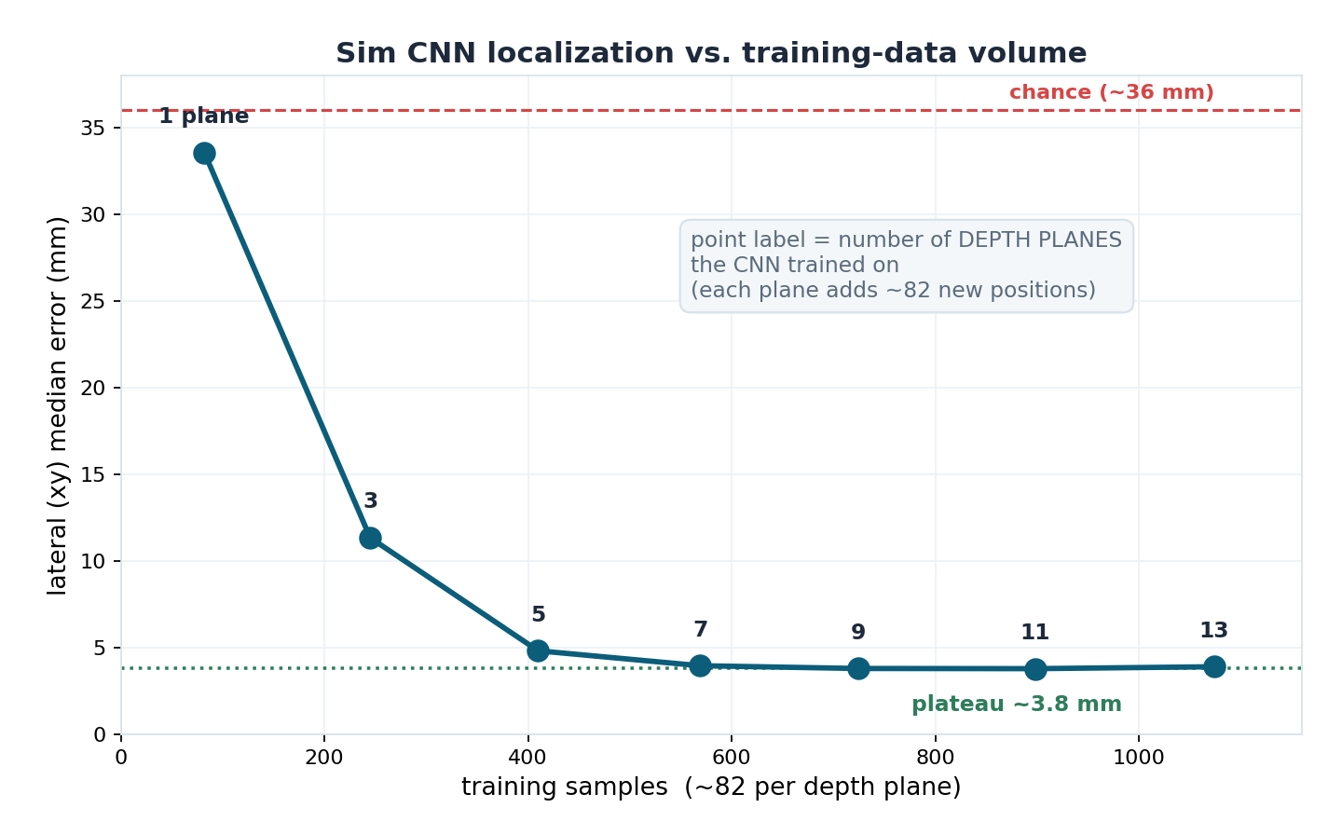
How much data does the CNN need?
Train on more depth planes (more distinct positions) and watch the error fall
The threshold
1 depth plane (82 positions): 33 mm, about chance. The conv net cannot train.
3 planes (245): 11 mm. 5 planes (410): 4.8 mm.
Plateau ~3.8 mm from 7 planes (about 570) on.
So it needs ~400 to 500 DISTINCT positions to localize; below ~250 it is poor.
Distinct positions matter, not raw sample count (see Part 3).

Slide 8
3D localization result (8-fold)
Every position predicted from a model that never saw it, lateral and depth separately
3.9 mm
2.1 mm
93 %
3.6 / 2.1
lateral (xy) median
vs 36.5 mm chance
depth (z) median
vs 16.3 mm chance
of positions within
10 mm laterally
beet (dielectric)
xy / z, same as metal
What this establishes
Depth is NOT the weak axis. With fine depth sampling and full-band frequency, z resolves to ~2 mm, better than the lateral k-NN floor.
A dielectric (beet) tumor localizes identically to metal (3.6 / 2.1 mm). In the noiseless sim the ~19 percent weaker contrast costs nothing.
Chance is 36 mm laterally / 16 mm in depth, so the model is about 10x better than guessing the centre on both axes.

Slide 9
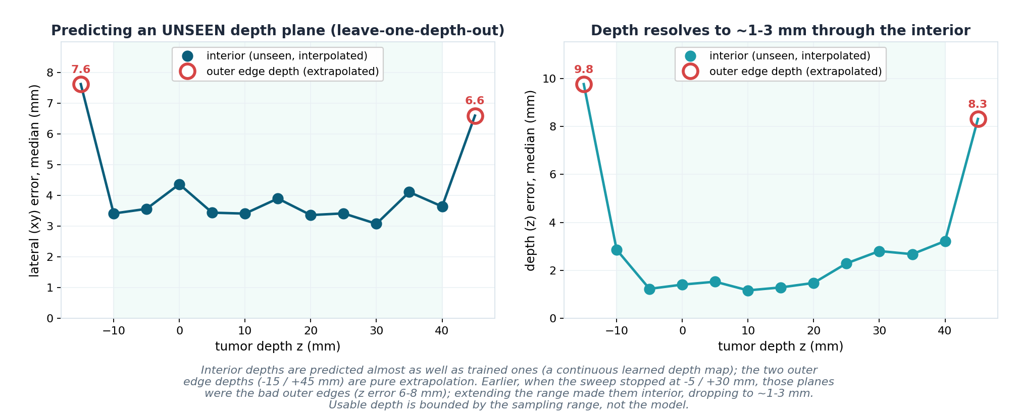
Predicting an unseen depth plane
Leave one whole depth out; interior depths interpolate, only the outer edge depths fail
Range-bound, not model-bound
Interior unseen depths: ~1 to 3 mm, a continuous learned depth map.
Only the two outer edge depths (-15 / +45) blow up, pure extrapolation.
Extending the sweep turned the OLD outer edges into good interior points.
Usable depth is bounded by the sampling range, not the model. Sample wider and the good region grows.

Slide 10
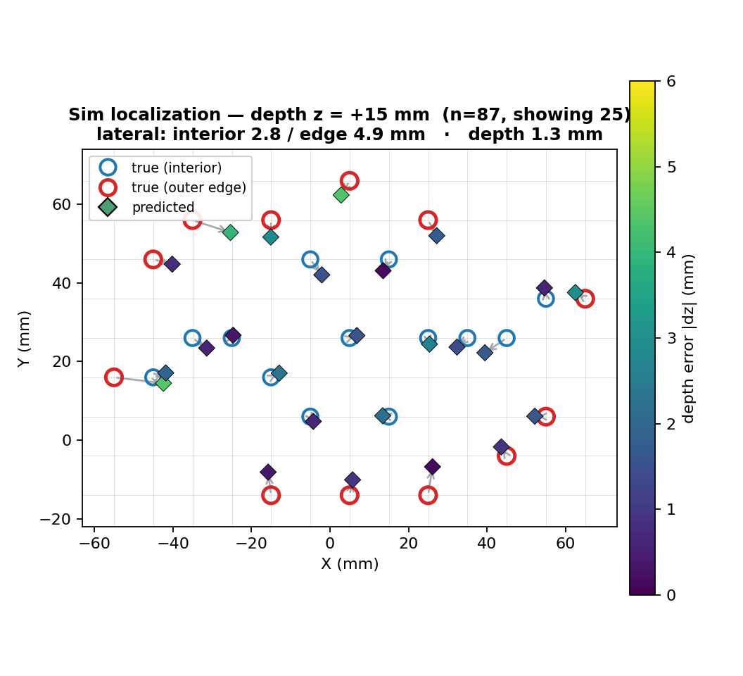
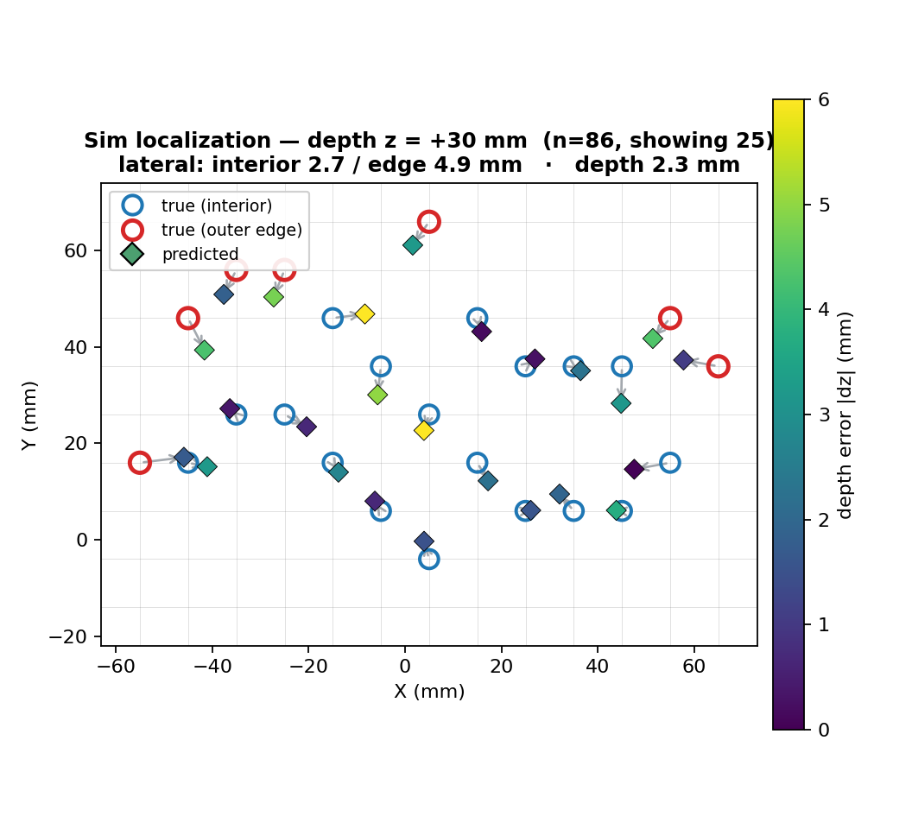
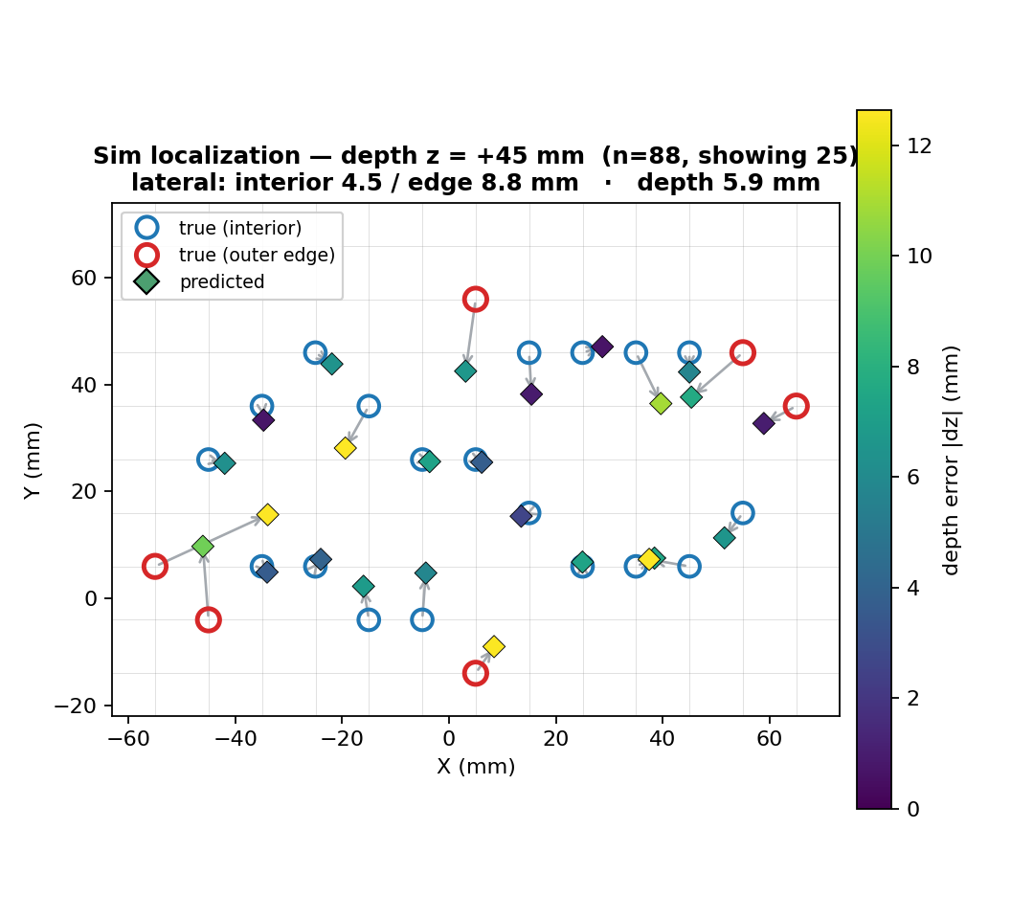
Predicted vs. actual, by depth
Arrows = lateral error, marker color = depth error, red ring = grid-edge position
z = +15 mm (peak signal)
z = +30 mm (interior)
z = +45 mm (outer edge)
Interior depths (z=+15/+30) predict tightly; the +45 mm outer edge shows the extrapolation blow-up in both lateral arrows and depth color.

Slide 11
Part 2, bottom line
1
Full 3D localization works in sim: 3.9 mm lateral, 2.1 mm depth. The CNN resolves all three coordinates well below a grid step.
2
Depth is a strong axis, not a weak one: fine depth sampling and full-band frequency make z (~2 mm) actually beat the lateral floor.
3
The CNN needs ~400 to 500 distinct positions: below that it degrades fast; at one depth plane (82) it collapses to chance. A concrete data target.
4
Depth generalizes across the sampled range: unseen interior depths interpolate to ~1 to 3 mm; only the outer edge depths extrapolate and fail.
5
Metal and dielectric localize equivalently in the noiseless sim: the realistic beet model produces enough differential signal for the CNN to localize as accurately as the metal target (3.6 vs 3.9 mm).
github.com/pmart1534/microwave-phantom-localization-cnn-mlp

