Slide 1
TUMOR LOCALIZATION · CHIP-DESIGN STUDY
Frequency Reduction
How narrow can the measurement band go before localization degrades?
CNN classification · raw S-parameters · LOSO · measured A3 phantom data
1–5 GHz
1/2
100%
matches full-band accuracy
the bandwidth of the full sweep
F5 accuracy retained (full array)
Peter Martin · University of Utah · Electrical & Computer Engineering

Slide 2
MOTIVATION
Smaller bandwidth, simpler chip
An integrated version of this system lives or dies on front-end complexity: a narrower sweep means simpler synthesizers, antennas and calibration. The question is what accuracy that costs, and where the band should sit.
1
WHERE does the information live?
slide a 2 GHz window across 0.1–8 GHz; full 4-antenna array
2
HOW WIDE must the band be?
expand 2 → 3 → 4 → 5 GHz around the winning region
3
Does it combine with reduced hardware?
winning band × fewer antennas / reflection-only
4
Is the band choice robust?
repeat the whole sweep with a single antenna (S11 only)
Every cell: CNN classifier, raw mag+phase input, 100-epoch leave-one-session-out, per-position vote.

Slide 3
STEP 1 · BAND PLACEMENT
A 2 GHz window slid across the sweep
Band (GHz) | Width | Empty | A3 + F4 | A3 + F5
0.1 – 2 | 2 GHz | 99.4 | 96.2 | 90.9
2 – 4 | 2 GHz | 99.4 | 97.4 | 92.9
4 – 6 | 2 GHz | 99.4 | 89.1 | 71.7
6 – 8 | 2 GHz | 99.4 | 97.4 | 69.7
0.1 – 8 (full) | 7.9 GHz | 99.3 | 97.4 | 100.0
All 16 S-parameters. LOSO per-position vote accuracy (%). Highlighted row = best 2 GHz window (mean across phantoms).
2-4 GHz is the highest-scoring 2 GHz window. Above 4 GHz, F5 drops to ~70%. The empty phantom scores 99.4 in every window.

Slide 4
STEP 2 · BANDWIDTH
Expanding the window around 2-4 GHz
Band (GHz) | Width | Empty | A3 + F4 | A3 + F5
2 – 4 | 2 GHz | 99.4 | 97.4 | 92.9
1.5 – 4.5 | 3 GHz | 99.4 | 98.1 | 97.0
1 – 5 | 4 GHz | 99.4 | 98.1 | 100.0
0.5 – 5.5 | 5 GHz | 99.4 | 97.4 | 100.0
0.1 – 8 (full) | 7.9 GHz | 99.3 | 97.4 | 100.0
All 16 S-parameters. Windows centred on the winning 2-4 GHz region.
1-5 GHz (4 GHz bandwidth, 3 GHz centre) matches full-band accuracy on all three phantoms, including 100% on F5. 0.5-5.5 GHz scores the same; 1.5-4.5 and 2-4 GHz score 3-7 points lower on F5.

Slide 5
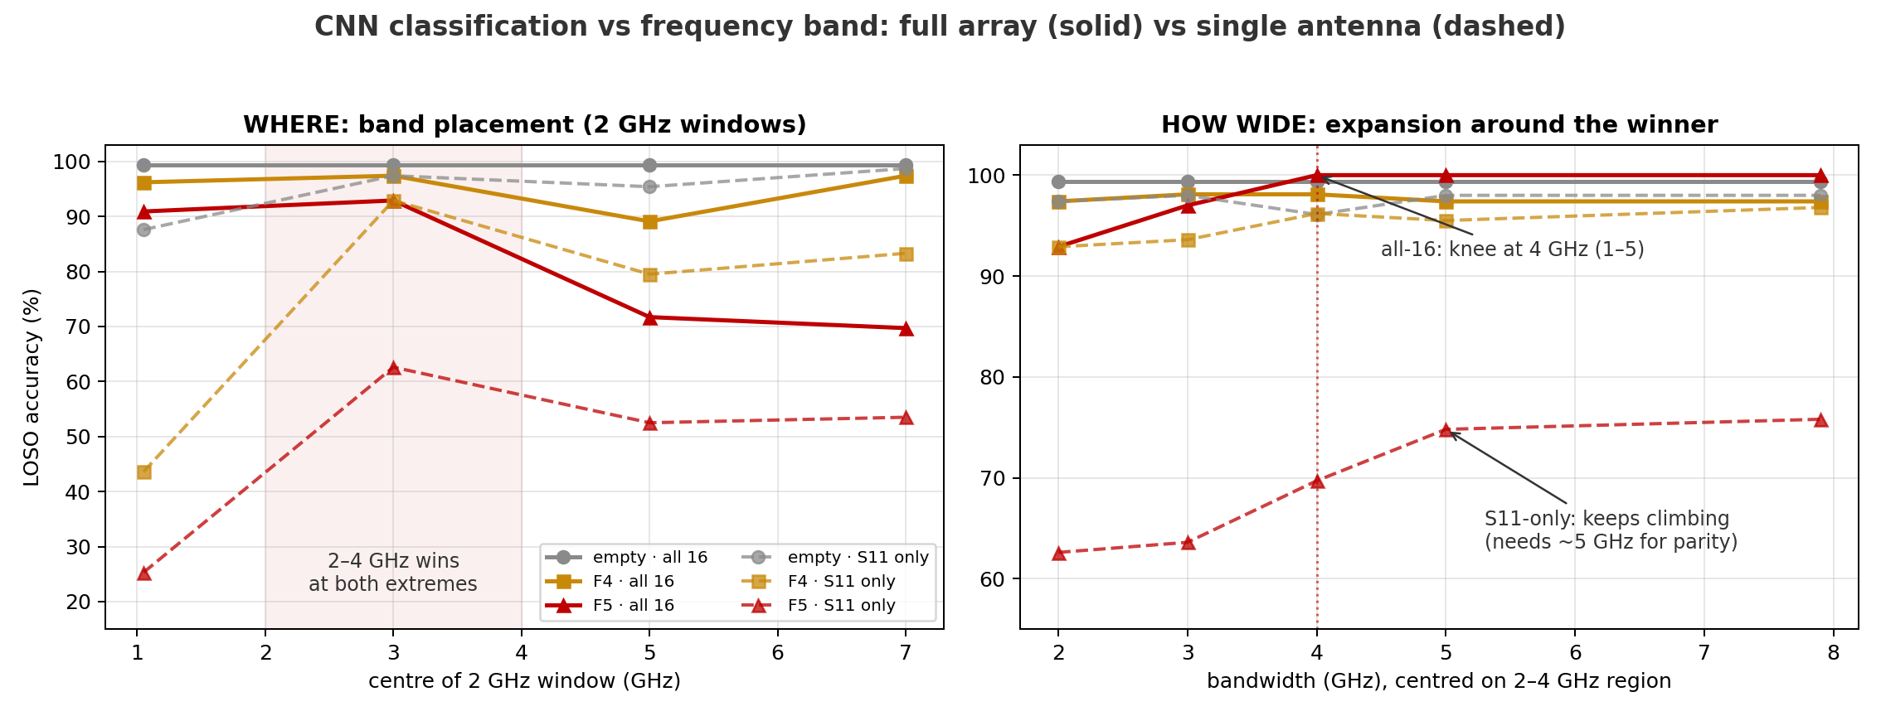
THE FULL PICTURE
Placement and width, at both hardware extremes
Solid = all 16 S-parameters · dashed = single antenna (S11 only). Left: where the 2 GHz window sits. Right: accuracy vs bandwidth around 2-4 GHz.

Slide 6
STEP 3 · COMBINED REDUCTIONS
The 1-5 GHz band with reduced hardware
Hardware @ 1-5 GHz | Empty | A3 + F4 | A3 + F5 | F5 @ full band
4 antennas, reflection only | 100.0 | 97.4 | 94.9 | 100.0
2 antennas (1 & 3), full S | 99.3 | 92.9 | 92.9 | 96.0
2 antennas, reflection only | 99.3 | 92.9 | 84.8 | 90.9
1 antenna (S11) | 96.1 | 96.2 | 69.7 | 75.8
With the full array, restricting to 1-5 GHz left accuracy unchanged; with reduced antennas the same restriction scores 3-6 points lower on F5 than full band. 4 antennas reflection-only at 1-5 GHz: 94.9 on F5.

Slide 7
STEP 4 · ROBUSTNESS CHECK
The same window sweep with one antenna
Band (GHz) | Width | Empty | A3 + F4 | A3 + F5
0.1 – 2 | 2 GHz | 87.6 | 43.6 | 25.3
2 – 4 | 2 GHz | 97.4 | 92.9 | 62.6
4 – 6 | 2 GHz | 95.4 | 79.5 | 52.5
6 – 8 | 2 GHz | 98.7 | 83.3 | 53.5
0.5 – 5.5 | 5 GHz | 98.0 | 95.5 | 74.8
0.1 – 8 (full) | 7.9 GHz | 98.0 | 96.8 | 75.8
S11 only. Note 0.1-2 GHz: fine with the full array (90.9 on F5), catastrophic alone (25.3).
With one antenna, 2-4 GHz is again the highest 2 GHz window. F5 accuracy rises with width through ~5 GHz (62.6 at 2 GHz -> 74.8 at 5 GHz). The 0.1-2 GHz window scores 25.3 on F5 with one antenna vs 90.9 with the full array.

Slide 8
RECOMMENDATION
Chip band specification
Spec: 1-5 GHz
Fallback: 1.5-4.5 GHz
4 GHz bandwidth, 3 GHz centre. Matched full-band accuracy on all three phantoms with the full array.
Scored 1-3 points below full band on F5; 2-4 GHz scored 7 below.
Low-scoring regions
Combined reductions at 1-5 GHz
F5: 71.7 / 69.7 at 4-6 / 6-8 GHz (full array); 25.3 at 0.1-2 GHz with one antenna.
F5: 94.9 (4-ant refl) / 92.9 (2-ant) / 84.8 (2-ant refl) / 69.7 (1 antenna).
All results: CNN classification, raw S-parameters, leave-one-session-out, measured A3 phantom data. Details in results/ and docs/CHANGELOG.md.

Slide 9
PART 2 · TRYING TO BREAK IT
New constraint, new question: where does it fail?
Follow-up task: stay entirely below 4 GHz (easier chip) and push the bandwidth down until the model breaks. That needs a definition of 'broken':
DEGRADED
mean below 90% of that phantom's full-band accuracy
UNSTABLE
fold-to-fold sigma of 10 points or more: works one session, fails the next
BROKEN
mean below 50%: wrong more often than right (the headline break)
DEEP
mean below 25%: approaching uselessness (still ~10x chance)
Method: descend bandwidth 3 -> 2 -> 1 -> 0.5 -> 0.25 -> 0.1 -> 0.05 GHz with the best placement at every width, plus a nine-window placement scan at 0.25 GHz. All below 4 GHz.

Slide 10
PART 2 · PLACEMENT
Nine 0.25 GHz windows across the span
Window (GHz) | Empty | A3 + F4 | A3 + F5
0.5 - 0.75 | 43.8 ± 7.9 | 45.5 ± 7.4 | 65.7 ± 6.3
1 - 1.25 | 48.4 ± 9.3 | 65.4 ± 6.1 | 74.7 ± 9.7
1.25 - 1.5 | 94.8 ± 4.5 | 66.7 ± 12.0 | 78.8 ± 3.0
1.5 - 1.75 | 99.3 ± 1.1 | 88.5 ± 9.0 | 74.7 ± 20.2
1.75 - 2 | 99.3 ± 1.1 | 96.8 ± 1.3 | 80.8 ± 12.6
2 - 2.25 | 100.0 ± 0.0 | 95.5 ± 5.7 | 83.8 ± 3.5
2.5 - 2.75 | 99.3 ± 1.1 | 96.8 ± 1.3 | 76.8 ± 4.6
3 - 3.25 | 99.3 ± 1.1 | 96.8 ± 3.8 | 74.7 ± 1.7
3.5 - 3.75 | 99.3 ± 1.1 | 98.1 ± 2.5 | 76.8 ± 3.5
Highest window: 2-2.25 GHz (highlighted), with lower fold sigma than 1.75-2. In the red rows (below ~1.25 GHz) empty and F4 score below 50%.

Slide 11
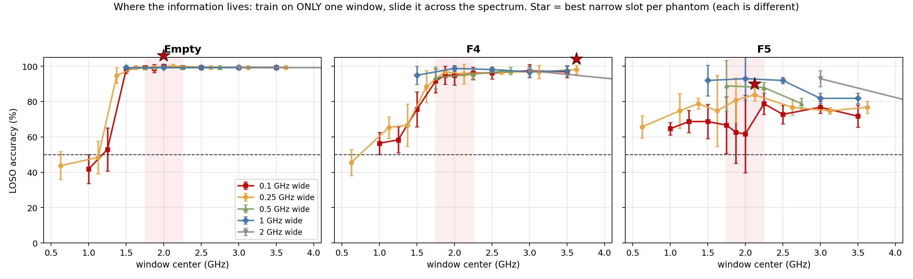
PART 2 · PLACEMENT SCAN
Each phantom has a different best frequency
The model is trained on only one window at a time, slid across the spectrum. Best narrow slot per phantom: empty ~2.0 GHz (99+ everywhere above 1.45), F4 ~3.0 GHz, F5 ~2.2-2.3 GHz. At 100 MHz width F5 scores 78.8 at 2.2-2.3 vs 62.6 at 1.825-1.925, the slot used in the Part 2 descent.

Slide 12
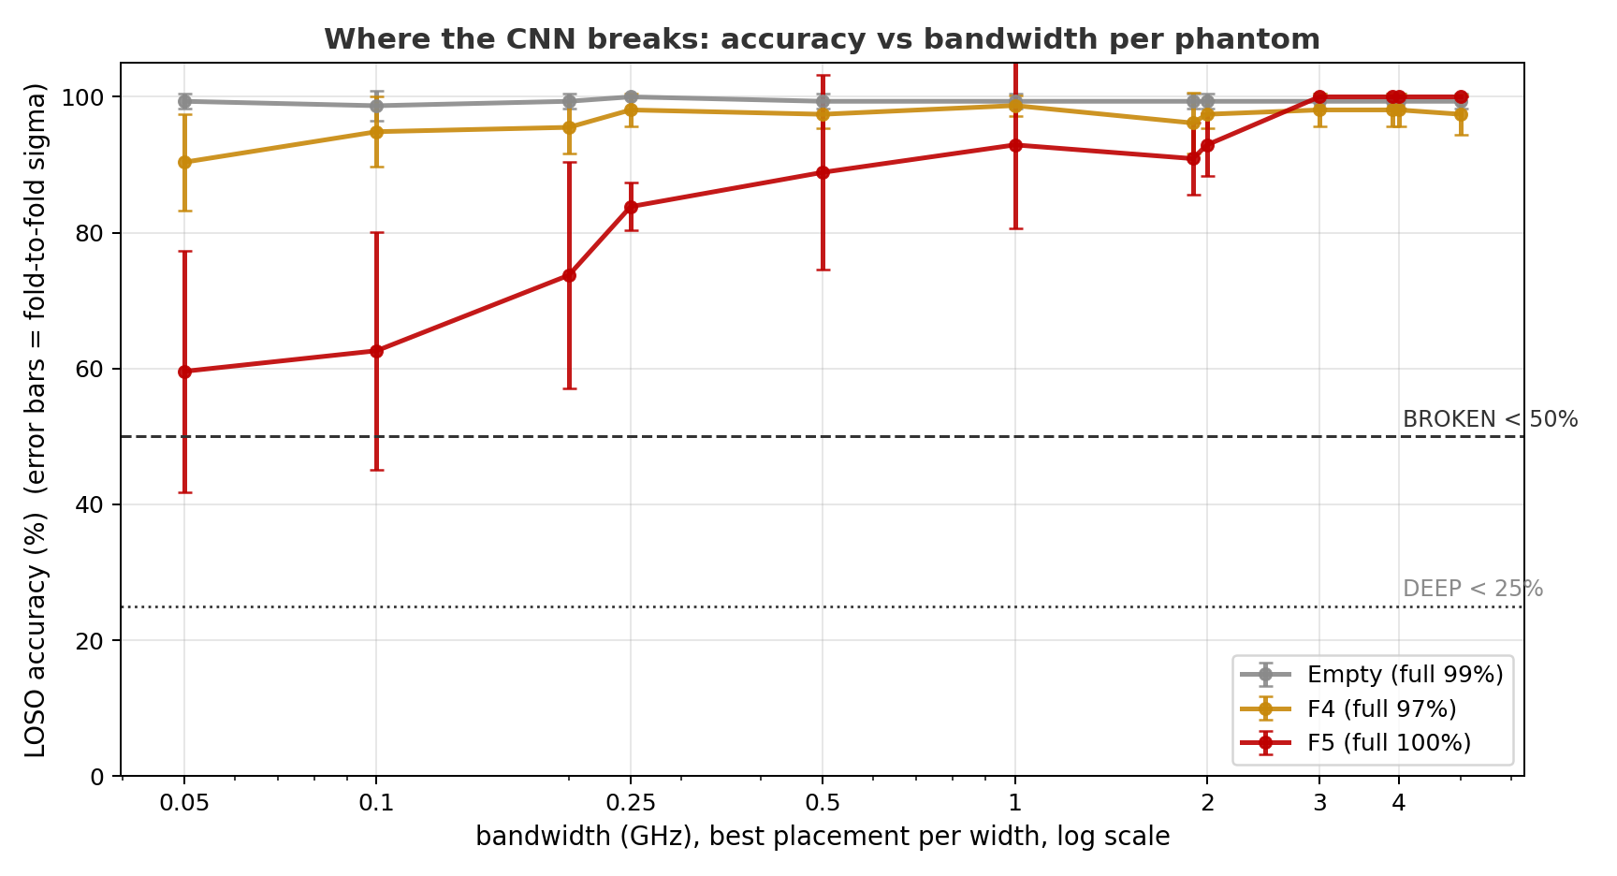
PART 2 · THE DESCENT
Best placement at every width, down to 0.05 GHz

Slide 13
PART 2 · VERDICT
Where each phantom breaks
Failure tier | Empty | A3 + F4 | A3 + F5
Degraded (<90% of full band) | never | never | 0.5 GHz
Unstable (fold sigma >= 10) | never | never | 1 GHz
Broken (<50%) | never | never | never
Floor at 0.05 GHz (50 MHz) | 99.3 ± 1.1 | 90.4 ± 7.1 | 59.6 ± 17.8
With all 16 S-parameters, no phantom scores below 50% at any width: at 50 MHz the floors are 99.3 / 90.4 / 59.6. F5 crosses the degraded tier at 0.5 GHz and the unstable tier at 1 GHz. Part 3 repeats the descent with reduced hardware.

Slide 14
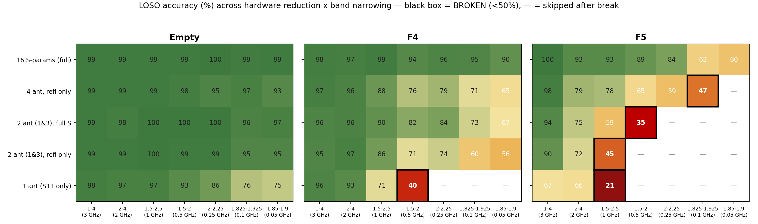
PART 3 · HARDWARE + BAND TOGETHER
The full break map: 5 hardware levels x 7 bands
Bands narrow left to right at the best placement per width; once a phantom scores below 50% (black box) it stops descending at that hardware level. Blank cells were skipped after the break. Empty does not cross 50% in any cell.

Slide 15
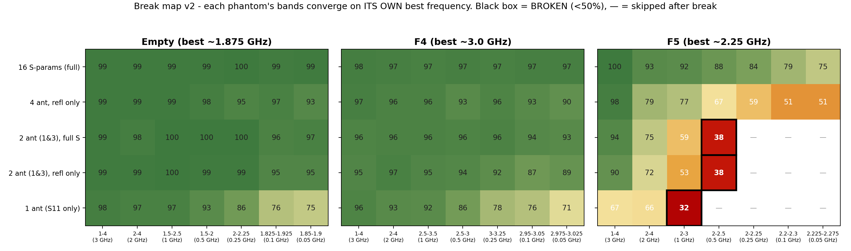
PART 3 · BREAK MAP V2
Same descent with per-phantom band centers
Bands re-centered per phantom: F4 -> 3.0 GHz, F5 -> 2.25 GHz. Empty keeps its original ~1.875 GHz bands: its full-array scan scored 99-100 in every window, and at single antenna the original slot scored higher (76/75 vs 71/59 at 0.1/0.05 GHz). With re-centered bands, F4's single-antenna row no longer crosses 50% (70.5 at 50 MHz vs 39.7 at 0.5 GHz before) and F5's sub-50% cells shift one column narrower.

Slide 16
PART 3 · SUMMARY
First band below 50%, original descent
Hardware | Empty | A3 + F4 | A3 + F5
16 S-params (full array) | never | never | never (floor 60)
4 antennas, reflection only | never | never | 0.1 GHz (47%)
2 antennas (1 & 3), full S | never | never | 0.5 GHz (35%)
2 antennas (1 & 3), reflection only | never | never | 1 GHz (45%)
1 antenna (S11 only) | never (floor 75) | 0.5 GHz (40%) | 1 GHz (21%)
Empty never scores below 50% in any cell. F4 crosses 50% only at 1 antenna + 0.5 GHz (and not at all with re-centered bands). F5 crosses 50% at every reduced-hardware level.
F5's first sub-50% band widens as hardware is reduced: 0.1 GHz (4 ant refl) -> 0.5 GHz (2 ant) -> 1 GHz (2 ant refl, 1 ant).

Slide 17
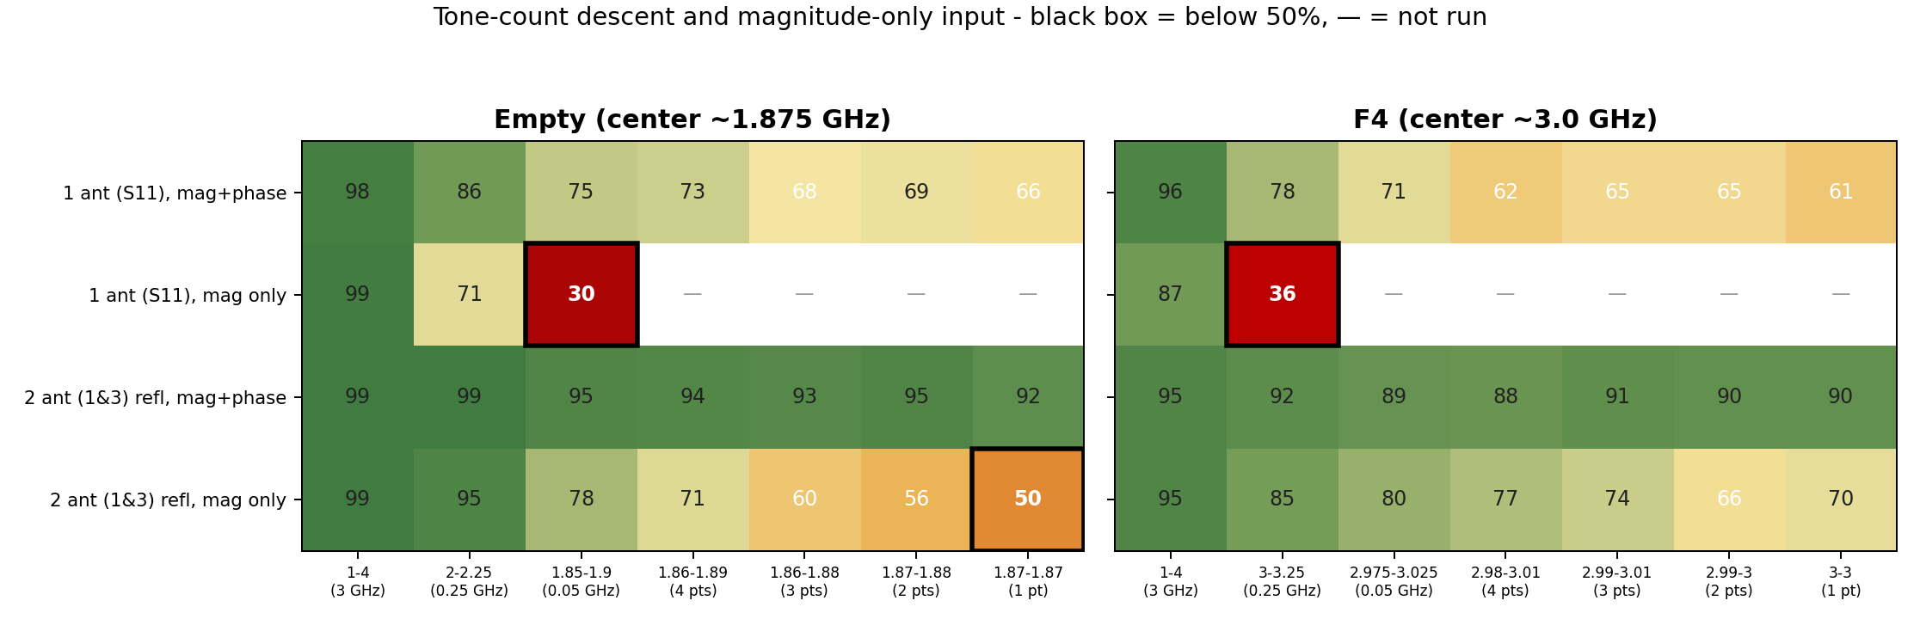
PART 4 · FURTHER REDUCTION
Tone-count descent and magnitude-only input
Configurations that had not crossed 50%, reduced further. Tone columns: 4 -> 1 frequency points on the native 10 MHz grid (1 pt = a single CW tone). Mag-only rows use |S| only (no phase). Single-tone, mag+phase: empty 66.0 (1 ant) / 91.5 (2 ant refl); F4 60.9 / 90.4. Mag-only with one antenna: 87-99 at 1-4 GHz but below 50% by 0.05-0.25 GHz (30.1 / 35.9); with two antennas: 49.7 (empty) and 69.9 (F4) at a single tone.

