Slide 1
PART 1 . PHYSICAL MEASUREMENTS
(x, y) tumor localization on the A3 phantom
Bench VNA S-parameters to continuous coordinate regression: CNN vs MLP, under LOSO, LOPO-cell and single-position hold-out
0.15 in
3.9 mm
3 phantoms
best cross-session error (empty)
about a sixth of a grid cell
empty, F4, F5 inserts

Slide 2
Measurement setup
4-port VNA, A3 breast phantom in canola oil, Sam Medium antennas
Phantom & medium
A3 breast phantom submerged in canola oil (breast-tissue-like permittivity). A metal fishing-weight tumor is moved to each grid position.
1
RF acquisition
4 antennas into a 4-port VNA. Full 4x4 S-matrix (16 S-parameters), magnitude and phase, swept 0.1 to 8 GHz (791 points).
2
Sampling grid
6x6 array of cells, pitch about 25.4 x 23.85 mm. Each cell has 4 sub-positions at its corners (about 9.5 mm in). Roughly 51 sub-positions on the empty phantom.
3
Repeats & sessions
16 takes per position; 3 to 4 sessions per phantom (re-set between sessions, so real drift). Three variants: empty, F4 (small insert), F5 (large insert).
4

Slide 3
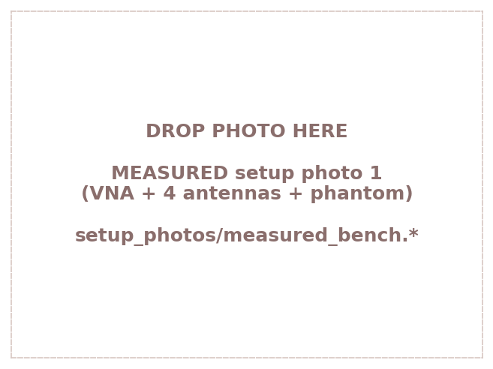
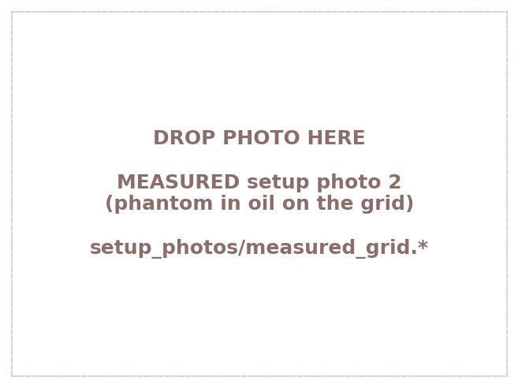
The measurement setup, in pictures
The bench VNA, the 4-antenna array, and the A3 phantom on the grid
Bench: VNA + antenna array
Phantom in oil on the grid
Replace the placeholders in regression_deck/setup_photos/ (measured_bench.*, measured_grid.*) with real photos.

Slide 4
From “which cell” to “exact (x, y)”
Same CNN and MLP as the classifier, with the head swapped for coordinate regression
Targets
Grid label RnCmPp to a true (x,y) in inches (corner offsets of 0.375 in; photo-digitized where an insert blocked a corner). Never snapped to a grid point.
1
Models
CNN: conv trunk (32 to 32) then fc(2) + regression. MLP: 3-seed ensemble. Input = raw 16 S-params as a 32 x freq image; per-session z-score; v2 preprocessing.
2
Metric
Euclidean error in inches (x25.4 = mm). Median error plus percent within the 0.5 in half-cell.
3
Protocols
LOSO holds out a whole session. LOPO-cell holds out a whole 1 in cell. LOPO single-position holds out one sub-position (its cell-mates stay in training).
4

Slide 5
Three ways to test the model
Each hold-out asks a harder question about generalization
LOSO
LOPO single-position
LOPO-cell
leave one session out
leave one sub-position out
leave one whole cell out
S1 train
S2 train
S3 test
one point held out,
cell-mates stay
one cell held out
Held out: a whole recording session
Held out: one point (its 3 cell-mates ~0.75 in away stay in)
Held out: all 4 points of a 1 in cell
Question: Can it read a NEW scan of positions it already knows?
Question: Can it reach an unseen point that has close neighbors?
Question: Can it bridge a full inch to a spot with NO nearby signature?
Easiest
Medium
Hardest

Slide 6
New scan of a known grid (LOSO)
Median localization error: the CNN nails it; the MLP lags and physics features break it
What it says
CNN wins everywhere: 0.15 in (3.9 mm) on empty, under a quarter inch even on F5.
Raw is as good as physics for the CNN, so raw is the pick (simpler, faster).
MLP is 3 to 4x worse; with physics it collapses to the predict-centre baseline.
At least 90 percent of positions land within the half-cell on all three phantoms.

Slide 7
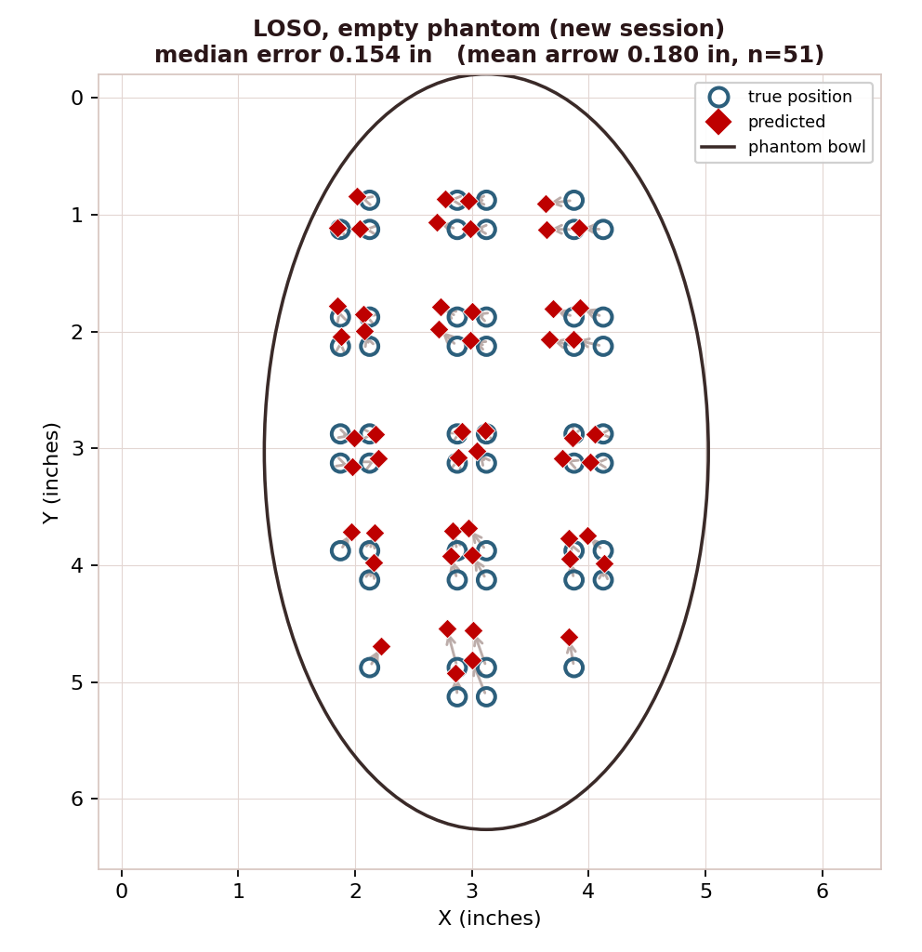
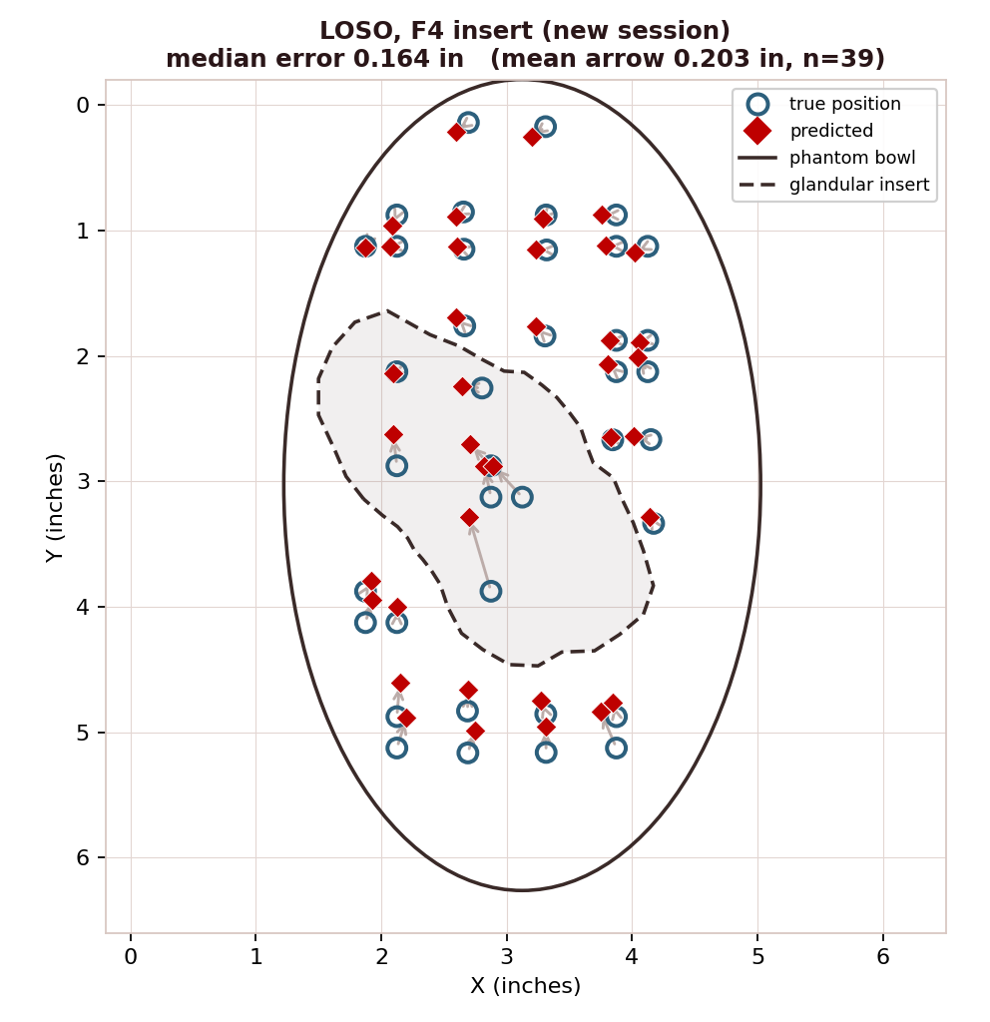
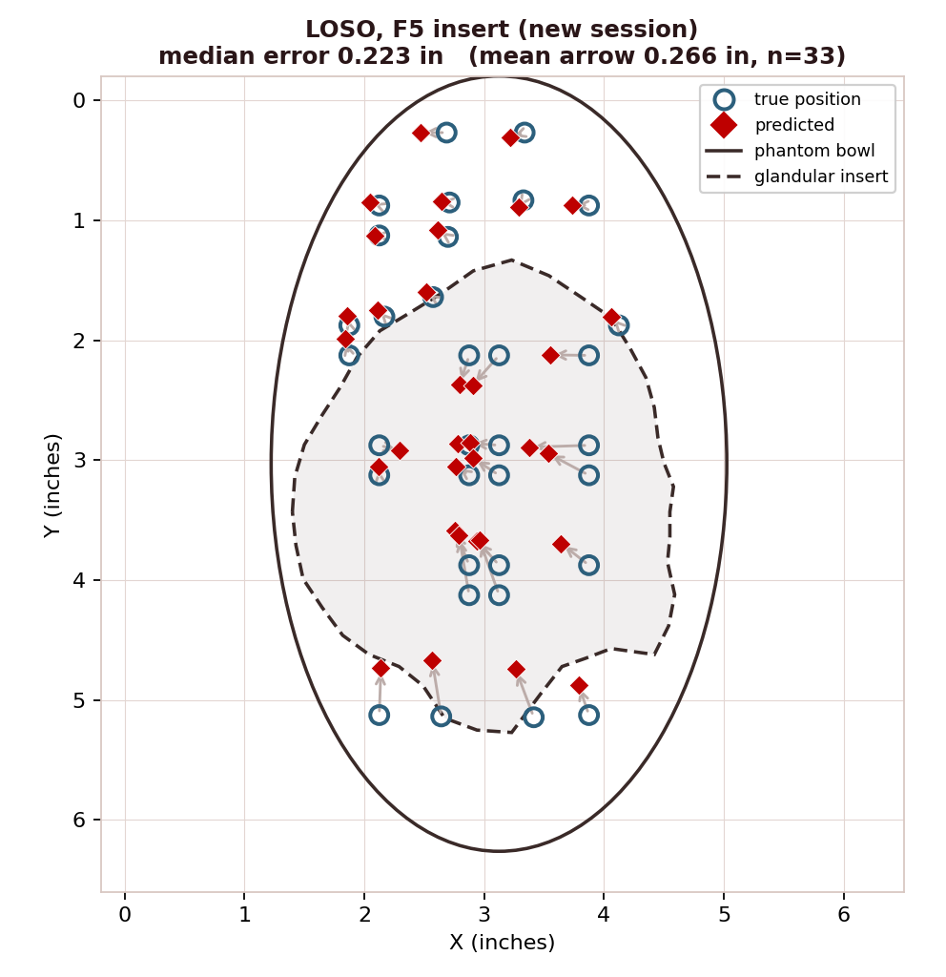
Predicted vs. actual, LOSO (CNN)
Crimson diamonds = prediction, open circles = true position, arrow = the error
Empty 0.15 in
F4 insert 0.16 in
F5 insert 0.22 in
Across empty, small (F4) and large (F5) inserts the CNN lands within a fifth of a cell. A new measurement session is not a problem.

Slide 8
Interpolating to an unseen cell (LOPO-cell, CNN)
Hold a whole 1 in cell out of training, then predict a spot with no signature nearby
Three findings
Model = CNN (raw, all 4 antennas), same as LOSO.
Pooled = the held-out cell is removed from EVERY session, train on all the rest. In-session = train and test inside one session (drift removed).
Interpolation is 3 to 4x harder than a new session (0.47 to 0.67 vs 0.15 to 0.22 in).
Pooled beats in-session on all three: for interpolation, more data beats removing drift.

Slide 9
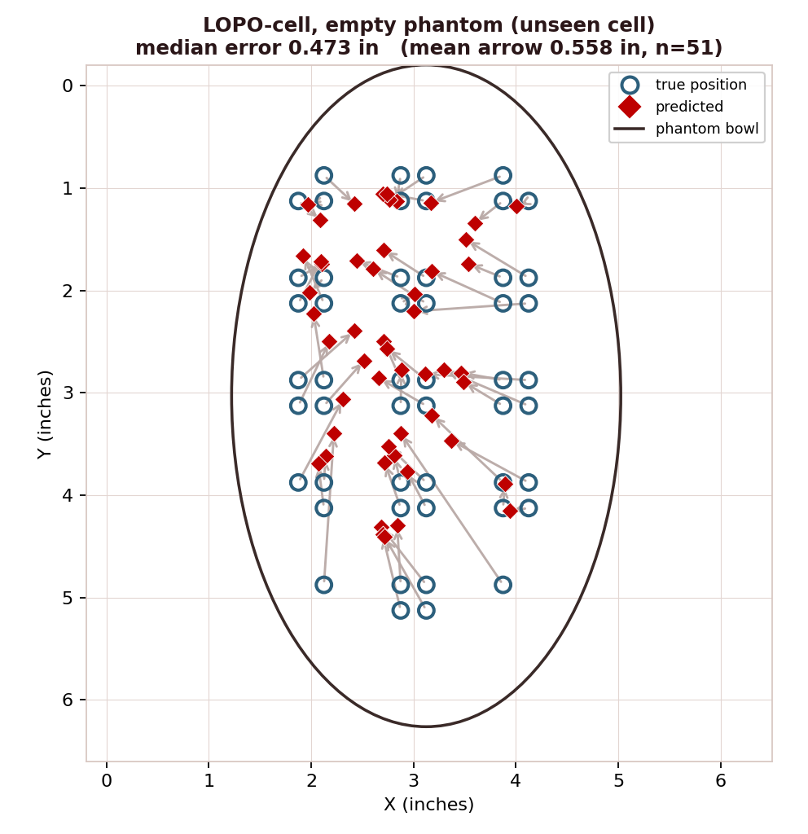
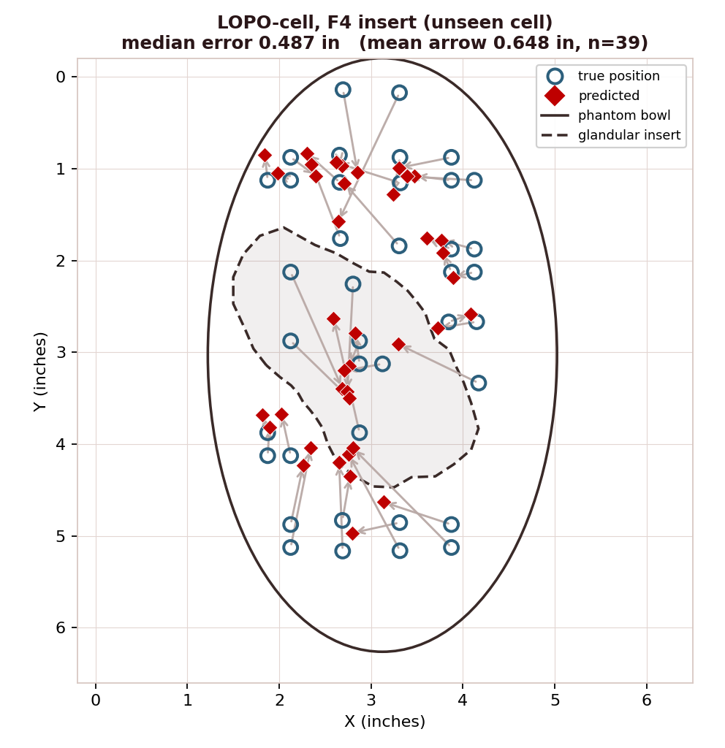
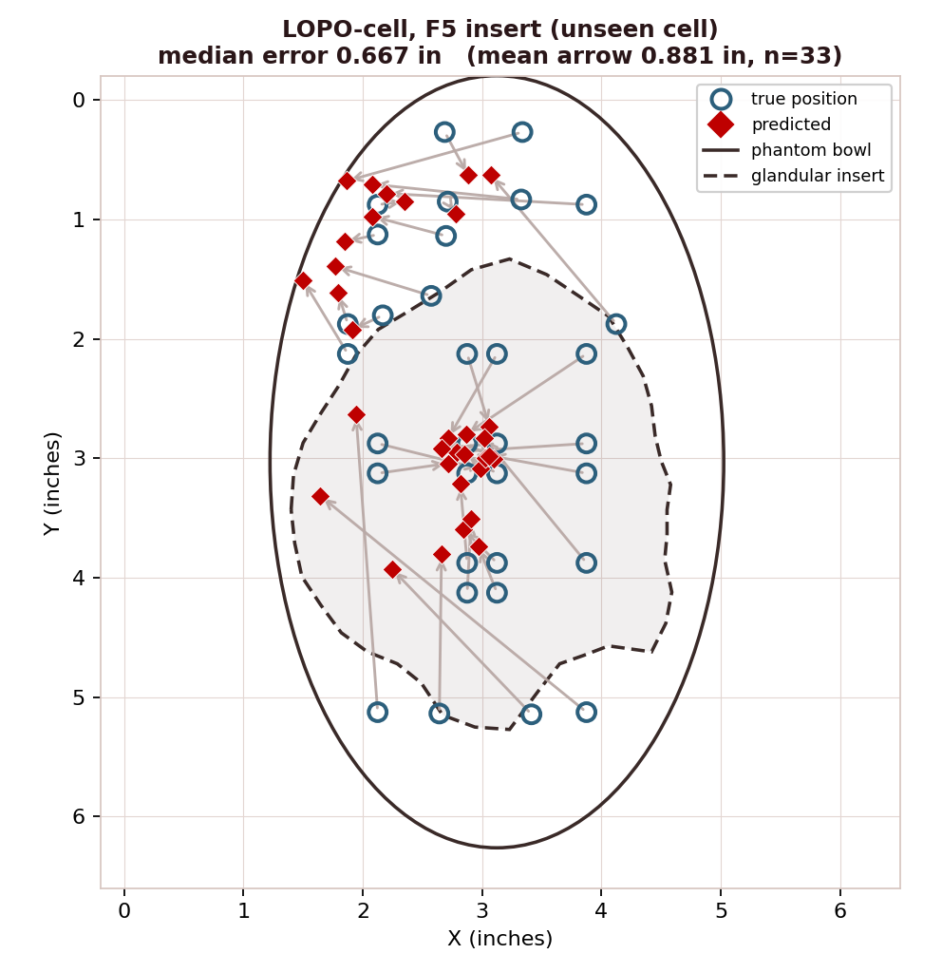
Predicted vs. actual, LOPO-cell (CNN, pooled)
Predicting locations never sampled; the dashed outline is the glandular insert
Empty 0.47 in
F4 insert 0.49 in
F5 insert 0.67 in
Interpolation error climbs with insert size (0.47, 0.49, 0.67 in) and predictions pull inward, concentrating over the glandular insert the CNN never sampled.

Slide 10
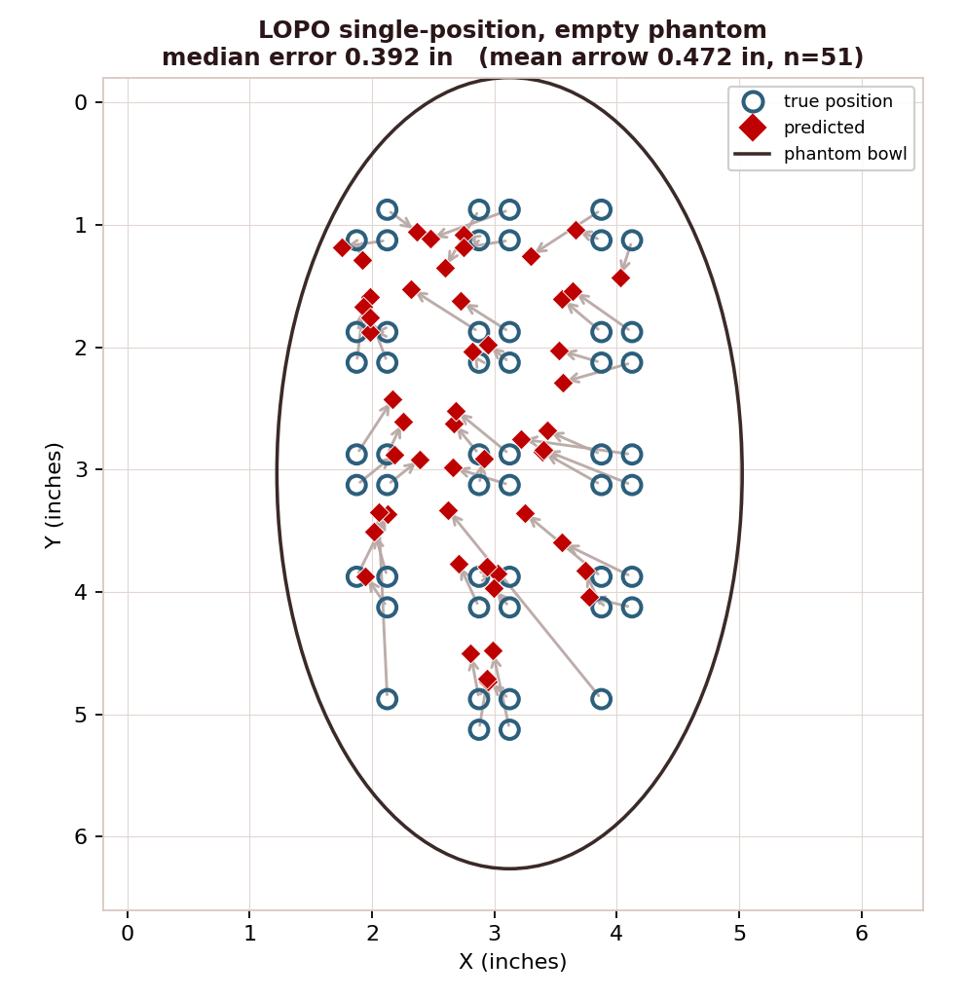
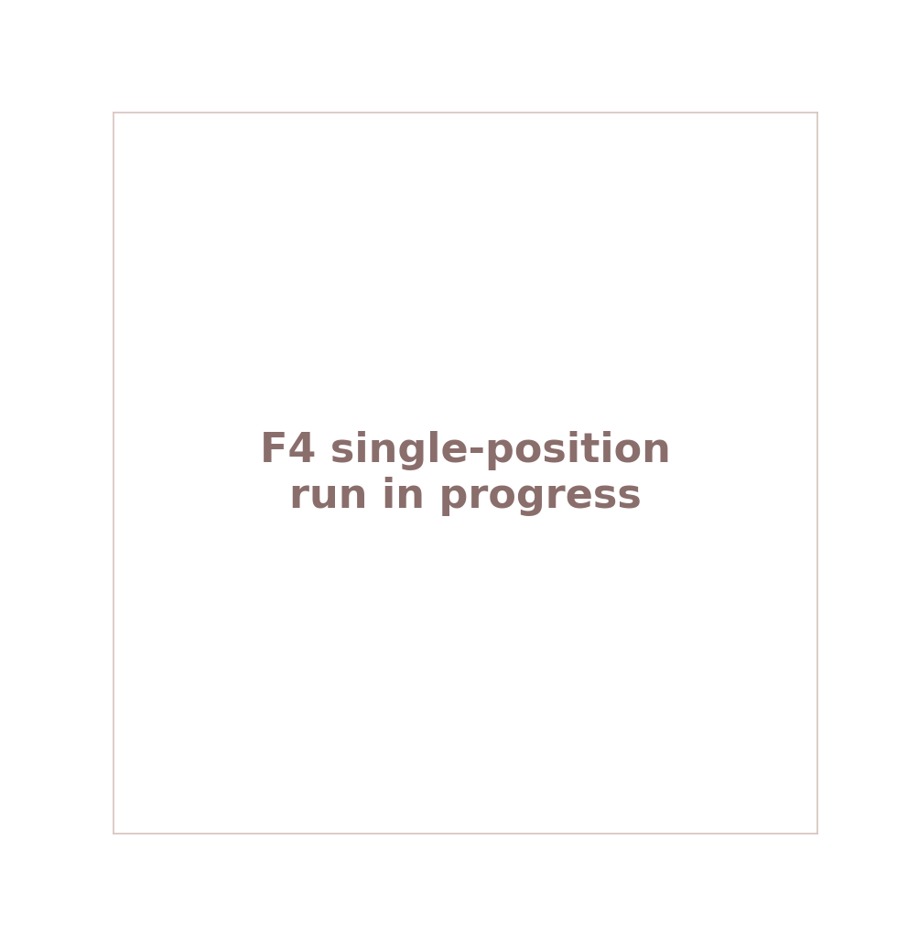
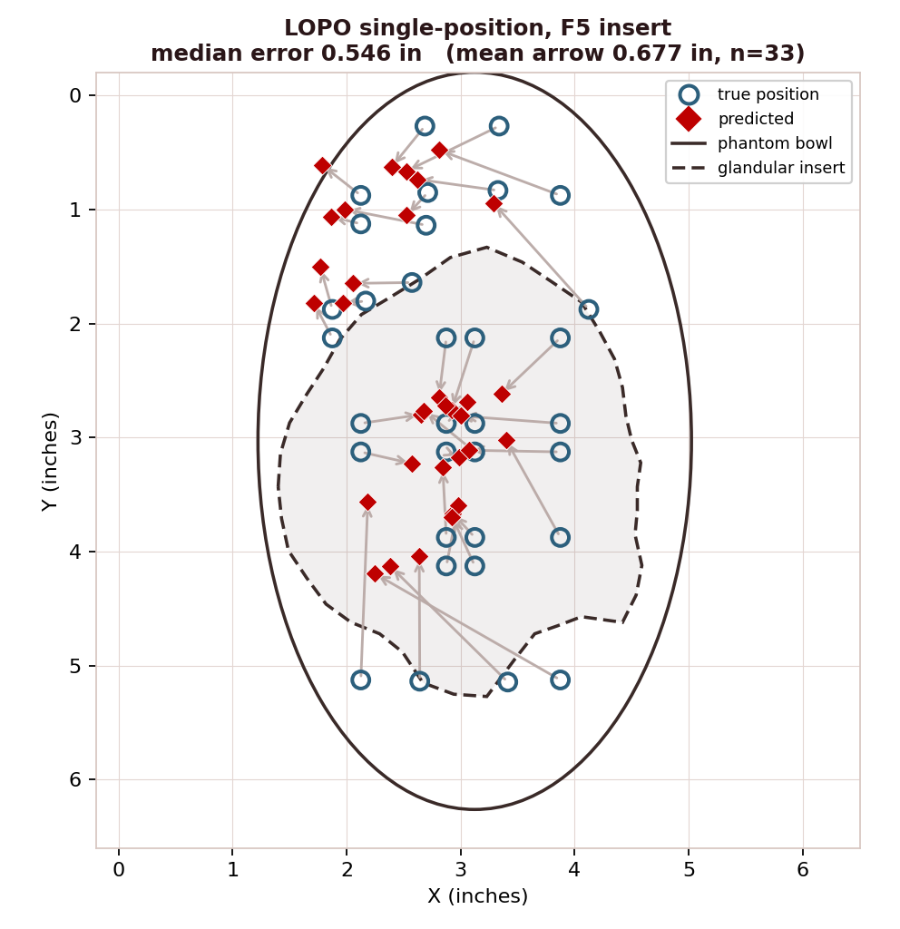
Predicted vs. actual, single-position (CNN, pooled)
Hold out one sub-position; its 3 cell-mates stay in training
Empty 0.39 in
F4 insert pending
F5 insert 0.55 in
With close cell-mates left in training, single-position error is lower than the whole-cell hold-out (empty 0.39 vs 0.47 in, F5 0.55 vs 0.67 in).

Slide 11
Single-position accuracy (CNN, pooled)
Leaving cell-mates in training makes this the middle rung of difficulty
Reading it
Empty 0.39 in (9.9 mm), F5 0.55 in (13.9 mm).
F4 is running and will drop in here.
Both are below the matching whole-cell numbers, since the 3 cell-mates give close anchors.
Still above the roughly 6 mm signal floor, so the CNN is data-limited on about 50 positions.

Slide 12
All three protocols side by side
How hard is each generalization task? (raw CNN median error, inches)
The ladder of difficulty
LOSO (0.15 to 0.22 in): a new scan of KNOWN positions. Easiest.
Single-position (0.39 to 0.55): unseen point, close anchors. Medium.
LOPO-cell (0.47 to 0.67): unseen 1 in cell, no anchor. Hardest.
Insert size raises every bar; the gap widens as the task gets harder.

Slide 13
Can we teach it to interpolate better?
Three tricks tried on the HARDEST case (F5 LOPO-cell, baseline 0.664 in); only one helps
What this shows
Lower is better. Grey bars made it worse than the baseline; the crimson bar is the only improvement.
Mixup, WIN
blend sample pairs and their (x,y): 0.664 to 0.572, and it helps the insert region most.
Position-split validation and heatmap output, NO
one starves the ~30 scarce training positions; the other biases predictions toward centre.

Slide 14
Part 1, bottom line
1
The CNN localizes to a sixth of a cell: about 0.15 in (3.9 mm) cross-session on empty, under a quarter inch with a glandular insert. Regression works, and the CNN owns it.
2
Raw beats physics for regression: physics features are redundant for the CNN and break the MLP, the reverse of the classification result.
3
Difficulty ladder: LOSO < single-position < cell: a new scan of known spots is easy; an unseen single point is medium; an unseen whole cell is 3 to 4x harder than LOSO.
4
The glandular insert is visible in the errors: LOPO predictions pull inward and concentrate over the traced insert, which the CNN never sampled.
5
Mixup is the one lever that helps: teaching a smooth signal-to-coordinate map cuts error 14 percent; validation-splitting and heatmap output hurt on this small set.
github.com/pmart1534/microwave-phantom-localization-cnn-mlp

