Slide 1
SIM AUGMENTATION
Making the simulation behave like the bench
The HFSS sim is noise-free, so classification is trivially perfect and there are no sessions to hold out. We inject the bench's two measured nuisances so the sim supports LOSO and classification.
SNR ~6.6x
~12%
-> LOSO + classify
per-take measurement noise
cross-session drift
on augmented sim

Slide 2
Why augment the simulation?
The deterministic sim cannot exercise the protocols the bench uses
The problem
The fix
HFSS gives ONE noise-free S-parameter set per position.
Classification is then trivially 100% - each position is a unique, exactly-repeatable signal.
There are no 'sessions' or repeat 'takes', so leave-one-session-out (LOSO) cannot even be run.
So the sim can't tell us where a real system breaks under noise, reduced antennas, or narrow bandwidth.
Inject the two nuisances the bench actually has, measured from the June18 A3 data:
per-take measurement noise (signal/noise ~6.6x)
cross-session drift (~12% of the signal)
Synthesize N sessions x takes per position, so the augmented sim has the SAME data structure as the bench.
Match the RATIOS, not absolute levels - the sim tumor signal is ~5-7x weaker (antenna-model mismatch).

Slide 3
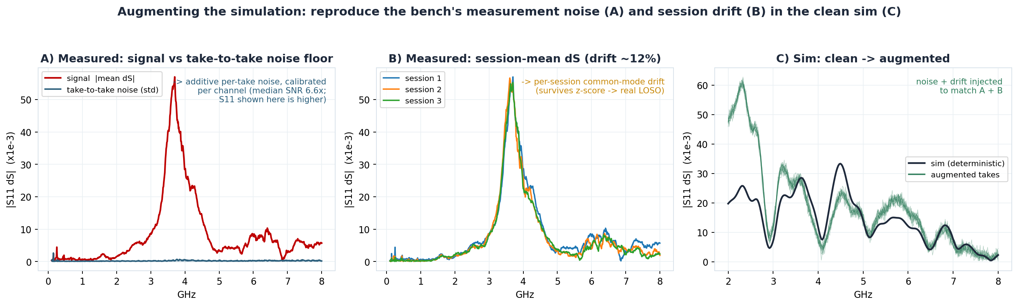
What the bench has that the sim lacks
Measured on the tumor differential dS: per-take noise (A), session-to-session drift (B); the augmentation reproduces both (C)

Slide 4
Step 1: additive measurement noise
Why: the bench has per-take noise How: SNR-matched, per S-parameter
Why
How
Each measured position is taken 16 times; the takes vary (thermal/receiver noise).
Measured signal / take-to-take noise = ~6.6x (median over all S-parameters).
Without this, the sim classifier never makes a mistake.
Add complex Gaussian noise to each S-parameter, generating multiple synthetic takes per position.
noise std per channel: sigma_c = sim_signal_c / SNR_c
SNR_c pulled per S-parameter from the bench (reflections higher, transmission lower), not one global value.
This matches the bench's signal-to-noise ratio while respecting that the sim signal is weaker.

Slide 5
Step 2: cross-session drift
Why: sessions differ, and LOSO must be a real test How: common-mode, frequency-structured
Why
How
Between sessions (recalibration, cabling, temperature) the response drifts ~12% of the signal.
A per-session z-score removes any constant scale, so drift must be FREQUENCY-STRUCTURED to survive it.
If it survives z-score, held-out sessions look genuinely different - so LOSO tests real generalization.
Per session: a smooth complex gain (a few low-order frequency modes) shared across antennas,
+ a small per-antenna gain and a small frequency (resonance) jitter.
Kept mostly COMMON-MODE across the 4 antennas so the 'which-antenna' spatial pattern is not scrambled.
Amplitude set so the synthetic cross-session variation lands at ~12%, matching the bench.

Slide 6
Validation: synthetic vs bench
The augmented sim reproduces the measured statistics it was calibrated to
Statistic | Bench (June18 A3) | Augmented sim
Per-channel SNR (signal / noise) | 6.6x | 6.8x (matched per S-param)
Cross-session drift (% of signal) | ~12% | 13%
Full-config LOSO classification | ~99-100% | 99.5% (CNN)
Noiseless sanity (no nuisances) | - | 100% (trivial)
Calibrated to, and validated against, the same measured baselines/tumor takes - not tuned by hand.

Slide 7
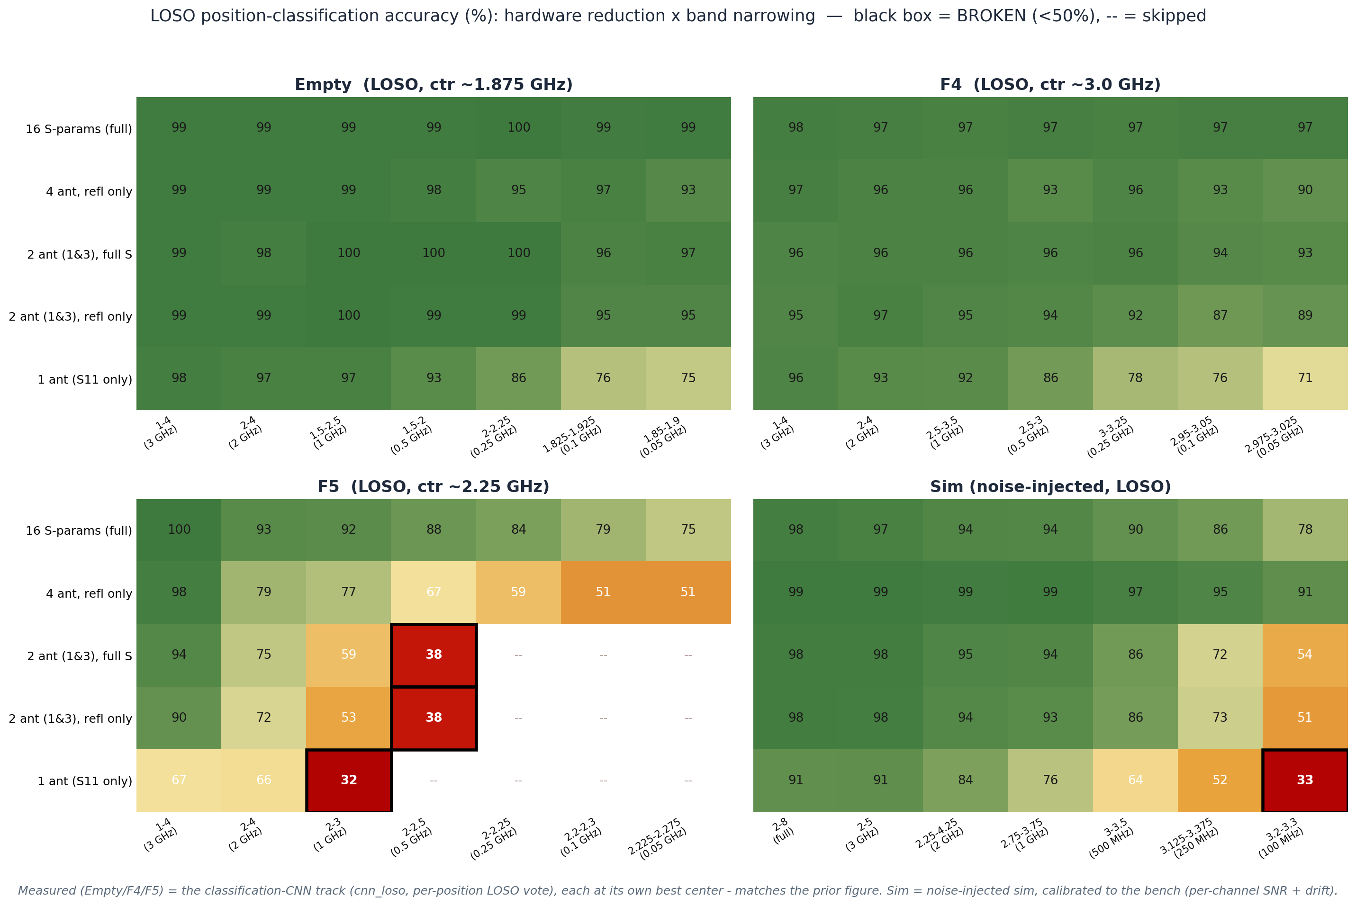
Result: classification under reduction (LOSO)
Measured (Empty/F4/F5) = the classification-CNN track (cnn_loso, per-position vote); Sim = augmented. Black box = <50%.

Slide 8
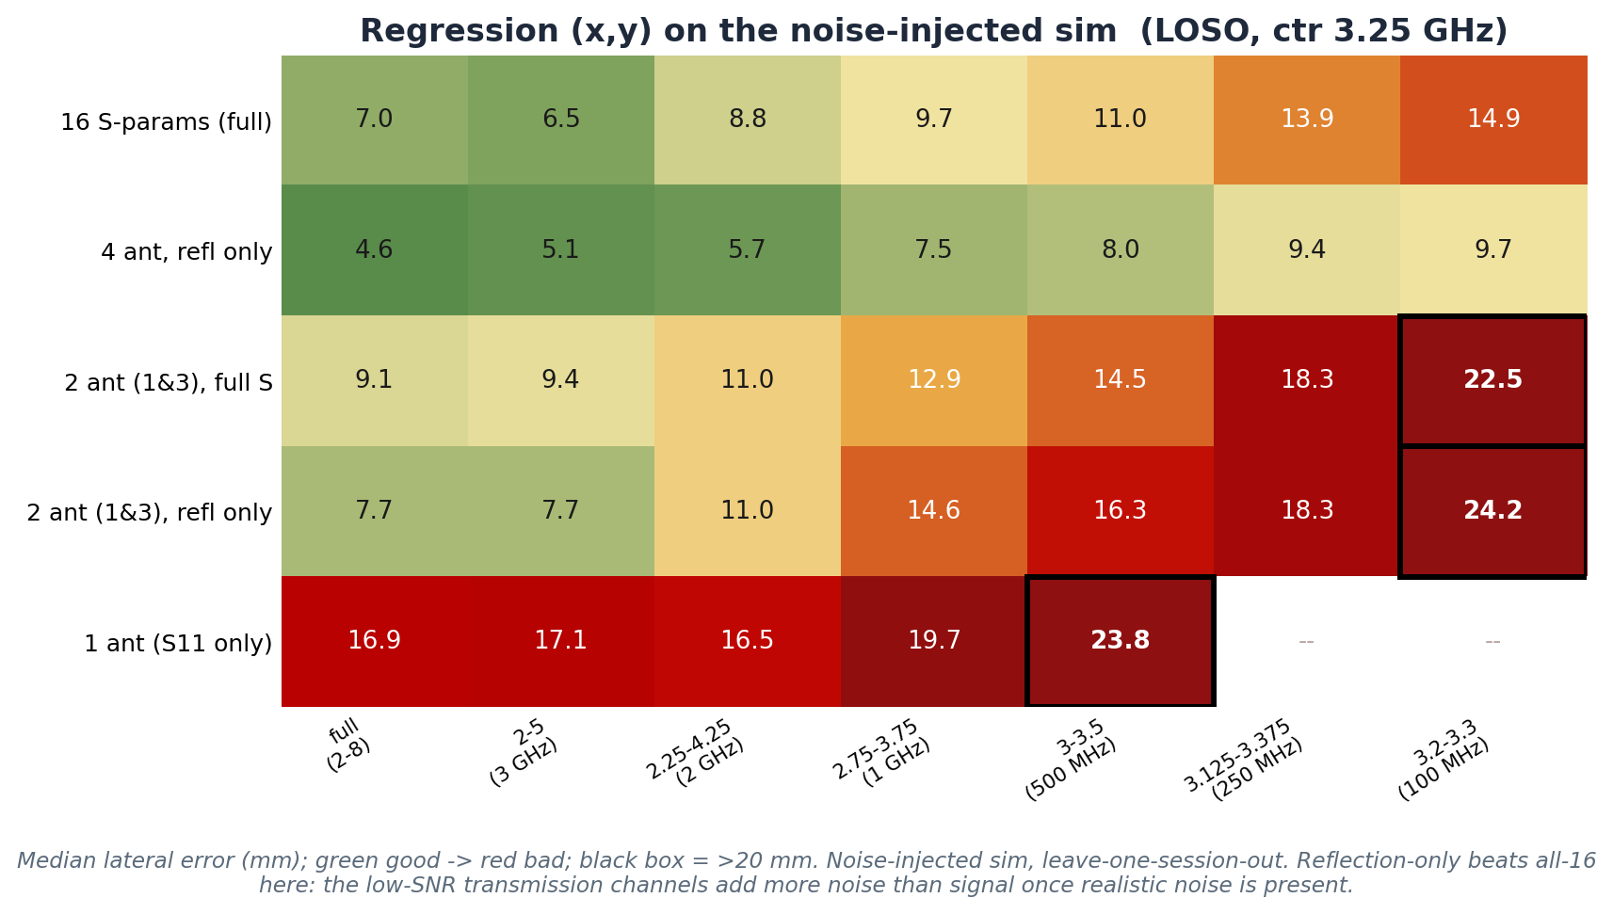
Regression (x,y) on the augmented sim (LOSO)
Median lateral error under hardware x band reduction; reflection-only beats all-16 once realistic noise is present

