Slide 1
RESULTS
Bandwidth & hardware reduction for the tumor localizer
Median (x,y) localization error as the RF band is narrowed and antennas / features are removed
Measured
Simulated
Metric
A3 phantom, session-LOSO CNN
HFSS metal, 8-fold CNN
median lateral (x,y) error, mm

Slide 2
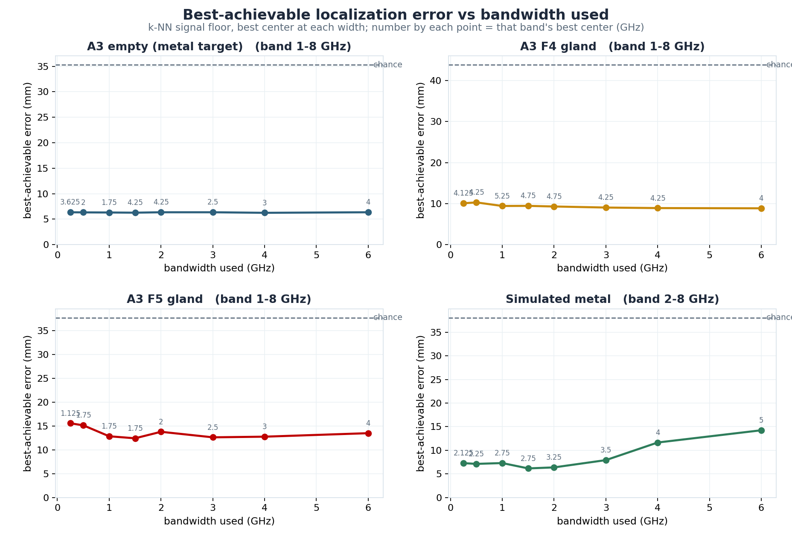
Localization error vs bandwidth used
k-NN signal floor; per configuration, best center at each width

Slide 3
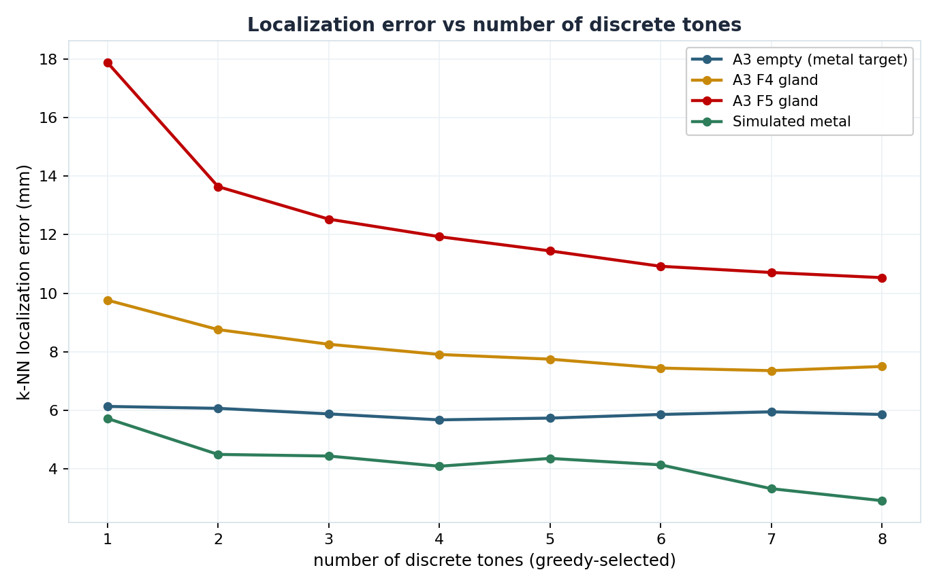
Localization error vs number of discrete tones
Greedy-selected frequency tones; per configuration

Slide 4
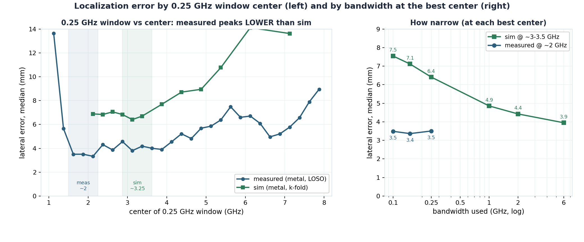
Error by 0.25 GHz window center, and by bandwidth at the best center
Measured (empty/F4/F5) and simulated; 0.25 GHz windows across the band (left), bandwidth knee (right)

Slide 5
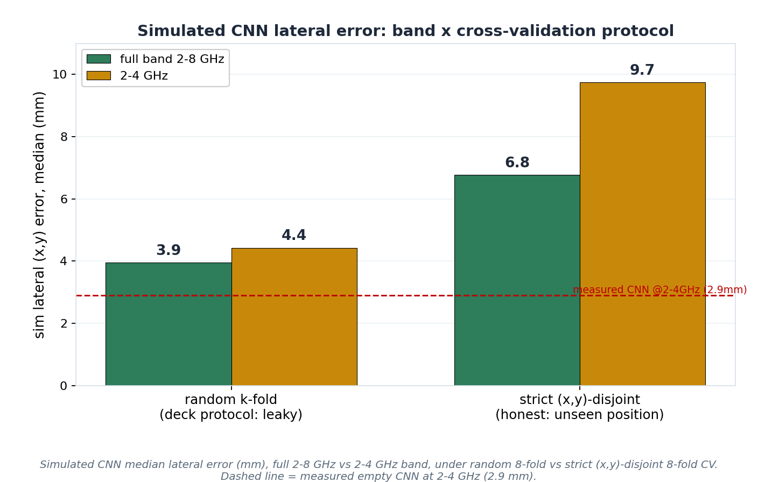
Simulated CNN error: band x cross-validation protocol
Full 2-8 GHz vs 2-4 GHz; random 8-fold vs strict (x,y)-disjoint 8-fold

Slide 6
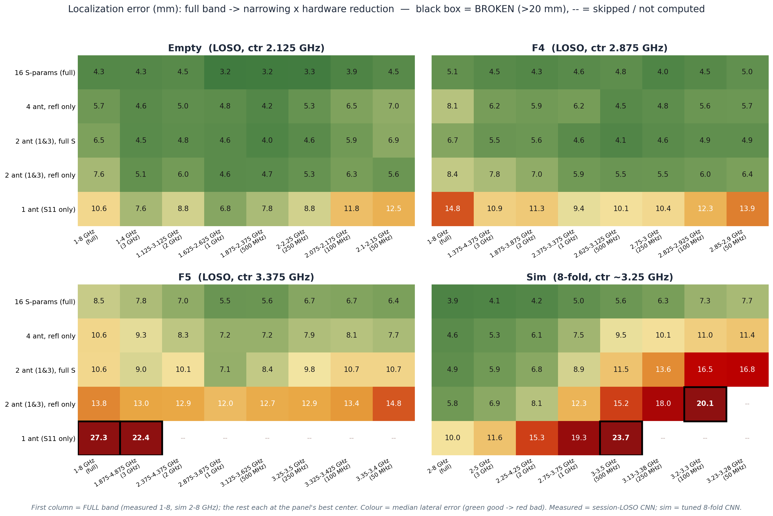
Hardware reduction x band narrowing
Median lateral (x,y) error, mm; each panel at its own best center; black box = >20 mm

Slide 7
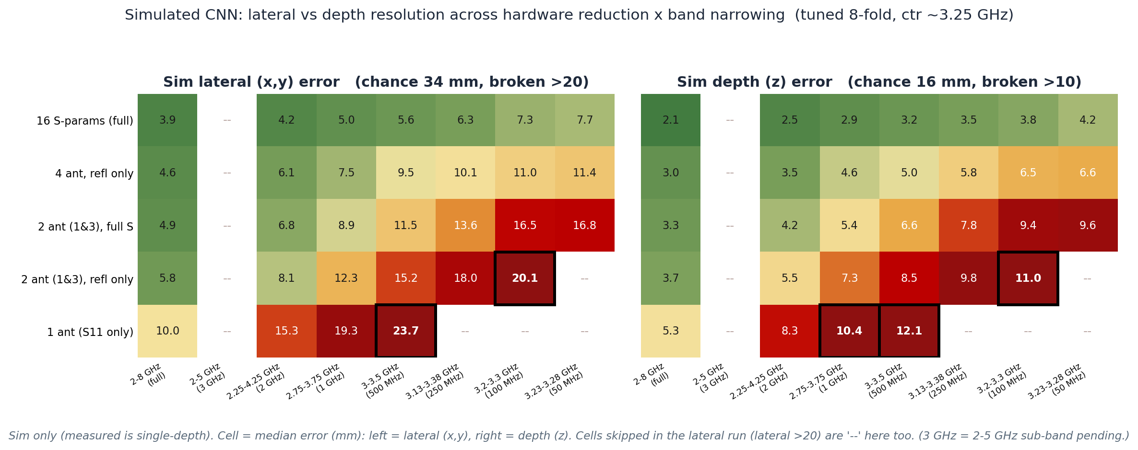
Simulated CNN: lateral (x,y) vs depth (z) error
Same reduction grid; simulated only (measured is single-depth)

