Slide 1
PART 3 . SIM vs MEASURED
Comparing simulation and bench, empty phantom
Do the two agree? The signal interpolates equally well on both; the apparent gap is data coverage, not simulation fidelity
6.7 vs 6.0 mm
distinct positions
R2 = 0.65
k-NN signal floor: sim ~ measured
the real driver of the CNN gap
empty signal transfers; tumor transfer still open

Slide 2
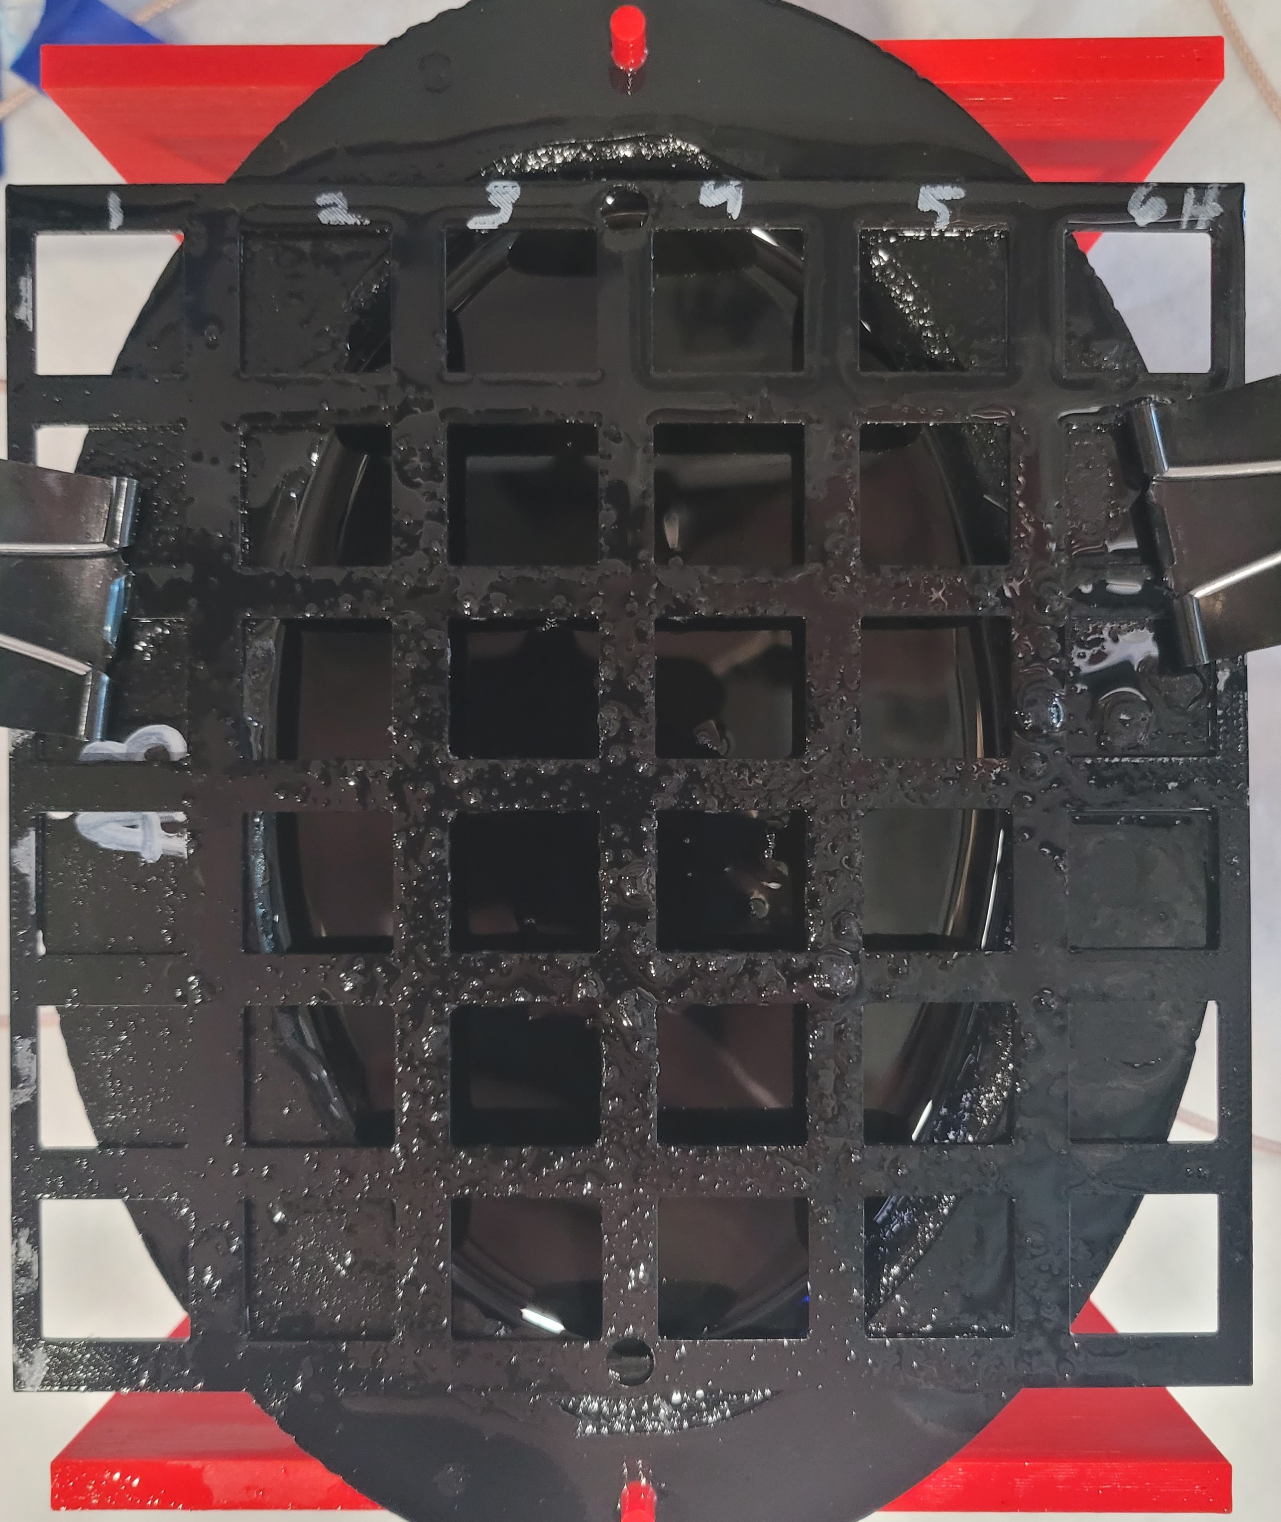
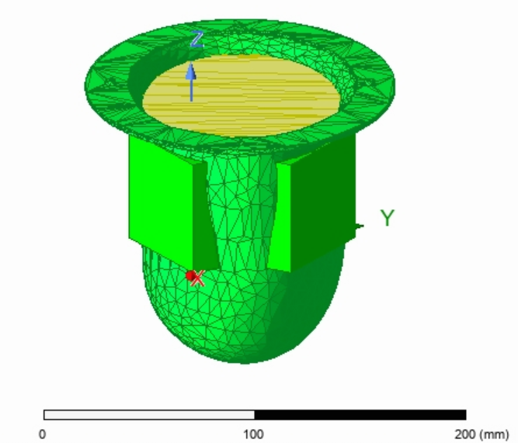
The two setups, side by side
The physical A3 phantom on its grid, and the HFSS model of the same phantom
Measured: A3 phantom + 6x6 grid + antennas
Simulated: HFSS phantom, oil, antennas, tumor

Slide 3
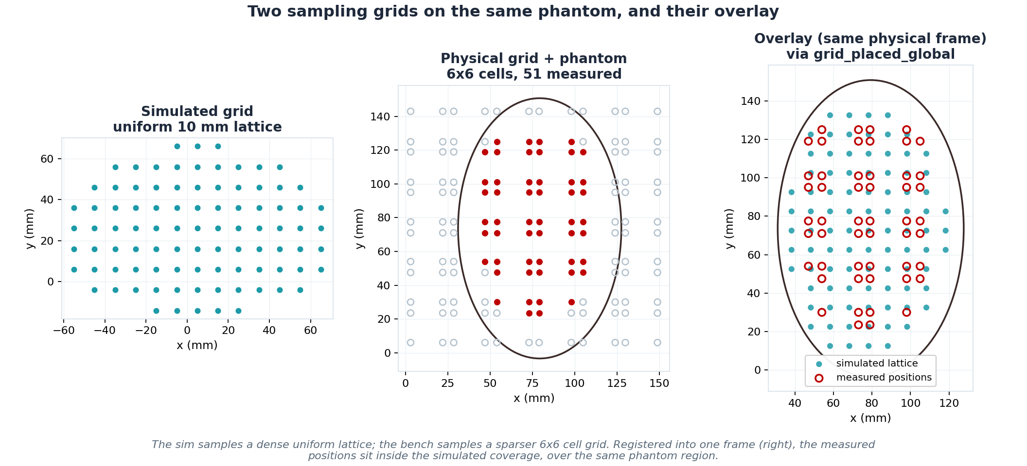
Two sampling grids, and their overlay
Same phantom, different coverage; the right panel registers both into one physical frame

Slide 4
What differs between the two
Same antenna design, but grid, depth coverage, band and noise differ
 | Simulated (HFSS) | Measured (bench VNA)
Antennas | Sam's Medium Antennas (HFSS model) | Sam's Medium Antennas (physical build)
Grid | uniform 10 mm lattice, 91 positions | 6x6 cells, 4 corners each; 51 measured
Depth | 13 planes, z = -15 to +45 mm | single height, ~5 to 20 mm (near the patch)
Frequency | 2 to 8 GHz, 3001 points | 0.1 to 8 GHz, 791 points
Noise / drift | none (deterministic solve) | measurement noise + cross-session drift
Repeats | one solve per position | 16 takes x 3 sessions per position
The 4 antennas are the SAME design in both; a fair sim vs measured comparison controls for the grid, depth, band and noise.

Slide 5
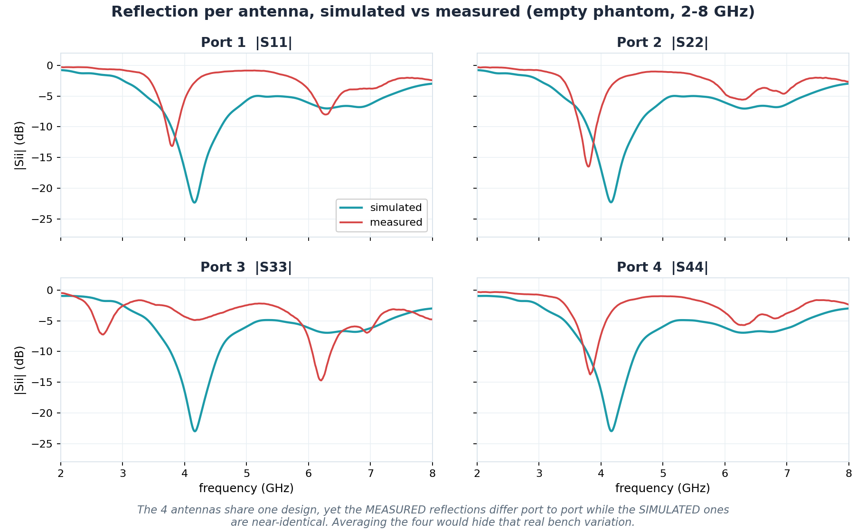
Reflection per antenna, sim vs measured
Same design, yet the measured ports differ from each other; the sim ones are near-identical

Slide 6
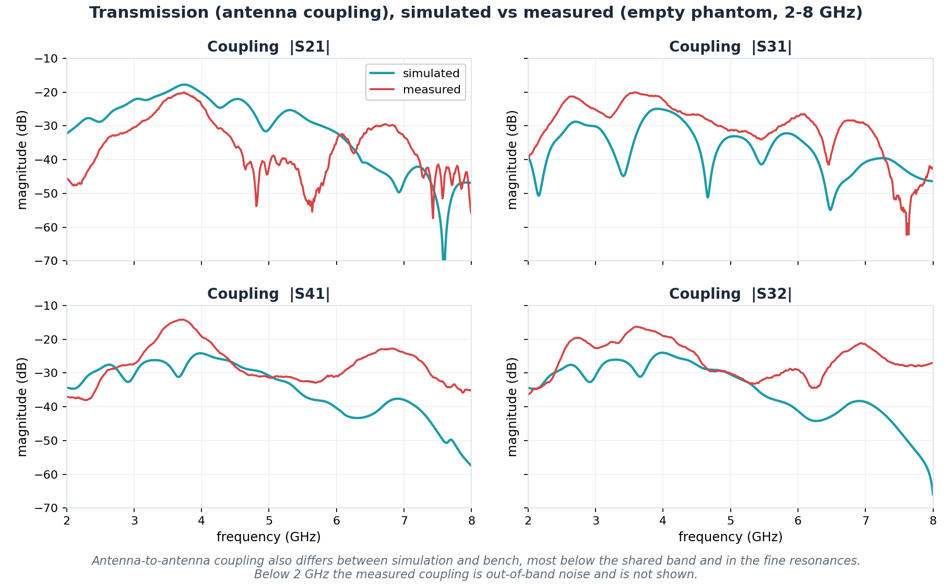
Transmission (coupling) per pair, sim vs measured
Four representative antenna-to-antenna terms; couplings also differ between domains

Slide 7
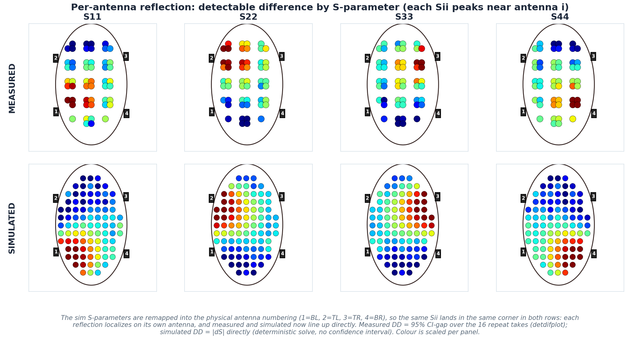
Detectable difference by reflection S-parameter
Each reflection Sii localizes on its antenna, in measured (top) and simulated (bottom)

Slide 8
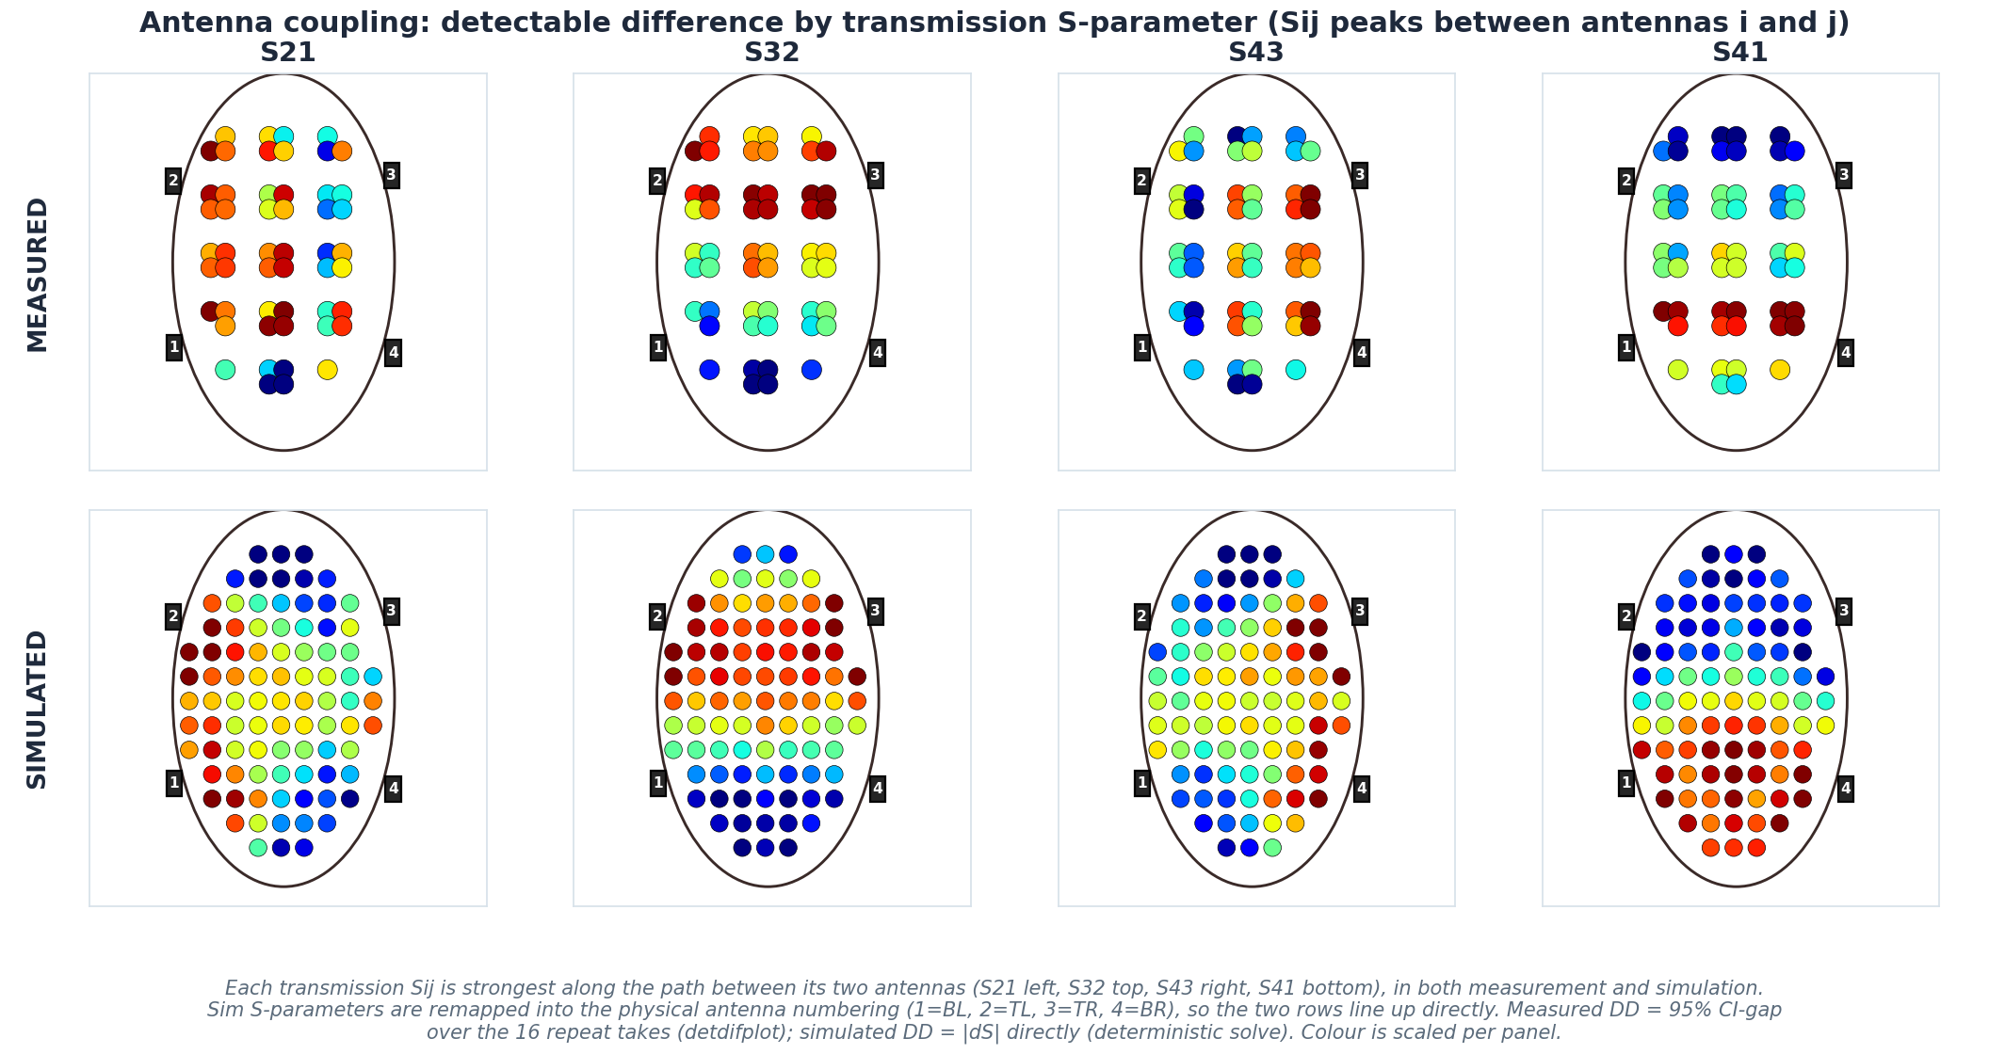
Detectable difference by transmission S-parameter
Each coupling Sij peaks between its two antennas (sim remapped to physical numbering)

Slide 9
The numbers, signal vs. model
Does the SIGNAL interpolate, and can the CNN learn it? (empty phantom)
Probe | Sim empty | Measured empty
k-NN (training-free signal floor) | 6.7 mm | 6.0 mm
CNN LOSO (new session, seen positions) | - | 3.9 mm
CNN LOPO single-position (unseen position) | - | 9.9 mm
CNN 8-fold (full depth stack, ~1000 pos) | 3.9 mm | -
What is k-NN?
A training-free baseline: to locate a held-out spot it just averages the (x,y) of the most similar measured signals. Nothing is fit, so it measures how well the SIGNAL alone pins down location, a floor any trained model should beat.
What the numbers mean
Signal floor is the same: sim 6.7 vs measured 6.0 mm; the two agree closely.
LOSO (3.9) sees a new session at KNOWN spots (easy); LOPO single-position (9.9) reaches an UNSEEN spot (hard, ~50 distinct positions).
Sim hits 3.9 on unseen spots only via ~1000 distinct positions.
The sim vs measured CNN gap is distinct-position COVERAGE, not fidelity. To match 3.9 mm on the bench: denser grid / more depths, not a better model.

Slide 10
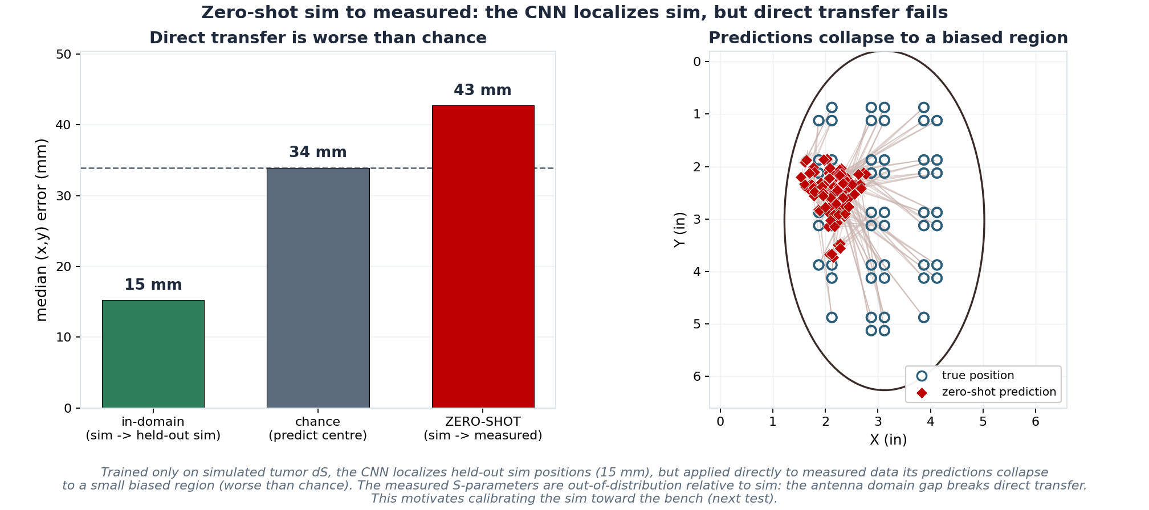
Test 1: zero-shot, train on sim only, test on the bench
If the CNN sees only simulated tumors, can it locate a real one? Direct transfer collapses
What this tests
Train a CNN on simulated tumor dS only; no measured data is seen in training.
Then hand it the measured S-parameters and ask for (x,y).
The result
In-domain (held-out sim) it localizes to 15 mm, so the pipeline works.
On the bench it hits 43 mm, worse than the 34 mm predict-centre chance line (median of 5 seeds).
Predictions collapse to one biased region: the measured signal is out-of-distribution for a sim-only model.
The antenna domain gap breaks direct transfer. The sim signal must be calibrated toward the bench first (next slides).

Slide 11
How the sim to measured map is learned
A linear transfer fit on the empty baseline and tested on frequencies it never saw
Pair the empty baselines
Sim empty phantom and measured empty phantom are the same physical state (no tumor), so their S-parameters can be matched frequency by frequency.
The equation
1
y = W x + b
One vector per frequency
At each of 512 frequencies (2 to 8 GHz), stack the real and imaginary parts of the 16 S-parameters into a 32-D vector. Sim = input x, measured = target y.
x = sim [Re, Im of 16 S-params] (32-D); y = predicted measured; W (32x32) and b learned on the train frequencies.
2
Split the frequencies 70 / 30
Fit on 70% of the frequencies; hold out the other 30% for testing. The map never sees the test frequencies while it is being fit.
Why R2 = 0.65 is meaningful
3
R2 is computed only on frequencies the map never used while fitting, so it measures genuine generalization, not curve-fitting.
A model that merely memorized the training frequencies would score near 0 on the held-out set. The flexible MLP did exactly that (R2 < 0).
So R2 = 0.65 says a fixed linear transform already recovers most of the measured signal from the sim, on data it has not seen.
Fit the linear map
Ridge (L2) regression learns a 32x32 matrix W and offset b that best convert the sim vector into the measured vector.
4
Test on the held-out 30%
Apply W and b to the unseen frequencies and compare to the true measured values, giving R2 = 0.65.
5

Slide 12
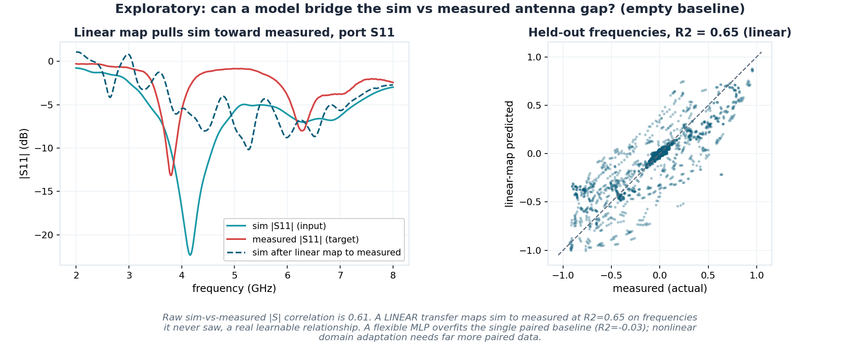
Can a model bridge the gap? (exploratory)
The learned map applied to one port, and its accuracy on unseen frequencies
How to read it
Left: the dashed line is the simulated S11 after the map (W x_sim + b). A perfect map would land on the measured (red) curve; it moves toward it but does not fully match.
Right: predicted vs measured on the held-out frequencies. Points on the diagonal are exact; the R2 = 0.65 spread shows the map captures most, not all, of the relationship.
A flexible MLP overfits and fails to generalize (R2 < 0).
Preliminary: only the empty baseline is cleanly paired. Nonlinear domain adaptation needs far more paired data (multiple sessions, matched tumor positions).

Slide 13
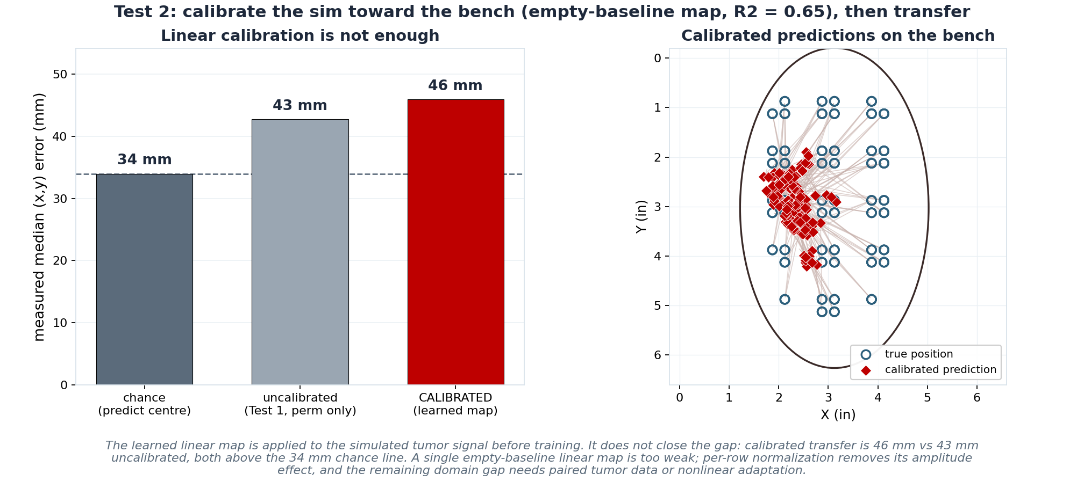
Test 2: calibrate the sim, then transfer
Apply the learned empty-baseline map to the sim tumor signal before training. Does it bridge the gap?
The idea
A tumor signal is a difference dS, so the map's offset cancels: dS_measured-like = W dS_sim.
Train the CNN on the calibrated sim, test on the untouched bench.
The result
The calibration does not close the gap: 46 mm calibrated vs 43 mm uncalibrated, both above 34 mm chance.
Per-sample normalization already removes the map's amplitude effect; what remains is a harder domain gap.
Bridging it needs paired tumor data or nonlinear adaptation, not a single empty-baseline linear map.
Honest negative result: the empty-baseline signal transfers (R2 = 0.65), but that alone is not enough to place a tumor from sim on the bench.

Slide 14
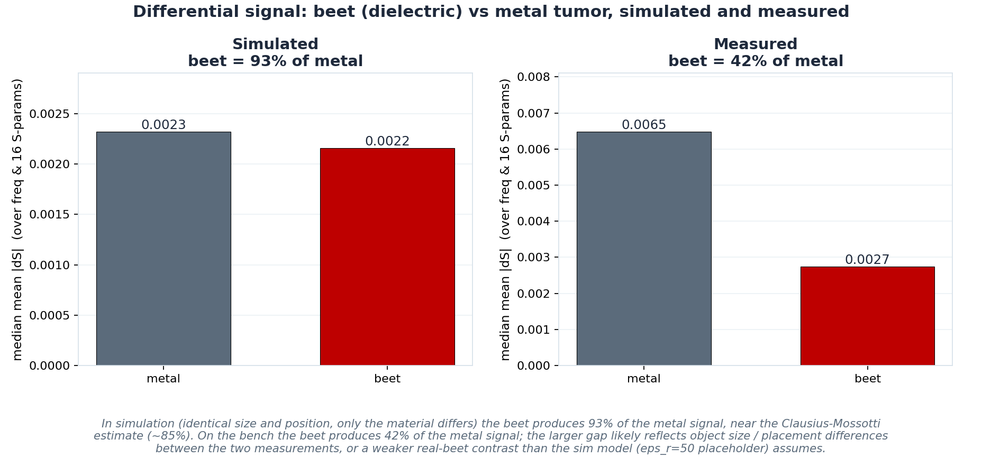
Beet (dielectric) vs metal tumor, sim and measured
How much differential signal a realistic dielectric target produces relative to metal

Slide 15
Part 3, bottom line
1
Sim and measured agree at the signal level: the empty phantom interpolates to ~6 mm on both (k-NN), indicating the simulated signal is realistic.
2
The detectable-difference pattern matches: bench and sim place the tumor's strongest change in the same regions (toward the antenna sides).
3
The CNN gap is data coverage, not fidelity: sim's 3.9 mm comes from ~1000 distinct positions; measured's 9.9 mm from only ~50. Same model, different coverage.
4
Sim predicts beet approximately equals metal, but the bench does not: in sim the beet produces 93% of the metal signal; on the bench only 42%, flagging an object-size / depth mismatch or an optimistic sim beet model.
5
The empty signal transfers, but a sim-only tumor model does not: a linear map reaches R2 = 0.65 on the empty baseline, yet a CNN trained only on sim lands at 43 mm on the bench (worse than chance), and that linear calibration alone does not fix it (46 mm). Closing the gap needs paired tumor data or nonlinear adaptation.
github.com/pmart1534/microwave-phantom-localization-cnn-mlp

