Slide 1
Random strains in Dilute TmVO₄
Notes on data analysis
2019-04-05

Slide 2
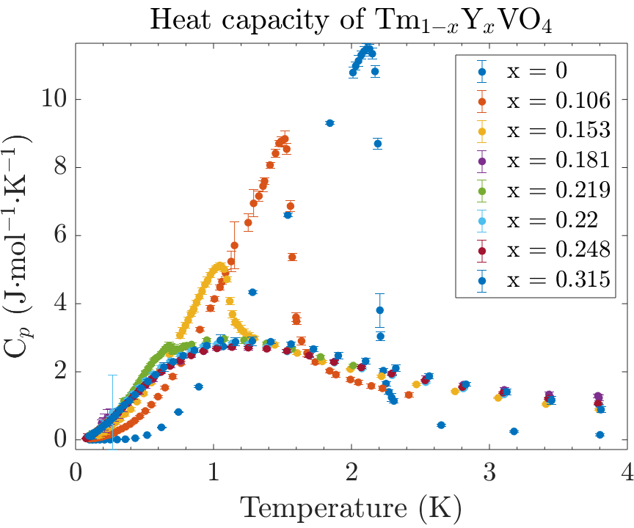
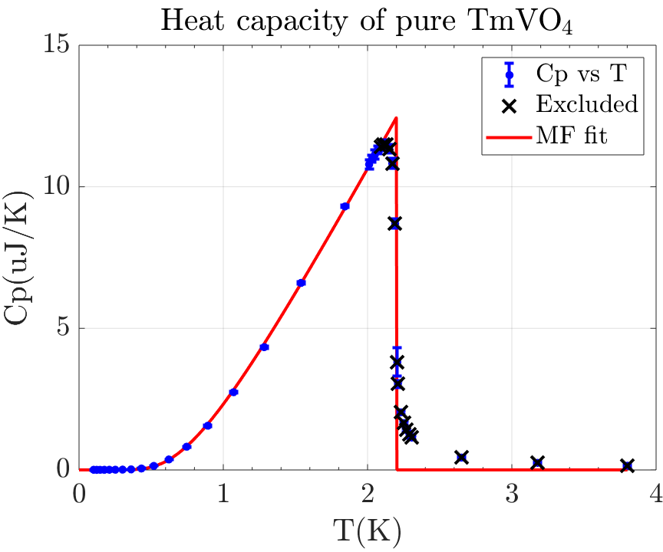
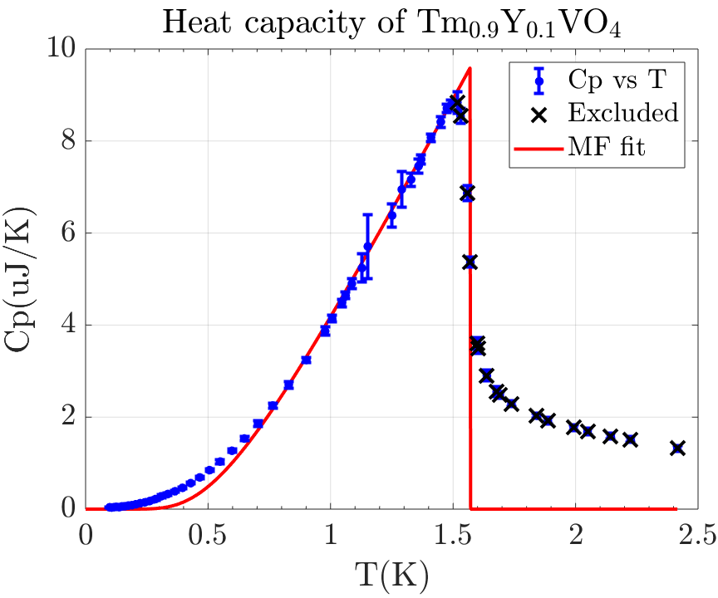
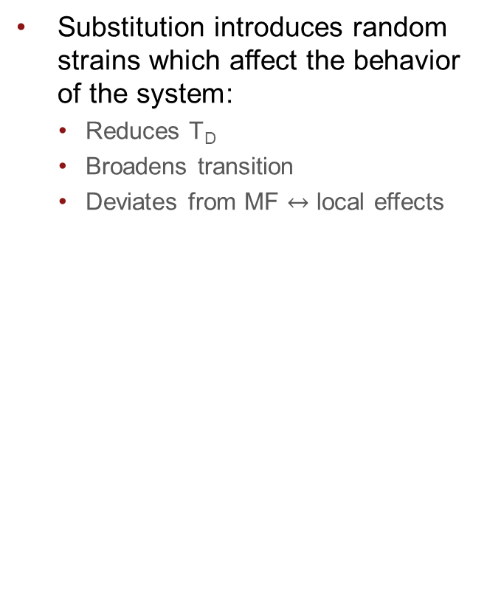
What is this relevant to?
Substitution introduces random strains which affect the behavior of the system:
Reduces T_{D}
Broadens transition
Deviates from MF $↔$ local effects

Slide 3
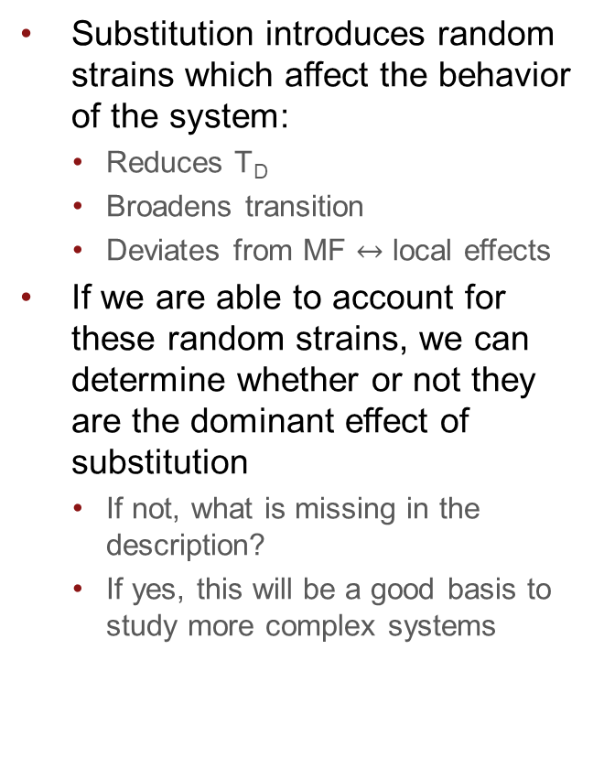
What is this relevant to?
Substitution introduces random strains which affect the behavior of the system:
Reduces T_{D}
Broadens transition
Deviates from MF $↔$ local effects
If we are able to account for these random strains, we can determine whether or not they are the dominant effect of substitution
If not, what is missing in the description?
If yes, this will be a good basis to study more complex systems

Slide 4
References
Most of this data analysis is based on the paper by Gehring, Swithenby and Wells, Solid State Comm. 18, 31, 1976.
The asymmetric part was introduced by Kasten et al.
I gave a group meeting about this on 2019-04-03

Slide 5
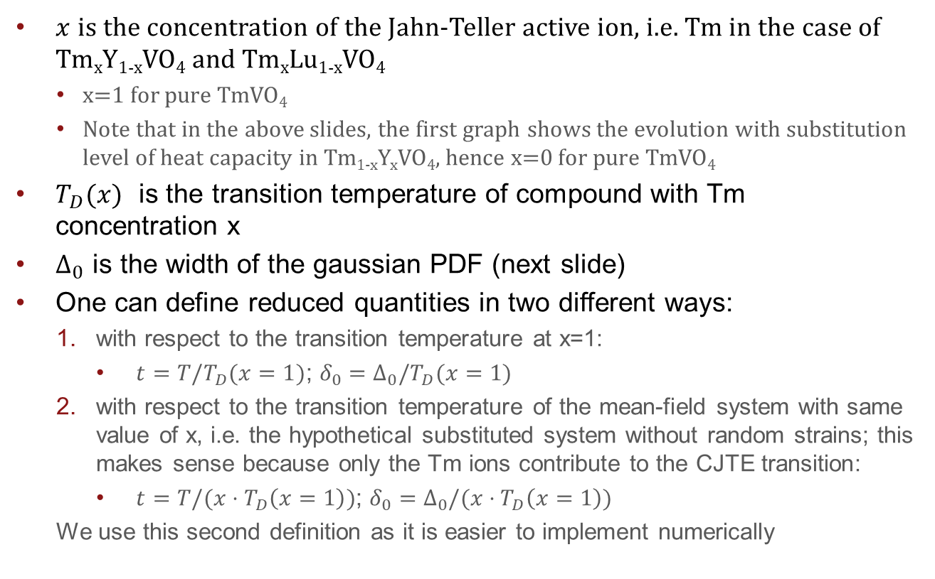
Notations
$x$ is the concentration of the Jahn-Teller active ion, i.e. Tm in the case of Tm_{x}Y_{1-x}VO₄ and Tm_{x}Lu_{1-x}VO₄
x=1 for pure TmVO₄
Note that in the above slides, the first graph shows the evolution with substitution level of heat capacity in Tm_{1-x}Y_{x}VO₄, hence x=0 for pure TmVO₄
$T_{D}(x)$ is the transition temperature of compound with Tm concentration x
$Δ_{0}$ is the width of the gaussian PDF (next slide)
One can define reduced quantities in two different ways:
with respect to the transition temperature at x=1:
$t=T/T_{D}(x=1)$; $δ_{0}=Δ_{0}/T_{D}(x=1)$
with respect to the transition temperature of the mean-field system with same value of x, i.e. the hypothetical substituted system without random strains; this makes sense because only the Tm ions contribute to the CJTE transition:
$t=T/(x⋅T_{D}\left(x=1\right))$; $δ_{0}=Δ_{0}/(x⋅T_{D}\left(x=1\right))$
We use this second definition as it is easier to implement numerically

Slide 6


Random probability distribution
Randomness described by normal (Gaussian) PDF with HWHM $Δ_{0}$
Equation (3) in the paper

Slide 7

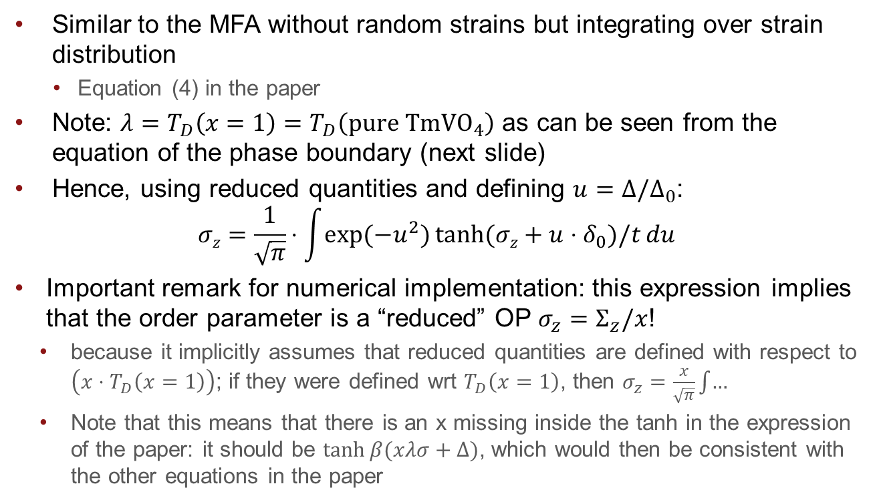

Self-consistent expression for the order parameter
$$σz=\tanh{βλσz}→$$
Similar to the MFA without random strains but integrating over strain distribution
Equation (4) in the paper
Note: $λ=T_{D}\left(x=1\right)=T_{D}\left(pure TmVO_{4}\right)$ as can be seen from the equation of the phase boundary (next slide)
Hence, using reduced quantities and defining $u=Δ/Δ_{0}$:
$$σz=\frac{1}{\sqrt{π}}⋅\int{\exp{(−u^{2})}\tanh{(σz+u⋅δ_{0})/t}}{du}$$
Important remark for numerical implementation: this expression implies that the order parameter is a “reduced” OP $σ_{z}=Σ_{z}/x$!
because it implicitly assumes that reduced quantities are defined with respect to $\left(x⋅T_{D}\left(x=1\right)\right)$; if they were defined wrt $T_{D}\left(x=1\right)$, then $σ_{z}=\frac{x}{\sqrt{π}}\int{…}$
Note that this means that there is an x missing inside the tanh in the expression of the paper: it should be $\tanh{β(xλσ+Δ)}$, which would then be consistent with the other equations in the paper

Slide 8
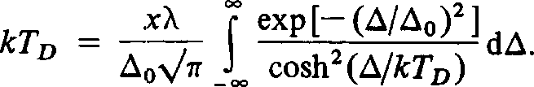
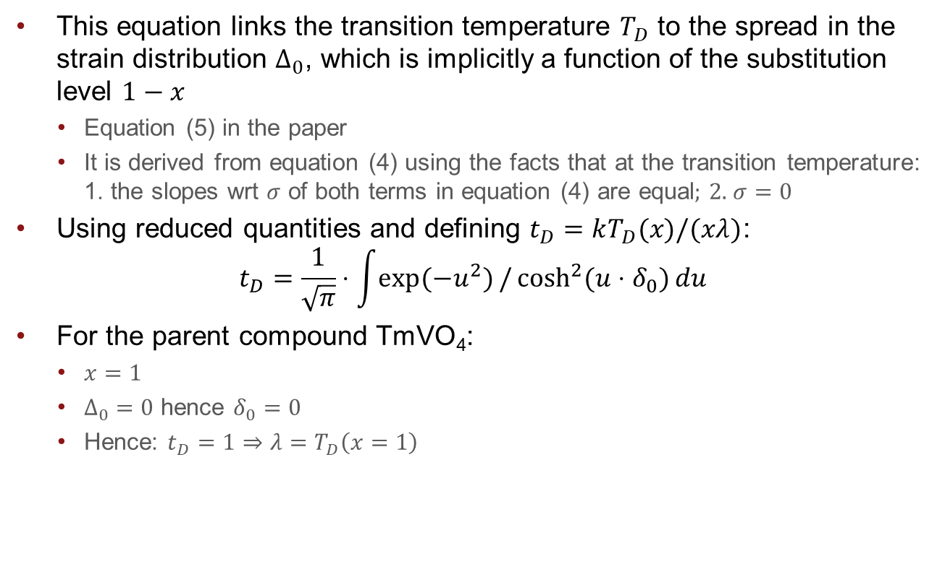
Equation of the phase boundary
This equation links the transition temperature $T_{D}$ to the spread in the strain distribution $Δ_{0}$, which is implicitly a function of the substitution level $1−x$
Equation (5) in the paper
It is derived from equation (4) using the facts that at the transition temperature: 1. the slopes wrt $σ$ of both terms in equation (4) are equal; 2. $σ=0$
Using reduced quantities and defining $t_{D}=kT_{D}(x)/(xλ)$:
$$t_{D}=\frac{1}{\sqrt{π}}⋅\int{\exp{(−u^{2})}/\cosh^{2}{(u⋅δ_{0})}}du$$
For the parent compound TmVO₄:
$x=1$
$Δ_{0}=0$ hence $δ_{0}=0$
Hence: $t_{D}=1⇒λ=T_{D}\left(x=1\right)$

Slide 9
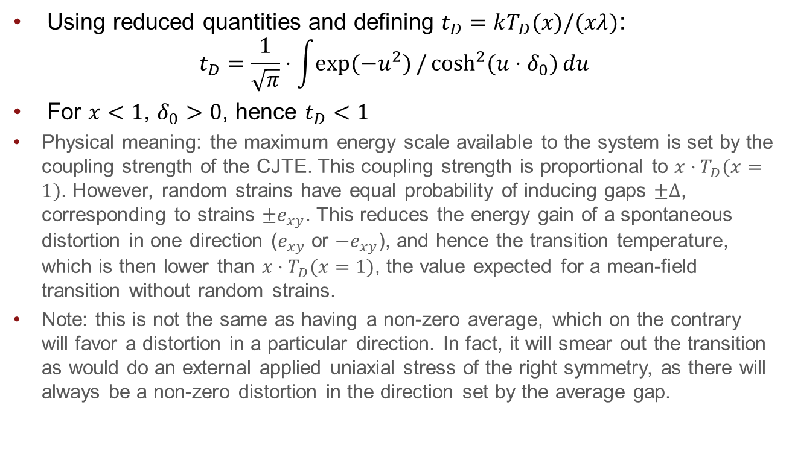
Equation of the phase boundary
Using reduced quantities and defining $t_{D}=kT_{D}(x)/(xλ)$:
$$t_{D}=\frac{1}{\sqrt{π}}⋅\int{\exp{(−u^{2})}/\cosh^{2}{(u⋅δ_{0})}}du$$
For $x<1$, $δ_{0}>0$, hence $t_{D}<1$
Physical meaning: the maximum energy scale available to the system is set by the coupling strength of the CJTE. This coupling strength is proportional to $x⋅T_{D}(x=1)$. However, random strains have equal probability of inducing gaps $±Δ$, corresponding to strains $±e_{xy}$. This reduces the energy gain of a spontaneous distortion in one direction ($e_{xy}$ or ${−e}_{xy}$), and hence the transition temperature, which is then lower than $x⋅T_{D}(x=1)$, the value expected for a mean-field transition without random strains.
Note: this is not the same as having a non-zero average, which on the contrary will favor a distortion in a particular direction. In fact, it will smear out the transition as would do an external applied uniaxial stress of the right symmetry, as there will always be a non-zero distortion in the direction set by the average gap.

Slide 10
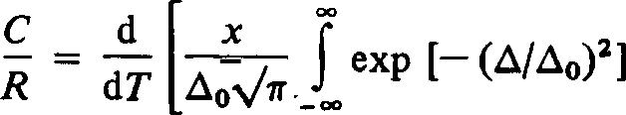
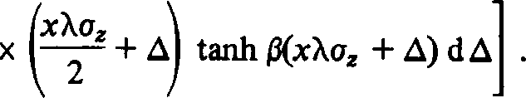
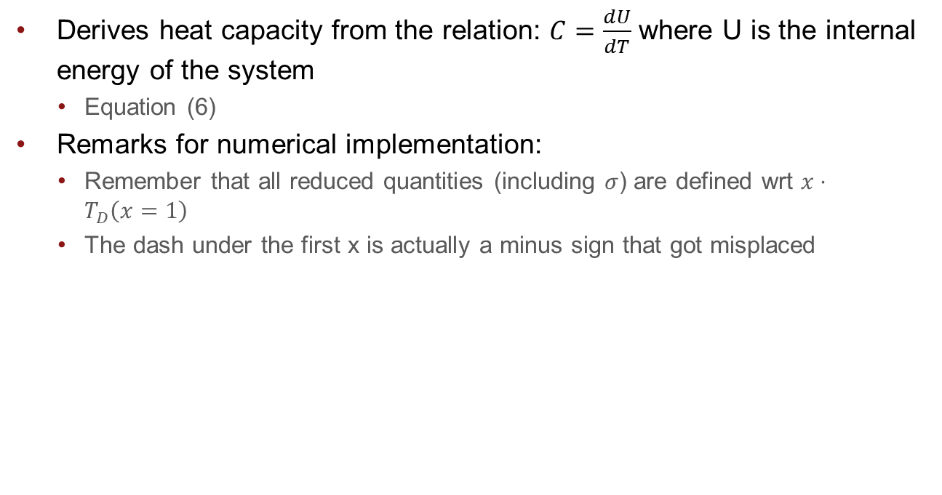
Expression of the heat capacity
Derives heat capacity from the relation: $C=\frac{dU}{dT}$ where U is the internal energy of the system
Equation (6)
Remarks for numerical implementation:
Remember that all reduced quantities (including $σ$) are defined wrt $x⋅T_{D}\left(x=1\right)$
The dash under the first x is actually a minus sign that got misplaced

Slide 11

Asymmetric strain distribution ⬄ offset strain
See second slide about equation of phase boundary
This is introduced in the paper by Kasten et al. 1987
Simply replace ${\exp{−\left(\frac{Δ}{Δ_{0}}\right)}}^{2}$ by $\exp{−{\left(\frac{Δ−Δ_{a}}{Δ_{0}}\right)}^{2}}$
Note: for negative values of $Δ_{a}$, the computation of the order parameter does not make sense; this is fine if $Δ$ is the amplitude of the gap induced by local strains, but then why are we integrating over negative values of $Δ$ as well?

Slide 12

Magnetic dipole interactions term
See paper, equation (7)
The authors claim that this term is only relevant in the disordered phase
Not sure why this would be more relevant for the substituted systems than for the pure one, however it is for sure not relevant for pure TmVO₄ as there is no heat capacity above $T_{D}$ in the latter
It is probably more relevant to model the behavior above $T_{D}$ with a gaussian distribution of Schottky anomalies and see how it compares with the distribution below the transition

Slide 13
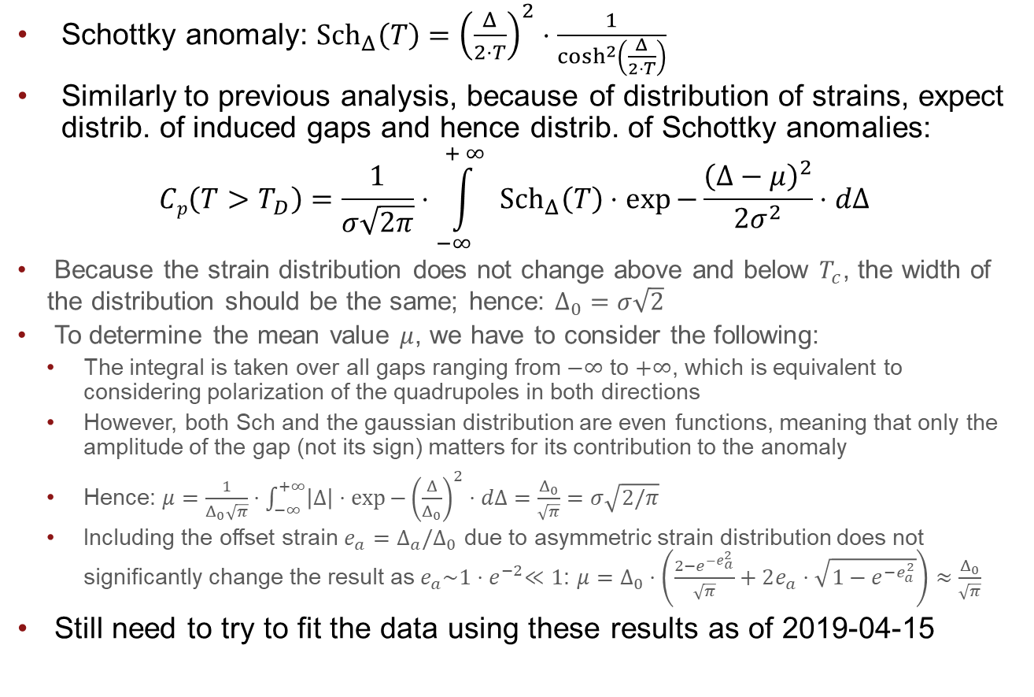
Gaussian distribution of Schottky anomalies
Schottky anomaly: ${Sch}_{Δ}\left(T\right)={\left(\frac{Δ}{2⋅T}\right)}^{2}⋅\frac{1}{\cosh^{2}\left(\frac{Δ}{2⋅T}\right)}$
Similarly to previous analysis, because of distribution of strains, expect distrib. of induced gaps and hence distrib. of Schottky anomalies:
$$Cp\left(T>T_{D}\right)=\frac{1}{σ\sqrt{2π}}⋅\int_{−∞ }^{+∞{ }}{{Sch}_{Δ}\left(T\right)⋅\exp{−\frac{{\left(Δ−μ\right)}^{2}}{2σ^{2}}}⋅dΔ}$$
Because the strain distribution does not change above and below $T_{c}$, the width of the distribution should be the same; hence: $Δ_{0}=σ\sqrt{2}$
To determine the mean value $μ$, we have to consider the following:
The integral is taken over all gaps ranging from $−∞$ to $+∞$, which is equivalent to considering polarization of the quadrupoles in both directions
However, both Sch and the gaussian distribution are even functions, meaning that only the amplitude of the gap (not its sign) matters for its contribution to the anomaly
Hence: $μ=\frac{1}{Δ_{0}\sqrt{π}}⋅\int_{−∞}^{+∞}{\left|Δ\right|⋅\exp{−{\left(\frac{Δ}{Δ_{0}}\right)}^{2}}⋅dΔ}=\frac{Δ_{0}}{\sqrt{π}}=σ\sqrt{2/π}$
Including the offset strain $e_{a}=Δ_{a}/Δ_{0}$ due to asymmetric strain distribution does not significantly change the result as $e_{a}\sim 1{⋅e}^{−2}≪1$: $μ=Δ_{0}⋅\left(\frac{2−e^{−e_{a}^{2}}}{\sqrt{π}}+2e_{a}⋅\sqrt{1−e^{−e_{a}^{2}}}\right)≈$ $\frac{Δ_{0}}{\sqrt{π}}$
Still need to try to fit the data using these results as of 2019-04-15

Slide 14
To do as of 2019-04-24
Compute Sz for negative offset strain using a starting point of -1 for fzero
Check that the result is the same as for positive offset strain with a starting point of +1
compare Delta_0 extracted from Gehring et al with "Schottky" distribution width
Fit YTmVO4 data with x>xc with distribution of Schottky anomalies and extract values of mu and sigma
Calculate critical strain and relation to splitting

