Slide 1
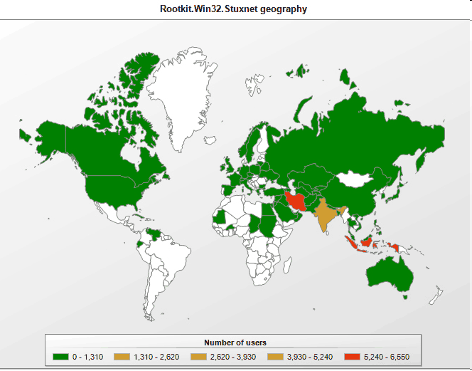
Real world example: Stuxnet Worm

Slide 2
Stuxnet: Overview
June 2010: A worm targeting Siemens WinCC industrial control system.
Targets high speed variable-frequency programmable logic motor controllers from just two vendors: Vacon (Finland) and Fararo Paya (Iran)
Only when the controllers are running at 807Hz to 1210Hz. Makes the frequency of those controllers vary from 1410Hz to 2Hz to 1064Hz.
http://en.wikipedia.org/wiki/Stuxnet

Slide 3
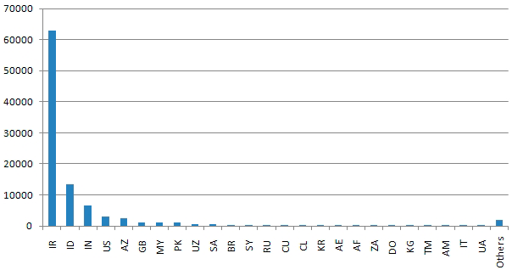
Stuxnet Infection Statistics
29 September 2010, From Symantic
Infected Hosts

Slide 4
Industrial Control Systems (ICS)
ICS are operated by a specialized assembly like code on programmable logic controllers (PLCs).
The PLCs are programmed typically from Windows computers.
The ICS are not connected to the Internet.
ICS usually consider availability and ease of maintenance first and security last.
ICS consider the “airgap” as sufficient security.

Slide 5
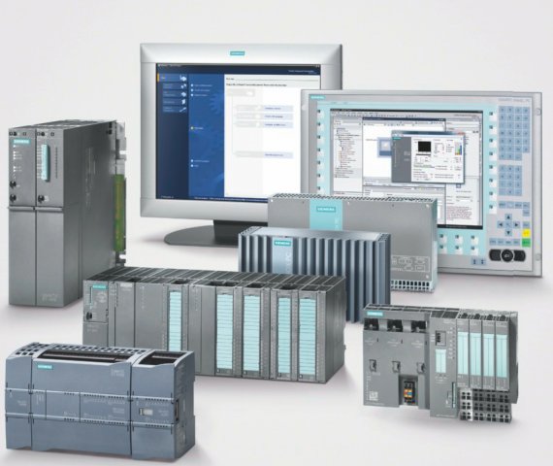
Seimens SIMATIC PLCs

Slide 6
Nuclear Centrifuge Technology
Uranium-235 separation efficiency is critically dependent on the centrifuges’ speed of rotation
Separation is theoretically proportional to the peripheral speed raised to the 4th power. So any increase in peripheral speed is helpful.
That implies you need strong tubes, but brute strength isn’t enough: centrifuge designs also run into problems with “shaking” as they pass through naturally resonant frequencies
“shaking” at high speed can cause catastrophic failures to occur.
www.fas.org/programs/ssp/nukes/fuelcycle/centrifuges/engineering.html

Slide 7
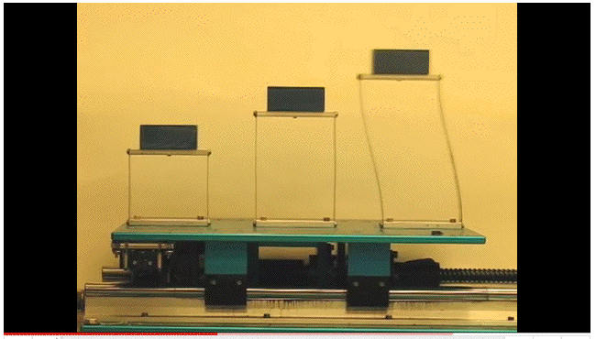
Conceptually Understanding “Shaking”
Video: http://www.youtube.com/watch?v=LV_UuzEznHs

Slide 8
Some Notes About That Video
The natural resonant frequency for a given element is not always the “highest” speed – the “magic” frequency is dependent on a variety of factors including the length of the vibrating element and the stiffness of its material.
While the tallest (rightmost) model exhibited resonant vibration first, the magnitude of its vibration didn’t necessarily continue to increase as the frequency was dialed up further. There was a particular value at which the vibration induced in each of the models was at its most extreme.
Speculation: Could the frequency values used by Stuxnet have been selected to particularly target a specific family of Iranian centrifuges?
The Iranians have admitted that *something* happened as a result of the malware.

Slide 9
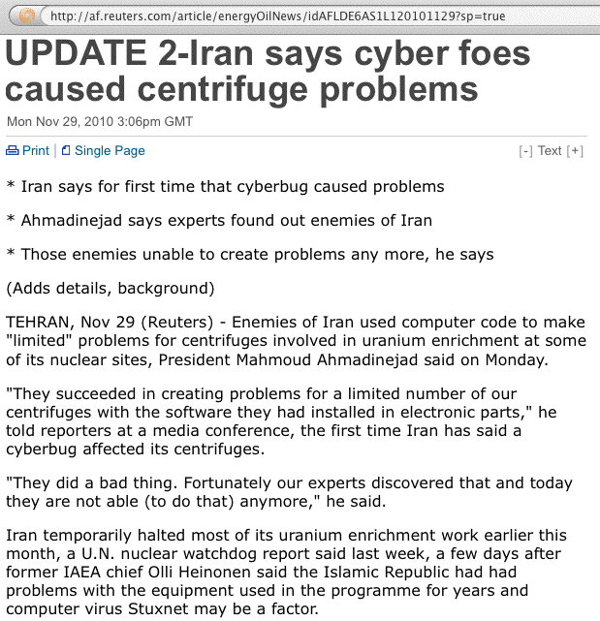
Stuxnet and Centrifuge Problems

Slide 10
Achieving A Persistent Impact
But why would Stuxnet want to make the centrifuges shake destructively? Wasn’t infecting their systems disruptive enough in and of itself? No.
If you only cause problems solely in the cyber sphere, it is, at least conceptually, possible to “wipe and reload” thereby fixing both the infected control systems and the modified programmable motor controllers at the targeted facility. Software-only cyber-only impacts are seldom “long term” or “persistent” in nature.
However, if the cyber attack is able to cause physical damage, such as causing thousands of centrifuges to shake themselves to pieces, or a generator to self destruct, that would take far longer to remediate.

Slide 11
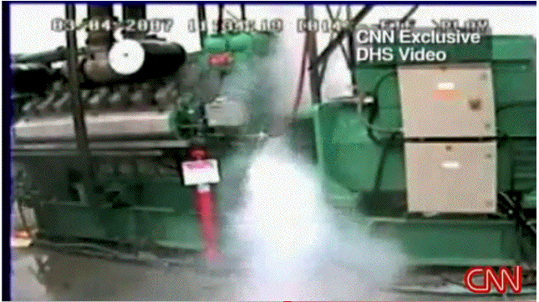
A Dept Homeland Security Video 2007
http://www.youtube.com/watch?v=fJyWngDco3g

Slide 12
Another Key Point: Avoiding Blowback
Why would a nation-state adversary release such a narrowly targeted piece of malware?
Blowback
a term borrowed from chemical warfare
an unexpected change in wind patterns can send an airborne chemical weapon drifting away from its intended enemy target and back toward friendly troops.
While most of the Stuxnet infections took place in Iran, some infections did happen in other countries, including the U.S.
Prudent “cyber warriors” might take all possible steps to insure that if Stuxnet did “get away from them,” it wouldn’t wreak havoc on friendly or neutral targets.
So now you know why Stuxnet appears to have been so narrowly tailored.

Slide 13
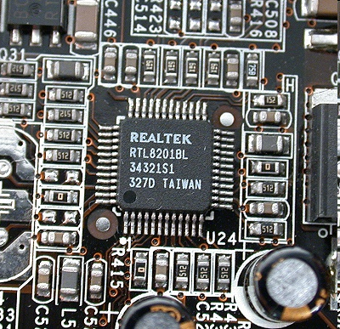
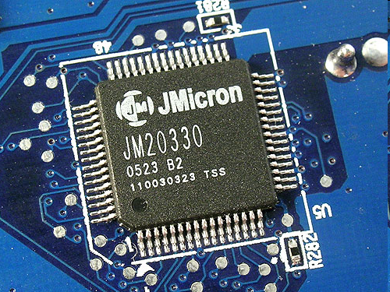
Timeline
2009 June: Earliest Stuxnet seen
Does not have signed drivers
2010 Jan: Stuxnet driver signed
With a valid certificate belonging to Realtek Semiconductors
2010 June: Virusblokada reports W32.Stuxnet
Verisign revokes Realtek certificate
2010 July: Anti-virus vendor Eset identifies new Stuxnet driver
With a valid certificate belonging to JMicron Technology Corp
2010 July: Siemens report they are investigating malware SCADA systems
Verisign revokes JMicron certificate

Slide 14
Stuxnet: Tech Overview
Components used
Zero-day exploits
Windows rootkit
PLC rootkit (first ever)
Antivirus evasion
Peer-to-Peer updates
Signed driver with a valid certificate
Command and control interface
Stuxnet consists of a large .dll file
Designed to sabotage industrial processes controlled by Siemens SIMATIC WinCC and PCS 7 systems.

Slide 15
Possible Attack Scenario (Conjecture)
Reconnaissance
Each PLC is configured in a unique manner
Targeted ICS’s schematics needed
Design docs stolen by an insider?
Retrieved by an early version of Stuxnet
Stuxnet developed with the goal of sabotaging a specific set of ICS.
Development
Mirrored development Environment needed
ICS Hardware
PLC modules
PLC development software
Estimation
6+ man-years by an experienced and well funded development team

Slide 16
Attack Scenario (2)
The malicious binaries need to be signed to avoid suspicion
Two digital certificates were compromised.
High probability that the digital certificates/keys were stolen from the companies premises.
Realtek and JMicron are in close proximity.
Initial Infection
Stuxnet needed to be introduced to the targeted environment
Insider
Third party, such as a contractor
Delivery method
USB drive
Windows Maintenance Laptop
Targeted email attack

Slide 17
Attack Scenario (3)
Infection Spread
Look for Windows computer that program the PLC’s
The Field PG are typically not networked
Spread the Infection on computers on the local LAN
Zero-day vulnerabilities
Two-year old vulnerability
Spread to all available USB drives
When a USB drive is connected to the Field PG, the Infection jumps to the Field PG
The “airgap” is thus breached

Slide 18
Attack Scenario (4)
Target Infection
Look for Specific PLC
Running Step 7 Operating System
Change PLC code
Sabotage system
Hide modifications
Command and Control may not be possible
Due to the “airgap”
Functionality already embedded

Slide 19
Stuxnet Architecture: 32 Exports
Infect connected removable drives, Starts remote procedure call (RPC) server
Hooks APIs for Step 7 project file infections
?
Calls the removal routine (export 18)
Verifies if the threat is installed correctly
Verifies version information
Calls Export 6
?
Updates itself from infected Step 7 projects
Updates itself from infected Step 7 projects
?
?
?
Step 7 project file infection routine
Initial entry point
Main installation
Replaces Step 7 DLL
Uninstalls Stuxnet
Infects removable drives
?
?
Network propagation routines
?
Check Internet connection
?
?
RPC Server
Command and control routine
Command and control routine
?
Updates itself from infected Step 7 projects
Same as 1

Slide 20
Stuxnet Architecture: 15 Resources
RID Function
201 MrxNet.sys load driver, signed by Realtek
202 DLL for Step 7 infections
203 CAB file for WinCC infections
205 Data file for Resource 201
207 Autorun version of Stuxnet
208 Step 7 replacement DLL
209 Data file (%windows%\help\winmic.fts)
210 Template PE file used for injection
221 Exploits MS08-067 to spread via SMB.
222 Exploits MS10-061 Print Spooler Vulnerability
231 Internet connection check
240 LNK template file used to build LNK exploit
241 USB Loader DLL ~WTR4141.tmp
242 MRxnet.sys rootkit driver
250 Exploits undisclosed win32k.sys vulnerability

Slide 21
Bypassing Intrusion Detection
Stuxnet calls LoadLibrary
With a specially crafted file name that does not exist
Which causes LoadLibrary to fail.
However, W32.Stuxnet has hooked Ntdll.dll
To monitor specially crafted file names.
Mapped to a location specified by W32.Stuxnet.
Where a .dll file was stored by the Stuxnet previously.

Slide 22
Code Injection
Stuxnet used trusted Windows processes or security products
Lsass.exe
Winlogin.exe
Svchost.exe
Kaspersky KAV (avp.exe)
Mcafee (Mcshield.exe)
AntiVir (avguard.exe)
BitDefender (bdagent.exe)
Etrust (UmxCfg.exe)
F-Secure (fsdfwd.exe)
Symantec (rtvscan.exe)
Symantec Common Client (ccSvcHst.exe)
Eset NOD32 (ekrn.exe)
Trend Pc-Cillin (tmpproxy.exe)
Stuxnet detects the version of the security product and based on the version number adapts its injection process

Slide 23
Configuration
Stuxnet collects and stores the following information:
Major OS Version and Minor OS Version
Flags used by Stuxnet
Flag specifying if the computer is part of a workgroup or domain
Time of infection
IP address of the compromised computer
file name of infected project file

Slide 24
Installation: Control Flow

Slide 25
Installation: Infection routine flow

Slide 26
Command & Control
Stuxnet tests if it can connect to
www.windowsupdate.com
www.msn.com
On port 80
Contacts the command and control server
www.mypremierfutbol.com
www.todaysfutbol.com
The two URLs above previously pointed to servers in Malaysia and Denmark
Sends info about the compromised computer

Slide 27
Command & Control (2)

Slide 28
Command & Control payload
Part 1
Part 2
0x00 byte 1, fixed value
0x01 byte from Configuration Data
0x02 byte OS major version
0x03 byte OS minor version
0x04 byte OS service pack major version
0x05 byte size of part 1 of payload
0x06 byte unused, 0
0x07 byte unused, 0
0x08 dword from C. Data
0x0C word unknown
0x0E word OS suite mask
0x10 byte unused, 0
0x11 byte flags
0x12 string computer name, null-terminated
0xXX string domain name, null-terminated
0x00 dword IP address of interface 1, if any
0x04 dword IP address of interface 2, if any
0x08 dword IP address of interface 3, if any
0x0C dword from Configuration Data 0x10 byte unused
0x11 string copy of S7P string from C. Data (418h)

Slide 29
Windows Rootkit Functionality
Stuxnet extracts Resource 201 as MrxNet.sys.
Registered as a service:
HKEY_LOCAL_MACHINE\SYSTEM\CurrentControlSet\Services\MRxNet\”ImagePath” = “%System%\drivers\mrxnet.sys”
Digitally signed with a legitimate Realtek digital certificate.
The driver then hides files that:
have “.LNK” extension.
are named “~WTR[four numbers].TMP”,
the sum of the four numbers, modulo 10 is 0.
size between 4Kb and 8Mb;
Examples:
“Copy of Copy of Copy of Copy of Shortcut to.lnk”
“Copy of Shortcut to.lnk”
“~wtr4141.tmp”

Slide 30
Propagation Methods: Network
Peer-to-peer communication and updates
Infecting WinCC machines via a hardcoded database server password
Network shares
MS10-061 Print Spooler Zero-Day Vulnerability
MS08-067 Windows Server Service Vulnerability

Slide 31
Propagation Methods: USB
LNK Vulnerability (CVE-2010-2568)
AutoRun.Inf

Slide 32
Modifying PLC’s
The end goal of Stuxnet is to infect specific types of PLC devices.
PLC devices are loaded with blocks of code and data written in STL
The compiled code is in assembly called MC7.
These blocks are then run by the PLC, in order to execute, control, and monitor an industrial process.
The original s7otbxdx.dll is responsible for handling PLC block exchange between the programming device and the PLC.
By replacing this .dll file with its own, Stuxnet is able to perform the following actions:
Monitor PLC blocks being written to and read from the PLC.
Infect a PLC by inserting its own blocks

Slide 33
Modifying PLC’s

Slide 34
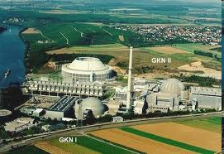
What was the target?
60% Infections in Iran
No other commercial gain
Stuxnet self destruct date
Siemens specific PLC’s
Bushehr Nuclear Plant in Iran

Slide 35
Who did it?
Israel?
19790509. A safe code that prevents infection
Where is this code already in ICS coded?
May 9,1979: Habib Elghanian was executed by a firing squad in Tehran
He was the first Jew and one of the first civilians to be executed by the new Islamic government
USA?
Russia?
UK?
China?

Slide 36
Propaganda
Iran’s Ministry of Foreign Affairs:
"Western states are trying to stop Iran's (nuclear) activities by embarking on psychological warfare and aggrandizing, but Iran would by no means give up its rights by such measures,“
"Nothing would cause a delay in Iran's nuclear activities“
Iran’s Minister of intelligence
“Enemy spy services" were responsible for Stuxnet

Slide 37
Propaganda: debka.com(2)
An alarmed Iran asks for outside help to stop Stuxnet
Not only have their own attempts to defeat the invading worm failed, but they made matters worse:
The malworm became more aggressive and returned to the attack on parts of the systems damaged in the initial attack.
One expert said: “The Iranians have been forced to realize that they would be better off not 'irritating' the invader because it hits back with a bigger punch.”

Slide 38
Conclusion
Stuxnet is a significant milestone in malicious code history
It is the first to exploit multiple 0-day vulnerabilities.
Used two (compromised) digital certificates.
Injected code into industrial control systems.
Hid the code from the operator.
Stuxnet is of great complexity
Requiring significant resources to develop
Stuxnet has highlighted that direct-attacks on critical infrastructure are possible.

Slide 39
References
Nicolas Falliere, Liam O Murchu, and Eric Chie, “W32.Stuxnet Dossier”, February 2011, Symantec.com
Ralph Langner, “Cracking Stuxnet, a 21st-century cyber weapon”, http://www.ted.com/, Mar 31, 2011.
Eric Byres, Andrew Ginter and Joel Langill, Stuxnet Report: A System Attack, A five part series, www.isssource.com/ stuxnet-report-a-system-attack/, March 2011
“Cyber War, Cyber Terrorism and Cyber Espionage,” http://pages.uoregon.edu/joe/cyberwar/cyberwar.ppt
ACK: Many sources on the web. I (pmateti@wright.edu) merely assembled the slides. May 2011.

