Slide 1
CEG 429: Internet Security
Last Lecture
Prabhaker Mateti

Slide 2
Internet Growth
Mateti
WSU CEG 429/Last Lecture

Slide 3
Internet host count
        1981 213
        1986 5,089
        1998 29,670,000
        2000 93,047,785
        2005 317,646,084
        2010 768,913,036
        2011 818,374,269
        source: www.isc.org
Mateti
WSU CEG 429/Last Lecture
Notes:
2011 numbers may actually be much higher because of NAT etc.

Slide 4
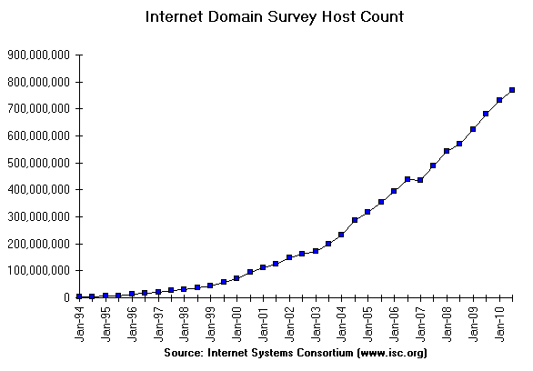
Mateti
WSU CEG 429/Last Lecture

Slide 5
‘Computers’?
Define `Computer’ System!
Main frames
PCs
Smart Phones
Embedded systems
Usage without Internet?
Mateti
WSU CEG 429/Last Lecture

Slide 6
Facts about data theft
More than 12,000 laptops lost per week in US airports alone;
One laptop is stolen every 53 seconds;
Viruses cost US businesses $55 billion annually; and
25% of all PC users suffer from data loss each year.
Source: http://www.technewsworld.com/ 01/20/2010
Mateti
WSU CEG 429/Last Lecture

Slide 7
Top N Lists
Mateti
WSU CEG 429/Last Lecture

Slide 8
Top Ten Web Sites in Security
www.cert.org/ US funded. Provides cyber alerts, defense and response to government agencies and industry partners.
www.infosyssec.org/ security portal with many tutorials.
www.phrack.org/ in-depth technical articles on exploits.
defcon.org/ Oldest and one of the largest hacker conventions.
www.securityfocus.com/ Hosts BUGTRAQ. white-hat site.
www.packetstormsecurity.org/ security portal. security tools and exploits.
www.schneier.com/ Security blog focused on crypto.
www.infowar.com/ takes a broader view of security and has articles about how countries can get affected.
www.undergroundnews.com/ “… does not restrict or censor”
www.microsoft.com/technet/security/default.mspx
Mateti
WSU CEG 429/Last Lecture

Slide 9
Links to Others
googleonlinesecurity.blogspot.com/2009/06/top-10-malware-sites.html
www.techsupportalert.com/best_computer_security_sites.htm
20 useful IT security Web sites
informationsecurityhq.com/10-top-websites-for-information-security/
www.secureroot.com/topsites/
Mateti
WSU CEG 429/Last Lecture

Slide 10
Top Internet Security Vulnerabilities
Top Vulnerabilities in Windows Systems
  W1. Windows Services
  W2. Internet Explorer
  W3. Windows Libraries
  W4. Microsoft Office and Outlook Express
  W5. Windows Configuration Weaknesses
Top Vulnerabilities in Cross-Platform Applications
  C1. Backup Software
  C2. Anti-virus Software
  C3. PHP-based Applications
  C4. Database Software
  C5. File Sharing Applications
  C6. DNS Software
  C7. Media Players
  C8. Instant Messaging Applications
  C9. Mozilla and Firefox Browsers
  C10. Other Cross-platform Applications
Top Vulnerabilities in UNIX Systems
  U1. UNIX Configuration Weaknesses
  U2. Mac OS X
Top Vulnerabilities in Networking Products
  N1. Cisco IOS and non-IOS Products
  N2. Juniper, CheckPoint and Symantec Products
  N3. Cisco Devices Configuration Weaknesses
Source: http://www.sans.org/top20/
Mateti
WSU CEG 429/Last Lecture

Slide 11
Top 100 Security Tools, 2006
http://www.insecure.org/tools.html
Each respondent could list up to 8.
No votes for the Nmap Security Scanner were counted.
The list is slightly biased toward "attack" tools rather than defensive ones.
Top 10 listed in the next three slides
Mateti
WSU CEG 429/Last Lecture

Slide 12
Top Ten Security Tools
Nessus is a remote security scanner for Linux and Windows. It performs over 1200 remote security checks. (It was open source for many years, but now $1200/year; free home use.)
WireShark/Ethereal is a network protocol analyzer for Linux and Windows. You can interactively browse each packet. Ethereal has several powerful features, including a rich display filter language and the ability to view the reconstructed stream of a TCP session. Free open source.
Snort is an intrusion detection system (IDS) capable of performing real-time traffic analysis and packet logging. It can be used to detect buffer overflows, stealth port scans, CGI attacks, SMB probes, OS fingerprinting attempts, …. Snort uses a flexible rule based language. Many people also suggested that the Analysis Console for Intrusion Databases (ACID) be used with Snort. Free open source.
Mateti
WSU CEG 429/Last Lecture

Slide 13
Top Ten Security Tools
Netcat is the network swiss army knife! It reads and writes data across network connections. It is designed to be a reliable "back-end" tool. Free open source.
Metasploit Hack the Planet. It ships with hundreds of exploits, as you can see in their online exploit building demo. This makes writing your own exploits easier. Free open source.
Hping2 is like ping on steroids. hping2 assembles and sends custom ICMP/UDP/TCP packets and displays any replies. It also has a traceroute mode and supports IP fragmentation. This tool is particularly useful when trying to traceroute/ping/probe hosts behind a firewall that blocks attempts using the standard utilities. Free open source.
Kismet A powerful wireless sniffer. It identifies networks by passively sniffing (as opposed to more active tools such as NetStumbler), and can even decloak hidden (non-beaconing) networks if they are in use. Free open source.
Mateti
WSU CEG 429/Last Lecture

Slide 14
Top Ten Security Tools
TCPDump is the classic Unix sniffer for network monitoring and data acquisition. Windows port named WinDump. TCPDump is also the source of the Libpcap/WinPcap packet capture library. Free open source.
Cain and Abel: Windows only password cracker. Includes ARP poisoning; can also analyze SSH and HTTPS. Free, but not open source.
John the Ripper: A fast multi-platform password cracker. Free open source.
Mateti
WSU CEG 429/Last Lecture

Slide 15
Open Web Application Security
not-for-profit worldwide charitable organization focused on improving the security of web application software.
free and open software license.
www.owasp.org/
Mateti
WSU CEG 429/Last Lecture

Slide 16
Black/? Hat Sites/Conferences
Suspend all judgments (other than technical quality).
defcon.org/ annual conference in Las Vegas. Excellent presentations by “hackers”.
blackhat.com/ Conferences and training!
shmoocon.org/ “… refusal to take anything about the Internet seriously…”
recon.cx/ reverse engineering. annually in Montreal
Mateti
WSU CEG 429/Last Lecture

Slide 17
Top 25 Software Errors, 2010
Improper Neutralization of Input During Web Page Generation ('Cross-site Scripting')
Improper Neutralization of Special Elements used in an SQL Command ('SQL Injection')
Buffer Copy without Checking Size of Input ('Classic Buffer Overflow')
Cross-Site Request Forgery (CSRF)
Improper Authorization
Reliance on Untrusted Inputs in a Security Decision
Improper Limitation of a Pathname to a Restricted Directory ('Path Traversal')
Unrestricted Upload of File with Dangerous Type
Improper Neutralization of Special Elements used in an OS Command ('OS Command Injection')
Missing Encryption of Sensitive Data
Use of Hard-coded Credentials
Buffer Access with Incorrect Length Value
Improper Control of Filename for Include/Require Statement in PHP Program ('PHP File Inclusion')
Improper Validation of Array Index
Improper Check for Unusual or Exceptional Conditions
Information Exposure Through an Error Message
Integer Overflow or Wraparound
Incorrect Calculation of Buffer Size
Missing Authentication for Critical Function
Download of Code Without Integrity Check
Incorrect Permission Assignment for Critical Resource
Allocation of Resources Without Limits or Throttling
URL Redirection to Untrusted Site ('Open Redirect')
Use of a Broken or Risky Cryptographic Algorithm
Concurrent Execution using Shared Resource with Improper Synchronization ('Race Condition')
http://cwe.mitre.org/top25/archive/2010/2010_cwe_sans_top25.pdf
Mateti
WSU CEG 429/Last Lecture

Slide 18
Recent Attacks
Mateti
WSU CEG 429/Last Lecture

Slide 19
Attacks on Sony
Sony’s PlayStation Network system was hacked, affecting more than 100 million online accounts worldwide and forcing the company to shut down the popular online gaming service. April 2011.
Database at Sony Ericsson’s Eshop, Canada breached. May 2011.
Sony in Greece.
Sony in Japan.
Sued George Hotz, 21. Hacked the fully locked Sony PS3 console in 2010 to run homebrew applications and released the method through his website.
Sony lawsuit demanded that social media sites including YouTube hand over IP addresses of people who visited Hotz’s pages and videos.
Mateti
WSU CEG 429/Last Lecture

Slide 20
Systems of US Congress
The Senate’s Sergeant at Arms reported last year that computer systems of Congress and executive branch agencies are probed or attacked
  1.8 billion times per month,
  costing about $8 billion annually.
Mateti
WSU CEG 429/Last Lecture

Slide 21
Cell Phone Malware
More mobile phones than people in many countries.
ZeuS botnet: Using infected HTML forms on the victim's browser, obtains cell number, sends a text message containing the new malware SymbOS/ Zitmo.A!tr designed to intercept and divert banking transactions. September 2010
Jailbreaking w/ no knowledge of security
  ssh Apple's default root password "alpine"
Mateti
WSU CEG 429/Last Lecture

Slide 22

Cell Phone Malware
Droid Dream Light, May 2011, Trojan
invoked on receipt of android.intent.action.PHONE_STATE intent (e.g. an incoming voice call).
contacts remote servers and supplies the IMEI, IMSI, Model, SDK Version and information about installed packages.
capable of downloading and prompting installation of new packages
Mateti
WSU CEG 429/Last Lecture

Slide 23
Estonia’s infrastructure
Baltic republic of Estonia
first country in the world to experience cyber war.
Government, financial and media computer networks were paralyzed by a series of attacks
April 2007
Estonia is a heavily wired country: 80 % of Estonians pay their taxes and do their banking on Internet.
Decided to relocate a Soviet war memorial
Russian hackers?
Estonia instituting a real cyber army?
Mateti
WSU CEG 429/Last Lecture

Slide 24
Stuxnet
Worm targeted at a “unique” target in the world
Target = A nuclear facility using specific equipment.
Infects many, but does not hurt any, except one.
Sohisticated internals
Developed by country-level attackers?
More details at http://www.cs.wright.edu/~pmateti/InternetSecurity/Lectures/Viruses/stuxnet-2011-pm.pptx
Mateti
WSU CEG 429/Last Lecture

Slide 25
Controversies

Slide 26
Being Able to Read the Source
Enables exploits
  Reverse Engineering not required
  Internal Structure is understood
  Weaknesses can be seen at the design level
Enables fast fixes
Intellectual Property Rights and Privileges
  Not (very) relevant in this course
  Think: Why do we make laws that let patents expire?
Mateti
WSU CEG 429/Last Lecture

Slide 27
Security Through Obscurity
Use secrecy (of design, implementation, etc.) to ensure security.
May have theoretical or actual security vulnerabilities, but its owners or designers believe that the flaws are not known, and that attackers are unlikely to find them.
We really mean "security implemented solely through obscurity."
Obscurity is not always bad.
Is Obscurity Ever Good?
TBD Read an opinion: www.darkreading.com/blog.asp? blog_sectionid=326&WT.svl=blogger1_1
Mateti
WSU CEG 429/Last Lecture

Slide 28
WikiLeaks
PBS was targeted in retaliation for broadcasting "Frontline: Wiki Secrets“ in May 2011
  www.pbs.org/wgbh/pages/frontline/wikileaks/ The inside story of Bradley Manning, Julian Assange and the largest intelligence breach in U.S. history
Mateti
WSU CEG 429/Last Lecture

Slide 29
Course Specific Items

Slide 30
Course Title?
Other titles for the Course
  Internet Security
  Network Security
  Computer Security
  System Security
  Cyber Security
Integrated View of Security Issues
Selection of Most Relevant Topics
Narrowest Title that Covers the Topics
Mateti
WSU CEG 429/Last Lecture

Slide 31
New or Revised * courses
CEG 234N Secure Computing Practices 4
CEG 235N System Security 4
CEG 429 * Internet Security 4
CEG 430N Security Attacks & Defenses 4
CEG 439N Secure Cloud Computing 4
CS 419 * Crypto and Data Security 3
CEG 433 * Operating Systems 4
Mateti
WSU CEG 429/Last Lecture

Slide 32
Ethics: A Personal Opinion
Ethics violations on small scale DOES NOT NECESSARILY IMPLY violations on large scale.
Cf. The movie: Crash (2004) - IMDb
Mateti
WSU CEG 429/Last Lecture

Slide 33
Big Issues

Slide 34
ww.privacyrights.org
“More than 220 million records containing sensitive personal information have been leaked in security breaches in the United States since January 2005. This site tracks every breach and provides links to resources businesses should consult if they experience a security breach and aren't sure how to respond”
Mateti
WSU CEG 429/Last Lecture

Slide 35
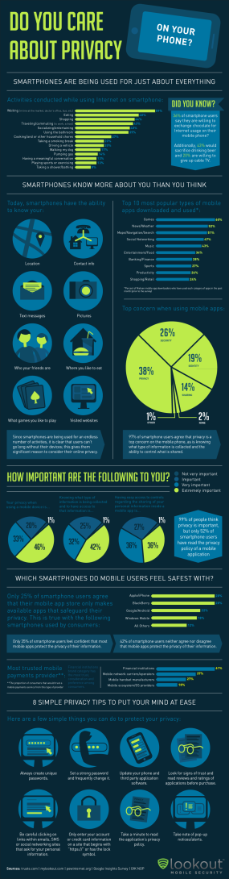
Mateti
WSU CEG 429/Last Lecture

Slide 36
Privacy
Gov't: We want stored emails, phone locations.
The Electronic Communication Privacy Act of 1986
  e.g., govt can get past cell phone geolocation data without warrant
www.eff.org/issues/national-security-letters
A new bill (May 2011) proposes requiring a warrant to seize email, cell phone location, or … stored in the cloud.
Mateti
WSU CEG 429/Last Lecture

Slide 37
Will Internet ever be trustworthy?
Non-Answers
  Equate the question with:
    “Will the world ever be trustworthy?”
Internet is a man-made entity.
Trustworthy = … ?
Ok if cost is high?
Will users get educated?
Mateti
WSU CEG 429/Last Lecture

Slide 38
Trustworthy = No Cheating + …
User authentication
Host authentication
Access authentication
Message/Transaction authentication
No repudiation
Mateti
WSU CEG 429/Last Lecture

Slide 39
Trustworthy = … + Reliable + …
Transactions/Operations/Services/…
  Availability
  correctly execute
  Terminate
    Successfully
    Failures
  Computer Resource consumption
    CPU time
    Memory
    …
Mateti
WSU CEG 429/Last Lecture

Slide 40
Trustworthy = + …?
Mateti
WSU CEG 429/Last Lecture

Slide 41
Will Internet ever be trustworthy?
Predictions

Slide 42
Will Internet ever be trustworthy?
Analysis

Slide 43
US Preparedness
Mateti
WSU CEG 429/Last Lecture

Slide 44
DHS' Classified NCCIC
National Cybersecurity and Communications Integration Center (NCCIC)
DHS-led inter-agency cybersecurity work
  responding to cyber threats against government networks
  monitoring network sensors across the government and
  coordinating response to cyber attacks against power plants or communications networks.
unclassified for one day 10/09/2010
Mateti
WSU CEG 429/Last Lecture

Slide 45
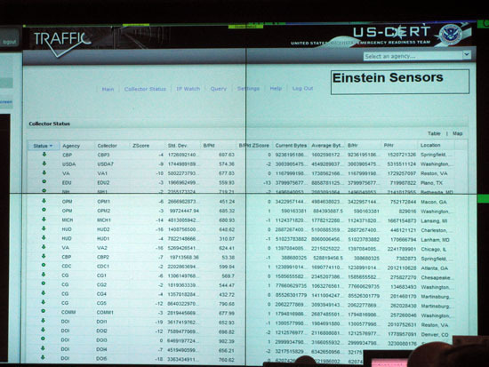
US-CERT Einstein Sensors
This screen shows a selection of real-time information from network flow analyzers placed strategically within government networks nationwide.
Einstein sensors is a series of technologies being deployed across the government for network monitoring, intrusion detection and intrusion prevention.
"We identify not only cyber threats, but also monitor the cyber health of the nation.”
Mateti
WSU CEG 429/Last Lecture

Slide 46
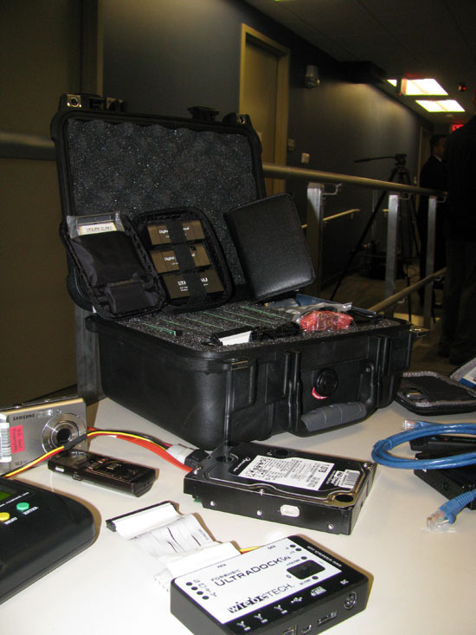
NCCIC Fly-Away Kit
NCCIC doesn't do malware analysis.
However, for demo purposes, DHS brought out some of its digital forensics tools for reporters to see, including these.
Mateti
WSU CEG 429/Last Lecture

Slide 47
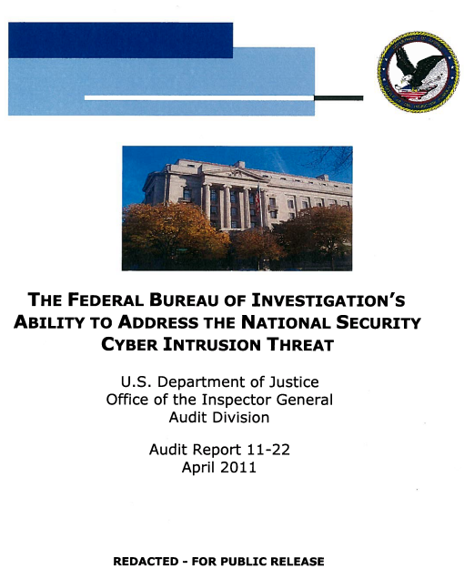
DOJ report critical of FBI
FBI in some cases lacks the skills to properly investigate national security intrusions.
justice.gov/oig/reports/FBI/a1122r.pdf
FBI cyber threat success: the taking down of the CoreFlood botnet.
Mateti
WSU CEG 429/Last Lecture

Slide 48
“Science of Cyber-Security”
Examines the theory and practice of cyber-security, and evaluates whether there are underlying fundamental principles that would make it possible to adopt a more scientific approach.
November 2010, DoD sponsored report
http://www.fas.org/irp/agency/dod/jason/cyber.pdf
Mateti
WSU CEG 429/Last Lecture

Slide 49
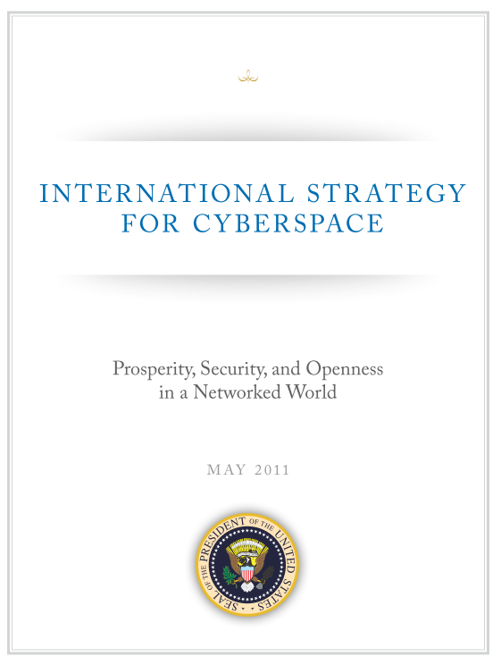
Mateti
WSU CEG 429/Last Lecture

Slide 50
Cybersecurity Plan 2011
International Strategy for Cyberspace
protecting Web infrastructure
freedom of expression and commerce via the Internet
denying those benefits to terrorists and criminals
“Cybersecurity threats and online technologies change quickly -- so quickly that any regulations for cybersecurity could be outdated before they are finalized.”
Mateti
WSU CEG 429/Last Lecture

Slide 51
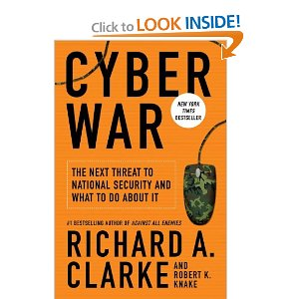
“Cyber War” A Book
Current state of cyber warfare compares to the early days of nuclear weaponry:
  Its enormous power is not yet understood and its use is not yet regulated.
America vulnerable to electronic attack.
Clark: former White House terrorism adviser
washingtonpost.com/ review 2010/05/21
4/5 stars (95 Amazon reviews)
Mateti
WSU CEG 429/Last Lecture

Slide 52
UK cyber weapons program
Cyber weapons as "an integral part of the country's armory"
Cyberspace represented "conflict without borders"
Cybersecurity a tier one priority
Extra £650m
May 2011
Mateti
WSU CEG 429/Last Lecture

Slide 53
Random Quote
“ Restrictions of free thought and free speech is the most dangerous of all subversions. It is the one un-American act that could most easily defeat us.”
- William O. Douglas,
US Supreme Court, 1939-1980
Mateti
WSU CEG 429/Last Lecture

