Slide 1
Finding even more bugs with FindBugs
CSE 6329 Project Team 1
Aliasgar Kagalwala
Aditya Mone
Derek White
Dengfeng (Thomas) Xia

Slide 2
What is FindBugs?
FindBugs is a static analysis tool for Java used to find warnings about bugs by analyzing the byte code (execution of the code is not required)
Searches for bug patterns
Claims a false warning rate of less than 50%
Free software released under the LGPL
Bug detectors can be written using either BCEL or ASM
A University of Maryland project that has received funding from Google, Sun Microsystems, NSF, Fortify Software, SureLogic and the IBM Eclipse Innovation award [1]

Slide 3
Goal: Add more bug detectors
A tool like FindBugs, which is based on a collection of known patterns, is most useful with a complete set of accurate bug detectors at its disposal
Our team must learn about how to extend FindBugs by using its extensible design to implement new bug detectors
We searched FindBug's SourceForge project page, finding suggestions for new bug detectors from the user community
Our goal is to study and implement some of them, hopefully contributing something back to the project

Slide 4
Candidates for new bug detectors
Report platform dependent environment (ID: 3147304)
Instance initializer notification (ID: 3098258)
Generating warnings for implicit sign extending byte values (ID: 3052560)
Throwing hashcodes vs Object.toString (ID: 2847861)

Slide 5
Inputs for the tool (feature)
Example code snippets from feature requests:
Feature: Reporting platform dependent environment.
System.getProperty("line.separator")
Calendar.getInstance() or new Date()
Any string operation that uses the default charset of the JVM
Feature: Warning for sign-extending byte values.
Given the code:
byte b = (some val);
int i = (int) b; // this will sign-extend
// 'b'. Values like 0x81
// will turn into
// 0xFFFFFF81.

Slide 6
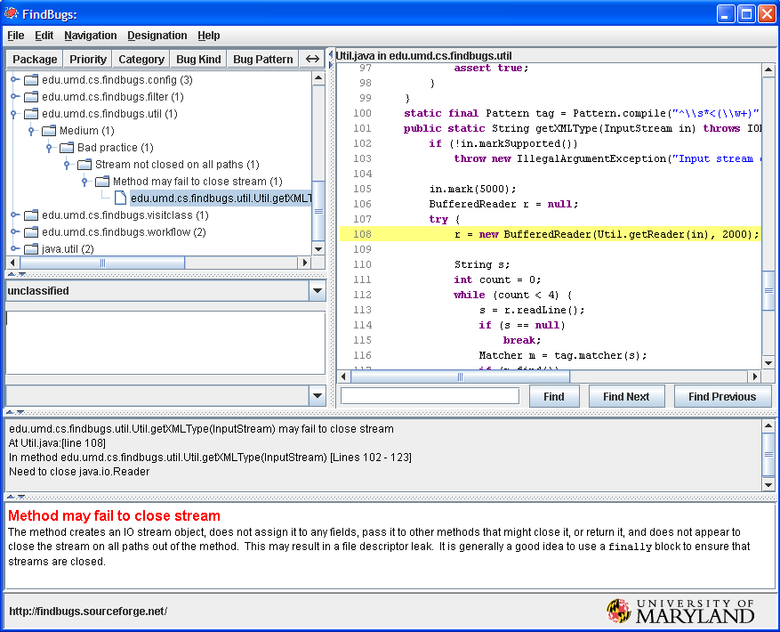
Output Information
The features proposed will generate following warning output:

Slide 7
Implementation of bug detectors
Looking at source of existing bug detectors is the recommended way of learning how to write one [2]
Often use one of the following techniques:
Inspection of class/method/field structure
Micropatterns
Stack-based patterns
Dataflow analysis
Inter-procedural analysis
Source: FindBugs tutorials on Google Code [4]

Slide 8
Implementation of bug detectors (2)
Most bug detectors extend:
BytecodeScanningDetector - more flexible, can detect more general problems
BytecodePatternDetector - good choice when pattern can be expressed as a sequence of bytecode patterns (micropatterns)
Provides default implementations for methods, or override select methods for new detectors
State can be accumulated as bytecode is walked
Once the detector is written, it is packaged in a FindBugs plug-in JAR format containing an XML file describing the detector
Source: IBM developerWorks, "FindBugs Part 2: Writing custom detectors" [2]

Slide 9
References
[1] FindBugs, URL: http://findbugs.sourceforge.net/
[2] FindBugs Part 2: IBM developerWorks: Writing custom detectors, URL: http://www.ibm.com/developerworks/java/library/j-findbug2/
[3] D. Hovemeyer, W.Pugh, "Finding Bugs is Easy", SIGPLAN Notices, December 2004
[4] FindBugs tutorials on Google Code: http://code.google.com/p/findbugs-tutorials

