Slide 1
FindBugs and Jlint
Automated Static Analysis for Concurrent Java Components
Margaret Wojcicki
University of Queensland

Slide 2
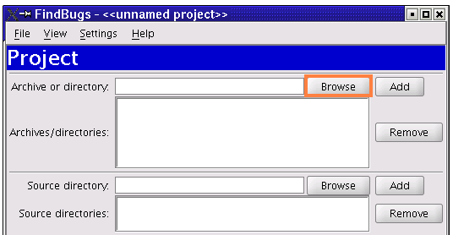
FindBugs – Create a Project
Open the application and create a project by selecting File>New Project and the following dialog window will appear.
Use the "Browse" button next to the “Archive or directory" text field to select a directory containing Java classes to analyse for bugs.

Slide 3
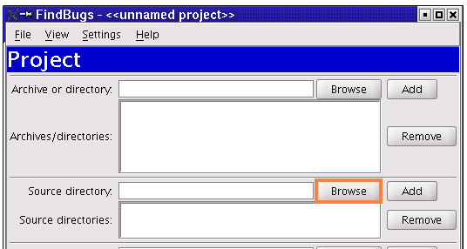
FindBugs – Create a Project
You can also add the source directories which contain the source code for the Java classes you are analysing.

Slide 4
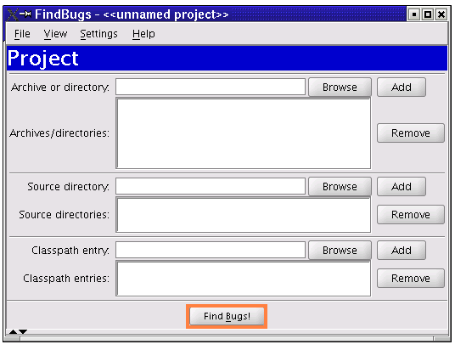
FindBugs – Run the Analysis
Click the "Find Bugs!" button to analyse the classes contained in the directory.

Slide 5
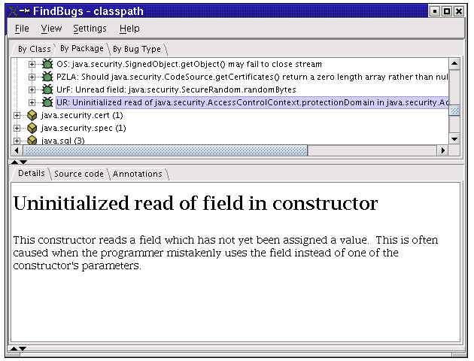
FindBugs – Browsing the Results
When the analysis completes, you will see a screen like the following:

Slide 6
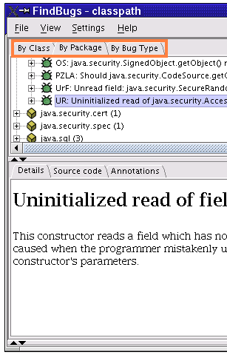
FindBugs – Browsing the Results
The top pane of the window shows the bug tree; this is a hierarchical representation of all of the potential bugs detected in the analysed files.
The tabs allow you to browse by class, package, or bug type.

Slide 7
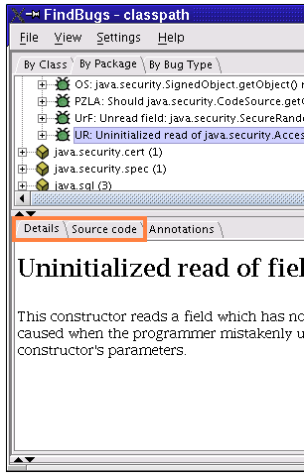
FindBugs – Browsing the Results
Select a bug instance in the top pane and you will see a description of the bug in the "Details" tab of the bottom pane.
The "Source code" tab of the bottom pane will show the program source code (possibly highlighted) where the potential bug occurs.

Slide 8
FindBugs – Browsing the Results
Record concurrency (or multithreaded type) errors
FindBugs is able to discover bugs which may cause failures resulting in interference
  FindBugs may report errors where none exist
  Be aware of this when determining which errors you record

Slide 9
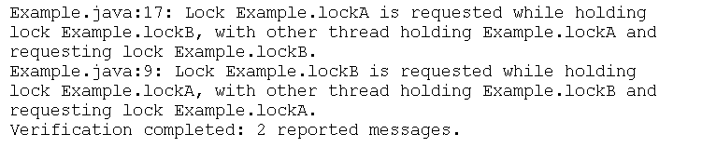
Jlint
In the directory containing Java classes, type “jlint <filename>.class” and examine the results
Error reports can be of the following format:

Slide 10
Jlint – Examining the results
Record concurrency (or synchronization type) errors
Jlint is able to discover bugs which may cause failures resulting in deadlock
  Jlint may report errors where none exist
  Be aware of this when determining which errors you record

