Slide 1

Findbugs
Tin Bui-Huy
September, 2009

Slide 2

Content
What is bug?
What is Findbugs?
How to use Findbugs?
Other static analysis tools for Java

Slide 3


What is bug?
An error or defect in software or hardware that causes a program to malfunction

Slide 4
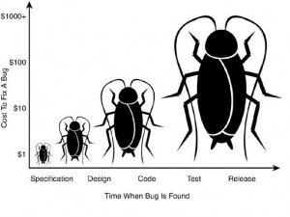
Bug fixing cost

Slide 5
What is Findbugs?
Result of a research project at the University of Maryland
Static analysis tool for Java

Slide 6
What is Findbugs?
Not concerned by formatting or coding standards
Concentrates on detecting potential bugs and performance issues
Can detect many types of common, hard-to-find bugs

Slide 7
How it works?
Use “bug patterns” to detect potential bugs
Examples
Address address = client.getAddress();
if ((address != null) || (address.getPostCode() != null)) {
...
}
NullPointerException
public class ShoppingCart {
private List items;
public addItem(Item item) {
items.add(item);
}
}
Uninitialized field

Slide 8
What Findbugs can do?
FindBugs comes with over 200 rules divided into different categories:
  Correctness
    E.g. infinite recursive loop, reads a field that is never written
  Bad practice
    E.g. code that drops exceptions or fails to close file
  Performance
  Multithreaded correctness
  Dodgy
    E.g. unused local variables or unchecked casts

Slide 9
How to use Findbugs?
Standalone Swing application
Eclipse plug-in
Integrated into the build process (Ant or Maven)

Slide 10
Steps to Run Findbugs Standalone
Download Findbugs from http://findbugs.sourceforge.net/downloads.html
Unzip the file
Execute findbugs.bat

Slide 11
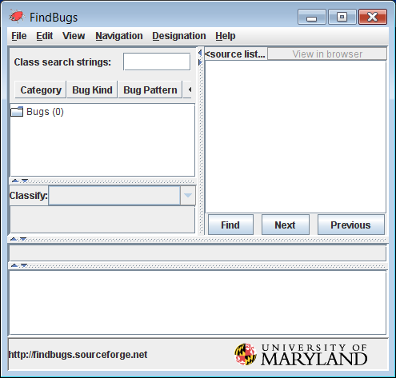
Steps to Run Findbugs Standalone
Finbugs’ GUI brought up
Select File | New project

Slide 12
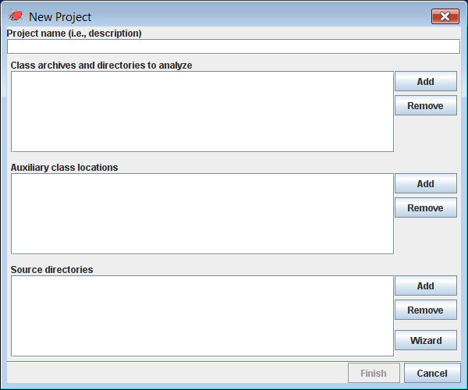
Steps to Run Findbugs Standalone
Select byte code files and their source code
[Point to jar files or class files]
[Point to java files]

Slide 13
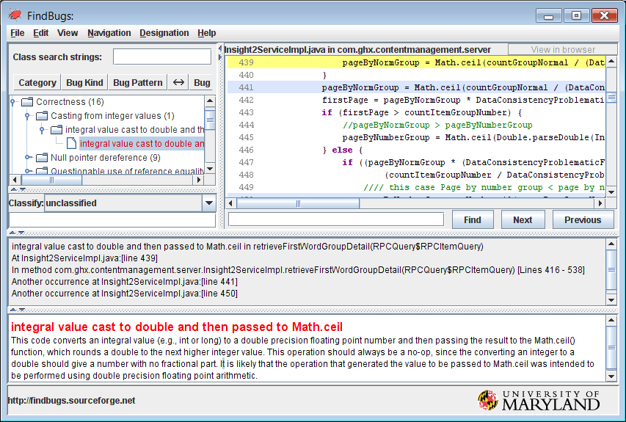
Steps to Run Findbugs Standalone
FindBugs’ results

Slide 14
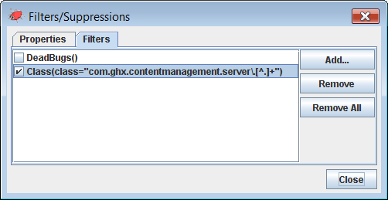
Selectively Suppressing Rules with FindBug Filters
Select Edit | Preferences then move to Filter
Add some filters that meet your expectation

Slide 15
Other static analysis tools for Java
Checkstyle
  (see Java Power Tools Chapter 21)
PMD
  (see Java Power Tools Chapter 22)

Slide 16
References
Java Power Tools (John Ferguson Smart, O'Reilly 2008)

Slide 17
Thank you!

