Slide 1
Debugging Tools
Towards better use of system tools to weed the nasty critters out of your programs

Slide 2
Bug Identification & Elimination
Bug reports should contain a test case, output, and the version number of the software.
Reproduce the bug using the same version the customer used.
Find the root cause of the bug.
Check if the bug still occurs with the latest version. If it does, fix it.
If it doesn’t, make sure it is not just masked by other changes to the software.
Add test cases used to reproduce the bug to the regression test suite.
Keep Records!

Slide 3
Debuggers
Debuggers are tools that can examine the state of a running program.
Common debuggers: adb, dbx, gdb, kdb, wdb, xdb.
Microsoft Visual Studio has a built-in debugger.
This talk will focus on the Visual Studio debugger.

Slide 4
Visual Debugger
Graphically Oriented
Run from Visual Studio
Can debug a failed process by selecting the Yes button at “Debug Application” dialog after a memory or other failure occurs
Can attach to a running process by choosing the Tools->Start Debug->Attach to Process menu option

Slide 5
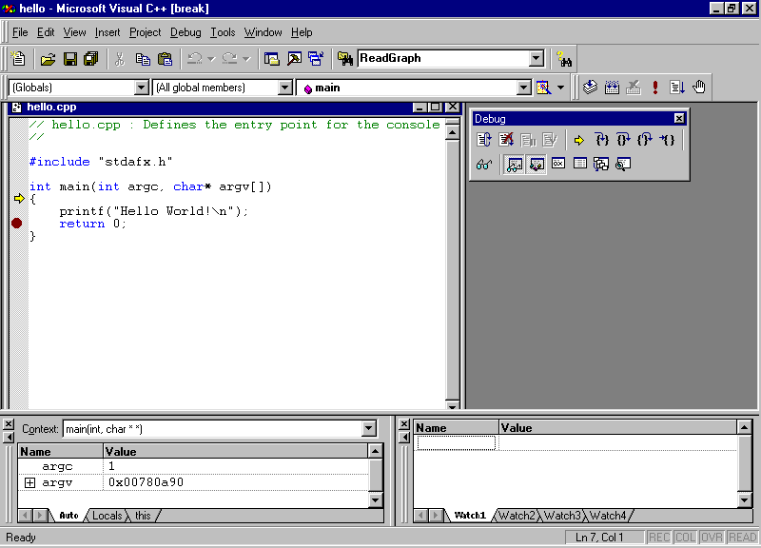
The Visual Debugger

Slide 6
Breakpoints
Can stop execution at any line and in any function. (Location)
Can set conditions on breakpoints if you are only interested in specific passes through a piece of code (Location->Condition)
Conditional breakpoints detached from any one line in the program are also possible, but make program execution very slow (Data).

Slide 7
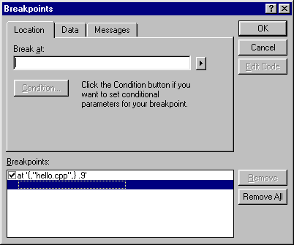
Breakpoint Window

Slide 8
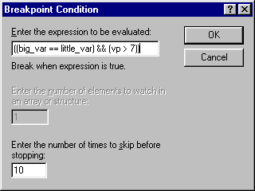
Conditional Window

Slide 9
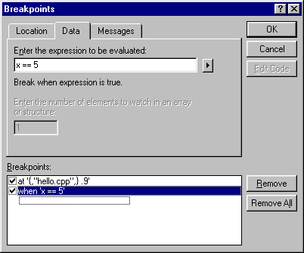
Conditional Data Breakpoint

Slide 10
Examining Program State
Print and/or Change variable state.
Walk up/down the stack trace.
View disassembled code.

Slide 11
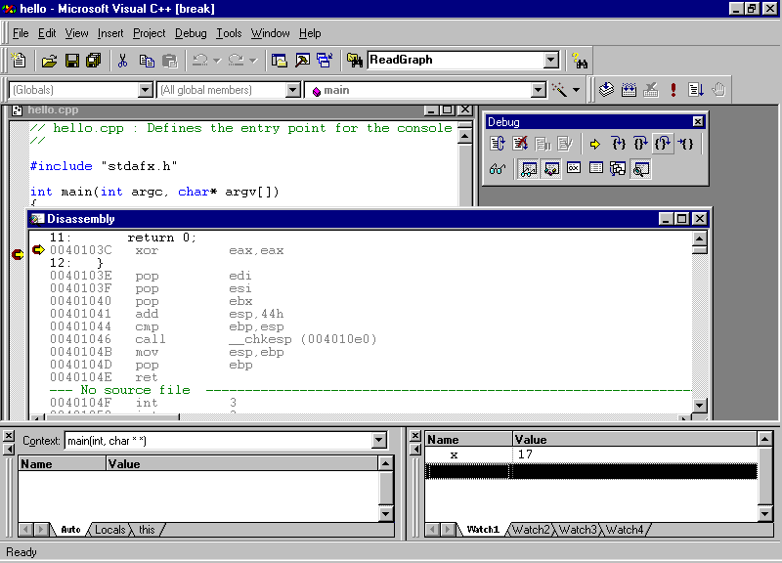

Slide 12
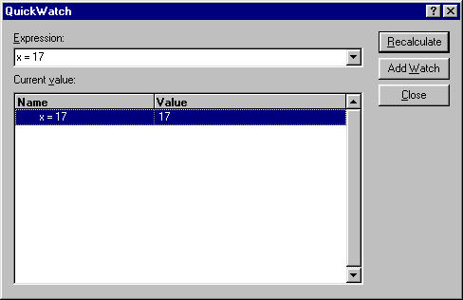
Quick Print/Change Variables

Slide 13
Execution Flow
Step Into - Execute code, step into a function if one is called
Step Out - Continue execution until N-1’st region of stack frame reached
Step Over - Execute code, execute any functions that are called without stopping.

Slide 14
Debugging Pointer and Dynamic Data Structure Problems
Pointers and explicitly allocated dynamic data structures are a central feature in many popular procedural and object-oriented languages
  Great power - especially in extreme cases (eg C/C++)
  Can be very painful to debug

Slide 15
Common Pointer Problems
Pointer to bogus memory
Corrupt data structure segments
Data sharing errors
Accessing data elements of the wrong type
Attempting to use memory areas after freeing them

Slide 16
Pointers to Bogus Memory
Uninitialized pointers
Failing to check memory allocation errors
Using stomped pointers corrupted by previous memory operations
Reminder: Bogus memory access does not necessarily trigger a memory protection fault
Remedy: Add data type info to dynamic data structures
Special Case: Indices above/below array space
Remedy: index checks

Slide 17
Corrupt Data Structure Segments
Incorrect Adds/Deletes in trees/lists/etc.
Stomped pointer values from previous memory operations
Remedy 1: Add type info to dynamic data structures
Remedy 2: Create routines to check integrity of data structures
Remedy 3: Flag deleted memory areas

Slide 18
Data Sharing Errors
Often share data between logically separate program entities
Problem 1: Bogus pointer handoff
Problem 2: Incorrect data format assumptions
Problem 3: Multiple ownership issues
Remedy 1: Type info in dynamic data
Remedy 2: Owner count in memory areas
Remedy 3: Flag deleted data structures
Remedy 4: Think through synchronization problems in the design stage

Slide 19
Accessing Elements of Wrong Type
Access data element of type x, but think you are accessing one of type y
Can be a source of frequent headaches depending on application/implementation
Remedy: Include type info in memory allocations

Slide 20
Accessing Data After Freeing It
Can be a source of many headaches
Remedy 1: Include freed flag in memory (not a guaranteed solution
Remedy 2: Create list of “freed” memory, but do not deallocate it. Check list when dereferencing pointers (very expensive in both time and space)
Big Brother Problem: Accessing data structure after adding it to a “free” list for quick future reuse
Remedy: Remedy 1 plus a use counter (also not a guaranteed solution)

Slide 21
Final Pointer Comments
Pointers are powerful, but are often a major source of program errors
Adding extra state and data structure walk routines can be a big help in debugging (degrades performance/increases memory footprint, but can be removed in release)

Slide 22
Debugging Multitasking Programs
Multiple process/multi-threaded code ubiquitous in modern programs
Many debuggers will work with these programs, but it is not always elegant or easy.
Fallback method: Put new processes to sleep and then attach a debugger to them before they awake.
Better solution: Read debugger documentation, find better one if it is weak in this area.

Slide 23
A Few Tips
Pointers and multithreading together can be extremely difficult to debug
Try to debug parts by themselves before tackling combined system
Analogous strategies to those used in pointer debugging can be a big help
Thread/process timing an important concern in the debugging process

Slide 24
Core Dumps
(Unix) If you run your code outside of the debugger and there is a fault a core file may be generated (depending on your system settings) where the current program state is stored.
Can debug your code post-mortem via: gdb executable-file core-file

Slide 25
Debug Prompts
Windows does not use core files.
If you run your code outside of a debugger and a problem occurs you will be given the option of either debugging the code or killing the executing process.

Slide 26
Abort Signal (Unix)
You can use the abort signal to help determine the cause of your problem
SIGBUS: Likely a dereference of a NULL pointer
SIGSEGV: Likely a dereference of a bogus pointer, an invalid write to code space, or a bad branch to data space
SIGFPE: Division by zero

Slide 27
Blame the Compiler
Sometimes software crashes in debugged code but not in optimized code
The tendency is to blame the compiler and de-optimize the file or function where the bug occurred
Most often the problem is in the code and is just exposed by the optimizer, typically an uninitialized global variable
Of course, sometimes it really is an optimizer bug. In that case, please submit a bug report to the compiler vendor with a nice short test program

Slide 28
Debugging Techniques
Use assertions liberally
Add conditionally compilable debugging code
Multiple platform execution has a way of bringing bugs to the surface

Slide 29
Assertions
Can be used to enforce function pre and post conditions
Make your implicit assumptions explicit
Can be turned off in final release for a performance boost or left in with messages to help in bug report creation

Slide 30
Conditional Compilation
Maintain multiple customized versions in one code base.
Typically have one debug version of your code for bug killing and a release version (sans debug code) for high performance.
Caveat 1: You do need to test the release version before shipping.
Caveat 2: Conditional Compilation not available in all languages.

Slide 31
Multiple Platform Execution
Additional initial design effort
Great debugging aid
Can be a commercial selling point

Slide 32
A few tricky cases before moving on . . .
The library function calls go nuts, but only when they are called after function X . . .
My program is freeing block x prematurely. How do I find out why (and more importantly because of where)?
I am using files to synchronize two programs “halves” under nfs. The process periodically breaks when a file open fails.

Slide 33
Debugging Aids
Lint for stricter code checks
Garbage Collectors for C/C++

Slide 34
Lint
Lint is a semantic checker that identifies potential bugs in C programs
Lint is a mistake!
In the early days of C on UNIX complete semantic checking was removed from the C compiler as a design decision. This allowed for smaller, simpler, and faster compilers at the expense of potentially buggy code.
Lint exists on UNIX systems (but not LINUX)
Most modern ANSI C compilers include Lint semantic checking functionality but only some of Lint’s other features
Use Lint Early and Often!

Slide 35
What does Lint Do?
Checks for consistency in function use across multiple files
Finds
  bugs
  non-portable code
  wasteful code
Typical Bugs Detected include
  Argument types transposed between function and call
  Function with wrong number of arguments takes junk from stack
  Variables being used before set or never used

Slide 36
More about Lint
See Unix man page
OR “Checking C Programs with lint” By Ian F. Darwin

Slide 37
Purify
Purify is a tool for locating runtime errors in a C/C++ program
Purify can find
  Array bounds errors
  Accesses through dangling pointers
  Uninitialized memory reads
  Memory allocation errors
  Memory leaks
Purify is available on Windows and UNIX systems and is a product of Rational Software www.rational.com

Slide 38
How Purify Works
Purify instruments a program by adding protection instructions around every load and store operation
When program is executed a viewer will be created to display errors as they happen
Purify is flexible and can be run standalone with any executable (written in C) or within a debugging environment like Visual Studio
Purify is customizable and can be set to ignore certain types of errors

Slide 39
How to Use Purify
add purify command to link command
program: $(OBJS)
purify [-option ...] $(CC) $(CFLAGS) -o\ program $(OBJS) $(LIBS)
OR run purify in Visual Studio
OR load file in purify executable

Slide 40
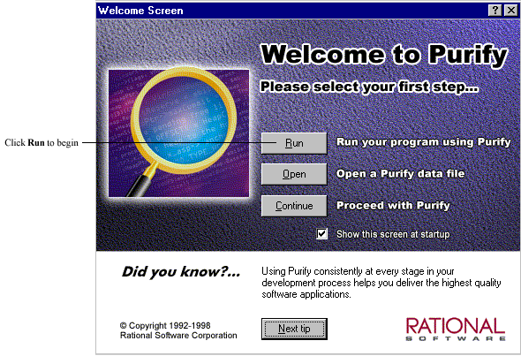

Slide 41
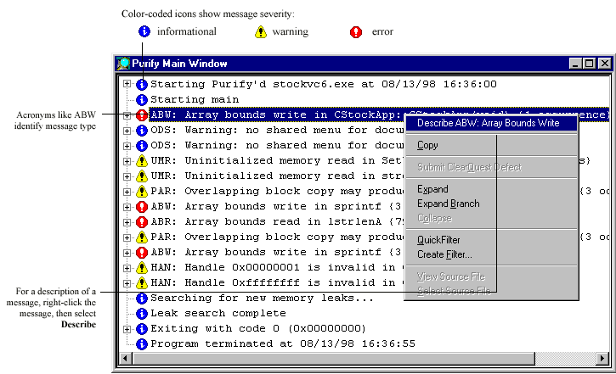

Slide 42
Linux Garbage Collection Aids
If you are using C then checker-gcc is an excellent tool - compile your code using modified gcc compiler and memory errors flagged
Options exist in C++ (checker-g++, ccmalloc, dmalloc), but they tend to be fragile and/or very slow.

Slide 43
Performance Tuning
Profiling
Code Tuning
Options Tuning

Slide 44
Performance Tuning
Why tune? Won’t processors be twice as fast next year?
Customers want it faster NOW
Processor speed isn’t always the bottleneck
Algorithmic improvements can speed up your code far more than 2x
Embedded systems

Slide 45
When Should I Tune?
Knuth: “Premature optimization is the root of all evil”
Tune after you test and debug your code
No point being fast if it’s wrong
Bug fixes can de-tune code
Tuning often makes code more complicated, making it more difficult to debug
Maintain/Improve performance after you ship
Add performance tracking to regression suite to prevent degradation

Slide 46
The Tuning Process
Don’t tune unless you really have to
Iterative process
Profile, tune, profile, tune . . .
This continues until you reach the point of diminishing returns

Slide 47
Profiling
Profiling will tell you where you’re program is spending it’s time
A typical program spends 90% of its time in 10% of the code
You want to speed up the hot code
NEVER tune without profiling
With complex software difficult to tell where the program spends its time
Profile under realistic conditions with realistic data

Slide 48
Profilers
All profilers are intrusive
They perturb the program being profiled
Want a profiler that minimizes the intrusion

Slide 49
Do-It-Yourself Profilers
Add timers to the source code
Usually want time spent in your process, not real time
Unix user+sys time not real time
Use HW counters
Often count cycles for all processes on the system, so you need to run on a quiescent machine

Slide 50
Function-level profilers
Two major types of profilers
  Instrumentation:
    Automatically add code to the program to
      count how often a function is called
      record how much time is spent in a function
    Usually requires recompiling or relinking
  Stochastic
    Stops program every 10-100ms and check what function the program counter is in
    Some work out of the box, others require a relink

Slide 51
Instruction-Level Profilers
Good for tuning within a function (if you read assembly code)
Usually stochastic profiler: requires longer run than function level since more fine-grained information
Shade (Solaris) and Atom (Alpha) interpret the machine code and count the number of times a given instruction is executed
CPU emulators can tell you anything you need to know (if you have the time)

Slide 52
Code Tuning Techniques
Change algorithm
  Most gain, but also most difficult
  Example: set data structure
    If sets are dense, bit vectors often better
    If sets are sparse, hash tables, binary trees, or another sparse data structure might be better

Slide 53
Code Tuning Techniques II
Make hot functions faster
  Throw more compiler optimizations at it
  Rewrite in assembly (often not worth it)
  Indirect calls -> direct calls
    C++: virtual functions -> non-virtual
    Java: non-static functions -> static
      Probably not worth it with latest JVM’s
  Move infrequently executed code out of the way
  Eliminate unnecessary I/O, system calls, allocation

Slide 54
Code Tuning Techniques III
Call hot functions less often
  Cache previously computed values (memoization)
  Inline: eliminates call overhead and allows compiler to do better job optimizing
    Inline by hand if compiler can’t (ex: indirect calls)
Java: less synchronization
  Ex “a” + “b” + “c”
    NewStringBuffer(“a”).append(“b”).append(“c”).toString()
    3 monitor enter instructions: All unnecessary

Slide 55
Intuitive Approach
Previous suggestions geared towards explicit speed improvements
Alternative approach is to code algorithms in a simple easy-to-understand manner
If it is easy for others to understand compiler can probably understand it, too
Result: Compiler optimization can be much more effective

Slide 56
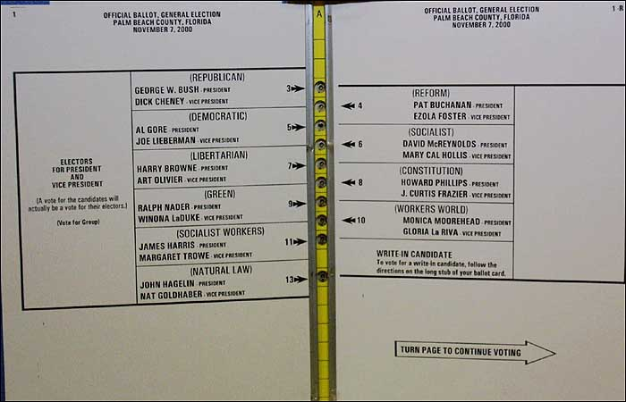
I was floored by it, and I have a Ph.D. . . .

Slide 57
Options Tuning
Don’t optimize a program whose running time doesn’t matter
Start with -O
  Typical Speedup: 2x
  Even local optimizations help 30-50%
  YMMV
Inlining: 10% if done blindly, 30% if done with profiling information
Aliasing options: Allow compiler to eliminate more memory references

Slide 58
Options Tuning for Java
Increase max heap size for less frequent GC
Experiment with vendor-specific options
  Often many options for improving synchronization performance

