Slide 1
Static Code Analysis to Find Bugs
Wright.edu CS7140 Spring 2013
(Slides collected from many sources)

Slide 2
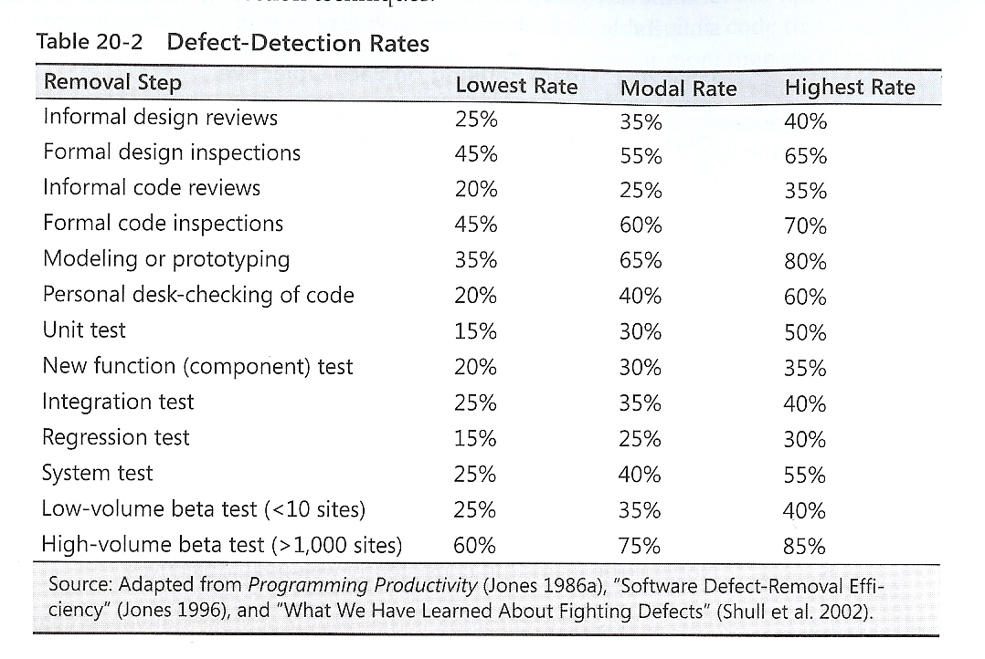
Comparison of Defect-Detection Approaches

Slide 3
Inspections?
The combination of design and code inspections usually removes 70-85 percent or more of the defects in a product (Jones 1996).
Designers and coders learn to improve their work through participating in inspections, and inspections increase productivity by about 20 percent (Fagan 1976, Humphrey 1989, Gilb and Graham 1993, Wiegers 2002).
On a project that uses inspections for design and code, the inspections will take up about 10-15 percent of project budget and will typically reduce overall project cost.

Slide 4
Best Results – Combine Approaches
The typical organization uses a test-heavy defect-removal approach and achieves only about 85 percent defect­ removal efficiency.
Leading organizations use a wider variety of techniques and achieve defect-removal efficiencies of 95 percent or higher (Gones 2000).

Slide 5
Code Review Tools
Advantages of Code Review Tools
Track suggestions
Allow follow up on tasks
Aid in comparing before and after changes
Source Code repository integration
Tools
Crucible
CodeCollaborator
Review Board
Rietveld
Code Striker

Slide 6
Code Analysis Tools
FindBugs
PMD
CheckStyle
Jdepend
Ckjm
Cpd
Javancss
Cobertura
jlint

Slide 7
FindBugs
A bug pattern is a code idiom that is often an error.
Difficult language features
Misunderstood API methods
Misunderstood invariants when code is maintaine
typos, wrong boolean operators, …
static analysis to inspect Java bytecode for bug patterns.
Without executing the program
don't even need the program's source
can report false warnings, and also miss real errors.
In practice, false warnings < 50%.

Slide 8
FindBugs Categories
Bad practice
Correctness
Dodgy
Experimental
Internationalization
Malicious code vulnerability
Multithreaded correctness
Performance
Security

Slide 9
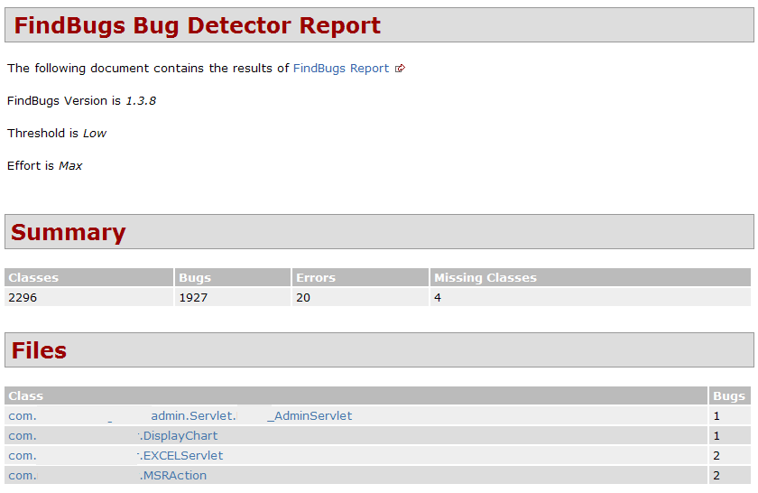

Slide 10

PMD scans Java source code and looks for potential problems like:
Possible bugs - empty try/catch/finally/switch statements
Dead code - unused local variables, parameters and private methods
Suboptimal code - wasteful String/StringBuffer usage
Overcomplicated expressions - unnecessary if statements, for loops that could be while loops
Duplicate code - copied/pasted code means copied/pasted bugs

Slide 11
PMD RuleSets
Android Rules: These rules deal with the Android SDK.
Basic Rules: The Basic Ruleset contains a collection of good practices which everyone should follow.
Braces Rules: The Braces Ruleset contains a collection of braces rules.
Clone Implementation Rules: The Clone Implementation ruleset contains a collection of rules that find questionable usages of the clone() method.
Code Size Rules: The Code Size Ruleset contains a collection of rules that find code size related problems.
Controversial Rules: The Controversial Ruleset contains rules that, for whatever reason, are considered controversial.
Coupling Rules: These are rules which find instances of high or inappropriate coupling between objects and packages.
Design Rules: The Design Ruleset contains a collection of rules that find questionable designs.
Import Statement Rules: These rules deal with different problems that can occur with a class' import statements.
JavaBean Rules: The JavaBeans Ruleset catches instances of bean rules not being followed.
JUnit Rules: These rules deal with different problems that can occur with JUnit tests.
Java Logging Rules: The Java Logging ruleset contains a collection of rules that find questionable usages of the logger.
Migration Rules: Contains rules about migrating from one JDK version to another.
Migration15: Contains rules for migrating to JDK 1.5
Naming Rules: The Naming Ruleset contains a collection of rules about names - too long, too short, and so forth.
Optimization Rules: These rules deal with different optimizations that generally apply to performance best practices.
Strict Exception Rules: These rules provide some strict guidelines about throwing and catching exceptions.
String and StringBuffer Rules: Problems that can occur with manipulation of the class String or StringBuffer.
Security Code Guidelines: These rules check the security guidelines from Sun.
Unused Code Rules: The Unused Code Ruleset contains a collection of rules that find unused code.

Slide 12
PMD Rule Example
PMD Basic Rules
EmptyCatchBlock: Empty Catch Block finds instances where an exception is caught, but nothing is done. In most circumstances, this swallows an exception which should either be acted on or reported.
EmptyIfStmt: Empty If Statement finds instances where a condition is checked but nothing is done about it.
EmptyWhileStmt: Empty While Statement finds all instances where a while statement does nothing. If it is a timing loop, then you should use Thread.sleep() for it; if it's a while loop that does a lot in the exit expression, rewrite it to make it clearer.
EmptyTryBlock: Avoid empty try blocks - what's the point?
EmptyFinallyBlock: Avoid empty finally blocks - these can be deleted.
EmptySwitchStatements: Avoid empty switch statements.
JumbledIncrementer: Avoid jumbled loop incrementers - it's usually a mistake, and it's confusing even if it's what's intended.
ForLoopShouldBeWhileLoop: Some for loops can be simplified to while loops - this makes them more concise.

Slide 13
CheckStyle
Development tool to help programmers write Java code that adheres to a coding standard. It automates the process of checking Java code to spare humans of this boring (but important) task.
Highly configurable and can be made to support almost any coding standard. An example configuration file is supplied supporting the Sun Code Conventions. Other sample configuration files are supplied for other well known conventions.

Slide 14
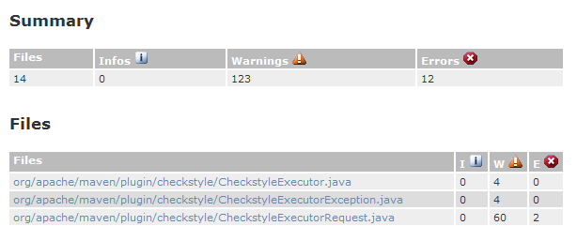
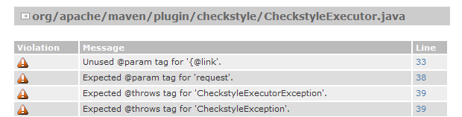
CheckStyle Example

Slide 15
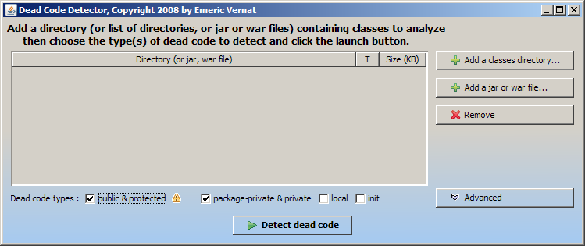
Dead Code Detector

Slide 16
Miscellaneous Tools
CKJM - Chidamber and Kemerer Java Metrics
Cobertura & EMMA – Test Code Coverage
JavaNCSS - A Source Measurement Suite
JDepend – Package Dependencies; Efferent Couplings (Ce) (number of other packages that the classes in the package depend upon)
PMD-CPD - Copy/Paste Detector (CPD)
Java2HTML - Source Code turned into a colorized and browseable HTML representation.

Slide 17
Structure Tools
Struture101 -- For understanding, analyzing, measuring and controlling the quality of your Software Architecture as it evolves over time.
Sotoarc/Sotograph — Architecture and quality in-depth analysis and monitoring for Java,
http://en.wikipedia.org/wiki/List_of_tools_for_static_code_analysis

Slide 18
XRadar
XRadar is an open extensible code report tool currently supporting all Java based systems.
The batch-processing framework produces HTML/SVG reports of the systems current state and the development over time - all presented in sexy tables and graphs.

Slide 19
Sonar
Dashboard to summarize Static and Dynamic analysis Tools.
Conventions (Checkstyle)
Bad Practices (PMD)
Potential Bugs (FindBugs)

Slide 20
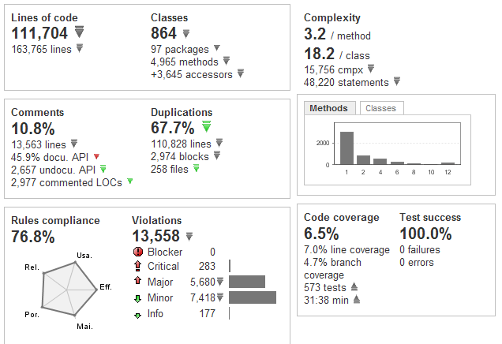
Sonar Application Dashboard

Slide 21
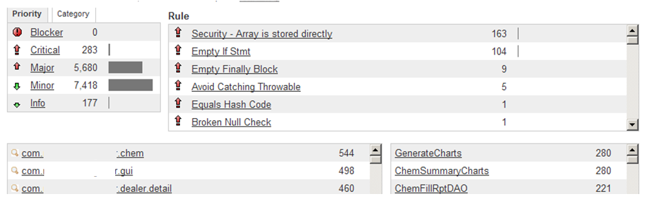
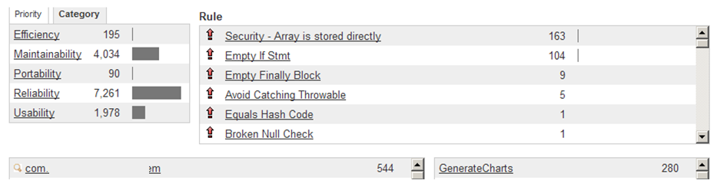
Sonar Violations Drilldown

Slide 22
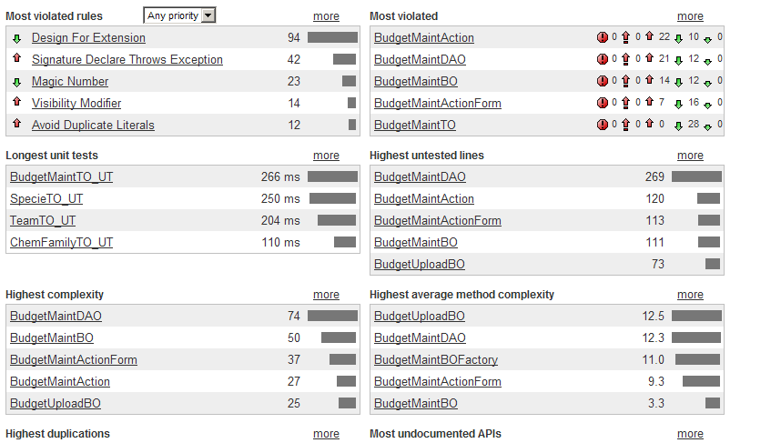
Sonar Hotspots

Slide 23
IntelliJ Idea
IDE Features | Community Edition | Ultimate Edition
Code Duplicates | No | Yes
Code Coverage | No | Yes
Code Inspector | Yes | Yes
Spell Checker | Yes | Yes
More than 600 automated Code Inspections
Finding probable bugs
Locating the “dead” code
Detecting performance issues
Improving code structure and maintainability
Conforming to coding guidelines and standards
Conforming to specifications

