Slide 1
Design patterns
Glenn D. Blank

Slide 2
Definitions
A pattern is a recurring solution to a standard problem, in a context.
Christopher Alexander, a professor of architecture…
  Why would what a prof of architecture says be relevant to software?
  “A pattern describes a problem which occurs over and over again in our environment, and then describes the core of the solution to that problem, in such a way that you can use this solution a million times over, without ever doing it the same way twice.”
Jim Coplein, a software engineer:
“I like to relate this definition to dress patterns…”
  What are dress patterns?
  “... I could tell you how to make a dress by specifying the route of
  a scissors through a piece of cloth in terms of angles and lengths of cut. Or, I could give you a pattern. Reading the specification, you would have no idea what was being built or if you had built the right thing when you were finished. The pattern foreshadows the product: it is the rule for making the thing, but it is also, in many respects,
  the thing itself.”

Slide 3
Patterns in engineering
How do other engineers find and use patterns?
  Mature engineering disciplines have handbooks
  describing successful solutions to known problems
  Automobile designers don't design cars from scratch
  using the laws of physics
  Instead, they reuse standard designs with successful
  track records, learning from experience
  Should software engineers make use of patterns? Why?
  “Be sure that you make everything according to the pattern
  I have shown you here on the mountain.” Exodus 25:40.
Developing software from scratch is also expensive
  Patterns support reuse of software architecture and design

Slide 4
The “gang of four” (GoF)
Erich Gamma, Richard Helm, Ralph Johnson
& John Vlissides (Addison-Wesley, 1995)
  Design Patterns book catalogs 23 different patterns as solutions to different classes of problems, in C++ & Smalltalk
  The problems and solutions are broadly applicable, used by many people over many years
  What design pattern did we discover with the Undo problem?
    Why is it useful to learn about this pattern?
    Patterns suggest opportunities for reuse in analysis, design and programming
  GOF presents each pattern in a structured format
    What do you think of this format? Pros and cons?

Slide 5
Elements of Design Patterns
Design patterns have 4 essential elements:
  Pattern name: increases vocabulary of designers
  Problem: intent, context, when to apply
  Solution: UML-like structure, abstract code
  Consequences: results and tradeoffs

Slide 6
Command pattern
Synopsis or Intent: Encapsulate a request as an object,
thereby letting you parameterize clients with different requests, queue or log requests, and support undoable operations
Context: You want to model the time evolution of a program:
  What needs to be done, e.g. queued requests, alarms, conditions for action
  What is being done, e.g. which parts of a composite or distributed action have been completed
  What has been done, e.g. a log of undoable operations
What are some applications that need to support undo?
  Editor, calculator, database with transactions
  Perform an execute at one time, undo at a different time
Solution: represent units of work as Command objects
  Interface of a Command object can be a simple execute() method
  Extra methods can support undo and redo
  Commands can be persistent and globally accessible, just like normal objects

Slide 7
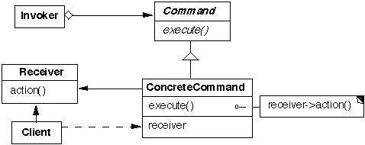
Command pattern, continued
Structure:
Participants (the classes and/or objects participating in this pattern):
Command (Command) declares an interface for executing an operation
ConcreteCommand defines a binding between a Receiver object and an action
  implements Execute by invoking the corresponding operation(s) on Receiver
Invoker asks the command to carry out the request
Receiver knows how to perform operations associated with carrying out the request
Client creates a ConcreteCommand object and sets its receiver

Slide 8
Command pattern, continued
Consequences:
  You can undo/redo any Command
    Each Command stores what it needs to restore state
  You can store Commands in a stack or queue
    Command processor pattern maintains a history
  It is easy to add new Commands, because you do not have to change existing classes
    Command is an abstract class, from which you derive new classes
    execute(), undo() and redo() are polymorphic functions

Slide 9
Design Patterns are NOT
Data structures that can be encoded in classes and reused as is (i.e., linked lists, hash tables)
Complex domain-specific designs
(for an entire application or subsystem)
If they are not familiar data structures or complex domain-specific subsystems, what are they?
They are:
  “Descriptions of communicating objects and classes
  that are customized to solve a general design problem
  in a particular context.”

Slide 10
Observer pattern
Intent:
  Define a one-to-many dependency between objects
  so that when one object changes state, all its dependents are notified and updated automatically
Used in Model-View-Controller framework
  Model is problem domain
  View is windowing system
  Controller is mouse/keyboard control
How can Observer pattern be used in other applications?
JDK’s Abstract Window Toolkit (listeners)
Java’s Thread monitors, notify(), etc.

Slide 11
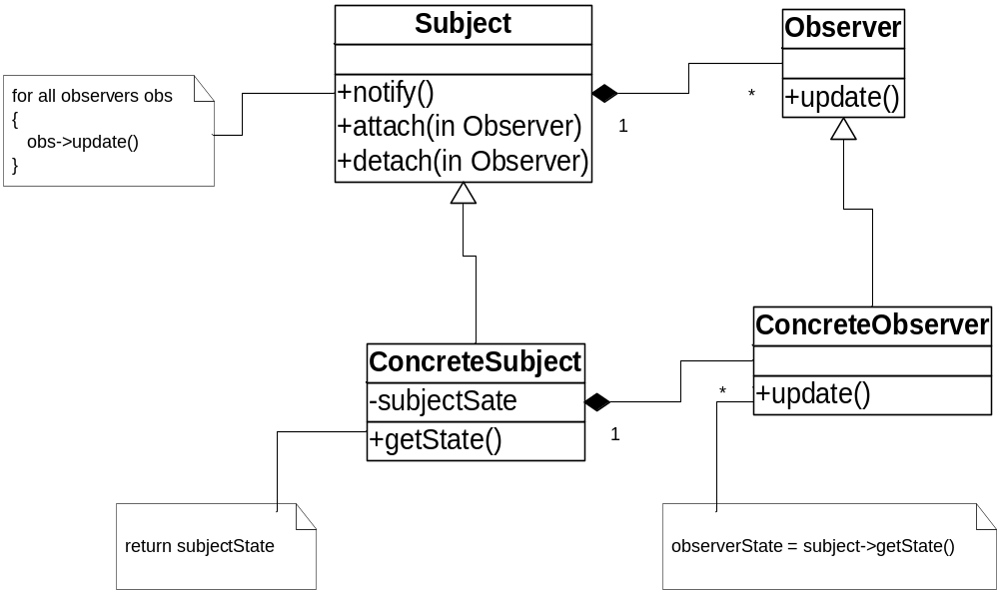
Structure of Observer Pattern

Slide 12
Three Types of Patterns
Creational patterns:
  Deal with initializing and configuring classes and objects
Structural patterns:
  Deal with decoupling interface and implementation of classes and objects
  Composition of classes or objects
Behavioral patterns:
  Deal with dynamic interactions among societies of classes and objects
  How they distribute responsibility

Slide 13

Singleton pattern (creational)
Ensure that a class has only one instance and provide a global point of access to it
  Why not use a global variable?
class Singleton
{ public:
static Singleton* getInstance();
protected: //Why are the following protected?
Singleton();
Singleton(const Singleton&);
Singleton& operator= (const Singleton&);
private: static Singleton* instance;
};
Singleton *p2 = p1->getInstance();

Slide 14
Creational Patterns
Abstract Factory:
  Factory for building related objects
Builder:
  Factory for building complex objects incrementally
Factory Method:
  Method in a derived class creates associates
Prototype:
  Factory for cloning new instances from a prototype
Singleton:
  Factory for a singular (sole) instance

Slide 15
Structural patterns
Describe ways to assemble objects to realize new functionality
  Added flexibility inherent in object composition due to ability to change composition at run-time
  not possible with static class composition
Example: Proxy
  Proxy: acts as convenient surrogate or placeholder for another object.
    Remote Proxy: local representative for object in a different address space
    Virtual Proxy: represent large object that should be loaded on demand
    Protected Proxy: protect access to the original object

Slide 16
Structural Patterns
Adapter:
  Translator adapts a server interface for a client
Bridge:
  Abstraction for binding one of many implementations
Composite:
  Structure for building recursive aggregations
Decorator:
  Decorator extends an object transparently
Facade:
  Simplifies the interface for a subsystem
Flyweight:
  Many fine-grained objects shared efficiently.
Proxy:
  One object approximates another

Slide 17
Behavioral Patterns
Chain of Responsibility:
  Request delegated to the responsible service provider
Command:
  Request or Action is first-class object, hence re-storable
Iterator:
  Aggregate and access elements sequentially
Interpreter:
  Language interpreter for a small grammar
Mediator:
  Coordinates interactions between its associates
Memento:
  Snapshot captures and restores object states privately
Which ones do you think you have seen somewhere?

Slide 18
Behavioral Patterns (cont.)
Observer:
  Dependents update automatically when subject changes
State:
  Object whose behavior depends on its state
Strategy:
  Abstraction for selecting one of many algorithms
Template Method:
  Algorithm with some steps supplied by a derived class
Visitor:
  Operations applied to elements of a heterogeneous object structure

Slide 19
Patterns in software libraries
AWT and Swing use Observer pattern
Iterator pattern in C++ template library & JDK
Façade pattern used in many student-oriented libraries to simplify more complicated libraries!
Bridge and other patterns recurs in middleware for distributed computing frameworks
…

Slide 20
More software patterns
Design patterns
  idioms (low level, C++): Jim Coplein, Scott Meyers
    I.e., when should you define a virtual destructor?
  design (micro-architectures) [Gamma-GoF]
  architectural (systems design): layers, reflection, broker
    Reflection makes classes self-aware, their structure and behavior accessible for adaptation and change:
    Meta-level provides self-representation, base level defines the application logic
Java Enterprise Design Patterns (distributed transactions and databases)
  E.g., ACID Transaction: Atomicity (restoring an object after a failed transaction), Consistency, Isolation, and Durability
Analysis patterns (recurring & reusable analysis models, from various domains, i.e., accounting, financial trading, health care)
Process patterns (software process & organization)
Notes:
Much of the initial patterns focus in the software community has been on design patterns. The patterns in the [GoF] book are object-oriented design patterns. However, there are many other kinds of software patterns besides design patterns. For example, Martin Fowler has written a book of Analysis Patterns. Patterns cover all aspects of software engineering including: development organization, software process, project planning, requirements engineering, and software configuration, management (just to name a few). Presently however, design patterns still seem to be the most popular (though organization patterns seem to be gaining momentum).
----
The difference between these three kinds of design patterns are in their corresponding levels of abstraction and detail. Architectural patterns are high-level strategies that concern large-scale components and the global
properties and mechanisms of a system. They have wide-sweeping implications which affect the overall skeletal structure and organization of a software system. Design patterns are medium-scale tactics that flesh
out some of the structure and behavior of entities and their relationships. They do not influence overall system structure, but instead define micro-architectures of subsystems and components. Idioms are
paradigm-specific and language-specific programming techniques that fill in low-level internal or external details of a component's structure or behavior.

Slide 21
Benefits of Design Patterns
Design patterns enable large-scale reuse of software architectures and also help document systems
Patterns explicitly capture expert knowledge and design tradeoffs and make it more widely available
Patterns help improve developer communication
Pattern names form a common vocabulary

Slide 22
Web Resources
http://home.earthlink.net/~huston2/dp/
http://www.dofactory.com/
http://hillside.net/patterns/
Java Enterprise Design Patterns

