Slide 1
Java Security: Lessons Learned
(Sanitized for Publishing)
Li Gong
Engineering and Research Institute
Sun Microsystems
and Tsinghua University, Beijing
June 16, 2003
li.gong@sun.com

Slide 2
Outline of Presentation
Why me speaking (a bit of context)
Most difficult problems encountered
Most “life-saving” features found
Things that should have gotten in and underutilized ideas
Things that should not have gotten in
Other headaches
Surprises, etc.

Slide 3
SRI Java Security Workshop
One-day workshop on Java security
05/03/1995, at SRI, organized by Peter Neumann and myself (date courtesy of PGN)
Attendees:
  Tahar ElGamal
  James Gosling (“we can use some help”)
  Butler Lampson (“no point in all this, PC users cannot understand and handle security policies”)
  Mike Schroeder (“if people in this room put their heads together, we can get Java/browser security right”)
  …

Slide 4
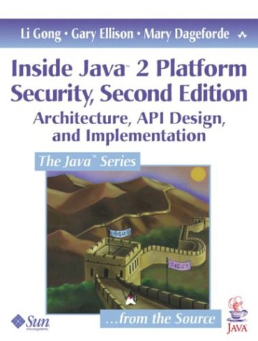
2nd Edition Just Out

Slide 5
Most Difficult Problems
Not understanding the new system and its interaction with security
  Confusion and mix-up between source programming language (Java), binary object code (bytecode), and system (JRE)
  Type safety not fully understood
  Obscure bytecode verifier (“Only Frank Yellin can parse it”)
  Class loader not part of the Java language

Slide 6
Difficult Problems Continued
Last-minute security hack
  Lack of clear “sandbox” design (where is the spec)
  Shaky sandbox implementation (“step-counting”)
  “Hardwired” security policy
  Policy mixed up with enforcement (SecurityManager)
Too much focused on desktop or set-top box, single user mode, scenarios
  Local vs remote code in deciding trust (fixed in JDK 1.2)
  System wide variables and parameters (not fixed)

Slide 7
“Life-Saving” Features
The sandbox concept
The implementation of the sandbox in the form of the SecurityManager
  Archimedes’s fulcrum
Serious and urgent attention to security at JavaSoft, because:
  JDK 1.0 was full of holes (and some of them being found out)
  MSFT always poking at Sun (and leaky)
  NSCP rushing ahead & “wanting to take over”

Slide 8
Underutilized Ideas
Erlingsson and Schneider, Inlined Reference Monitor (IRM)
  Why interesting: support for arbitrary enforceable policy
  Why not in: too late in the JDK 1.2 cycle
Balfanz and Gong, multi-processing
  Why: support for different security policies and properties for different processes
  Why not: too radical departure from JDK, too disruptive to existing code, not backward compatible
GuardedObject
  Why: more flexible, cleaner implementation, context switch, coders do not need to know about security managers or access control checks (could be used more widely within JDK)
  Why not: alien to the familiar usage of calling SecurityManager

Slide 9
Things That Shouldn’t Gotten In
AccessController.doPrivileged()
  What: this is to solve the setuid problem
  Why: beginPrivileged() and endPrivileged pair was perfectly fine
  SecurityManager.beginPrivileged();
  (do something)
  SecurityManager.endPrivileged();
  Why not: reason for change was invalid, action was forced, and result not pretty

Slide 10
Other Headaches
Java cannot guarantee sequential execution
X = 0;
X = 1;
X = 0;
The use of NULL (you cannot change the behavior of a NULL)
  Null ClassLoader
  Null SecurityManager
Overloading functions between finding a class (which should be easily extensible) and defining it (which should be tightly controlled)

Slide 11
Perennial Issues
Code theft
Resource consumption
Access control protection via Java package/class definitions
Security features vs. JVM/JRE performance
…

Slide 12
Surprises (Political Pressure)
Sun: (you have to be at the talk)
IBM (TJ Watson ambush): (see above)
Netscape: (see above)
Others:

Slide 13
Interesting Company We Kept
Netcape – front-line requirements (Jim Roskind)
IBM – Bob Blakley, Tony Nadalin, Larry Koved
Princeton – Ed Felten, Drew Dean, Dan Wallach, Dirk Balfanz (72hrs deadline)
U Washington – Brian Bershad, Gun Sirer (bytecode basher)
Stanford – John Mitchell and others (bytecode verification)
Advisory council (Jerry Saltzer, Fred Schneider, Mike Schroeder, …)
Others (Gary McGraw, et. All)

Slide 14
Other Lessons
There will always be software bugs
Often there are security holes
Not all known holes are plugged (for unexpected but rational reasons)
Some programmer will take shortcuts
No one will tell you the truth about the state of security
No one knows the truth about this

Slide 15
Q & A

