Slide 1
Chapter 7: Security
Outline
7.1 Introduction
7.2 Ancient Ciphers to Modern Cryptosystems
7.3 Secret-key Cryptography
7.4 Public-key Cryptography
7.5 Cryptanalysis
7.6 Key Agreement Protocols
7.7 Key Management
7.8 Java Cryptography Extension (JCE)
7.8.1 Password-Based Encoding with JCE|
7.8.2 Decorator Design Pattern
7.9 Digital Signatures
7.10 Public-key Infrastructure, Certificates and Certification Authorities
7.10.1 Java Keystores and keytool
7.11 Java Policy Files
7.12 Digital Signatures for Java Code

Slide 2
Chapter 7 Security
7.13 Authentication
7.13.1 Kerberos
7.13.2 Single Sign-On
7.13.3 Java Authentication and Authorization Service (JAAS)
7.14 Secure Sockets Layer (SSL)
7.14.1 Java Secure Socket Extension (JSSE)
7.15 Java Language Security and Secure Coding
7.16 Internet and World Wide Web Resources

Slide 3
7.1 Introduction
Need for Internet security
  Consumers buying products, trading stocks and banking online
  Credit-card, social security and confidential business information exchanged
  Security attacks
    Data theft and hacker attacks
    Wireless transmissions easier to intercept
Secure transaction fundamentals
  Privacy: no third party
  Integrity: information unaltered
  Authentication: proving identities
  Non-repudiation: legal proof of message received

Slide 4
7.1 Introduction (cont.)
Availability
  Network stays in operation continuously and are becoming wireless
4 main security issues
  Privacy
  Integrity
  Authentication
  Non-repudiation

Slide 5
7.2 Ancient Ciphers to Modern Cryptosystems
Cryptography
  Cipher/cryptosystem (algorithm) encrypts message
    Plaintext: unencrypted data
    Ciphertext: encrypted data
  Key: used by sender and receiver to encrypt and decrypt message
Ancient Ciphers
  Substitution ciphers: given letter replaced by different letter
  Transposition ciphers: letter ordering shifted
  Restricted algorithms: security relies on keeping encryption algorithm secret

Slide 6
7.2 Ancient Ciphers to Modern Cryptosystems (cont.)
Digital cryptosystems
  Algorithms based on bits/blocks of binary string (computer data)
  Key length: stronger encryption for longer keys
  US government used to limit key length of exported cryptosystems
    Regulations now less stringent

Slide 7
7.3 Secret-key Cryptography
Symmetric/secret-key cryptography
  Same key encrypts and decrypts message
  Disadvantages
    Need secure method to transfer key
    No authentication because same key used on both ends
    Sender needs separate secret key for each receiver
  Key distribution center (KDC)
    Shares secret key with users in network
    Encrypts session key with secret keys to sender and receiver
    Session key used for transaction
    New keys and less couriers for transactions, but security depends on security on KDC

Slide 8
7.3 Secret-key Cryptography (cont.)
Data Encryption Standard (DES)
  Uses block cipher: creates bit groups from message and applies algorithm to whole block
  DES standard set by American National Standards Institute (ANSI) for years, no loner considered secure
    DES Cracker Machines developed to crack DES code
Triple DES (3DES) replaced DES
  Three DES systems in row with unique secret key
Advanced Encryption Standard (AES) is new standard
  Nation Institute of Standards and Technology (NIST) currently evaluating Rijndael for AES

Slide 9
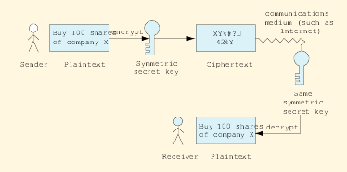
7.3 Secret-key Cryptography (cont.)
Fig. 7.1 Encrypting and decrypting a message using a symmetric secret key.

Slide 10
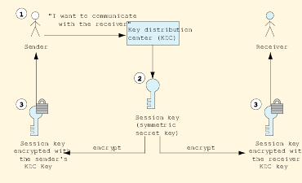
7.3 Secret-key Cryptography (cont.)
Fig. 7.2 Distributing a session key with a key distribution center.

Slide 11
7.4 Public-key Cryptography
Public-key Cryptography
  Uses public-key (distributed) and private-key (kept secret)
  Public-key decrypts private-key and vice-versa
  Computationally infeasible to deduce private-key from public-key
  Authentication
    If receiver’s public-key and sender’s private key are both used, both parties are authenticated
RSA: most common public-key algorithm
  Used by most Fortune 1000 and e-commerce businesses
Pretty Good Privacy (PGP)
  Encrypts e-mails and files using “web of trust”

Slide 12
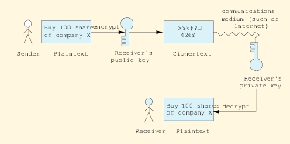
7.4 Public-key Cryptography (cont.)
Fig. 7.3 Encrypting and decrypting a message using public-key cryptography.

Slide 13
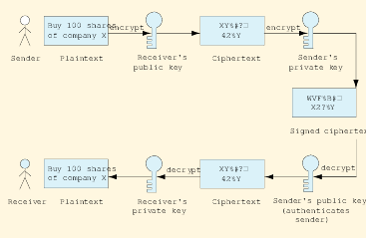
7.4 Public-key Cryptography (cont.)
Fig. 7.4 Authentication with a public-key algorithm

Slide 14
7.5 Cryptanalysis
Even if keys are secret, it is possible to compromise the security of a system
Cryptanalysis: trying to decrypt ciphertext without knowledge of the decryption key
  Cryptanalytic attacks
Attacks can be reduced if proper key management structures are in place and keys use expiration dates

Slide 15
7.6 Key Agreement Protocols
Public-key algorithms not efficient for large amounts of data
  Large computing power requirements slow communication
Key Agreement Protocol
  Two parties exchange keys over unsecure medium
  Digital envelope: symmetric secret key encrypted using public-key encryption

Slide 16
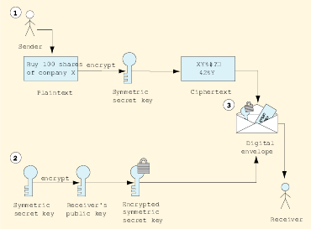
7.6 Key Agreement Protocols (cont.)
Fig. 7.5 Creating a digital envelope.

Slide 17
7.7 Key Management
Secrecy of private keys crucial to system security
  Poor key management: mishandling of private keys
  Key generation: process by which keys created
    Should be as random as possible
  Brute-force cracking: decrypting message using every possible decryption key

Slide 18
7.8 Java Cryptography Extension (JCE)
Java Cryptography Extension (JCE)
  provides Java applications with various security facilities
  supports
    secret-key encryption
      3DES
    public-key algorithms
      Diffie-Hellman
      RSA
  customizable levels of encryption through
    multiple encryption algorithms
    various key sizes
  architecture is provider-based
    developers add algorithms by adding providers’ algorithms

Slide 19
7.8.1 Password-Based Encoding with JCE
Class EncipherDecipher
  demonstrates Password-Based Encryption (PBE)
  to randomize sets of generated keys, uses
    array of bytes called salt
    integer

Slide 20
Fig. 7.6 EnciphyerDecipher application for demonstrating Password-Based Encryption.
Lines 28-31
Line 34
Lines 28-34
1 // EncipherDecipher.java
2 // Displays a frame that allows users to specify
3 // a password and a file name. Contents written
4 // to an Editor Pane can be encrypted and written
5 // to a file, or encrypted contents can be read from
6 // a file and decrypted
7 package com.deitel.advjhtp1.security.jce;
8
9 // Java core package
10 import java.awt.*;
11 import java.awt.event.*;
12 import java.io.*;
13 import java.util.*;
14 import java.security.*;
15 import java.security.spec.*;
16
17 // third-party packages
18 import com.sun.crypto.provider.SunJCE;
19
20 // Java extension package
21 import javax.swing.*;
22 import javax.crypto.*;
23 import javax.crypto.spec.*;
24
25 public class EncipherDecipher extends JFrame {
26
27 // salt for password-based encryption-decryption algorithm
28 private static final byte[] salt = {
29 ( byte )0xf5, ( byte )0x33, ( byte )0x01, ( byte )0x2a,
30 ( byte )0xb2, ( byte )0xcc, ( byte )0xe4, ( byte )0x7f
31 };
32
33 // iteration count
34 private int iterationCount = 100;
35
salt
randomize sets of generated keys
iteration counter

Slide 21
Fig. 7.6 EnciphyerDecipher application for demonstrating Password-Based Encryption.
Line 45
36 // user input components.
37 private JTextField passwordTextField;
38 private JTextField fileNameTextField;
39 private JEditorPane fileContentsEditorPane;
40
41 // frame constructor
42 public EncipherDecipher() {
43
44 // set security provider
45 Security.addProvider( new SunJCE() );
46
47 // initialize main frame
48 setSize( new Dimension( 400, 400 ) );
49 setTitle( "Encryption and Decryption Example" );
50
51 // construct top panel
52 JPanel topPanel = new JPanel();
53 topPanel.setBorder( BorderFactory.createLineBorder(
54 Color.black ) );
55 topPanel.setLayout( new BorderLayout() );
56
57 // panel where password and file name labels will be placed
58 JPanel labelsPanel = new JPanel();
59 labelsPanel.setLayout( new GridLayout( 2, 1 ) );
60 JLabel passwordLabel = new JLabel( " Password: " );
61 JLabel fileNameLabel = new JLabel( " File Name: " );
62 labelsPanel.add( fileNameLabel );
63 labelsPanel.add( passwordLabel );
64 topPanel.add( labelsPanel, BorderLayout.WEST );
65
add security provider implementation. Provides system with various algorithm implementations.

Slide 22
Fig. 7.6 EnciphyerDecipher application for demonstrating Password-Based Encryption.
66 // panel where password and file name textfields placed
67 JPanel textFieldsPanel = new JPanel();
68 textFieldsPanel.setLayout( new GridLayout( 2, 1 ) );
69 passwordTextField = new JPasswordField();
70 fileNameTextField = new JTextField();
71 textFieldsPanel.add( fileNameTextField );
72 textFieldsPanel.add( passwordTextField );
73 topPanel.add( textFieldsPanel, BorderLayout.CENTER );
74
75 // construct middle panel
76 JPanel middlePanel = new JPanel();
77 middlePanel.setLayout( new BorderLayout() );
78
79 // construct and place title label for contents pane
80 JLabel fileContentsLabel = new JLabel();
81 fileContentsLabel.setText( " File Contents" );
82 middlePanel.add( fileContentsLabel, BorderLayout.NORTH );
83
84 // initialize and place editor pane within scroll panel
85 fileContentsEditorPane = new JEditorPane();
86 middlePanel.add(
87 new JScrollPane( fileContentsEditorPane ),
88 BorderLayout.CENTER );
89
90 // construct bottom panel
91 JPanel bottomPanel = new JPanel();
92
93 // create encrypt button
94 JButton encryptButton =
95 new JButton( "Encrypt and Write to File" );
96 encryptButton.addActionListener(
97
98 new ActionListener() {
99

Slide 23
Fig. 7.6 EnciphyerDecipher application for demonstrating Password-Based Encryption.
100 public void actionPerformed( ActionEvent event )
101 {
102 encryptAndWriteToFile();
103 }
104 }
105 );
106 bottomPanel.add( encryptButton );
107
108 // create decrypt button
109 JButton decryptButton =
110 new JButton( "Read from File and Decrypt" );
111 decryptButton.addActionListener(
112
113 new ActionListener() {
114
115 public void actionPerformed( ActionEvent event )
116 {
117 readFromFileAndDecrypt();
118 }
119 }
120 );
121 bottomPanel.add( decryptButton );
122
123 // initialize main frame window
124 JPanel contentPane = ( JPanel ) this.getContentPane();
125 contentPane.setLayout( new BorderLayout() );
126 contentPane.add( topPanel, BorderLayout.NORTH );
127 contentPane.add( middlePanel, BorderLayout.CENTER );
128 contentPane.add( bottomPanel, BorderLayout.SOUTH );
129
130 } // end constructor
131

Slide 24
Fig. 7.6 EnciphyerDecipher application for demonstrating Password-Based Encryption.
Lines 147-148
Lines 151-152
Line 155
Lines 158-159
Line 162
Lines 165-166
132 // obtain contents from editor pane and encrypt
133 private void encryptAndWriteToFile()
134 {
135
136 // obtain user input
137 String originalText = fileContentsEditorPane.getText();
138 String password = passwordTextField.getText();
139 String fileName = fileNameTextField.getText();
140
141 // create secret key and get cipher instance
142 Cipher cipher = null;
143
144 try {
145
146 // create password based encryption key object
147 PBEKeySpec keySpec =
148 new PBEKeySpec( password.toCharArray() );
149
150 // obtain instance for secret key factory
151 SecretKeyFactory keyFactory =
152 SecretKeyFactory.getInstance( "PBEWithMD5AndDES" );
153
154 // generate secret key for encryption
155 SecretKey secretKey = keyFactory.generateSecret( keySpec );
156
157 // specifies parameters used with password based encryption
158 PBEParameterSpec parameterSpec =
159 new PBEParameterSpec( salt, iterationCount );
160
161 // obtain cipher instance reference
162 cipher = Cipher.getInstance( "PBEWithMD5AndDES" );
163
164 // initialize cipher in encrypt mode
165 cipher.init( Cipher.ENCRYPT_MODE, secretKey,
166 parameterSpec );
PBEKeySpec instance acts as wrapper for array of characters that represents password for encrypting and decrypting array of bytes
generate secret key from password byte array
obtain reference to SecretKeyFactory, which generates secret keys
contains randomization information (salt, iteration count)
obtain PBEWithMD5AndDES algorithm
initialize Cipher instance

Slide 25
Fig. 7.6 EnciphyerDecipher application for demonstrating Password-Based Encryption.
Lines 170-173
Lines 176-179
Lines 182-185
Lines 188-191
Lines 194-197
167 }
168
169 // handle NoSuchAlgorithmException
170 catch ( NoSuchAlgorithmException exception ) {
171 exception.printStackTrace();
172 System.exit( 1 );
173 }
174
175 // handle InvalidKeySpecException
176 catch ( InvalidKeySpecException exception ) {
177 exception.printStackTrace();
178 System.exit( 1 );
179 }
180
181 // handle InvalidKeyException
182 catch ( InvalidKeyException exception ) {
183 exception.printStackTrace();
184 System.exit( 1 );
185 }
186
187 // handle NoSuchPaddingException
188 catch ( NoSuchPaddingException exception ) {
189 exception.printStackTrace();
190 System.exit( 1 );
191 }
192
193 // handle InvalidAlgorithmParameterException
194 catch ( InvalidAlgorithmParameterException exception ) {
195 exception.printStackTrace();
196 System.exit( 1 );
197 }
198
199 // create array of bytes
200 byte[] outputArray = null;
201
algorithm does not exist
invalid key specification is sent to method generateSecret from class SecretKeyFactory
invalid key handed to method init from class Cipher
invalid padding scheme specified
invalid algorithm parameters handed to method init of class Cipher

Slide 26
Fig. 7.6 EnciphyerDecipher application for demonstrating Password-Based Encryption.
Line 203
Line 217
Lines 227-228
Line 228
Line 228
Lines 232-234
202 try {
203 outputArray = originalText.getBytes( "ISO-8859-1" );
204 }
205
206 // handle UnsupportedEncodingException
207 catch ( UnsupportedEncodingException exception ) {
208 exception.printStackTrace();
209 System.exit( 1 );
210 }
211
212 // create FileOutputStream
213 File file = new File( fileName );
214 FileOutputStream fileOutputStream = null;
215
216 try {
217 fileOutputStream = new FileOutputStream( file );
218 }
219
220 // handle IOException
221 catch ( IOException exception ) {
222 exception.printStackTrace();
223 System.exit( 1 );
224 }
225
226 // create CipherOutputStream
227 CipherOutputStream out =
228 new CipherOutputStream( fileOutputStream, cipher );
229
230 // write contents to file and close
231 try {
232 out.write( outputArray );
233 out.flush();
234 out.close();
235 }
236
convert user input into array of bytes conforming to ISO-8859-1 standard
instantiate output stream to selected file
instantiate decorator ChipherOutputStream
decorates output stream
Cipher object to encode bytes
write to file and close

Slide 27
Fig. 7.6 EnciphyerDecipher application for demonstrating Password-Based Encryption.
237 // handle IOException
238 catch ( IOException exception ) {
239 exception.printStackTrace();
240 System.exit( 1 );
241 }
242
243 // contain bytes read from file
244 Vector fileBytes = new Vector();
245
246 // read contents from file to show user encrypted text
247 try {
248 FileInputStream in = new FileInputStream( file );
249
250 // read bytes from stream.
251 byte contents;
252
253 while ( in.available() > 0 ) {
254 contents = ( byte )in.read();
255 fileBytes.add( new Byte( contents ) );
256 }
257
258 in.close();
259 }
260
261 // handle IOException
262 catch ( IOException exception ) {
263 exception.printStackTrace();
264 System.exit( 1 );
265 }
266

Slide 28
Fig. 7.6 EnciphyerDecipher application for demonstrating Password-Based Encryption.
267 // create byte array from contents in Vector fileBytes
268 byte[] encryptedText = new byte[ fileBytes.size() ];
269
270 for ( int i = 0; i < fileBytes.size(); i++ ) {
271 encryptedText[ i ] =
272 ( ( Byte ) fileBytes.elementAt( i ) ).byteValue();
273 }
274
275 // update Editor Pane contents
276 fileContentsEditorPane.setText( new String( encryptedText ) );
277 }
278
279 // obtain contents from file and decrypt
280 private void readFromFileAndDecrypt()
281 {
282
283 // used to rebuild byte list
284 Vector fileBytes = new Vector();
285
286 // obtain user input
287 String password = passwordTextField.getText();
288 String fileName = fileNameTextField.getText();
289
290 // create secret key
291 Cipher cipher = null;
292
293 try {
294 // create password based encryption key object
295 PBEKeySpec keySpec =
296 new PBEKeySpec( password.toCharArray() );
297
298 // obtain instance for secret key factory
299 SecretKeyFactory keyFactory =
300 SecretKeyFactory.getInstance( "PBEWithMD5AndDES" );
301

Slide 29
Fig. 7.6 EnciphyerDecipher application for demonstrating Password-Based Encryption.
Line 310
Lines 313-134
302 // generate secret key for encryption
303 SecretKey secretKey = keyFactory.generateSecret( keySpec );
304
305 // specifies parameters used with password based encryption
306 PBEParameterSpec parameterSpec =
307 new PBEParameterSpec( salt, iterationCount );
308
309 // obtain cipher instance reference.
310 cipher = Cipher.getInstance( "PBEWithMD5AndDES" );
311
312 // initialize cipher in decrypt mode
313 cipher.init( Cipher.DECRYPT_MODE, secretKey,
314 parameterSpec );
315 }
316
317 // handle NoSuchAlgorithmException
318 catch ( NoSuchAlgorithmException exception ) {
319 exception.printStackTrace();
320 System.exit( 1 );
321 }
322
323 // handle InvalidKeySpecException
324 catch ( InvalidKeySpecException exception ) {
325 exception.printStackTrace();
326 System.exit( 1 );
327 }
328
329 // handle InvalidKeyException
330 catch ( InvalidKeyException exception ) {
331 exception.printStackTrace();
332 System.exit( 1 );
333 }
334
create instance of Cipher
initialize to decrypt data

Slide 30
Fig. 7.6 EnciphyerDecipher application for demonstrating Password-Based Encryption.
Lines 351-352
Lines 354-355
Line 362
335 // handle NoSuchPaddingException
336 catch ( NoSuchPaddingException exception ) {
337 exception.printStackTrace();
338 System.exit( 1 );
339 }
340
341 // handle InvalidAlgorithmParameterException
342 catch ( InvalidAlgorithmParameterException exception ) {
343 exception.printStackTrace();
344 System.exit( 1 );
345 }
346
347
348 // read and decrypt contents from file
349 try {
350 File file = new File( fileName );
351 FileInputStream fileInputStream =
352 new FileInputStream( file );
353
354 CipherInputStream in =
355 new CipherInputStream( fileInputStream, cipher );
356
357 // read bytes from stream.
358 byte contents = ( byte ) in.read();
359
360 while ( contents != -1 ) {
361 fileBytes.add( new Byte( contents ) );
362 contents = ( byte ) in.read();
363 }
364 in.close();
365
366 }
367
create input stream
create input stream decorator
read decrypted content

Slide 31
Fig. 7.6 EnciphyerDecipher application for demonstrating Password-Based Encryption.
368 // handle IOException
369 catch ( IOException exception ) {
370 exception.printStackTrace();
371 System.exit( 1 );
372 }
373
374 // create byte array from contents in Vector fileBytes
375 byte[] decryptedText = new byte[ fileBytes.size() ];
376
377 for ( int i = 0; i < fileBytes.size(); i++ ) {
378 decryptedText[ i ] =
379 ( ( Byte )fileBytes.elementAt( i ) ).byteValue();
380 }
381
382 // update Editor Pane contents.
383 fileContentsEditorPane.setText( new String( decryptedText ) );
384 }
385
386 // create frame and display
387 public static void main( String[] args )
388 {
389 EncipherDecipher crypto =
390 new EncipherDecipher();
391 crypto.validate();
392 crypto.setVisible( true );
393 }
394 }

Slide 32
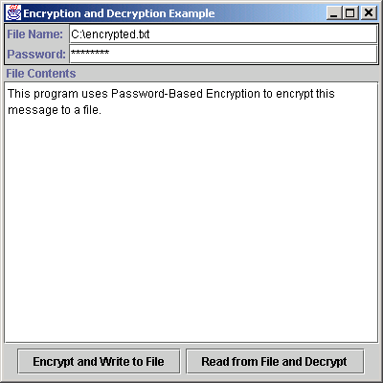
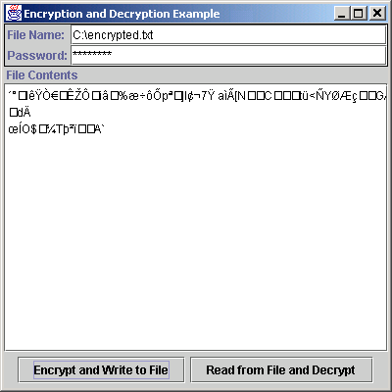
7.8.1 Password-Based Encoding with JCE (cont.)
Fig. 7.7 EncipherDecipher before and after encrypting contents.

Slide 33
7.8.2 Decorator Design Pattern
EncypherDecipher
  uses Decorator design pattern
    Decorator design pattern is “chaining” two elements
      no need create additional classes to extend functionality
    ChipherOutputStream decorates FileOutputStream
      ChipherOutputStream takes reference to OutputStream
        can decorate any OutputStream
    ChipherInputStream decorates FileInputStream
      ChipherInputStream takes reference to InputStream
        can decorate any InputStream

Slide 34
7.9 Digital Signatures
Digital signatures: provide authentication and integrity in public-key cryptography
  Hash function: calculation assigns hash value to message
  Chance of collision: two messages with same hash value is statistically insignificant
  Digital signature, hash function and encrypted message sent to receiver
    Message integrity: recalculated message hash value matches that sent in signature, verifies integrity
  Timestamping: solves non-repudiation problem
    Executed by timestamping agency who only sees encrypted message
  Digital Signature Algorithm: standard for digital signatures

Slide 35
7.10 Public-key Infrastructure, Certificates and Certification Authorities
Public-key Infrastructure
  Integrates public-key cryptography with digital certificates and certification authorities (CA’s)
    Digital certificate: identifies user, issued by certification authority (such as VeriSign)
    Digital certificates stored in certificate repositories
  Certificate authority hierarchy
    Root certification authority, the Internet Policy Registration Authority (IPRA), signs certificates for policy creation authorities who set policies for obtaining digital certificates
    Policy creation authorities sign for CA’s who sign for individuals and organizations
    Signings use public-key cryptography

Slide 36
7.10 Public-key Infrastructure, Certificates and Certification Authorities (cont.)
Changing keys necessary for maintaining security
  Digital certificates have expiration dates
  Canceled and revoked certificates placed on certificate revocation list (CRL)
Ensuring authenticity
  Check certificate with CRL (inconvenient)
  Online Certificate Status Protocol (OCSP) validates certificates in real-time
PKI and digital certificate transactions are more secure than phone line, mail or even credit-card transactions

Slide 37
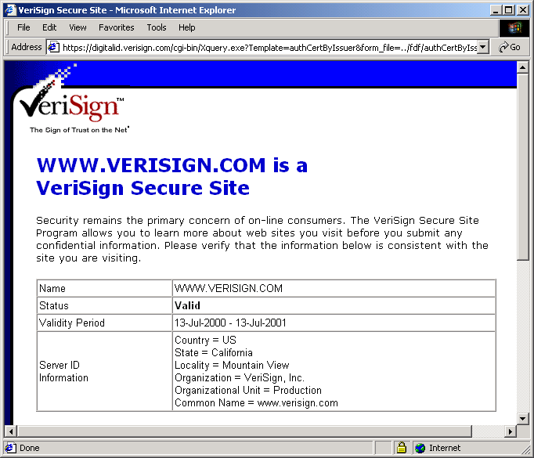
7.10 Public-key Infrastructure, Certificates and Certification Authorities (cont.)
Fig. 7.8 A portion of the VeriSign digital certificate. (Courtesy of VeriSign, Inc.)

Slide 38
7.10.1 Java Keystores and keytool
Java provides keytool utility for
  managing keys
  generating keys
Keystore
  repository for storing public and private keys
  modifying stored keys requires use of password
  default keystore located in home/user/.keystore
  command line arguments
    -genkey
      produces private and public key pair
    -export
      export a certificate
    -import
      import certificate from trusted source
    -list
      list all contents of keystore
    -alias <alias_name>
      identify public and private pair for later use

Slide 39
7.10.1 Java Keystores and keytool (cont.)
keytool-generated certificates identified through
  commonName (CN)
  organizationUnit (OU)
  organizationName (O)
  localityName (L)
  stateName (S)
  country (C)

Slide 40
7.10.1 Java Keystores and keytool (cont.)
To generate a public and private key pair
  keytool –genkey –alias MyCertificate
Obtain digital certificate from certificate authority
keytool –certreq –alias MyCertificate –file myRequest.cer
Submit certificate file to authority
  follow authority’s steps on Web site
To generate certificate other users may use
keytool –export –alias MyCertificate –file myCertificate.cer

Slide 41
7.11 Java Policy Files
Basis for Java security is Java Sandbox
  protected environment in which Java applications run
User must grant application resource permissions
Java Sandbox security model comprised of
  bytecode verifier
  class loader
  security manager
Permissions
  granted on basis of security policy
  comprised of varying levels of access to system resources
    common examples:
      writing to files
      connecting to identified port on host machine

Slide 42
7.11 Java Policy Files (cont.)
  policy files declare permissions explicitly
    permission not declared explicitly, permission not granted
    system-wide policy loaded automatically by JVM
      java.policy located in lib/security folder
    particular applications can specify custom security policy files
      do not compromise original system-wide configuration

Slide 43
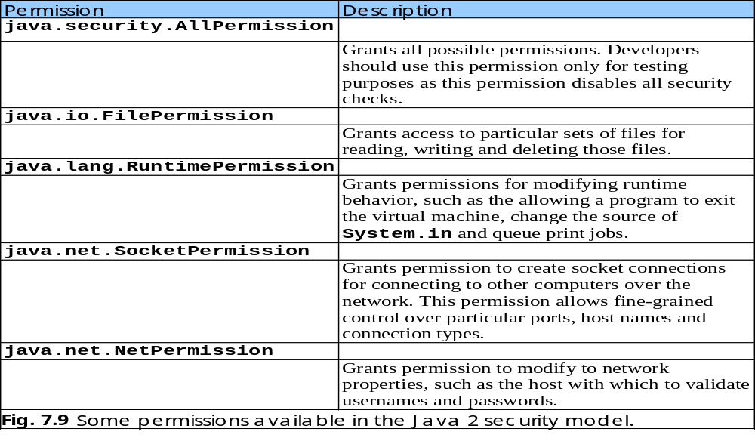
7.11 Java Policy Files (cont.)

Slide 44
Fig. 7.10 AuthorizedFileWriter writes to file using a security manager.
Line 15
Lines 26-39
1 // AuthorizedFileWriter.java
2 // AuthorizedFileWriter writes to file using a security manager.
3 // Permissions must be given via policy files.
4 package com.deitel.advjhtp1.security.policyfile;
5
6 // Java core package
7 import java.io.*;
8
9 public class AuthorizedFileWriter {
10
11 // launch application
12 public static void main( String[] args )
13 {
14 // create and set security manager
15 System.setSecurityManager( new SecurityManager() );
16
17 // check command-line arguments for proper usage
18 if ( args.length != 2 )
19 System.err.println( "Usage: java com.deitel.advjhtp1." +
20 "security.policyfile.AuthorizedFileWriter file " +
21 "filebody" );
22
23 // write fileBody to file
24 else {
25
26 String file = args[ 0 ];
27 String fileBody = args[ 1 ];
28
29 // write fileBody to file
30 try {
31
32 // create FileWriter
33 FileWriter fileWriter = new FileWriter( file );
34
35 fileWriter.write( fileBody );
SecurityManager protects against unauthorized access
write to file

Slide 45
Fig. 7.10 AuthorizedFileWriter writes to file using a security manager.
36
37 fileWriter.close();
38
39 System.exit( 0 );
40 }
41
42 // handle IO exception
43 catch ( IOException ioException ) {
44 ioException.printStackTrace();
45 System.exit( 1 );
46 }
47 }
48 }
49 }

Slide 46
7.11 Java Policy Files
authorized.policy
  grants write FilePermission for file authorized.txt
  commandline
    java –Djava.security.policy=authorized.policy com.deitel.advjhtp1.security.policyfile.AuthorizedFileWriter “authorized.txt” “Policy file authorized.policy granted file write permission for file authorized.txt.”
  if command line specifies different file, permission is denied

Slide 47
Fig. 7.11 Policy file grants permission to write to file authorized.txt
Line 7
1 // authorized.policy
2 // Policy file that grants file write permission
3 // only to file "authorized.txt"
4
5 grant {
6 permission java.io.FilePermission
7 "authorized.txt", "write";
8 };
authorize write permission to file authorized.txt

Slide 48
7.11 Java Policy Files (cont.)
codebase_authorized.policy
  grants c:/myclasses codebase write FilePermission for file codebase_authorized.txt
  commandline
    java –Djava.security.policy=codebase_authorized.policy com.deitel.advjhtp1.security.policyfile.AuthorizedFileWriter “codebase_authorized.txt” “Policy file codebase_authorized.policy granted file write permission for file codebase_authorized.txt to codebase c:/myclasses.”
  if code executing from different codebase, permission denied

Slide 49
Fig. 7.12 Policy file grants permission to the specified codebase.
Line 7
1 // codebase_authorized.policy
2 // Policy file that grants write permission to
3 // file "codebase_authorized.txt" for codebase "C:/myclasses"
4
5 grant codebase "file:/C:/myclasses" {
6 permission java.io.FilePermission
7 "codebase_authorized.txt", "write";
8 };
authorizes write permission to codebase c:/myclasses

Slide 50
7.12 Digital Signatures for Java Code
Distributing applets with special permissions
  must sign applets with digital signatures
    enables users to verify applet originated from trusted company
FileTreePanel displays tree of user’s files
  Java sandbox does not allow default file access from applets
    must sign applet
      Java Plug-in prompts user of digital signature
      user grants permission
    must store applet in JAR file

Slide 51
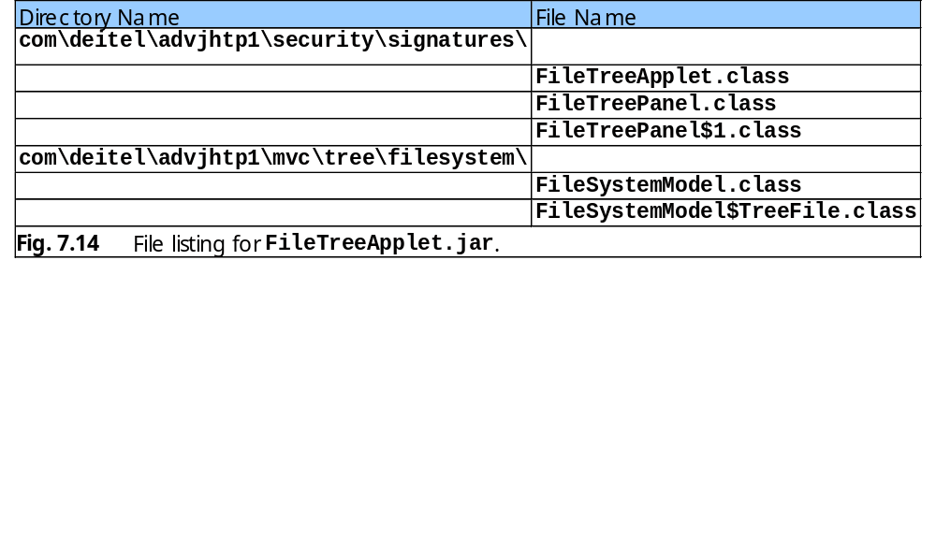
7.12 Digital Signatures for Java Code (cont.)

Slide 52
Fig. 7.13 Applet that browses a user’s local filesystem.
1 // FileTreeApplet.java
2 // A JApplet that browses files on the local file system
3 // using a FileTreePanel.
4 package com.deitel.advjhtp1.security.signatures;
5
6 // Java extension packages
7 import javax.swing.*;
8
9 // Deitel packages
10 import com.deitel.advjhtp1.security.signatures.FileTreePanel;
11
12 public class FileTreeApplet extends JApplet {
13
14 // initialize JApplet
15 public void init()
16 {
17 // get rootDirectory from user
18 String rootDirectory = JOptionPane.showInputDialog( this,
19 "Please enter a directory name:" );
20
21 // create FileTreePanel for browsing user's hard drive
22 FileTreePanel panel = new FileTreePanel( rootDirectory );
23
24 getContentPane().add( panel );
25 }
26 }

Slide 53
7.12 Digital Signatures for Java Code (cont.)
Java Plug-in supports RSA-signed applets
Steps
  generate RSA keypair
  keytool –genkey –keyalg RSA –alias MyCertificate
  export digital signature to file
  keytool –export –alias MyCertificate –file myCertificate.cer
  add to keystore
  keytool –import –alias MyTrustedCertificate –keystore cacerts
  –file myCertificate.cer
      cacerts is complete path to keystore
  sign applet’s JAR file with digital signature
    jarsigner FileTreeApplet.jar MyCertificate
  enable Java Plug-in instead of Web browser’s JVM
    htmlconverter signedApplet.html

Slide 54
Fig. 7.15 HTML file for FileTreeApplet.
Line 13
1 <html>
2
3 <head>
4 <title>FileTreeApplet Signed Applet</title>
5 </head>
6
7 <body>
8
9 <h1>File Browser</h1>
10
11 <applet
12 code = "com.deitel.advjhtp1.security.signatures.FileTreeApplet"
13 archive = "FileTreeApplet.jar" width = "400" height = "200">
14 </applet>
15
16 </body>
17
18 </html>
signed applet jar file

Slide 55
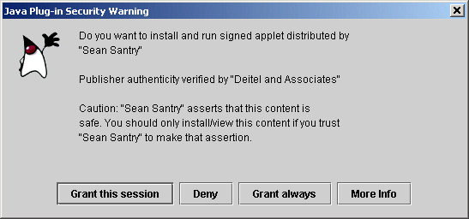
7.12 Digital Signatures for Java Code (cont.)
Fig. 7.16 Java Plug-in security warning when loading a signed applet.

Slide 56
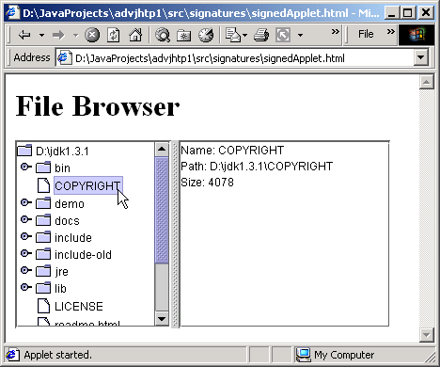
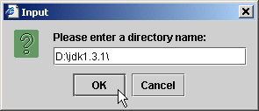
7.12 Digital Signatures for Java Code (cont.)
Fig. 7.17 FileTreeApplet browsing the D:\jdk1.3.1\ directory.

Slide 57
7.13 Authentication
Current authentication models
  restrict access to certain aspects of a program
  allow users to connect to a network
  regulate resources available to users on network
Java Authentication and Authorization Service (JAAS)
  based on plug-in framework
  allows Kerberos and single sign-on implementations

Slide 58
7.13.1 Kerberos
Employs secret key cryptography
Authentication handled by
  Kerberos system
    authenticates client’s identity
  secondary Ticket Granting Service (TGS)
    similar to key distribution centers
    authenticates client’s rights to access services
Authentication cycle
  client submits user name and password to Kerberos server
  server returns Ticket-Granting Ticket (TGT)
    encrypted with client’s key
  client decrypts TGT
  client requests service ticket by sending decrypted TGT to TGS
  server authorizes client with renewable service ticket

Slide 59
7.13.2 Single Sign-On
Single sign-on allows users to log into different servers once with single password.
three types:
    workstation login scripts
      login script sends password to each application
        stores password on workstation
    authentication server scripts
      authenticate users with central server
    tokens
      once authenticated, non-reusable token identifies user

Slide 60
7.13.3 Java Authentication and Authorization Service (JAAS)
Protects applications from unauthorized users.
Based on Pluggable Authentication Module (PAM)
  supports multiple authentication systems
  different authentication systems may be combined
Can control access by
  user
    governs access to resources on user policies
  group
    associates user to group, bases policies on group privileges
  role-based security policies
    similar to group policies
    unlike group policies, no default policies exist
      users obtain privileges to needed applications based on intended task

Slide 61
Fig. 7.18 AuthenticateNT uses the NTLoginModule to authenticate a user and invoke a PrivilegedAction.
Lines 20-21
Line 24
Line 31
Line 34
1 // AuthenticateNT.java
2 // Authenticates a user using the NTLoginModule and performs
3 // a WriteFileAction PrivilegedAction.
4 package com.deitel.advjhtp1.security.jaas;
5
6 // Java extension packages
7 import javax.swing.*;
8 import javax.security.auth.*;
9 import javax.security.auth.login.*;
10
11 public class AuthenticateNT {
12
13 // launch application
14 public static void main( String[] args )
15 {
16 // authenticate user and perform PrivilegedAction
17 try {
18
19 // create LoginContext for AuthenticateNT context
20 LoginContext loginContext =
21 new LoginContext( "AuthenticateNT" );
22
23 // perform login
24 loginContext.login();
25
26 // if login executes without exceptions, login
27 // was successful
28 System.out.println( "Login Successful" );
29
30 // get Subject now associated with LoginContext
31 Subject subject = loginContext.getSubject();
32
33 // display Subject details
34 System.out.println( subject );
35
create new LoginContext with name AuthenticateNT
begin authentication process
prints Subject’s information including Principals (represent different role or identities a user assumes during particular log session)
obtains Subject, which represents particular user or entity (this particular case, user currently logged in)

Slide 62
Fig. 7.18 AuthenticateNT uses the NTLoginModule to authenticate a user and invoke a PrivilegedAction.
Line 37
Line 40
36 // perform the WriteFileAction as current Subject
37 Subject.doAs( subject, new WriteFileAction() );
38
39 // log out current Subject
40 loginContext.logout();
41
42 System.exit( 0 );
43
44 } // end try
45
46 // handle exception loggin in
47 catch ( LoginException loginException ) {
48 loginException.printStackTrace();
49 System.exit( -1 );
50 }
51
52 } // end method main
53 }
log out from current LoginContext
make request using given Subject and priviledgedAction instance
Login Successful
Subject:
Principal: NTUserPrincipal:
userName: santry
Principal: NTDomainPrincipal:
domainName DEITEL
Principal: NTSidUserPrincipal:
NTSid: S-1-5-21-1275210071-1682526488-1343024091-1000
Principal: NTSidPrimaryGroupPrincipal:
NTSid: S-1-5-21-1275210071-1682526488-1343024091-513
Principal: NTSidGroupPrincipal:
NTSid: S-1-5-21-1275210071-1682526488-1343024091-513

Slide 63
Fig. 7.18 AuthenticateNT uses the NTLoginModule to authenticate a user and invoke a PrivilegedAction.
Principal: NTSidGroupPrincipal:
NTSid: S-1-1-0
Principal: NTSidGroupPrincipal:
NTSid: S-1-5-32-544
Principal: NTSidGroupPrincipal:
NTSid: S-1-5-32-545
Principal: NTSidGroupPrincipal:
NTSid: S-1-5-5-0-39645
Principal: NTSidGroupPrincipal:
NTSid: S-1-2-0
Principal: NTSidGroupPrincipal:
NTSid: S-1-5-4
Principal: NTSidGroupPrincipal:
NTSid: S-1-5-11
Public Credential: NTNumericCredential:
value: 896

Slide 64
Fig. 7.19 WriteFileAction is a PrivilegedAction for writing a simple text file.
Line 10
1 // WriteFileAction.java
2 // WriteFileAction is a PrivilegedAction implementation that
3 // simply writes a file to the local file system.
4 package com.deitel.advjhtp1.security.jaas;
5
6 // Java core packages
7 import java.io.*;
8 import java.security.PrivilegedAction;
9
10 public class WriteFileAction implements PrivilegedAction {
11
12 // perform the PrivilegedAction
13 public Object run()
14 {
15 // attempt to write a message to the specified file
16 try {
17 File file = new File( "D:/", "privilegedFile.txt" );
18 FileWriter fileWriter = new FileWriter( file );
19
20 // write message to File and close FileWriter
21 fileWriter.write( "Welcome to JAAS!" );
22 fileWriter.close();
23 }
24
25 // handle exception writing file
26 catch ( IOException ioException ) {
27 ioException.printStackTrace();
28 }
29
30 return null;
31
32 } // end method run
33 }
implements interface PrivilegedAction

Slide 65
Fig. 7.20 Configuration file for authentication using NTLoginModule.
Line 5
1 // jaas.config
2 // Configures JAAS to use NTLoginModule
3 // for authentication.
4 AuthenticateNT {
5 com.sun.security.auth.module.NTLoginModule required debug=false;
6 };
subject must authenticate with NTLoginModule

Slide 66
Fig. 7.21 JAAS policy file for granting permissions to a Principal and codebase.
Line 4
Line 3
Lines 6-7
Lines 9-10
1 // jaas.policy
2 // Policy file defining the permissions for the named Principal
3 grant codeBase "file:D:/JavaProjects/advjhtp1/src/-",
4 Principal com.sun.security.auth.NTUserPrincipal "santry" {
5
6 permission java.io.FilePermission "D:/privilegedFile.txt",
7 "write";
8
9 permission java.io.FilePermission "D:/privilegedFile.txt",
10 "read";
11 };
target subject
grant write permissions to D:/privilegedFile.txt
codebase to which apply permissions
grant read permissions to D:/privilegedFile.txt

Slide 67
Fig. 7.22 Policy file for JAAS application.
Line 6
Line 13
Lines 15-19
1 // java.policy
2 // Policy file that grants AllPermission
3 // to JAAS modules and specific permissions
4 // to the D:\Projects\Java codebase.
5 grant codebase "file:/D:/jdk1.3.1/jre/lib/ext/jaas.jar" {
6 permission java.security.AllPermission;
7 };
8
9 grant codebase "file:/D:/JavaProjects/advjhtp1/src/-" {
10 permission javax.security.auth.AuthPermission
11 "createLoginContext";
12
13 permission javax.security.auth.AuthPermission "doAs";
14
15 permission java.io.FilePermission "D:/privilegedFile.txt",
16 "write";
17
18 permission java.io.FilePermission "D:/privilegedFile.txt",
19 "read";
20 };
enables JAAS to perform authentication on behalf of application
grants permission to execute PrivilegedActions using method doAs
permission to read and write file D:/privilegedFile.txt

Slide 68
7.13.3 Java Authentication and Authorization Service (JAAS) (cont.)
To execute AuthenticateNT:
  java –Djava.security.policy==java.policy
  -Djava.security.auth.policy==jaas.policy
  -Djava.security.auth.login.config==jaas.config
  com.deitel.advjhtp1.security.jaas.AuthenticateNT

Slide 69
7.14 Secure Sockets Layer (SSL)
Nonproprietary protocol
Used to secure communications between computers
Implements
  public-key technology using RSA algorithm
  digital certificates
    to authenticate server
    to protect private information
Does not require user authentication

Slide 70
7.14 Secure Sockets Layer (SSL) (cont.)
Process:
    client sends message to server
    server responds with digital certificate
    client and server negotiate session keys
      use public key cryptography for negotiation
    once keys established, communication proceeds
      information encrypted
      information transmitted
      information decrypted at receiving end
Primarily secure point-to-point connections

Slide 71
7.14.1 Java Secure Socket Extension (JSSE)
SSL encryption integrated into Java through Java Secure Socket Extension (JSEE).
Secures passage of information between two clients.
Use of SSL connections transparent to user.

Slide 72
Fig. 7.23 LoginServer uses an SSLServerSocket for secure communication.
Line 25
Line 29
1 // LoginServer.java
2 // LoginServer uses an SSLServerSocket to demonstrate JSSE's
3 // SSL implementation.
4 package com.deitel.advjhtp1.security.jsse;
5
6 // Java core packages
7 import java.io.*;
8
9 // Java extension packages
10 import javax.net.ssl.*;
11
12 public class LoginServer {
13
14 private static final String CORRECT_USER_NAME = "Java";
15 private static final String CORRECT_PASSWORD = "HowToProgram";
16
17 private SSLServerSocket serverSocket;
18
19 // LoginServer constructor
20 public LoginServer() throws Exception
21 {
22 // SSLServerSocketFactory for building SSLServerSockets
23 SSLServerSocketFactory socketFactory =
24 ( SSLServerSocketFactory )
25 SSLServerSocketFactory.getDefault();
26
27 // create SSLServerSocket on specified port
28 serverSocket = ( SSLServerSocket )
29 socketFactory.createServerSocket( 7070 );
30
31 } // end LoginServer constructor
32
obtains factory object
create SSL socket

Slide 73
Fig. 7.23 LoginServer uses an SSLServerSocket for secure communication.
Line 46
Lines 49-55
Lines 57-58
Lines 60-61
33 // start server and listen for clients
34 private void runServer()
35 {
36 // perpetually listen for clients
37 while ( true ) {
38
39 // wait for client connection and check login information
40 try {
41
42 System.err.println( "Waiting for connection..." );
43
44 // create new SSLSocket for client
45 SSLSocket socket =
46 ( SSLSocket ) serverSocket.accept();
47
48 // open BufferedReader for reading data from client
49 BufferedReader input = new BufferedReader(
50 new InputStreamReader( socket.getInputStream() ) );
51
52 // open PrintWriter for writing data to client
53 PrintWriter output = new PrintWriter(
54 new OutputStreamWriter(
55 socket.getOutputStream() ) );
56
57 String userName = input.readLine();
58 String password = input.readLine();
59
60 if ( userName.equals( CORRECT_USER_NAME ) &&
61 password.equals( CORRECT_PASSWORD ) ) {
62
63 output.println( "Welcome, " + userName );
64 }
65
66 else {
67 output.println( "Login Failed." );
accepts new client connection
obtain input and output streams
read first two lines of text. Details of encryption hidden from developer.
verify user name and password

Slide 74
Fig. 7.23 LoginServer uses an SSLServerSocket for secure communication.
Lines 71-73
68 }
69
70 // clean up streams and SSLSocket
71 output.close();
72 input.close();
73 socket.close();
74
75 } // end try
76
77 // handle exception communicating with client
78 catch ( IOException ioException ) {
79 ioException.printStackTrace();
80 }
81
82 } // end while
83
84 } // end method runServer
85
86 // execute application
87 public static void main( String args[] ) throws Exception
88 {
89 LoginServer server = new LoginServer();
90 server.runServer();
91 }
92 }
close all streams

Slide 75
Fig. 7.24 LoginClient communicates with LoginServer via SSL.
Lines 22-23
Lines 26-28
Lines 31-32
1 // LoginClient.java
2 // LoginClient uses an SSLSocket to transmit fake login
3 // information to LoginServer.
4 package com.deitel.advjhtp1.security.jsse;
5
6 // Java core packages
7 import java.io.*;
8
9 // Java extension packages
10 import javax.swing.*;
11 import javax.net.ssl.*;
12
13 public class LoginClient {
14
15 // LoginClient constructor
16 public LoginClient()
17 {
18 // open SSLSocket connection to server and send login
19 try {
20
21 // obtain SSLSocketFactory for creating SSLSockets
22 SSLSocketFactory socketFactory =
23 ( SSLSocketFactory ) SSLSocketFactory.getDefault();
24
25 // create SSLSocket from factory
26 SSLSocket socket =
27 ( SSLSocket ) socketFactory.createSocket(
28 "localhost", 7070 );
29
30 // create PrintWriter for sending login to server
31 PrintWriter output = new PrintWriter(
32 new OutputStreamWriter( socket.getOutputStream() ) );
33
create SSL socket factory
create SSL socket
create output stream

Slide 76
Fig. 7.24 LoginClient communicates with LoginServer via SSL.
Line 39
Line 46
Lines 51-52
Line 55
Lines 61-63
34 // prompt user for user name
35 String userName = JOptionPane.showInputDialog( null,
36 "Enter User Name:" );
37
38 // send user name to server
39 output.println( userName );
40
41 // prompt user for password
42 String password = JOptionPane.showInputDialog( null,
43 "Enter Password:" );
44
45 // send password to server
46 output.println( password );
47
48 output.flush();
49
50 // create BufferedReader for reading server response
51 BufferedReader input = new BufferedReader(
52 new InputStreamReader( socket.getInputStream () ) );
53
54 // read response from server
55 String response = input.readLine();
56
57 // display response to user
58 JOptionPane.showMessageDialog( null, response );
59
60 // clean up streams and SSLSocket
61 output.close();
62 input.close();
63 socket.close();
64
65 } // end try
66
send user name to server
send password to server
create input stream
obtain server response
close all streams

Slide 77
Fig. 7.24 LoginClient communicates with LoginServer via SSL.
67 // handle exception communicating with server
68 catch ( IOException ioException ) {
69 ioException.printStackTrace();
70 }
71
72 // exit application
73 finally {
74 System.exit( 0 );
75 }
76
77 } // end LoginClient constructor
78
79 // execute application
80 public static void main( String args[] )
81 {
82 new LoginClient();
83 }
84 }

Slide 78
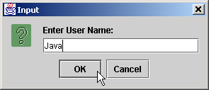

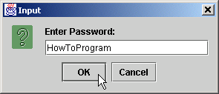
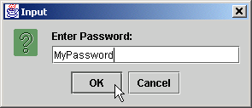
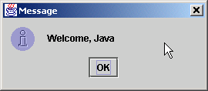
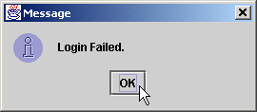
7.14.1 Java Secure Socket Extension (JSSE) (cont.)
Fig. 7.25 Two sample executions of class LoginClient.

Slide 79
7.14.1 Java Secure Socket Extension (JSSE) (cont.)
SSL requires LoginServer use certificate.
  using keytool
    keytool –genkey –keystore SSLStore –alias SSLCertificate
To execute LoginServer
  specify keystore contining LoginServer’s certificate
    java –Djavax.net.ssl.keyStore=SSLStore
    -Djavax.net.ssl.keyStorePassword=password
    com.deitel.advjhtp1.security.jsse.LoginServer
    where password is keystore password
To execute LoginClient
  specify keystore contining LoginClient’s certificate
    java –Djavax.net.ssl.trustStore=SSLStore
    -Djavax.net.ssl.trustStorePassword=password
    com.deitel.advjhtp1.security.jsse.LoginClient
    where password is truststore password

Slide 80
7.15 Java Language Security and Secure Coding
Java language provides security other languages lack.
  e.g., JVM ensures memory beyond end of array not read
Java compiler performs security checks compiling
  classes do not read from uninitialized variables
  access modifiers ensure method access rights
    private
    public
    protected
  detects illegal casts between data types
Bytecode verifier
  ensures that byte codes do not perform illegal operations

Slide 81
7.15 Java Language Security and Secure Coding (cont.)
JVM performs remaining integrity checks
  checks remaining cast operations
  array-bounds checking
  class loaders use separate namespaces
    prevents malicious code from interacting with safe code
  Java security manager
    performs access permission checks while code is running

