Slide 1



Evaluating and Tuning a Static Analysis to Find Null Pointer Bugs
Dave Hovemeyer
Bill Pugh
Jaime Spacco

Slide 2
How hard is it to find null-pointer exceptions?
Large body of work
  academic research
    too much to list on one slide
  commercial applications
    PREFix / PREFast
    Coverity
    Polyspace

Slide 3
Lots of hard problems
Aliasing
Infeasible paths
Resolving call targets
Providing feedback to developers under what conditions an error can happen

Slide 4
Can we use simple techniques to find NPE?
Yes, when you have code like:
// Eclipse 3.0.1
if (in == null)
try {
in.close();
} catch (IOException e) {}
Easy to confuse == and !=

Slide 5
Easy to confuse && with ||
// JBoss 4.0.0RC1
if (header != null ||
header.length > 0) {
...
}
This type of error (and less obvious bugs) occur in production mode more frequently than you might expect

Slide 6
The FindBugs Project
Open-Source static bug finder
  http://findbugs.sourceforge.net
  127,394 downloads as of Saturday
  Java bytecode
Used at several companies
  Goldman-Sachs
Bug-driven bug finder
  start with a bug
  What’s the simplest analysis to find the bug?

Slide 7
FindBugs null pointer analysis
Intra-procedural analysis
  Compute all reaching paths for a value
Take conditionals into account
  Use value numbering analysis to update all copies of updated value
No modeling of heap values
Don’t report warnings that might be false positives due to infeasible paths
Extended basic analysis with limited inter-procedural analysis using annotations

Slide 8
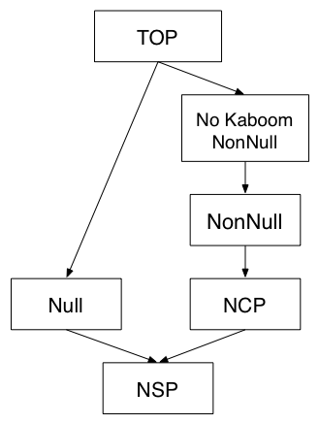
Dataflow
Lattice

Slide 9
Null on a Simple Path (NSP)
Merge null with anything else
We only care that there is control flow where the value is null
  We don’t try to identify infeasible paths
  The NPE happens if the program achieves full branch coverage

Slide 10
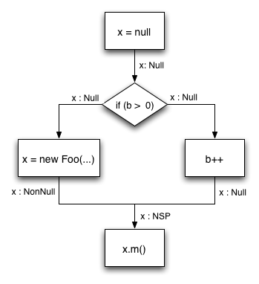
Null on a Simple Path (NSP)

Slide 11
Null on a Complex Path (NCP)
Most conservative approximation
  Tell the analysis we lack sufficient information to justify issuing a warning when the value is dereferenced
    so we don’t issue any warnings
Used for:
  method parameters
  Instance variables
  NSP values that reach a conditional

Slide 12
No Kaboom Non-Null
Definitely non-null because the pointer was dereferenced
Suspicious when programmer compares a No-Kaboom value against null
  Confusion about program specification or contracts

Slide 13
// Eclipse 3.0.1
// fTableViewer is method parameter
property = fTableViewer.getColumnProperties();
...
if (fTableViewer != null) {
...
}

Slide 14
// Eclipse 3.0.1
// fTableViewer is method parameter
// fTableViewer : NCP
property = fTableViewer.getColumnProperties();
...
if (fTableViewer != null) {
...
}

Slide 15
// Eclipse 3.0.1
// fTableViewer is method parameter
// fTableViewer : NCP
property = fTableViewer.getColumnProperties();
// fTableViewer : NoKaboom nonnull
...
if (fTableViewer != null) {
...
}

Slide 16
// Eclipse 3.0.1
// fTableViewer is method parameter
// fTableViewer : NCP
property = fTableViewer.getColumnProperties();
// fTableViewer : NoKaboom nonnull
...
// redundant null-check => warning!
if (fTableViewer != null) {
...
}

Slide 17
Redundant Checks for Null (RCN)
Compare a value statically known to be null (or non-null) with null
Does not necessarily indicate a problem
  Defensive programming
Assume programmers don’t intend to write (non-trivial) dead code

Slide 18
Extremely Defensive Programming
// Eclipse 3.0.1
File dir = new File(...);
if (dir != null && dir.isDirectory()) {
...
}

Slide 19
Non-trivial dead code
x = null
… does not assign x…
if (x!=null) {
// non-trivial dead code
x.importantMethod()
}

Slide 20
What do we report?
Dereference of value known to be null
  Guaranteed NPE if dereference executed
  Highest priority
Dereference of value known to be NSP
  Guaranteed NPE if the path is ever executed
  Exploitable NPE assuming full branch coverage
  Medium priority
If paths can only be reached if an exception occurs
  lower priority

Slide 21
Reporting RCNs
No-Kaboom RCNs
  higher priority
RCNs that create dead code
  medium priority
other RCNs
  low priority

Slide 22
Evaluate our analysis using:
Production software
  jdk1.6.0-b48
  glassfish-9.0-b12 (Sun's application server)
  Eclipse 3.0.1
    Manually classified each warning
Student programming projects

Slide 23
Production Results
Software | # NP derefs and RCN warnings
JDK 1.6.0-b48 | 242
Glassfish-9.0-b12 (Sun’s app server) | 317
Eclipse 3.0.1 | 169

Slide 24
Eclipse Results with Manual Inspection of warnings
Warning Type | Accurate Warnings | False Positives | Precision
Null Deref. | 73 | 16 | 82%
No KaBoom RCN | 33 | 15 | 69%
Other RCN | 15 | 17 | 47%

Slide 25
How many of the existing NPEs are we detecting?
Difficult question for production software
Student code base allows us to study all NPE produced by a large code base covered by fairly complete unit tests
  How many NP Warnings correspond with a run-time fault?
    False Positives
  How many NPE do we issue a warning for?
    False Negatives

Slide 26
The Marmoset Project
Automated snapshot, submission and testing system
  Eclipse plug-in captures snapshots of all saves to central repository
Students submit code to a central server for testing against suite of unit tests
  End of semester we run all snapshots against tests
  Also run FindBugs on all intermediate snapshots

Slide 27
Overall numbers, Fall 2004, 2nd semester OOP course
student | 73
snapshots | 51,484
compilable | 40,742
unique | 33,015
total test outcomes | 505,423
not implemented | 67,650
exception thrown | 63,488
NP exception | 29,467
assertion failed | 138,834
passed | 235,448

Slide 28
Analyzing Marmoset results
Analyze two projects
  Binary Search Tree
  WebSpider
Difficult to decide what to count
  per snapshot, per warning, per NPE?
  false positives persist and get over-counted
  multiple warnings / NPEs per snapshot
  exceptions can mask each other
  difficult to match warnings and NPEs

Slide 29
Marmoset Results
project | snapshots with |  | precision
 | warning | NPE
BST | 2 | 2 | 100%
WebSpider | 77 | 75 | 97%
project | snapshots with |  | recall
 | NPE | warning
BST | 71 | 1 | 1%
WebSpider | 162 | 47 | 29%

Slide 30
What are we missing?
Projects have javadoc specifications about which parameters and return values can be null
Encode specifications into a format FindBugs can use for limited inter-procedural analysis
Easy to add annotations to the interface students were to implement
  Though we did this after the semester

Slide 31
Annotations
Lightweight way to communicate specifications about method parameters or return values
  @NonNull
    issue warning if ever passed a null value
  @CheckForNull
    issue warning if unconditionally dereferenced
  @Nullable
    null in a complicated way
    no warnings issued

Slide 32
@CheckForNull vs @Nullable
By default, all values are implicitly @Nullable
Mark an entire class or package @NonNull or @CheckForNull by default
  Must explicitly mark some values as @Nullable
  Map.get() can return null
    Not every application needs to check every call to Map.get()

Slide 34
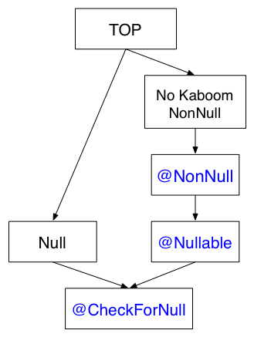

Slide 35
Marmoset Results with Annotations
project | snapshots with |  | precision | previous precision
 | warning | NPE
BST | 40 | 36 | 90% | 100%
WebSpider | 129 | 101 | 78% | 97%
project | snapshots with |  | recall | previous recall
 | NPE | warning
BST | 71 | 38 | 54% | 1%
WebSpider | 162 | 127 | 78% | 29%

Slide 36
Related Work
Lint (Evans)
Metal (Engler et al)
  “Bugs as Deviant Behavior”
ESC Java
  more general annotations
Fahndrich and Leino
  Non-null types for C#

Slide 37
Conclusions
We can find bugs with simple methods
  in student code
  in production code
  student bug patterns can often be generalized into patterns found in production code
Annotations look promising
  lightweight way of simplifying inter-procedural analysis
  helpful when assigning blame

Slide 38
Thank you!
Questions?

Slide 39
Difficult to decide what to count
False positives tend to persist
  over-counted
Students fix NPEs quickly
  under-count
Multiple warnings / exceptions per snapshot
Some exceptions can mask other exceptions

