Slide 1
Improving Software Quality with Static Analysis
Jeff Foster, Mike Hicks, William Pugh,
Polyvios Pratikakis and Saurabh Srivastava
(and lots of other students!)
Univ. of Maryland, College Park
http://www.cs.umd.edu/projects/PL

Slide 2
Students
Nat Ayewah
Brian Corcoran
Mike Furr
David Greenfieldboyce
Chris Hayden
Gary Jackson
Iulian Neamtiu
Nick L. Petroni, Jr.
Polyvios Pratikakis
Saurabh Srivastava
Nikhil Swamy
Octavian Udrea

Slide 3
Approach to Building Useful Tools
Scope
  What properties are of interest?
Technique
  Bug finding or verification?
  How to balance efficiency, utility, and precision?
Evaluation
  How to show that tools are actually useful?

Slide 4
Approach Applied
Scope
  We focus on tools that can be used to improve reliability and security of software
Technique
  We run the gamut from unsound to sound, from simple to precise
Evaluation
  We empirically validate our tools on available, industrial-strength software development efforts

Slide 5
Open Source
We release all of our tools
Allows and encourages real industrial involvement and feedback
Allows academic community to learn from and build on our work

Slide 6
University of Maryland
Our department also has a number of faculty in software engineering and human computer interaction
  The division between SE and PL is fuzzy, artificial and not particularly significant
This encourages and facilitates our efforts to look at how software development is practiced in the world today

Slide 7
This Presentation
An overview of four tools we have developed
  FindBugs - a tool for finding bugs in Java programs
  Locksmith - a sound* tool for verifying the absence of races in C programs
  CMod - a backward-compatible module system for C
  Pistachio - a mostly-sound tool for verifying network protocol implementations
Some retrospective thoughts
Looking ahead
* rather, as sound as is reasonable for C

Slide 8
FindBugs
An accidental research project
Over 407,860 downloads
Used by many major financial firms and tech companies
Turns out that lots of stupid errors exist in production code and can be found using simple techniques
  but successfully using this in the software development process can be a challenge
An agile effort
  do just want is needed to be useful in finding bugs
  be driven by real bugs and real customers

Slide 9
Linus Torvalds
Nobody should start to undertake a large project. You start with a small, trivial project, and you should never expect it to get large. If you do, you'll just overdesign and generally think it is more important than it likely is at that stage. Or, worse, you might get scared away by the sheer size of the work you envision. So start small and think about the details. Don't think about some big picture and fancy design. If it doesn't solve some fairly immediate need, it's almost certainly overdesigned.

Slide 10
Cities with Most Downloads This Year

Slide 12
Working with Companies
Working with Fortify Software and SureLogic as sponsors
Visiting lots of companies that are using FindBugs
  working in depth with a few of them
Gaining appreciation for lots of issues
  including many that never come up at PLDI/PASTE

Slide 13
Locksmith: Data Race Detection for C
Multi-core chips are here
  Induced by the hardware frequency & power walls
  Already, Intel published 80-core prototype
But multithreaded software is
  More complicated, difficult to reason about, difficult to debug, difficult to test
Data races are particularly important
  Can we build a tool to detect them automatically?

Slide 14
Why Data Races?
Data races can cause major problems
  2003 Northeastern US blackout
    Partially due to data race in a C++ program
      http://www.securityfocus.com/news/8412
  Therac-25 medical accelerator
    Data race caused some patients to receive lethal doses of radiation
Data races complicate program semantics
  Meaning of programs with races often undefined
Race freedom underpins other useful properties, like atomicity

Slide 15
Programming Against Data Races
x ~ l (“x is correlated with lock l”)
  Means that l is held during some access to x, e.g:
    lock(&l);
    x = 4;
    unlock(&l);
x and l are consistently correlated if x is always correlated with l
  I.e., l is always held when x is accessed
  I.e., x is guarded-by l
If all shared variables are consistently correlated, then the program is race-free

Slide 16
Locksmith: Data Race Detection for C [PLDI 06]
Detect races in programs that use locks to synchronize
  Note: there are other ways to synchronize than locks, but locks are:
    Widely used
    Easy to understand and program
We want to be sound
  If Locksmith reports no races, then there are no races
Locksmith at a glance:
  At each dereference, correlate pointer with acquired locks
  For every shared pointer, intersect acquired locksets of all dereferences
  Verify that each shared pointer is protected consistently

Slide 17
Example
void foo(pthread_mutex_t *l, int *p) {
pthread_mutex_lock(l);
*p = 3;
pthread_mutex_unlock(l);
}
pthread_mutex_t L1 = ...;
int x;
foo(&L1, &x);
x
L1
*p
*l
Static analysis representation:
Graph representing “flow” and
correlation

Slide 18
Example
void foo(pthread_mutex_t *l, int *p) {
pthread_mutex_lock(l);
*p = 3;
pthread_mutex_unlock(l);
}
pthread_mutex_t L1 = ...;
int x;
foo(&L1, &x);
x
L1
*p
*l
Actuals “flow” to
formals

Slide 19
Example
void foo(pthread_mutex_t *l, int *p) {
pthread_mutex_lock(l);
*p = 3;
pthread_mutex_unlock(l);
}
pthread_mutex_t L1 = ...;
int x;
foo(&L1, &x);
*p accessed with *l held
x
L1
*p
*l
~

Slide 20
Example
void foo(pthread_mutex_t *l, int *p) {
pthread_mutex_lock(l);
*p = 3;
pthread_mutex_unlock(l);
}
pthread_mutex_t L1 = ...;
int x;
foo(&L1, &x);
When we solve the graph,
we infer x accessed with L held
x
L1
~
*p
*l
~

Slide 21
Challenges
Context-sensitivity for function calls
  Suppose we call foo(&x, &L) and foo(&y, &M)
  Want to know x ~ L and y ~ M exactly
    If we thought x accessed with M held, would report false race
Flow-sensitivity for locks
  Need to compute what locks held at each point
  Can acquire and release a lock at any time (even in different functions)
Need to worry about type casts, void*, inline asm(), etc.
  Conservative analysis necessary for soundness
  …without sacrificing precision
Need to determine shared locations
  No need to hold locks for thread-local data

Slide 22
Locksmith Results
Locksmith addresses these challenges
  Usually, no annotations required from the programmer
    Few annotations if locks are in data structures
  As sound as is reasonable for C
  Still small number of warnings
Evaluation
  Standalone POSIX thread programs
  Linux device drivers
    Wrote small model of kernel that creates two threads and calls device driver in various ways

Slide 23
Evaluation
Experiments on a dual core Xeon processor, 2.8MHz, with 4GB memory
Three counts, each per shared location
  Warnings: number of locations x reported to be in a data race
  Unguarded: number of shared locations sometimes accessed without a lock
    Not all are races–some programs used semaphores to protect shared locations
  Races: actual data races

Slide 24
Experiments

Slide 25
Summary
Locksmith was able to find data races automatically
  Some of the races are benign, several can cause the program to misbehave
Relatively low false positive rate
  Most false positives are due to conservative handling of aliasing and C type casts
Formalized and proved correct key parts of the system
  Basic race detection framework (correlation)
  Locks in data structures

Slide 26
CMod: A module system for C [TLDI 07]
Module Systems:
  Information Hiding
    Symbols and types
    Multiple implementations
  Type Safe Linking
    Separate compilation
Modules in C?
  Physical modules:
    .c files as implementations; .h as interfaces
  Documented? - No.
  Practiced? - Yes.
priv_{A}
pub_{B}
priv_{B}
pub_{A}
s : t₁-> t₂
s : t₁-> t₂

Slide 27
The Objective
Enforce information hiding and type-safe linking in C
Convention
  .h files as interfaces
  .c files as implementations
The problem
  Convention not enforced by compiler/linker
  Basic pattern not sufficient for properties
CMod: A set of four rules
  Overlay on the compiler/linker
  Properties of modular programming formally provable
Notes:
Why would should anybody care. Why should C be important.

Slide 28
Violating Modularity Properties
Provider
Client
bitmap.h:
struct BM;
void init(struct BM *);
void set(struct BM *, int);
main.c:
#include “bitmap.h”
extern void privatefn(void);
Accessing Private Functions
int main(void) {
struct BM *bitmap;
init ( bitmap );
set ( bitmap , 1 );
…
}
struct BM { int *data; };
bitmap.c:
struct BM { int data; };
void set(struct BM *map, int bit) { … }
void privatefn(void) { … }
Interface--Implementation
disconnect
#include “bitmap.h”
int main(void) {
struct BM *bitmap;
init ( bitmap );
set ( bitmap , 1 );
…
}
void init(struct BM *map, int val) { … }
void init(struct BM *map) { … }
privatefn();
bitmap.data = …
Violating Type Abstraction
information hiding
type-safe linking
Bottom-line: Compiler happy, but
not guaranteed

Slide 29
Example Rule; Rule1: Shared Headers
Whenever one file links to a symbol defined by another file, both must include a header that declares the symbol.
Prevents bad instances
Flexible:
  Multiple .c files may share a single .h header
    Useful for libraries
  Multiple .h headers for a single .c file
    Facilitates multiple views
    Provider includes all; clients include relevant view

Slide 30
Rule 1:
Shared Headers
symbols
type
preprocessor
interaction
???
Rule 2:
Type Ownership

Slide 31
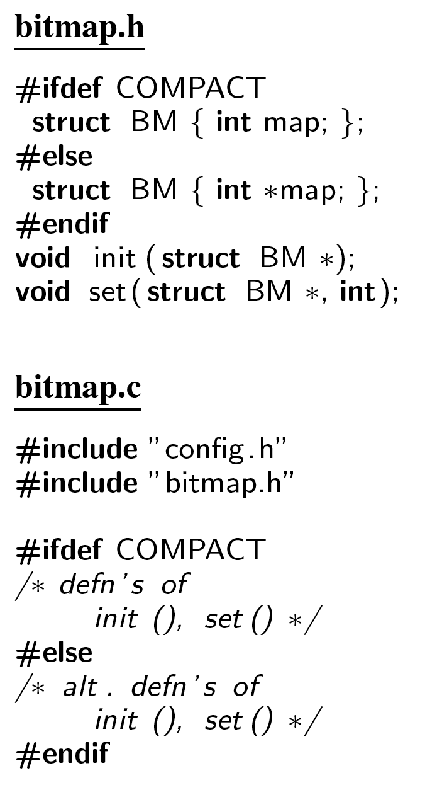
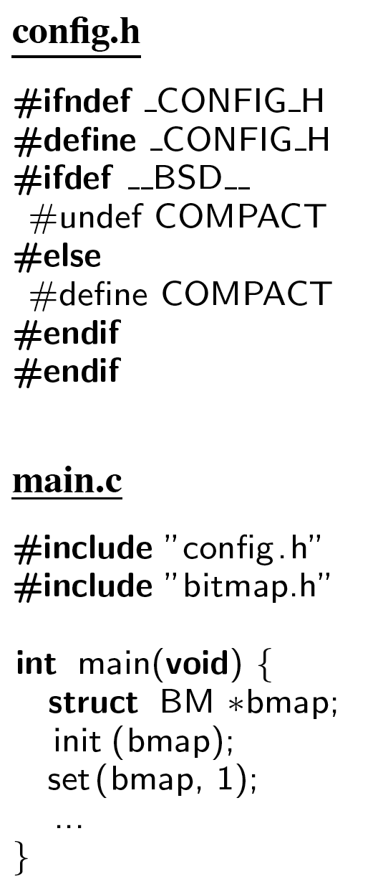
Preprocessor configuration
Its important that
both files be compiled
with the same -D flags
Provider switches
between two versions
of the implementation
depending on the flag
COMPACT
The order of these
includes is important

Slide 32
Consistent Interpretation
Consistent Interpretation
  A header is included in multiple locations
  Should preprocess to the same output everywhere
Causes of inconsistent interpretation:
  Order of includes Rule 3
  Compilation with differing -D flags Rule 4

Slide 33
Rules 1,2
gcc
symbols
type safety + inf hiding?
Rules 3,4
type
preprocessor
interaction
System sound?
Does it work in practice?
gcc
type safety + inf hiding? no

Slide 34
CMod Properties
Formal language
Small step operational semantics for CPP
If a program passes CMod’s tests and compiles and links, then
  Global Variable Hiding
  Type Definition Hiding
  Type-Safe Linking
Information Hiding

Slide 35
Experimental Results
30 projects / 3000 files / 1Million LoC (1k--165k)
Average rule violations per project:
  Rule 1+2 (symbols and types): 66 and 2
  Rule 3+4 (preprocessor interaction): 41 and 12
Average property violations per project:
  Information Hiding: 39
  Type Safety: 1
Average LoC changes to make the projects conform not significant

Slide 36
Experiments: Example Violation
Information Hiding and Typing Violation in zebra-0.95
Provider
Client
bgpd/bgp_zebra.c:
void bgp_zebra_init (int enable)
{
…
}
bgpd/bgpd.c:
void bgp_init ()
{
void bgp_zebra_init ();
…
/* Init zebra. */
bgp_zebra_init ();
…
}

Slide 37
Summary
CMod rules:
  Formally ensure type-safety and information hiding
  Compatible with existing practice
CMod implementation:
  Points out large problems with existing code
  Few violations can easily be fixed
  Violations highlight
    Brittle code
    Type errors
    Information hiding problems

Slide 38
Pistachio [Usenix Security 06]
Network protocols must be reliable and secure
Lots of work has been done on this topic
  But mostly focuses on abstract protocols
  ==> Implementation can introduce vulnerabilities
Goal: Check that implementations match specifications
  Ensure that the protocol we’ve modeled abstractly and thought hard about is actually what’s in the code

Slide 39
Summary of Results
Ran on LSH, OpenSSH (SSH2 implementations) and RCP
Found wide variety of known bugs and vulnerabilities
  Well over 100 bugs, of many different kinds
Roughly 5% false negatives, 38% false positives
  As measured against bug databases

Slide 40
Pistachio Architecture
Existing documents and code
RFC/IETF
Standard
C Source
Code
Bug
Database
Pistachio
Evaluate
Warnings
Rule-Based
Specification
Theorem
Prover
Errors
Detected
Notes:
The first step in using Pistachio is to translate the English specification document into a formal Rule-Based Specification, which is what Pistachio checks the code against.
Given such a specification and a C program, Pistachio uses symbolic execution to simulate the program, tracking a set of facts that hold at each point in the program. For example, after a statement “x=5”, Pistachio records the fact that x=5.
When Pistachio encounters a conditional branch, it uses a theorem prover, currently Darwin, to decide which branch to take. (If it can’t decide which, it takes both.)
When Pistachio encounters a statement that triggers a rule (i.e., a function call that matches the pattern in its hypothesis, usually “receive”), it assumes the facts in the hypothesis and simulates forward, and tries to show that on all paths from that point, the conclusion pattern is eventually matched (usually a “send”), and the facts in the conclusion can be proven (using the theorem prover) from the current state when we match the conclusion. If not, Pistachio reports a potential error.

Slide 41
Sample Rule and Trace
If n is not received,
then resend n
{ val=1, n=1 }
1. recv(sock,&recval,sizeof(int));
{ val=1, n=1, in=&recval, in[0..3] != n }
2. if(recval == val) { TP: branch not taken }
3. val += 1;
{TP: Does val=1, n=1, in=&recval, in[0..3] != n
imply val[0..3] = n? YES, rule verifies }
4. send(sock,&val,sizeof(int));
recv(_, in, _)
in[0..3] != n
=>
send(_, out, _)
out[0..3] = n
Only execute realizable paths
Use theorem prover to reason about branches, rule conclusions
Generally tracks sets of “must” facts (intersect at join points)
Not guaranteed sound
Notes:
An example showing Pistachio checking a rule. The rule on the left means:
If we encounter a recv statement
Call the second argument “in”
Assume that in[0..3], the first four bytes of in, contain “n”.
(The value of “n” is a “ghost variable,” and it would be set by a previous rule. Such variables are used to keep implicit state across rules.)
Then on all paths from the recv forward, there must be a send
Call the second argument of the send “out”
It must be that we send n again
The right part of the figure shows sets of facts in green, assuming that initially val and n are 1. After the receive, we add fact “in=&recval” to record that the name “in” now stands for the second argument to recv, and we add the assumption in[0..3] != n. At the branch, we ask the theorem prover whether recval == val, which is false (we can derive that recval != n from the last two facts after line 1, but val = n). Thus we fall through the if statement and reach the send with the same set of facts. We then ask the theorem prover whether val[0..3]=n, which it does, so the rule verifies.

Slide 42
Challenges
May need to iterate checking
  Need to keep simulating around loop
  Pistachio tries to find fixpoint
  Gives up after 75 iterations
Functions inlined
C data modeled as byte arrays
Assume everything initialized to 0

Slide 43
Experimental Framework
We used Pistachio on two protocols:
  LSH implementation of SSH2 (0.1.3 – 2.0.1)
    87 rules initially
    Added 9 more to target specific bugs
  OpenSSH (1.0p1 - 2.0.1)
    Same specification as above
  RCP implementation in Cygwin (0.5.4 – 1.3.2)
    51 rules initially
    Added 7 more to target specific bugs
Rule development time – approx. 7 hours

Slide 44
Example SSH2 Rule
“It is STRONGLY RECOMMENDED that the ‘none’ authentication method not be supported.”
recv(_, in, _ )
in[0] = SSH_MSG_USERAUTH_REQUEST
isOpen[in[1..4]] = 1
in[21..25] = “none”
=>
send(_, out, _ )
out[0] = SSH_MSG_USERAUTH_FAILURE
If we get an auth
request
For the none method
Then send failure

Slide 45
Example Bug
Message received
1. fmsgrecv(clisock, SSH2_MSG_SIZE);
2. if(!parse_message(MSGTYPE_USERAUTHREQ, inmsg, len(inmsg), &authreq))
3. return;
...............
4. if(authreq.method == USERAUTH_PKI) {
...............
5. } else if (authreq.method == USERAUTH_PASSWD) {
...............
6. } else {
...............
7. }
8. sz = pack_message(MSGTYPE_REQSUCCESS, payload, outmsg, SSH2_MSG_SIZE);
9. fmsgsend(clisock,outmsg,sz);
Handle PKI auth method
Handle passwd auth method
Oops – allow any other method
Send success; not supposed
to send for none auth method

Slide 46
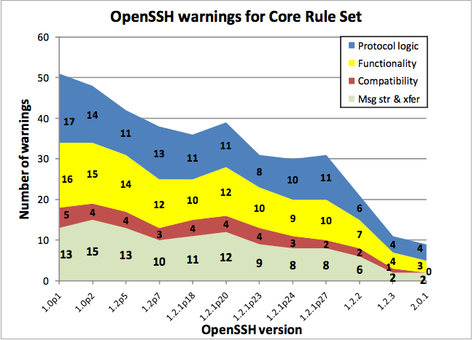

Slide 47
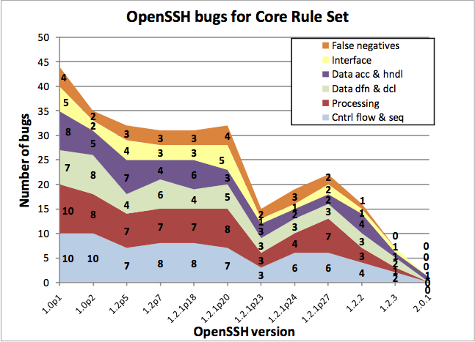

Slide 48
Summary
Rule-based specification closely related to RFCs and similar documents
Initial experiments show Pistachio is a valuable tool
  Very fast (under 1 minute)
  Detects many security related errors
  ...with low false positive and negative rates

Slide 49
Back to the Beginning
We have built several static analysis tools
  The tools often employ novel algorithms exercising a range of tradeoffs
  They have been evaluated on lots of “real” software
But are these (and others’) tools actually useful?
  Are they adding value to the customer?

Slide 50
Evaluating Tool Utility
Many popular “micro”-metrics
  How many “real” bugs found?
  What is the false/true alarm ratio?
  How many total warnings emitted?
  How fast does the tool run?
  How many user annotations are required?
Ultimate metric
  Can developers find and fix bugs which make a noticeable difference in software quality?
    Which bugs to report?
    How to help developers find and fix them?

Slide 51
Which bugs?
Which class of bugs to look for?
  Data races, deadlocks, null pointer dereferences, …
Which bugs within a class should a tool report?
  Ones that actually cause runtime misbehavior
  Ones that could eventually (during maintenance) cause misbehavior
  Ones that are easier to fix
  Ones that could cost the company money
    Security vulnerabilities, customer complaints, …
How much can the users decide?

Slide 52
A useful characterization: trust
Singer and Lethbridge, in “What’s so great about grep?” say that given a choice of tools to solve a problem:
  Programmers use tools that they trust
  Programmers trust tools that they understand
For defect detection, understanding can be useful to
  Quickly diagnose false alarms
    By knowing the sources of imprecision
  Quickly determine how to fix the bug
    By knowing what the tool was looking for

Slide 53
Trustworthy Analysis Tools
FindBugs
  Uses simple (understandable) algorithms
  Is consistent: mostly complains about real bugs
    Thus, even if the tool is not completely understood, programmers are willing to invest time on its errors, knowing they’ll likely hit paydirt
Can we help developers trust sophisticated tools?
  How much do they need to understand about what the tool is doing generally?
  How can we make particularly defect reports more understandable?
    May require new analysis algorithms

Slide 54
Understanding particular errors
How to make an error report more understandable?
  Report the error as a proposed fix
    Weimer [GPCE 06]
      Found that filing such reports more often resulted in a committed fix
    Lerner et al [PLDI 07]
      Applied to type inference errors
  Focus on relevant details
    Highlight and allow navigation of an error path
    Sridharan et al [PLDI 07] allow path to be extended/contracted on demand

Slide 55
Next Steps
Not all, or even many, of these questions are technical
  Include issues of process engineering, economics, human-computer interaction
User studies are challenging and resource-intensive, but they can be extremely useful
  Typical quantitative metrics are meant to approximate this
We are working on generic error visualization back-end
  Focus is on paths
  Backing up our ideas with user studies

Slide 56
Tools for Software Quality
We have built a range of static analysis tools: FindBugs, Locksmith, CMod, Pistachio, and others
  All are available for download
  All have been evaluated on real software
  Each explores different analysis tradeoffs
Our ultimate goal: building useful tools
For more information
http://www.cs.umd.edu/projects/PL

