Slide 1

CS533 Concepts of Operating Systems
Jonathan Walpole

Slide 2
Implementing Remote Procedure Calls (Slides adapted from an earlier presentation by Abdussalam Alawini)

Slide 3
Overview
Introduction
- Remote Procedure Call vs Local Procedure Call
- Design Choices
RPC Implementation
- Basic Structure
- Binding
- Network Protocol
- Exception Handling
- Use of Processes
Evaluation

Slide 4
1. Introduction

Slide 5
CS533 Context
We’ve studied the:
- Procedural (thread-based) model
- Message passing (event-based) model
- Duality of the two models
Wrappers to translate calls between models
Here we study an implementation of a procedural model on a distributed, message passing substrate
- Conceptually, threads pass from one machine to the other and back again
- The programmer is unaware of the underlying message-based substrate

Slide 6
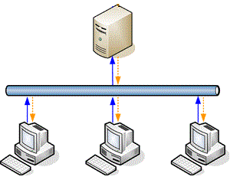
What is A “Remote” Procedure Call?
Server
Compute
F(x,y)
result
Z=F(x,y)
Communication
Network
F(x,y)
Client
Notes:
Suspend calling environment and process procedure code remotely.
Based on a “well-known” procedure call mechanism in single machine.
RPC has the same procedure call mechanism of transferring data and control across a communication network

Slide 7
Design Alternatives
Explicit message passing
- i.e. force the programmer to change models
Shared virtual address space
- Access remote data ... but how to move computation?
Remote fork
- Parallelism in addition to distribution
Remote procedure call
- threads libraries, such as Pthreads, make a similar choice

Slide 8
Goals
Simplicity
- Make RPCs as similar to procedure calls as possible
- Simplify distrusted computation
Efficiency
- Anticipated heavy use justifies special support
Security
- Secure end-to-end communications with RPC
Notes:
1- Programmer should handle distrusted systems issues (timing, independent component failure, coexistence of independent execution environments)
2- If not the gain of single unified comm paradigm will be lost (a layer in top of RPC will be required)

Slide 9
2. Implementing RPC

Slide 10
RPC Structure
Caller Machine
- User (application code module)
- User-Stub
- Caller instance of RPCRuntime (RPC communications package)
Callee Machine
- Server (server code module)
- Server-stub
- Callee instance of RPCRuntime

Slide 11
RPC Components Interactions
Caller Machine
Callee Machine
Normal
Local Proc Call
Do work and return results
User Application
Libraries
(Server code)
Unpack & make local call
Import
Interface
Pack target spec + proc arguments
Export
Interface
User-stub
Server-stub
transmit packet “Reliably”
Call Packet
Pass them to server-stub
Results Packet
Caller
RPCRuntime
Callee
RPCRuntime
Network
Notes:
User => Normal procedure call to the corresponding procedure in the user-stub.
User-stub => Place target specification + procedure arguments in a packet or more and ask RPCRuntime to transmit them.
RPCRuntime =>Responsible for retransmission, acknowledgments, packet routing, and encryption.
Server => Contain the server-side modules
Server-stub => unpack call-packets and prepare ack + results packets and asks RPCRuntime to transmit them.

Slide 12
Who Does What?
Caller Machine
Mesa Interface Modules
Callee Machine
User Application
Programmer
Libraries
(Server code)
Interface
Interface
User-stub
Lupine
(Auto Generation)
Server-stub
Caller
RPCRuntime
Part of Cedar
Callee
RPCRuntime
Network
Notes:
Programmer => Code distributed code for user and server, and define the interface module.
Lupine => Uses the user defined Mesa interface modules to generate user and server stubs.
Cedar => is a development environment

Slide 13
Binding Process
How does a client of the binding mechanism specify what to be bound to?
- Naming
How does the caller specify the callee machine address and the specific procedure to invoke?
- Locating

Slide 14
Naming (Interface Name)
Importer of an interface
Binding
Exporter of an interface
Type: Which interface the caller expects the callee to implement.
- Service Name (e.g Mail-server)
Instance: Which particular implementer of an abstract interface is desired.
- Machine Address (e.g Specific mail-server address)

Slide 15
Design Alternatives for Location
1- Include network address in user application
Binding is too early!
2- Broadcasting Protocol
Too much interference with innocent bystanders
Not convenient for binding machines not in the same local network
Not scalable

Slide 16


Grapevine Database Locating an appropriate exporter
Server 1 (Ebbets) 3#22#
Server 2 (Luther) 3#276#
Server3
(Facc) 3#43#
Export Interface
Type FileAccess
Instance Ebbets
Grapevine Database
Type (Group) | Member-list
FileAccess | {Ebbets, Luther, Facc}
Instance(Individual) | Connect-site
Ebbets | 3#22#
Luther | 3#276#
Facc | 3#43#
Import Interface
Type FileAccess
Instance Ebbets

Slide 17
Exporting an Interface (Making it available to a client)
ExportInterface make sure that type and instance is correct
RPCRuntime
Record exported interface in a table
Callee Machine
Grapevine Database
RPCRuntime
Server-stub
Server
Set the address of the current machine in the connect-site
Record in
table
Export [FA, Ebbets,…]
Export [FA, Ebbets]
Do update
Call ExportInterface
(Interface Name,
Dispatcher)
Adds the instance to the member-list of the type of the instance
SetConnect
Call server-sub
Interface exported
(Can be accessed remotely)
Table [tableIndex,
InterfaceName,DispatcherProd, UniqueID]
AddMember
Do update
Return
Notes:
ExportInterface=> is given interface name(type, instance) and a procedure (dispatcher)
Dispatcher => implemented in the server-stub to handle incoming calls for the interface.
ExportInterface => calls Grapevine database and ensures that instance is one of the type members, and the connect-site of the instance is the address of the exporting machine
RPCRuntime Table => Interface name, Dispatcher procedure from server-stub, Unique Identifier, and table index
Unique Identifier => Has a successive counter, initiated to 1-second-realtime clock, and guaranteed to be less than the current value of that clock

Slide 18
Binding An Importer to An Exporter Interface (Getting ready for remote calls)

Slide 19
Now let see how this will work
OK, now I’ve got UID, TableIndex, and exporter NT Address. I will record them
Exporter Interface is ready for your next remote procedure calls
Call user-stub
“I need to import Interface[FA, Ebbets”
Call ImportInterface
“Here’s the type and instance we need”
OK, I will ask grapevine DB and get the NT address of exporting Interface
Lookup
Grapevine Database
Here’s the NT address
“connect-site”
Caller Machine
Callee Machine
User
User-stub
RPCRuntime
RPCRuntime
Server-stub
Server
Lookup the table of current exports
Send the corresponding binding info
Alright, I’ll call the exporter RPCRuntime to get the binding info
Import [FA, Ebbets]
Import [FA, Ebbets]
Get
Connect
1-Lookup current exports
2- verify UID
3- send call packet to dispatcher
After unpacking,
Dispatcher uses the info to map to the right procedure
Normal call to procedure openFile(y)
Call the local procedure using provided arguments
1- Retrieve interface binding information
2- Prepare call packet
Alright, I will transmit it to the machine with address “connect-site”
Bind[FA, Ebbets]
Return
Record
result
Table
lookup
X= openFile(y)
openFile -> 2
transmit
Check UID
In table
2 -> openFile
X= openFile(y)
Notes:
1- user code call user-stub
2- user-stub calls ImportInterface(Interface type and instance) procedure, in RPCRuntime
3- RPCRuntime asks Grapevine database for the interface exporter’s connect-site (NT Address)
4- Importer machine’s RPCRuntime makes a remote procedure call to RPCRuntime on the exporter machine. Asking for binding information.
5- The table maintained by the Exporter’s RPCRuntime yields the corresponding UID,TableIndex,
6- Then the exporter NT address, UID, and TableIndex remembered by the user-stub

Slide 20
Binding Mechanism Advantages
Stateless: Importing an interface has no effect on the state of the exporting machine
The use of UID means that bindings are implicitly broken if the exporter crashes and restarts.
Restricting the set of users who can update Grapevine DB .
To avoid security problems
Several choices of binding time
- Importer specifies the type only

Slide 21
New Transport Protocol (Why?)
Substantial performance gains
Minimize the elapsed real-time between initializing a call and getting results.
Unacceptable to have large amount of state info.
Unacceptable to have expensive handshaking.
Guarantee procedure in the server has been invoked precisely once
Not just “at most once” or “at least once”

Slide 22
Simple Calls Example
RPC compares Seq# in CID to the one it has in a table that maintains seq# of the last call invoked by each calling activity
If caller Seq# EQ Cseq then Ack if needed
if callerSeq# LT Cseq then drop “repeated”
If callerSeq# GT Cseq then new call packet
Result packet is sufficient Ack to the caller.
Monotonic for each activity.
No repeats (calls might eliminated as dup. )
Proposes
1- Ensure the result packet is for this call
2- Callee can eliminate duplicates
Procedure arguments which is the input or output that will be used by RP
Desired Procedure Info:
UId, Table Index, Procedure entry point.
“Activity”
is the
Machine Id, and Processes’ Ids
Each activity has at most 1 remote call at any time
[Machine Id, Process]
Seq#
Caller Machine
Callee Machine
User
RPC+Stub
Call
RPC+Stub
Server
CallID
DP info
Arugs
Call
Send Call
Packet
Invoke proc
Do call
Wait Ack or Result
Result
CallID
results
Return
Send
results
Return

Slide 23
Is this “Stack Ripping”?
In manual stack management the necessary data is taken off the stack and put on the heap
In RPC it’s taken off the stack and put in a message
- Sent to the other side
Put on a different stack ...
Similar to taking the state off the stack and putting it in a continuation.
- Executed by a separate event handler

Slide 24
Complex Call Example

Slide 25
Now all arguments are ready, so the dispatching process starts
Return results to caller process (user code)
No subsequent call arrived, so ask the caller to do an explicit Ack that it has received the results
Send results
And wait for another call “works as an Ack”
Satisfying Ack: process waits for results
Caller sends probe pkts periodically (can detect communication failure)
In case of lost packet, long call duration or long gaps between calls retransmit the last pkt and ask for ack
Send the rest of the data in Data Pkt
Call pkt must be acknowledged
Arguments going to be in 2 packets
Caller Machine
Callee Machine
User
RPC+Stub
Call
RPC+Stub
Server
CallID, Pkt=0, PlsAck,…
Call
Send CallPkt
Wait for Ack
Ack
Start arg record
CallID, Pkt=0,
Build next pkt
Acknowledge
Wait next pkt
Data
Transmit it
Wait for ack
CallID, Pkt=1, dontAck,….
Invoke call
Do call
Data
Retransmit
Wait for ack
CallID, Pkt=1, PlsAck ,….
Ack
CallID, Pkt=1,
Acknowledge
Wait for result
Result
CallID, Pkt=2, dontAck ,….
Send result
Wait for ack
Return
Return
Result
CallID, Pkt=2, PlsAck ,….
Retransmit
Wait for ack
Ack
Acknowledgment
CallID, Pkt=2,
Idle

Slide 26
4. Data Integrity and Security

Slide 27
Exception Handing (Remote Process Exception)
Two level of exception
- Communication Failure Exception (Explained with complicated call example), considered to be the primary difference between procedure call and RPC
- Remote Process Exception

Slide 28
If the catch phrase terminated by a jump, then the callee will be notified
Exception handling results packet.
Events processed normally
If there’s a catch phrase, exception will be handled and results will be sent back to the callee machine
Caller does sends regular call packet as we saw before
If an exception occur, the process passes the exception to RPC
Prepare and send exception packet instead of results packet
Don’t invoke new call, instead raise an exception in the calling process
Caller Machine
Callee Machine
User
RPC+Stub
Call
RPC+Stub
Server
CallID
DP info
Arugs
Call
Send Call
Packet
Invoke proc
Do call
Exception
Wait Ack, Result
or Exception
Exception
CallID
Exception
Catch exception
Return
With exception
Send
Exception
Return
With exception
Results
Call with Exception results
Send EH results
CallID
DP info
Arugs
Invoke proc that caused the excep
Continue doing call

Slide 29
Use of Processes
If there’s no corresponding process waiting for this packet then it will be dispatched to one of the free processes
(Current, New, or Dup)
RPC will exchange SrcProcess with DestProcess so that it can return the results to the right process
Process 7 made a remote procedure call to process 3
RPC now transmit the packet back to the caller (result, exception, or Ack)
Interrupt handler in RPC look at the destProcess, if the process is waiting then it transfers the pkt directly
This part is the process identifiers, which is part of the activity info within the CallID
7
3
SrcProcess
DestProcess
Idle Server Processes
Processes Waiting
For RPC packet
7
3
7
3
SrcProcess
DestProcess
Network
Caller Machine
Callee Machine

Slide 30
4. Evaluation

Slide 31
Optimizations
Use of thread pool (idle processes) in caller and callee machines to reduce process creation costs.
The use of process source and destination allow processes to get the packets they’re waiting for directly from the interrupt handler.
Use of subsequent packet for implicit acknowledgments of previous packets.
Avoid the cost of establishing and terminating connections by the implementation of packet-level protocol.

Slide 32
Performance Evaluation
They’ve measured the elapsed time between two machines for 12,000 calls for each of the following procedures:
0-10 arguments/results.
1-100 word array.
- Caller Resume and unwind exception handling.

Slide 33
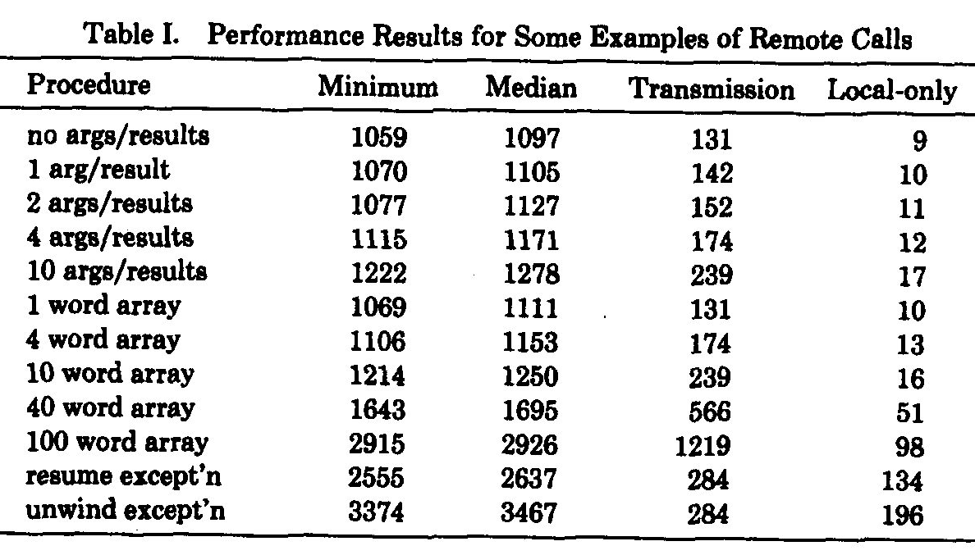
Performance Results

Slide 34
Performance Summary
For transferring large amounts of data in one direction products other than RPC have advantage.
- Transfer fewer packets in the other direction
They haven’t measure the performance of exporting or importing interfaces.
Used by:
- Alpine [File server supports multi-machine transactions]
- Control communication for an Ethernet-based for telephone and audio project
- Networking games.

Slide 35
Conclusion
RPC is used to communicate between processes in different address spaces
- May be on separate machines or on the same machine
Communication is implicit
- RPC makes distributed programming easier
- Allows thread-based programming model on distributed platforms
- Reliably transfers data and control

