Slide 1

Basic Control Hijacking Attacks
Control Hijacking

Slide 2
Control hijacking attacks
Attacker’s goal:
Take over target machine (e.g. web server)
Execute arbitrary code on target by hijacking application control flow
Examples.
Buffer overflow attacks
Integer overflow attacks
Format string vulnerabilities

Slide 3
Example 1: buffer overflows
Extremely common bug in C/C++ programs.
First major exploit: 1988 Internet Worm. fingerd.
Source: web.nvd.nist.gov

Slide 4
What is needed
Understanding C functions, the stack, and the heap.
Know how system calls are made
The exec() system call
Attacker needs to know which CPU and OS used on the target machine:
Our examples are for x86 running Linux or Windows
Details vary slightly between CPUs and OSs:
Little endian vs. big endian (x86 vs. Motorola)
Stack Frame structure (Unix vs. Windows)

Slide 5
Linux process memory layout
0xC0000000
user stack
%esp
shared libraries
0x40000000
brk
run time heap
Loaded from exec
0x08048000
unused
0

Slide 6
Stack Frame
high
arguments
return address
stack frame pointer
exception handlers
local variables
Stack
Growth
callee saved registers
SP
low

Slide 7
What are buffer overflows?
Suppose a web server contains a function:
void func(char *str) { char buf[128];
strcpy(buf, str); do-something(buf); }
When func() is called stack looks like:
argument: str
return address
stack frame pointer
char buf[128]
SP

Slide 8
What are buffer overflows?
What if *str is 136 bytes long?
After strcpy:
void func(char *str) { char buf[128];
strcpy(buf, str); do-something(buf); }
argument: str
return address
stack frame pointer
*str
char buf[128]
Problem: no length checking in strcpy()
SP

Slide 9
Basic stack exploit
Program P
high
Suppose *str is such that after strcpy stack looks like:
Program P: exec(“/bin/sh”)
When func() exits, the user gets shell !
Note: attack code P runs in stack.
(exact shell code by Aleph One)
return address
char buf[128]
low

Slide 10
The NOP slide
Program P
high
Problem: how does attacker determine ret-address?
Solution: NOP slide
Guess approximate stack state when func() is called
Insert many NOPs before program P:
nop , xor eax,eax , inc ax
NOP Slide
return address
char buf[128]
low

Slide 11
Details and examples
Some complications:
Program P should not contain the ‘\0’ character.
Overflow should not crash program before func() exists.
(in)Famous remote stack smashing overflows:
Overflow in Windows animated cursors (ANI). LoadAniIcon()
Past overflow in Symantec virus detection
test.GetPrivateProfileString "file", [long string]
Notes:
Animated cursor on web page or email message would result in arbitrary code execution. Used for rendering cursors, animated cursors, and icons.

Slide 12
Many unsafe libc functions
strcpy (char *dest, const char *src)
strcat (char *dest, const char *src)
gets (char *s)
scanf ( const char *format, … ) and many more.
“Safe” libc versions strncpy(), strncat() are misleading
e.g. strncpy() may leave string unterminated.
Windows C run time (CRT):
strcpy_s (*dest, DestSize, *src): ensures proper termination

Slide 13
Buffer overflow opportunities
Exception handlers: (Windows SEH attacks)
Overwrite the address of an exception handler in stack frame.
Function pointers: (e.g. PHP 4.0.2, MS MediaPlayer Bitmaps)
Overflowing buf will override function pointer.
Longjmp buffers: longjmp(pos) (e.g. Perl 5.003)
Overflowing buf next to pos overrides value of pos.
Heap or stack
buf[128]
FuncPtr
Notes:
Windows media player bitmaps (skins) – heap overflow, Feb. 2006
setjmp – used for exception handling (jump to global error handling code in case of error)

Slide 14
Corrupting method pointers
Compiler generated function pointers (e.g. C++ code)
After overflow of buf :
method #1
FP1
ptr
FP2
method #2
FP3
method #3
data
vtable
Object T
NOP slide
shell code
buf[256]
vtable
ptr
data
object T

Slide 15
Finding buffer overflows
To find overflow:
Run web server on local machine
Issue malformed requests (ending with “$$$$$” )
Many automated tools exist (called fuzzers – next week)
If web server crashes, search core dump for “$$$$$” to find overflow location
Construct exploit (not easy given latest defenses)

Slide 16
More Control Hijacking Attacks
Control Hijacking

Slide 17
More Hijacking Opportunities
Integer overflows: (e.g. MS DirectX MIDI Lib)
Double free: double free space on heap
Can cause memory mgr to write data to specific location
Examples: CVS server
Use after free: using memory after it is freed
Format string vulnerabilities

Slide 18
Integer Overflows (see Phrack 60)
Problem: what happens when int exceeds max value?
int m; (32 bits) short s; (16 bits) char c; (8 bits)
c = 0x80 + 0x80 = 128 + 128 ⇒ c = 0
s = 0xff80 + 0x80 ⇒ s = 0
m = 0xffffff80 + 0x80 ⇒ m = 0
Can this be exploited?

Slide 19
An example
void func( char *buf1, *buf2, unsigned int len1, len2) {
char temp[256];
if (len1 + len2 > 256) {return -1} // length check
memcpy(temp, buf1, len1); // cat buffers
memcpy(temp+len1, buf2, len2);
do-something(temp); // do stuff
}
What if len1 = 0x80, len2 = 0xffffff80 ?
⇒ len1+len2 = 0
Second memcpy() will overflow heap !!

Slide 20
Integer overflow exploit stats
Source: NVD/CVE

Slide 21
Format string bugs

Slide 22
Format string problem
int func(char *user) {
fprintf( stderr, user);
}
Problem: what if *user = “%s%s%s%s%s%s%s” ??
Most likely program will crash: DoS.
If not, program will print memory contents. Privacy?
Full exploit using user = “%n”
Correct form: fprintf( stdout, “%s”, user);

Slide 23
Vulnerable functions
Any function using a format string.
Printing:
printf, fprintf, sprintf, …
vprintf, vfprintf, vsprintf, …
Logging:
syslog, err, warn

Slide 24
Exploit
Dumping arbitrary memory:
Walk up stack until desired pointer is found.
printf( “%08x.%08x.%08x.%08x|%s|”)
Writing to arbitrary memory:
printf( “hello %n”, &temp) -- writes ‘6’ into temp.
printf( “%08x.%08x.%08x.%08x.%n”)

Slide 25
Platform Defenses
Control Hijacking

Slide 26
Preventing hijacking attacks
Fix bugs:
Audit software
Automated tools: Coverity, Prefast/Prefix.
Rewrite software in a type safe languange (Java, ML)
Difficult for existing (legacy) code …
Concede overflow, but prevent code execution
Add runtime code to detect overflows exploits
Halt process when overflow exploit detected
StackGuard, LibSafe, …

Slide 27
Marking memory as non-execute (DEP)
Prevent attack code execution by marking stack and heap as non-executable
NX-bit on AMD Athlon 64, XD-bit on Intel P4 Prescott
NX bit in every Page Table Entry (PTE)
Deployment:
Linux (via PaX project); OpenBSD
Windows: since XP SP2 (DEP)
Visual Studio: /NXCompat[:NO]
Limitations:
Some apps need executable heap (e.g. JITs).
Does not defend against `Return Oriented Programming’ exploits
Notes:
/NXCOMPAT: tells linker that app is compatible with DEP. :NO indicates don’t use DEP.
DEP: data execute prevention

Slide 28
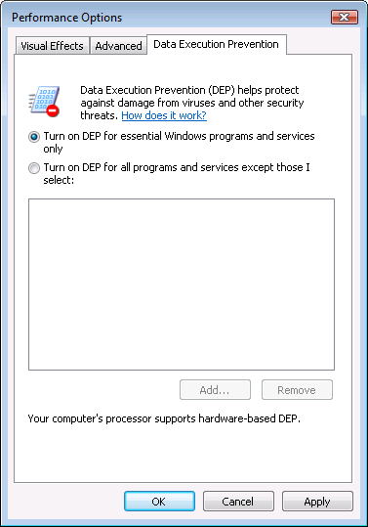
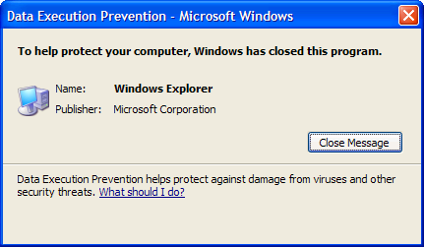
Examples: DEP controls in Windows
DEP terminating a program

Slide 29
Attack: Return Oriented Programming (ROP)
Control hijacking without executing code
stack
libc.so
args
ret-addr
exec()
sfp
printf()
local buf
“/bin/sh”
Notes:
NX wasted effort?

Slide 30
Response: randomization
ASLR: (Address Space Layout Randomization)
Map shared libraries to rand location in process memory
⇒ Attacker cannot jump directly to exec function
Deployment: (/DynamicBase)
Windows 7: 8 bits of randomness for DLLs
aligned to 64K page in a 16MB region ⇒ 256 choices
Windows 8: 24 bits of randomness on 64-bit processors
Other randomization methods:
Sys-call randomization: randomize sys-call id’s
Instruction Set Randomization (ISR)
Notes:
Combination of NX and ASLR is effective.
/DynamicBase: Visual Studio flag to indicate that application works with ASLR.

Slide 31
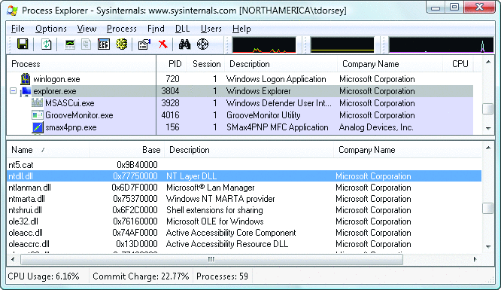
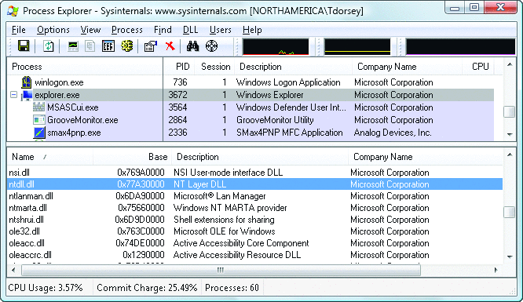
ASLR Example
Booting twice loads libraries into different locations:
Note: everything in process memory must be randomized
stack, heap, shared libs, base image
Win 8 Force ASLR: ensures all loaded modules use ASLR

Slide 32
More attacks : JiT spraying
Idea: 1. Force Javascript JiT to fill heap with executable shellcode
2. then point SFP anywhere in spray area
NOP slide
shellcode
execute enabled
execute enabled
heap
execute enabled
execute enabled
vtable
Notes:
Bion Blazakis [Blakchat 2010]

Slide 33
Hardening the executable
Control Hijacking Defenses

Slide 34
Run time checking: StackGuard
Many run-time checking techniques …
we only discuss methods relevant to overflow protection
Solution 1: StackGuard
Run time tests for stack integrity.
Embed “canaries” in stack frames and verify their integrity prior to function return.
Frame 2
Frame 1
top of stack
local
canary
sfp
ret
str
local
canary
sfp
ret
str

Slide 35
Canary Types
Random canary:
Random string chosen at program startup.
Insert canary string into every stack frame.
Verify canary before returning from function.
Exit program if canary changed. Turns potential exploit into DoS.
To corrupt, attacker must learn current random string.
Terminator canary: Canary = {0, newline, linefeed, EOF}
String functions will not copy beyond terminator.
Attacker cannot use string functions to corrupt stack.

Slide 36
StackGuard (Cont.)
StackGuard implemented as a GCC patch
Program must be recompiled
Minimal performance effects: 8% for Apache
Note: Canaries do not provide full protection
Some stack smashing attacks leave canaries unchanged
Heap protection: PointGuard
Protects function pointers and setjmp buffers by encrypting them: e.g. XOR with random cookie
Less effective, more noticeable performance effects

Slide 37
StackGuard enhancements: ProPolice
ProPolice (IBM) - gcc 3.4.1. (-fstack-protector)
Rearrange stack layout to prevent ptr overflow.
String Growth
args
ret addr
Protects pointer args and local pointers from a buffer overflow
SFP
CANARY
Stack Growth
local string buffers
local non-buffer variables
pointers, but no arrays
copy of pointer args
Notes:
/ProPolice: replicates pointers in arguments to bottom of local vars area.
ProPolicy: also called SSP – stack smashing protection.
/GS: Arguments, return address, cookie, arrays, local variables, copies of some pointer arguments, alloca

Slide 38
MS Visual Studio /GS [since 2003]
Compiler /GS option:
Combination of ProPolice and Random canary.
If cookie mismatch, default behavior is to call _exit(3)
Function prolog:
sub esp, 8 // allocate 8 bytes for cookie
mov eax, DWORD PTR ___security_cookie
xor eax, esp // xor cookie with current esp
mov DWORD PTR [esp+8], eax // save in stack
Function epilog:
mov ecx, DWORD PTR [esp+8]
xor ecx, esp
call @__security_check_cookie@4
add esp, 8
Enhanced /GS in Visual Studio 2010:
/GS protection added to all functions, unless can be proven unnecessary
Notes:
ANI bug happened because /GS was not applied to function LoadAniIcon() since it did not contain string buffers. Visual Studio 2010 applies /GS protection more aggressively.

Slide 39
/GS stack frame
args
String Growth
ret addr
Canary protects ret-addr and exception handler frame
SFP
exception handlers
CANARY
Stack Growth
local string buffers
local non-buffer variables
pointers, but no arrays
copy of pointer args
Notes:
/GS: Arguments, return address, cookie, arrays, local variables, copies of some pointer arguments, alloca

Slide 40
Evading /GS with exception handlers
When exception is thrown, dispatcher walks up exception list until handler is found (else use default handler)
After overflow: handler points to attacker’s code
exception triggered ⇒ control hijack
Main point: exception is triggered before canary is checked
0xffffffff
SEH frame
SEH frame
high
mem
next
handler
buf
next
next
ptr to attack code
handler
next
handler
Notes:
SEH: structured exception handler

Slide 41
Defenses: SAFESEH and SEHOP
/SAFESEH: linker flag
Linker produces a binary with a table of safe exception handlers
System will not jump to exception handler not on list
/SEHOP: platform defense (since win vista SP1)
Observation: SEH attacks typically corrupt the “next” entry in SEH list.
SEHOP: add a dummy record at top of SEH list
When exception occurs, dispatcher walks up list and verifies dummy record is there. If not, terminates process.
Notes:
SAFESEH: safe structured exception handling
SEHOP: structured exception handling overwrite protection. Enabled with a regkey DisableExceptionChainValidation.

Slide 42
Summary: Canaries are not full proof
Canaries are an important defense tool, but do not prevent all control hijacking attacks:
Heap-based attacks still possible
Integer overflow attacks still possible
/GS by itself does not prevent Exception Handling attacks
(also need SAFESEH and SEHOP)

Slide 43
What if can’t recompile: Libsafe
Solution 2: Libsafe (Avaya Labs)
Dynamically loaded library (no need to recompile app.)
Intercepts calls to strcpy (dest, src)
Validates sufficient space in current stack frame: |frame-pointer – dest| > strlen(src)
If so, does strcpy. Otherwise, terminates application
top of stack
sfp
ret-addr
dest
src
buf
sfp
ret-addr
Libsafe strcpy
main

Slide 44
How robust is Libsafe?
low memory
sfp
ret-addr
dest
src
buf
sfp
ret-addr
high memory
Libsafe strcpy
main
strcpy() can overwrite a pointer between buf and sfp.

Slide 45
More methods …
StackShield
At function prologue, copy return address RET and SFP to “safe” location (beginning of data segment)
Upon return, check that RET and SFP is equal to copy.
Implemented as assembler file processor (GCC)
Control Flow Integrity (CFI)
A combination of static and dynamic checking
Statically determine program control flow
Dynamically enforce control flow integrity

Slide 46
Control Flow Guard (CFG) (Windows 10)
Poor man’s version of CFI:
Protects indirect calls by checking against a bitmask of all valid function entry points in executable
ensures target is the entry point of a function

Slide 47
Control Flow Guard (CFG) (Windows 10)
Poor man’s version of CFI:
Protects indirect calls by checking against a bitmask of all valid function entry points in executable
Does not prevent attacker from causing a jump to a valid wrong function
ensures target is the entry point of a function

Slide 48
Advanced Hijacking Attacks
Control Hijacking

Slide 49
Heap Spray Attacks
A reliable method for exploiting heap overflows

Slide 50
Heap-based control hijacking
Compiler generated function pointers (e.g. C++ code)
Suppose vtable is on the heap next to a string object:
method #1
FP1
ptr
FP2
method #2
FP3
method #3
data
vtable
Object T
buf[256]
vtable
ptr
data
object T

Slide 51
Heap-based control hijacking
Compiler generated function pointers (e.g. C++ code)
After overflow of buf we have:
method #1
FP1
ptr
FP2
method #2
FP3
method #3
data
vtable
Object T
shell code
buf[256]
vtable
ptr
data
object T

Slide 52
A reliable exploit?
<SCRIPT language="text/javascript">
shellcode = unescape("%u4343%u4343%...");
overflow-string = unescape(“%u2332%u4276%...”);
cause-overflow( overflow-string ); // overflow buf[ ]
</SCRIPT>
Problem: attacker does not know where browser places shellcode on the heap
???
buf[256]
vtable
ptr
data
shellcode

Slide 53
Heap Spraying [SkyLined 2004]
Idea: 1. use Javascript to spray heap with shellcode (and NOP slides)
2. then point vtable ptr anywhere in spray area
NOP slide
shellcode
heap
vtable
heap spray area

Slide 54
Javascript heap spraying
var nop = unescape(“%u9090%u9090”)
while (nop.length < 0x100000) nop += nop
var shellcode = unescape("%u4343%u4343%...");
var x = new Array ()
for (i=0; i<1000; i++) {
x[i] = nop + shellcode;
}
Pointing func-ptr almost anywhere in heap will cause shellcode to execute.

Slide 55


Vulnerable buffer placement
Placing vulnerable buf[256] next to object O:
By sequence of Javascript allocations and frees make heap look as follows:
Allocate vuln. buffer in Javascript and cause overflow
Successfully used against a Safari PCRE overflow [DHM’08]
free blocks
heap
object O

Slide 56
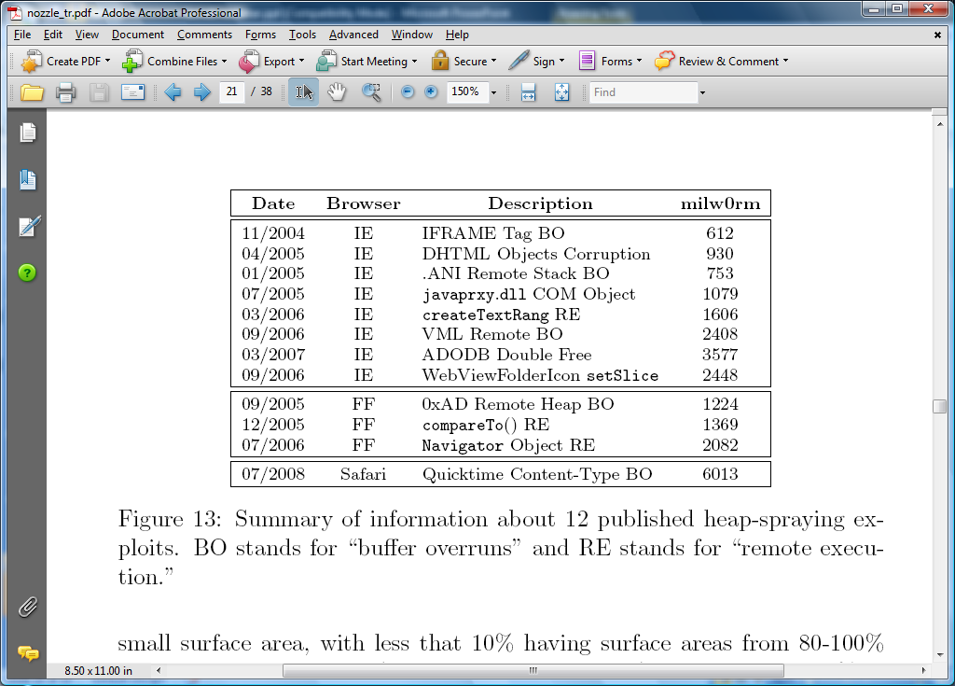
Many heap spray exploits
[RLZ’08]
Improvements: Heap Feng Shui [S’07]
Reliable heap exploits on IE without spraying
Gives attacker full control of IE heap from Javascript

Slide 57

(partial) Defenses
Protect heap function pointers (e.g. PointGuard)
Better browser architecture:
Store JavaScript strings in a separate heap from browser heap
OpenBSD heap overflow protection:
Nozzle [RLZ’08] : detect sprays by prevalence of code on heap
prevents cross-page overflows
non-writable pages

Slide 58
References on heap spraying
[1] Heap Feng Shui in Javascript, by A. Sotirov, Blackhat Europe 2007
[2] Engineering Heap Overflow Exploits with JavaScript M. Daniel, J. Honoroff, and C. Miller, WooT 2008
[3] Nozzle: A Defense Against Heap-spraying Code Injection Attacks,
by P. Ratanaworabhan, B. Livshits, and B. Zorn
[4] Interpreter Exploitation: Pointer inference and JiT spraying, by Dion Blazakis

Slide 59
End of Segment

